Slide 1


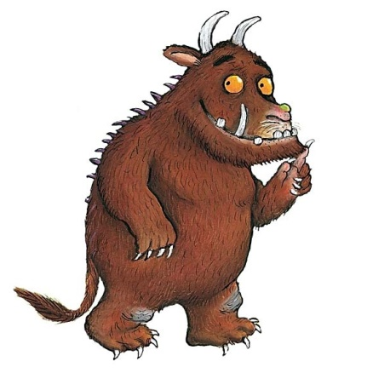
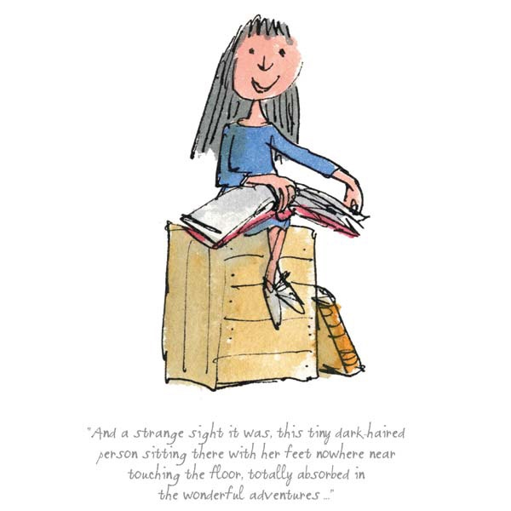

Slide 2


Slide 3
Welcome to Year 2:
Unicorns Class
Miss Morrison - Class teacher
Mrs Dhar– Teacher Assistant

Slide 4

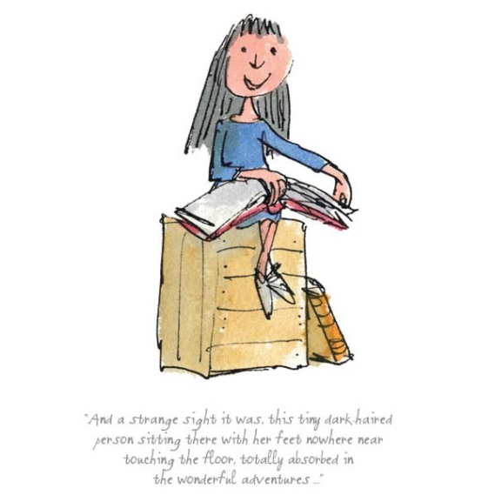
Timings of the day
Gates open at 8.35
Registration is at 8:45
Lunch is at 12.00 until 13.00
School ends at 15.10

Slide 5
Uniform Standards
ALL items of clothing must be clearly named, coats, jumpers, cardigans, hats and gloves included.
Red P.E. kit, green P.E. kit, plimsolls, spare socks, water bottles, school bags, lunch boxes, snack boxes!
Please ensure children's hair is tied back.
Water bottles will be sent home daily to be cleaned and refilled with water only.
Name, name, name everything!

Slide 6
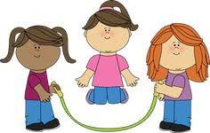

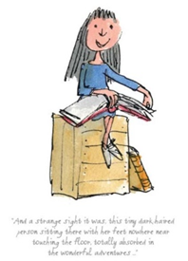
PE
Children come to school dressed in PE kits on
Wednesday and Friday. PE on Wednesday is taken by an external specialist sports teacher.

Slide 7
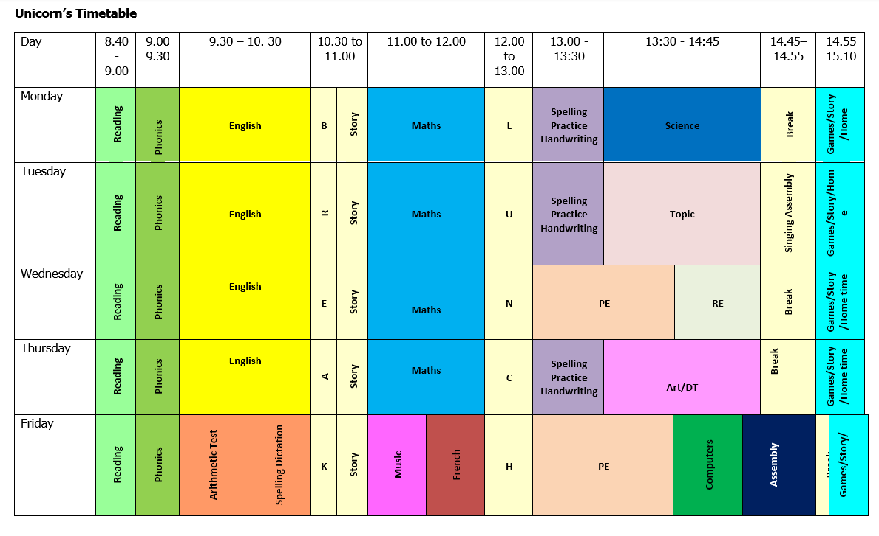

Slide 8
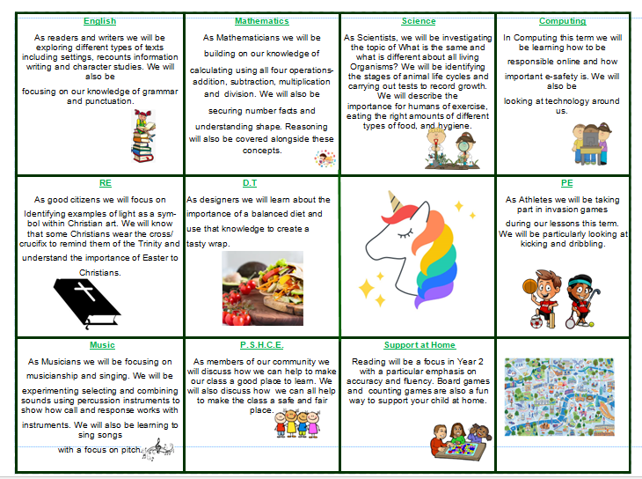
The Curriculum Overview for Autumn

Slide 9



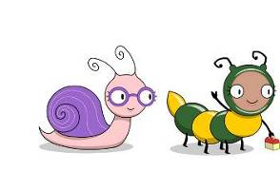
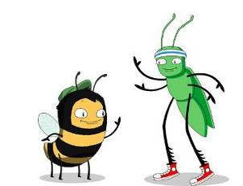
Curriculum – Reading -Phonics
.
Phonics is taught daily in Year two using the Bug Club scheme.
We use our phonics not only for reading but also for aiding the development of independent writing.

Slide 10
Curriculum - Reading
.
Send in your child’s reading folder on Mondays.
The reading folder will be kept and sent home on
Tuesdays with two new books for the week from
the Bug Club reading scheme. Children will be able
to select a book from the class library to go home,
read and enjoy with an adult.
Please write the title and a brief comment about your
child’s reading in the reading log.

Slide 11

Year 2 Homework
Homework is designed to support and consolidate the learning in class with a focus on basic skills. Tasks may sometimes be repetitive or timed and this is to increase pace and embed learning.
We will be setting homework, this will start from next week. A homework grid system sets out the work that children can do. Children select one task per week which should take
20 minutes to complete, reasonably independently.
Maths homework will be set weekly.
Children have been given 2 books to read per week.

Slide 12
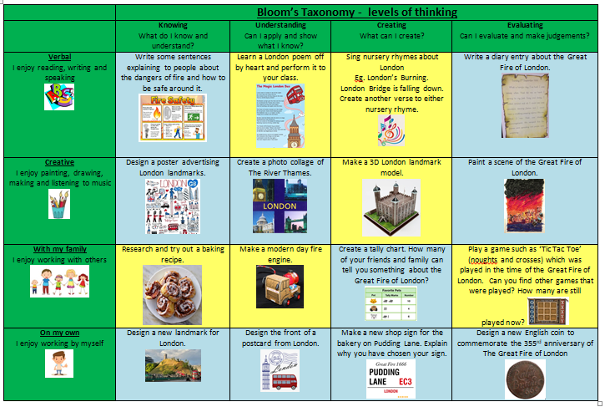
Year 2 Homework

Slide 13
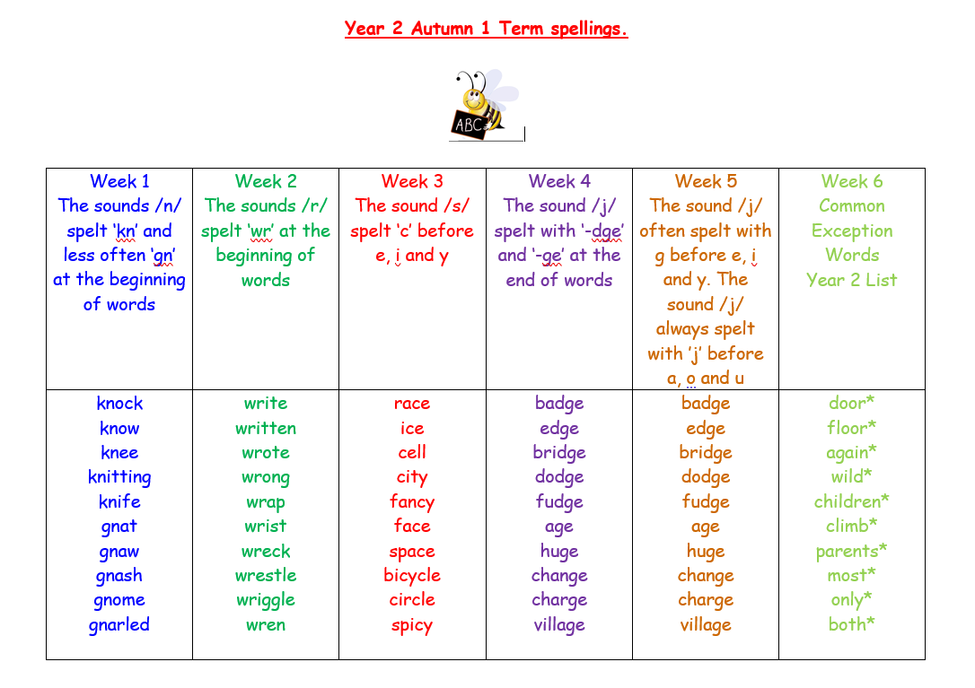

Spelling lists will be given out termly. Children will receive their first list after half term.
.

Slide 14

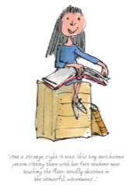
English Curriculum – this half term
English writing will focus on:
writing stories with descriptive settings, based The Snow Queen

Slide 15

Math Curriculum – this half term
Maths
Place value includes ordering and comparing numbers. Addition and Subtraction of 2 digit and single digit numbers and finding missing numbers.

Slide 16
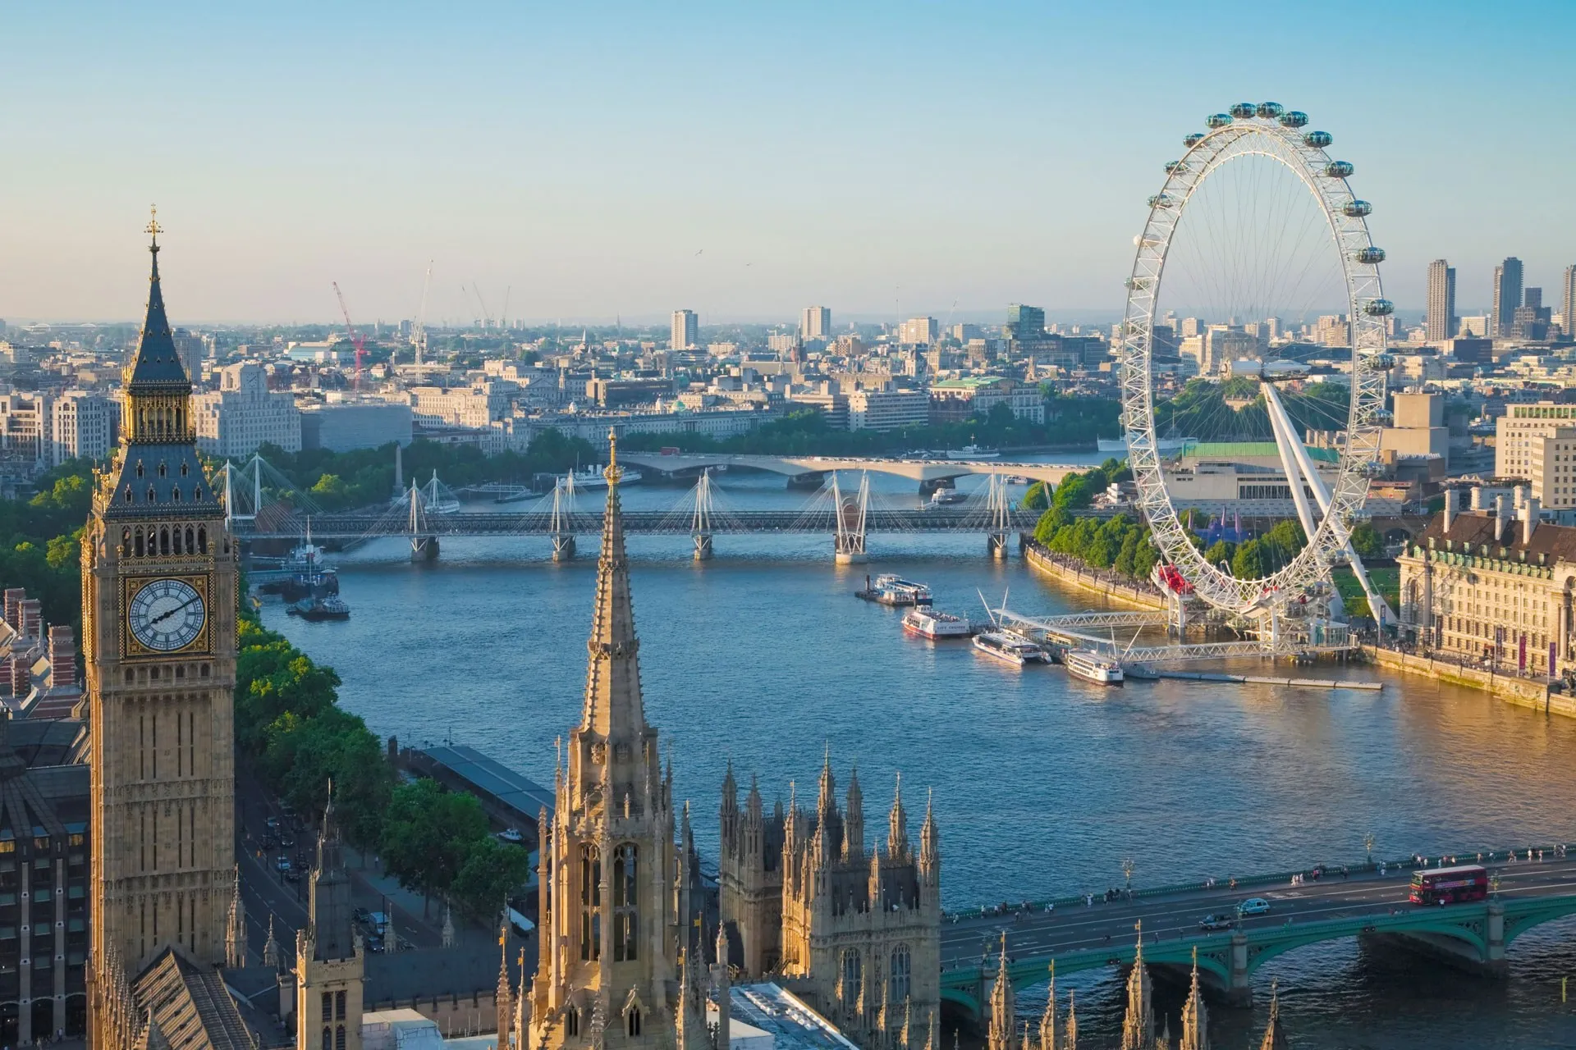

The Curriculum for the Year with Big Question
Where would you rather live Farnborough Village/Beckenham or London?
Autumn Term:?
We will study the geography of Farnborough Village. Then compare this to the area surrounding the River Thames using aerial photographs and maps to recognise landmarks and basic
human and physical features.

Slide 17
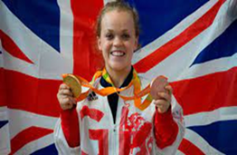
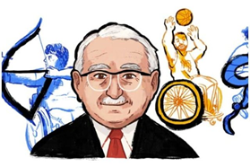

The Curriculum for the Year
Autumn Term 2:
What was the incredible impact of Sir Ludwig Guttmann?
The children will learn about the Paralympics and its origins. They will look at significant figures and events that have made an impact on our society today.

Slide 18

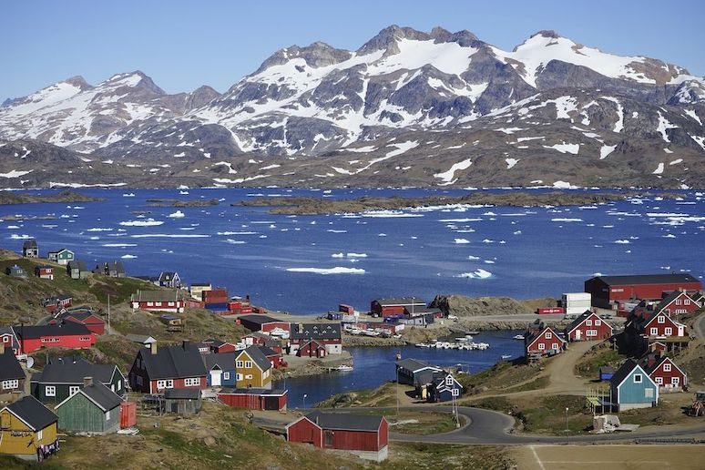

The Curriculum for the Year
Spring Term: Greenland v Madagascar – which island is the easier to live on
The children will learn about different countries as they travel around the world and discover many wonderful and exciting places. In particular the islands of Madagascar and Greenland. As they visit the various countries, they will link the countries with their continents.
identify seasonal and daily weather patterns in the United Kingdom and compare them to the contrasting climates of Madagascar and Greenland.

Slide 19
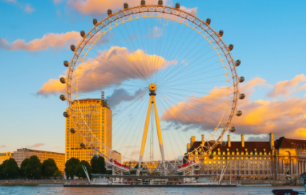
Trip and Events
To support our topics
We are planning a trip to the London for the London Eye Cruise.
Thursday 6th November
Macmillan Coffee Morning
Friday 26th September

Slide 20

Houses and House Points
The Houses and House Point system is continued from last year
Each child is slotted into a house and they remain in the same house during their life at Farnborough.
The houses are named after famous Olympians, they are called Farah, Simmonds, Redgrave and Ennis-Hill.
The children are awarded house points by the teachers
for their behaviour, attitude to learning and school as
well as their work. We celebrate their achievements
every week in our Friday assembly.

Slide 21

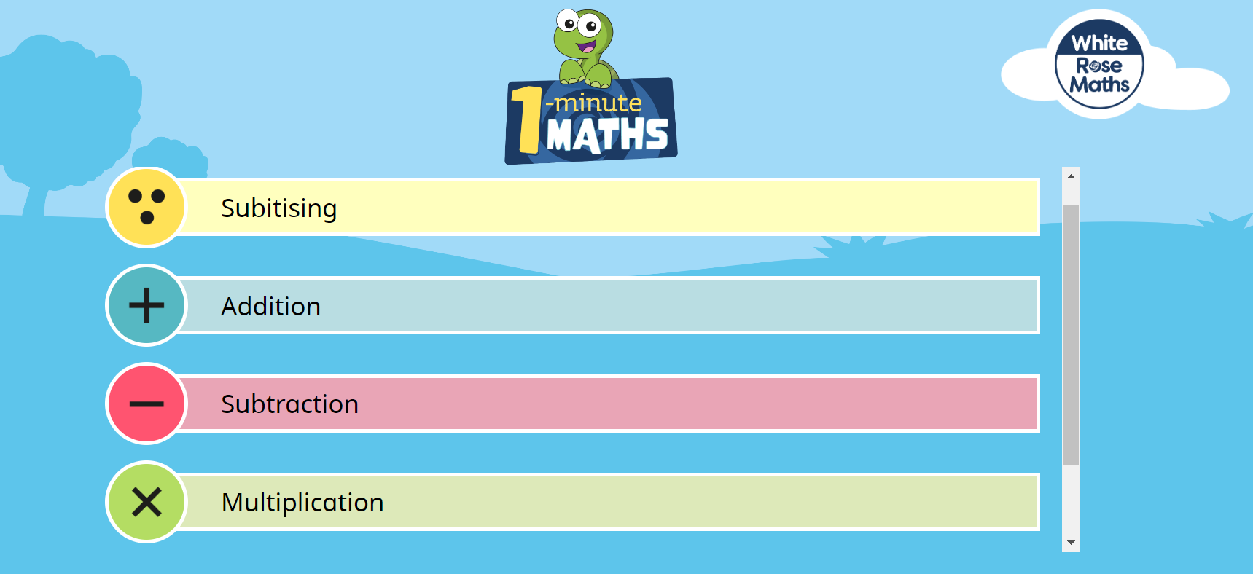
Supporting at Home
.
One way to support your children is by using

Slide 22

Supporting at Home
.
EYFS & KS1 Maths App
We are excited to share a new, exciting app suitable for children in EYFS and Key Stage One to help them develop their mental arithmetic skills. White Rose Maths is used by many schools to support the planning and activities in class, and now they have developed 1 Minute Maths for children to use in school and at home.
The app can be downloaded through the Apple Store, Google Play or Amazon Kindle app stores and is currently free of charge.
Once in the app, children can select from subitising (recognising amounts without needing to count them), adding, subtracting and multiplying.
Within each section, children can select practice activities that they have been learning in class and use the quick-fire questions to help improve their recall of key number facts.

Slide 23

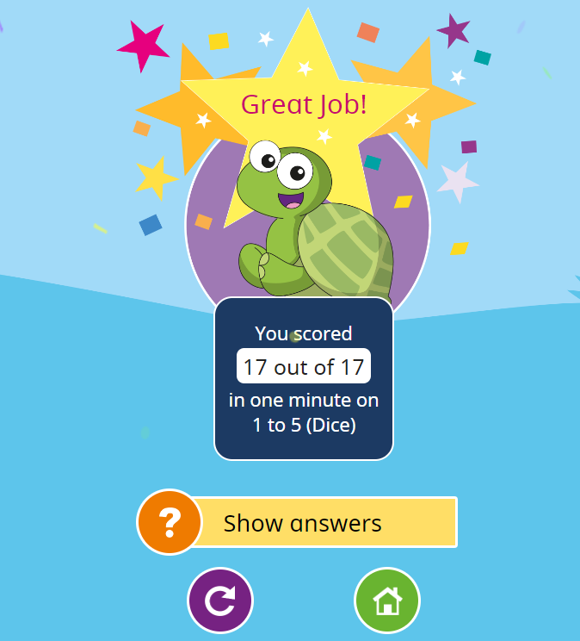
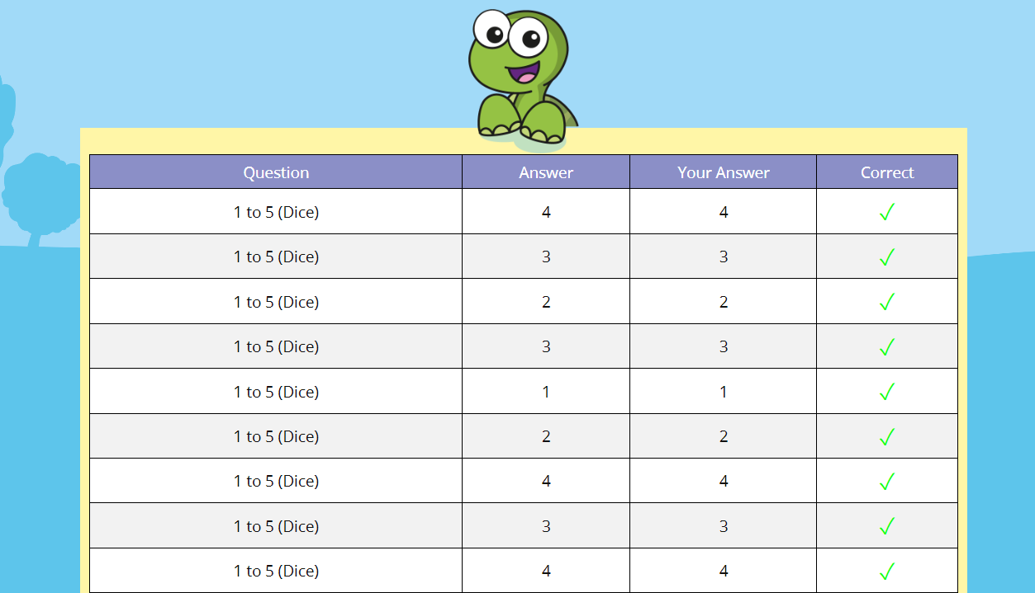

Supporting at Home
.
Select practice activities.
Quickfire questions

Slide 24



Supporting at Home
.
Another way to support your children is by using
When it comes to times tables, speed AND accuracy are important — the more facts your child remembers, the easier it is for them to do harder calculations. Times Table Rock Stars is a fun and challenging programme designed to help students master the times tables. World Famous musicians need to practice and so do children with their tables!

Slide 25
Supporting at Home
.
Another way to support your children is by using
For your child to be fully motivated and for them
to get the best out of the practice, they need your help - your praise, reminders and support will help your child feel confident and motivated.

Slide 26
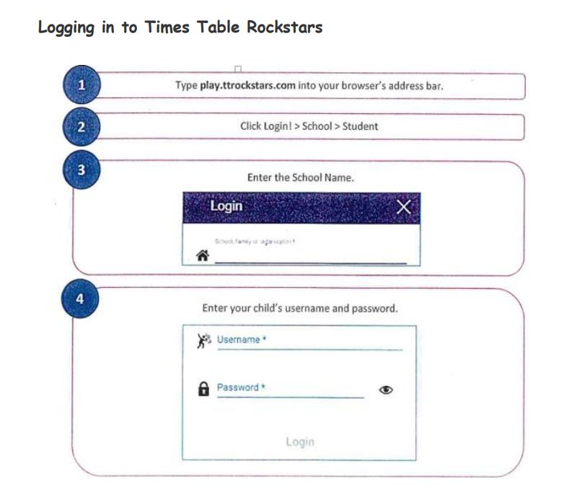
Supporting at Home
.

Slide 27
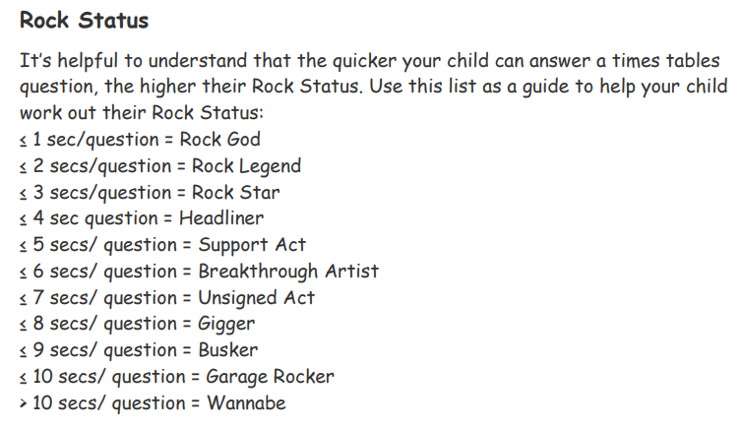
Supporting at Home
.

Slide 28
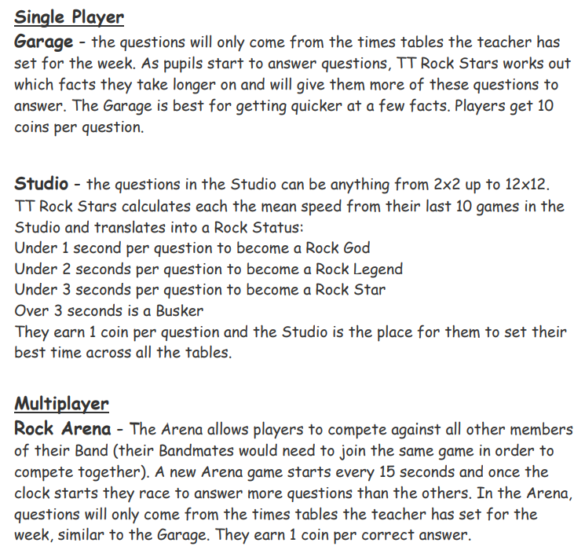
Supporting at Home
.

Slide 29
Supporting at Home
.

Slide 30
Supporting at Home
.

Slide 31
Thank you!
I am looking forward to a fantastic year with your children!
Thank you for listening.

