Slide 1


Welcome to our
Phonics workshop
Reception
Notes:
Phonics is a process of teaching children to correlate its individual sound (phoneme) with its corresponding letter or letter group (grapheme). It teaches children how to decode letters into their respective sounds. A skill which is essential for children to read unfamiliar words by themselves. Keep in mind that most words are unfamiliar to early readers in print, even if they have spoken knowledge of the word.

Slide 2
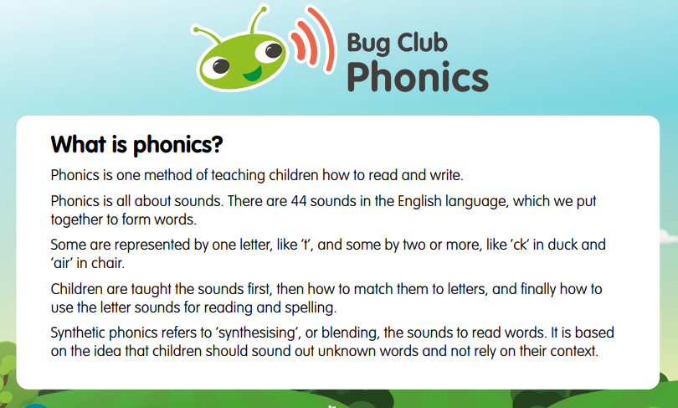

Slide 3
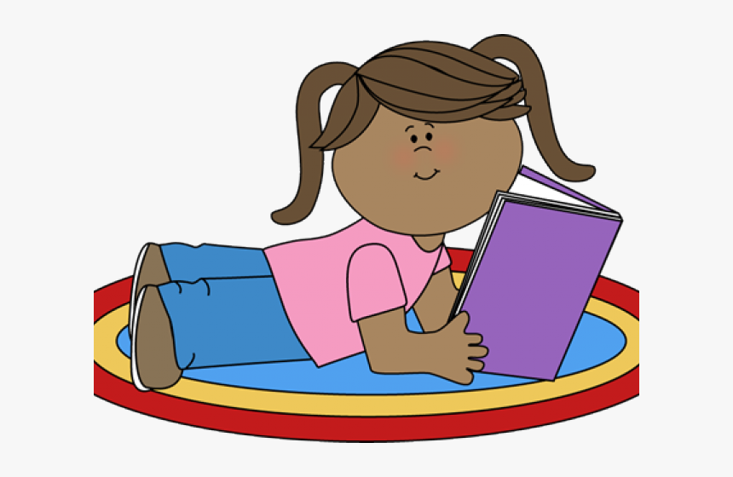
Phonics began in your child’s
first week at school.
It is broken down into phases.
Only when the child is confident with the phonemes or alternative spellings in the phase, will he/she be moved to the next phase.
The children are assessed regularly
to identify any gaps in their early
reading skills.
Notes:
The sounds are arranged 44 sounds and the alternative spellings of the sounds are taught in phases.
The sounds in front of you …. Can you put them in the order that they will be taught?

Slide 4
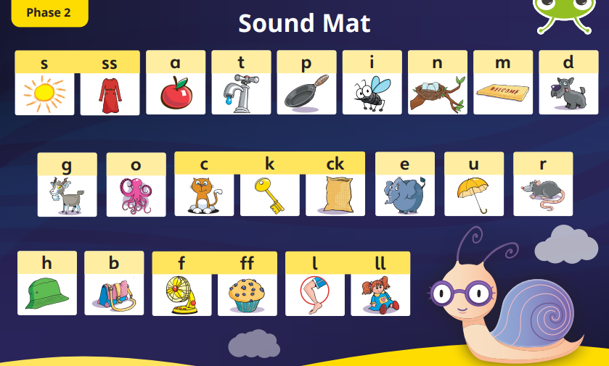
In Reception children learn the phonemes in phase 2 and are recapped in Year One.
Notes:
The sounds are arranged 44 sounds and the alternative spellings of the sounds are taught in phases.
The sounds in front of you …. Can you put them in the order that they will be taught?

Slide 5
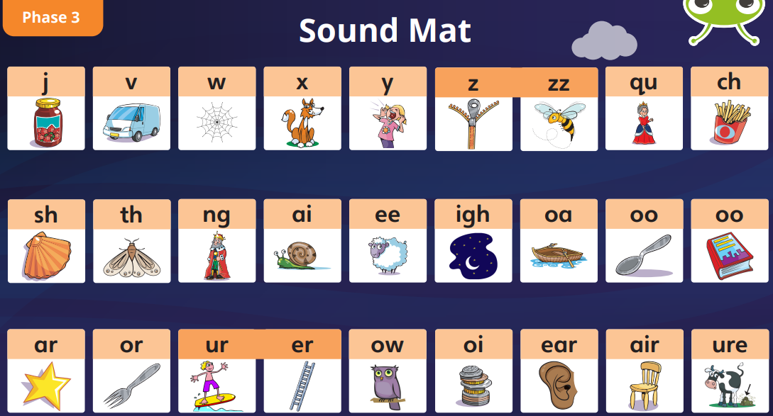
In Reception children learn the phonemes in phase 3 and are recapped in Year 1.
Notes:
The sounds are arranged 44 sounds and the alternative spellings of the sounds are taught in phases.
The sounds in front of you …. Can you put them in the order that they will be taught?

Slide 6
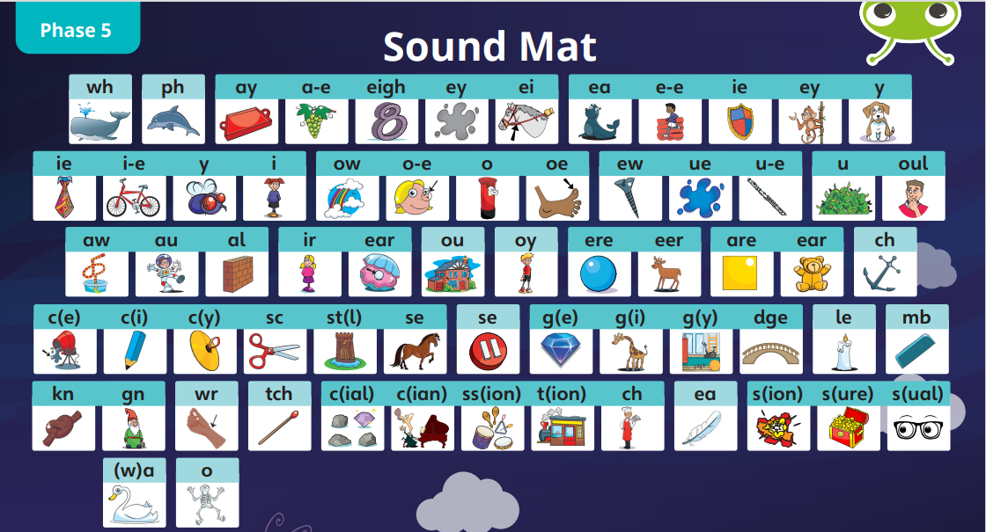
In Year One children learn the phonemes in phase 5.
Notes:
The sounds are arranged 44 sounds and the alternative spellings of the sounds are taught in phases.
The sounds in front of you …. Can you put them in the order that they will be taught?

Slide 7
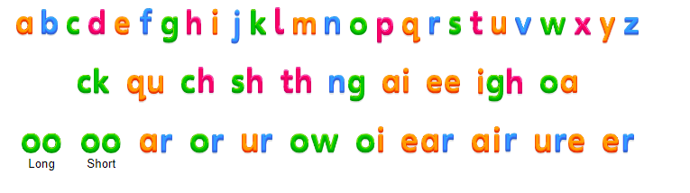


If you would like to practise the phonemes your child learns, they can be found on the Farnborough school website.
Alphabet (pearsonschoolsandfecolleges.co.uk)
Notes:
The children learn the sounds in an order. Phonemes are taught in an order .Have a go at sorting the sounds into the order they learn.

Slide 8
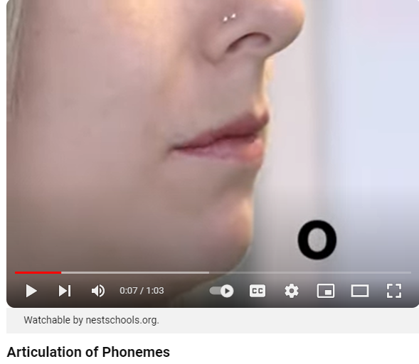
How do we pronounce the phonemes? https://www.youtube.com/watch?v=BqhXUW_v-1s
How is phonics
taught at
Farnborough Primary School ?
Notes:
The children learn the sounds in an order. Phonemes are taught in an order .Have a go at sorting the sounds into the order they learn.

Slide 9
Reading
Once the children have learnt the first few sounds, they are taught to blend.
Blending happens when phonemes are pronounced in isolation and blended together (synthesised)
Notes:
The children learn the sounds in an order. Phonemes are taught in an order .Have a go at sorting the sounds into the order they learn.

Slide 10

Notes:
The children learn the sounds in an order. Phonemes are taught in an order .Have a go at sorting the sounds into the order they learn.

Slide 11

Blending
Blending means putting sounds together to say/read the word.
At the beginning, it can take time for a child to start blending, even if they can recognise the sounds.
Notes:
Blending means putting together the sounds/phonemes to say the word. Have a go blending some of the words on your table.

Slide 12
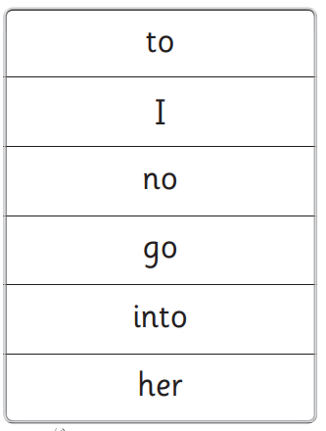
Tricky Words
Tricky words cannot be broken down fully by sounds.
Notes:
The children learn the sounds in an order. Phonemes are taught in an order .Have a go at sorting the sounds into the order they learn.

Slide 13
Sound cards then word cards then reading books are sent home in Reception.
Reading at home
Notes:
The children learn the sounds in an order. Phonemes are taught in an order .Have a go at sorting the sounds into the order they learn.

Slide 14
How to read
Bug club paper books.
Reading at home
Notes:
The children learn the sounds in an order. Phonemes are taught in an order .Have a go at sorting the sounds into the order they learn.

Slide 15

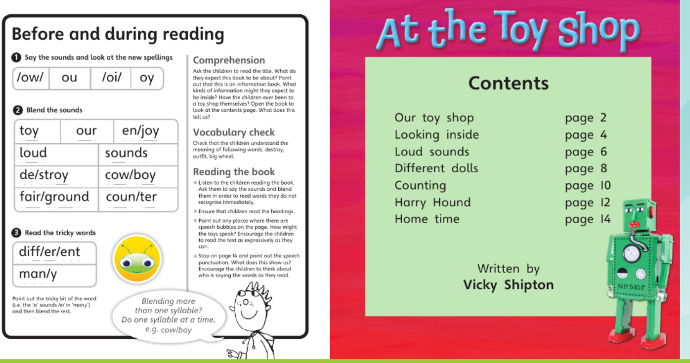

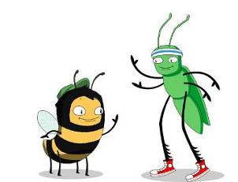
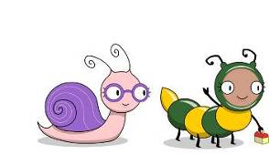
Read the inside of the front cover first. Children learn at sound, word then text level.
.

Slide 16
Then let you child read at his/her pace. Sounding and blending the words on each page.
Remember to write a comment for your class teacher and how many times the sounds, words, books have been read, for example x 3.
Reading at home
Notes:
The children learn the sounds in an order. Phonemes are taught in an order .Have a go at sorting the sounds into the order they learn.

Slide 17
We recommend
Sound cards and word cards and reading books are practised every night.
Read bug club books at least 10 minutes, 5 days a week for phonics progression.
Reading at home
Notes:
The children learn the sounds in an order. Phonemes are taught in an order .Have a go at sorting the sounds into the order they learn.

Slide 18
Repeat reading is important for your child’s reading development.
It will improve decoding, comprehension and fluency skills.
Reading at home
Notes:
The children learn the sounds in an order. Phonemes are taught in an order .Have a go at sorting the sounds into the order they learn.

Slide 19
Thank you for listening.
We hope the workshop helps with supporting your child to learn to read at home.
Remember every child’s reading journey is different.
Notes:
Blending means putting together the sounds/phonemes to say the word. Have a go blending some of the words on your table.

