Slide 1
Year 6 SATs 2024

Slide 2
In May every year, children in Year 6 (end of Key Stage 2) take part in statutory assessments called Standard Assessment Tests (SATs).
For most children, these will be the first external tests which are completed under exam conditions.
What are the SATs?

Slide 3
We have been helping the children to prepare and will continue to so that the SATs experience is a positive experience for them.
Our aim is to make the week as enjoyable as possible for the children.
“That was my favourite week!” Year 6, 2023

Slide 4
The SATs are very important, but they are not the only important thing. As teachers, SATs give us a good indication that a child is ready for secondary school, but we also use many other judgements.
As teachers we also submit reports and speak with Secondary Schools (usually Head of Year 7) about each child.
How important are the SATs?

Slide 5
Breakfast club
On the week of the SATs, we will be running a breakfast club for Year 6 so they can arrive in plenty of time and settle themselves. We will send out a letter with further details closer to the time.
We find this helps the children to relax and prepare themselves for the day, as they have had some food and a chat with friends.

Slide 6
The timetable is dictated by the Government and the tests this year are on the week commencing Monday 13th May 2024.
When are the SATs?

Slide 7
Monday 13 May 2024: Spelling, Punctuation & Grammar – Paper 1
Monday 13 May 2024: Spelling Punctuation & Grammar – Paper 2
Tuesday 14 May 2024: English Reading
Wednesday 15 May 2024: Maths Paper 1 (Arithmetic)
Wednesday 15 May 2024: Maths Paper 2 (Reasoning)
Thursday 16 May 2024: Maths Paper 3 (Reasoning)

Slide 8
Grammar
Papers 1 and 2

Slide 9
Paper 1 is a 20-word spelling test taking approximately 15 minutes.
Paper 2 is a grammar, punctuation and vocabulary test, which will involve some multiple-choice answers and some written answers. This is a 45-minute test.
Grammar

Slide 10
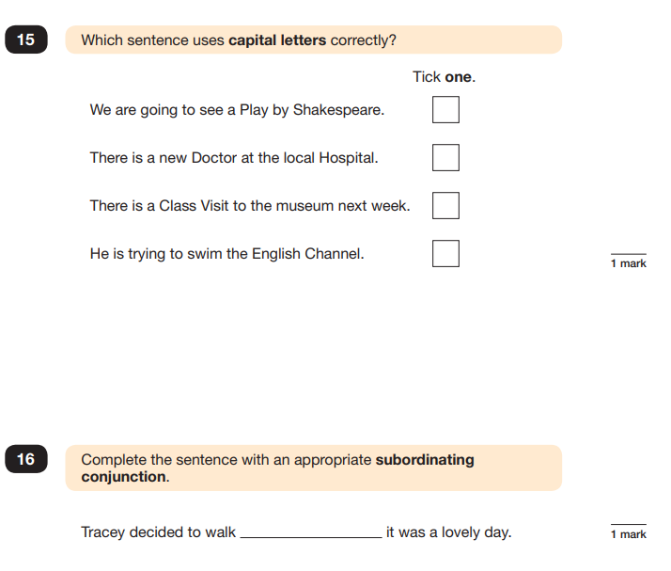

Slide 11
The reading test for Year 6 pupils will involve one paper, consisting of a reading booklet with a selection of texts and a separate answer booklet, with comprehension questions related to the reading booklet. This is an hour test.
English - Reading

Slide 12
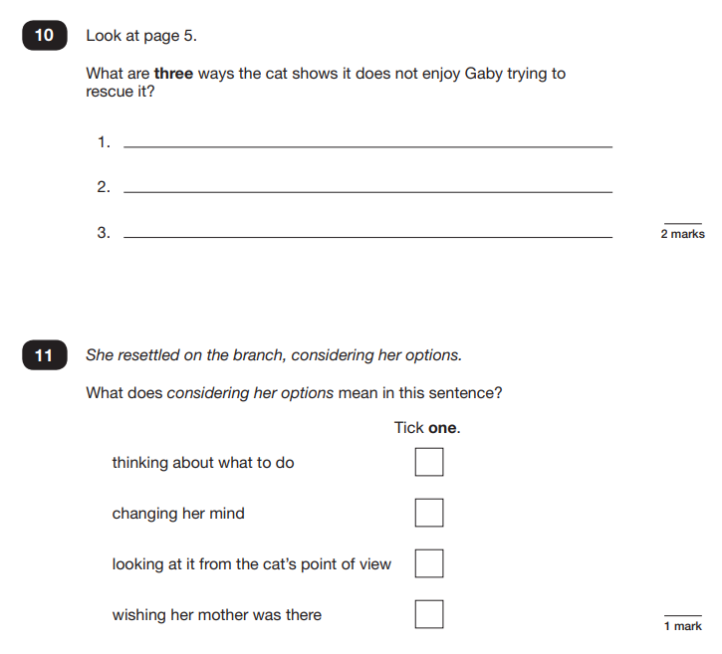

Slide 13
Maths
Paper 1 – arithmetic
Paper 2 – reasoning
Paper 3 - reasoning

Slide 14
Arithmetic
Paper 1 is an arithmetic test, consisting of a list of calculations to complete. This is a 30-minute test.
You should hopefully be familiar with this style of test as the homework arithmetic papers are laid out in a very similar way.
Reasoning
Papers 2 and 3 are both reasoning papers. They are 40-minutes each. There are a mix of shorter and longer questions the children are expected to work through.

Slide 15
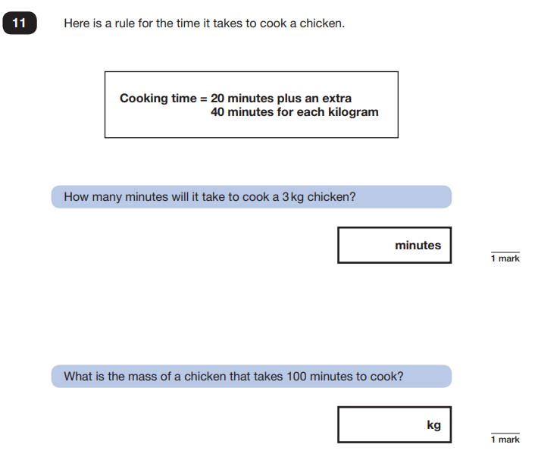

Slide 16
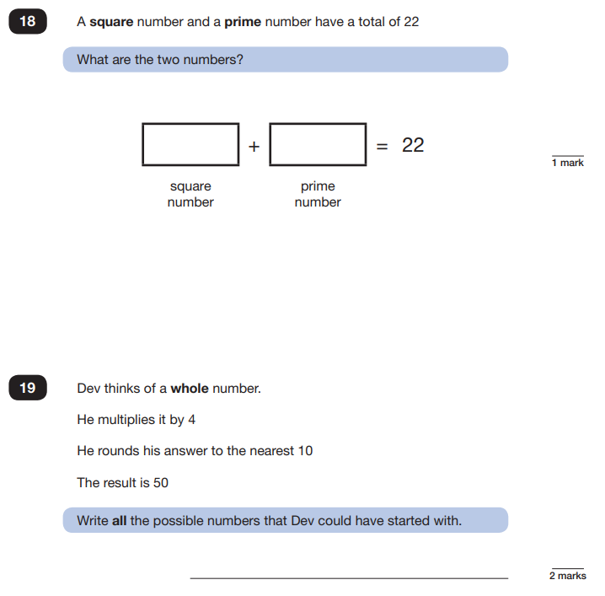

Slide 17
Access Arrangements
Some children will be eligible for access arrangements (such as 25% extra time). We will discuss this individually at parents evening at the end of March.

Slide 18
Results
Test papers will be sent off and marked externally and children will be given a scaled score. In addition, each child will receive an overall result saying whether they have achieved the required standard in the tests (AS) or not (NS).
Teacher assessments will also be used to build up a picture of your child’s learning and achievements.
All test and Teacher Assessment results will be reported to you in July along with your child’s school report.

Slide 19
How to support your child

Slide 20
We know many of you will want to help your children prepare for the SATs.
I will create a SATs help area in the homework section of Google Classroom towards the end of March.
It would be very helpful if your child could complete some of the tasks over the Easter break so that they keep their hard work this term fresh in their minds. However, it is also equally important that the children feel well rested and have a good break over the holidays.

Slide 21
Thank you
Thank you
Any questions?

