Slide 2
Welcome to Year 2:
End of KS1 Assessment Presentation

Slide 3
What are End of Key Stage 1 Assessments
At the end of Year 2, children will be sitting end of Key Stage 1 Assessments. These are non-statutory assessments which are optional.
The assessments include:
*English – Reading
**Mathematics – Arithmetic & Reasoning
The assessments are low key to ensure children are not worried or anxious about taking them.

Slide 4
Reading Paper 1 - consists of a combined reading prompt and answer booklet. The test takes approximately 30 minutes.
Reading Paper 2 - consists of an answer booklet and a separate reading booklet. It contains more challenging texts than Paper 1. The test takes approximately 40 minutes.
Maths Paper 1 - arithmetic consists of a single test paper and takes approximately 20 minutes.
Maths Paper 2 - reasoning consists of a single test paper and takes approximately 35 minutes. The paper includes a practice question and 5 aural questions. After the aural questions, the time allowed for the remainder of the paper should be around 30 minutes.

Slide 5
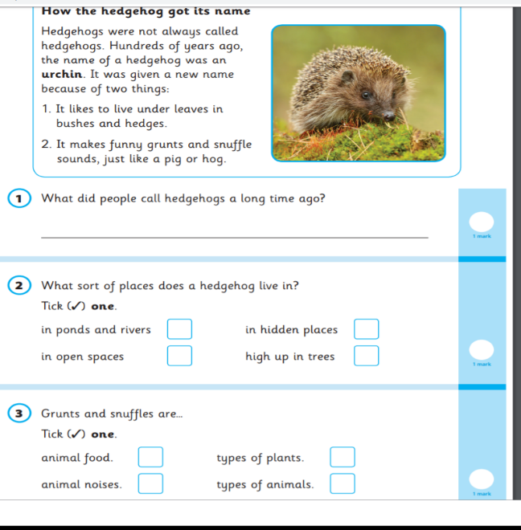
Reading Paper Example 1

Slide 6
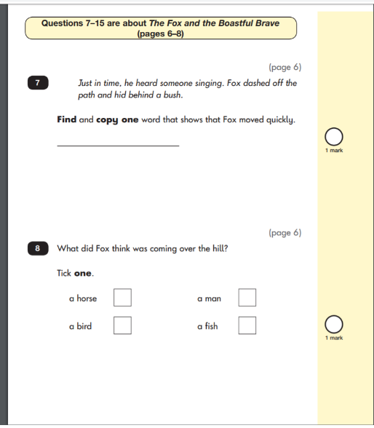
Reading Paper 2 Example Page

Slide 7
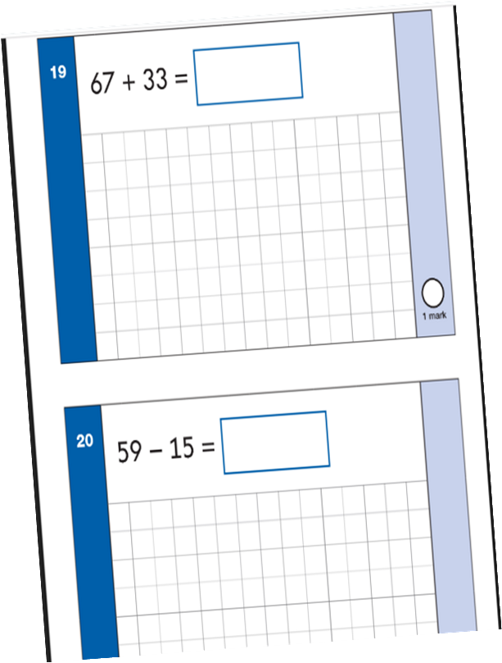
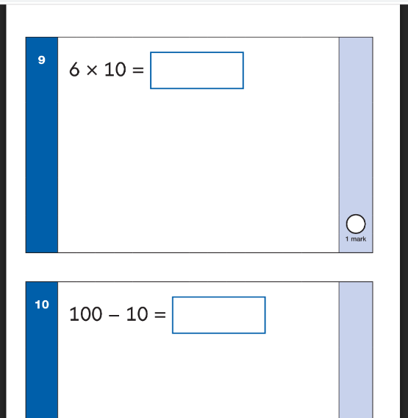
Maths Paper 1 (Arithmetic) Example Page
.

Slide 8
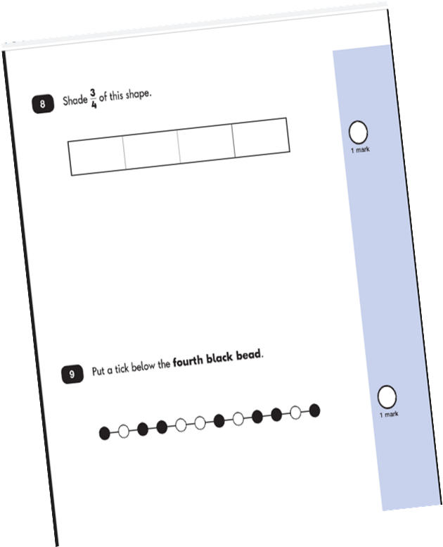
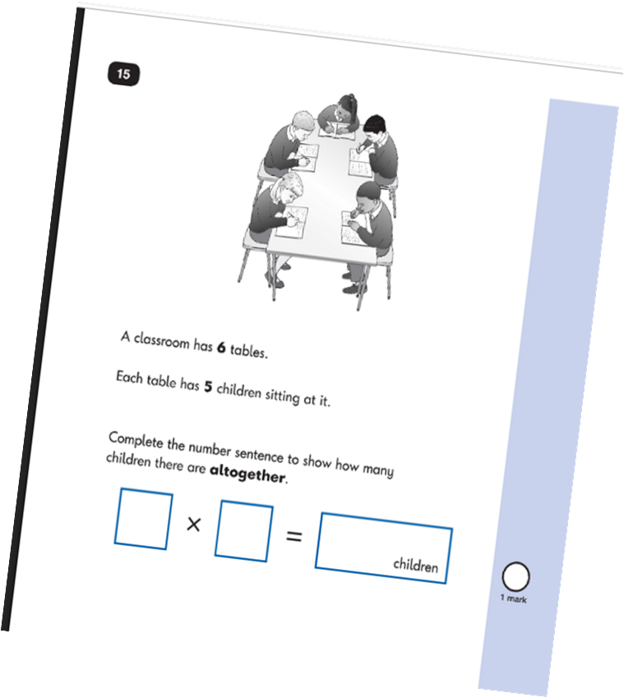
Maths Paper 2 (Reasoning) Example Page:
.

Slide 9
How can you help at home?
First and foremost, support and reassure your child that there is nothing to worry about and they should always just try their best.
Help your child with reading, listen to them read and focus on bringing out a ‘love of reading’. Also reading stories to your child allows them to develop language, listening skills and comprehension. Encourage making predictions of what might happen next.
Help your child with writing, support with weekly spellings. Write together to make shopping lists and letter writing.
Help your child with maths, play times table games. Encourage them to help with cooking, weighing and measuring ingredients. Work out what time it is together. Provide opportunities for your child to pay for things in a shop, to work out how much things cost and how much change will be needed.

Slide 10
Useful Websites:
https://www.bbc.co.uk/bitesize
https://www.ictgames.com/mobilePage/index.html
https://whiterosemaths.com/advice-and-guidance#start
https://nrich.maths.org/maths-at-home
https://mathszone.co.uk/
https://www.topmarks.co.uk/maths-games
https://www.topmarks.co.uk/maths-games/hit-the-button

Slide 11
Thank you for attending the End of Key Stage 1 Assessments presentation.

