Slide 1
Welcome to our
Phonics workshop
Year One
Notes:
Phonics is a process of teaching children to correlate its individual sound (phoneme) with its corresponding letter or letter group (grapheme). It teaches children how to decode letters into their respective sounds. A skill which is essential for children to read unfamiliar words by themselves. Keep in mind that most words are unfamiliar to early readers in print, even if they have spoken knowledge of the word.

Slide 3
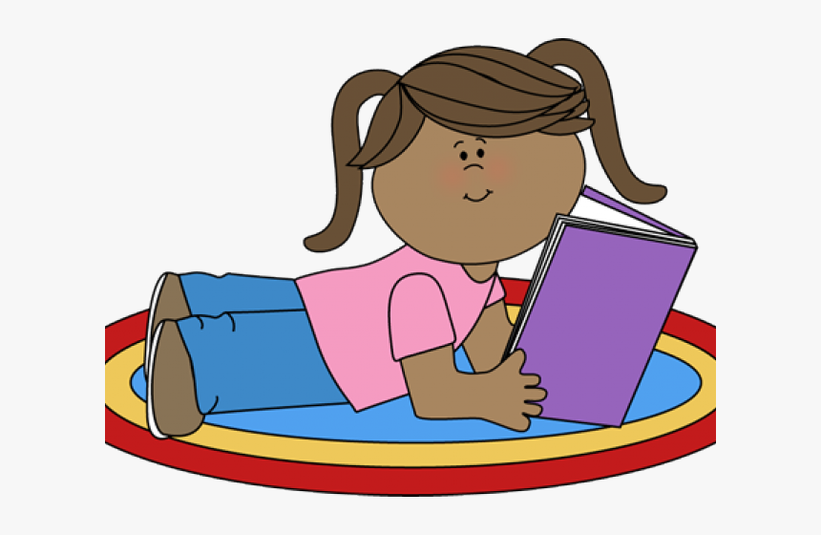
Phonics begins in Reception.
It is broken down into phases.
Only when the child is confident with the phonemes or alternative spellings in the phase, will he/she be moved to the next phase.
The children are assessed regularly
to identify any gaps in their early
reading skills.
Notes:
The sounds are arranged 44 sounds and the alternative spellings of the sounds are taught in phases.
The sounds in front of you …. Can you put them in the order that they will be taught?

Slide 4
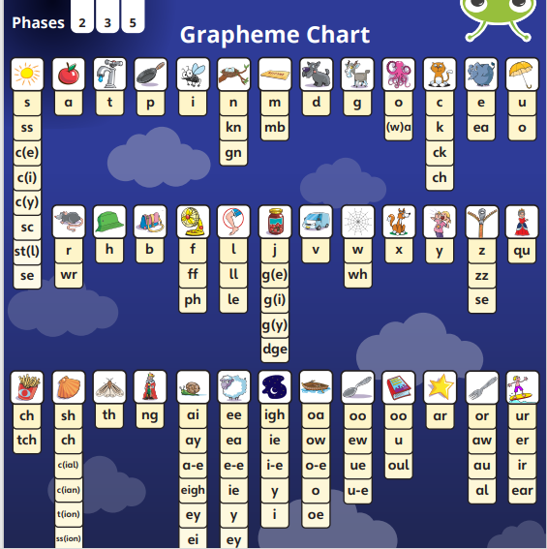
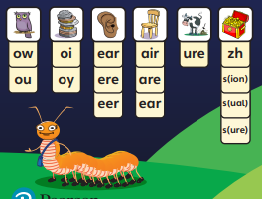
In Year One children learn
phonemes from phase 2 to 5.
Notes:
The sounds are arranged 44 sounds and the alternative spellings of the sounds are taught in phases.
The sounds in front of you …. Can you put them in the order that they will be taught?

Slide 5
If you would like to practise the phonemes your child learns, they can be found on the Farnborough school website. Alphabet (pearsonschoolsandfecolleges.co.uk)
Notes:
The children learn the sounds in an order. Phonemes are taught in an order .Have a go at sorting the sounds into the order they learn.

Slide 6
Reading Blending happens when phonemes are pronounced in isolation and blended together (synthesised)
Notes:
The children learn the sounds in an order. Phonemes are taught in an order .Have a go at sorting the sounds into the order they learn.

Slide 7
Blend these words: p l a n e s t r i k e p er f u m e s u n / f l ow er Have a go reading the words at your tables. Can you break the words into individual sounds?
Notes:
The children learn the sounds in an order. Phonemes are taught in an order .Have a go at sorting the sounds into the order they learn.

Slide 8
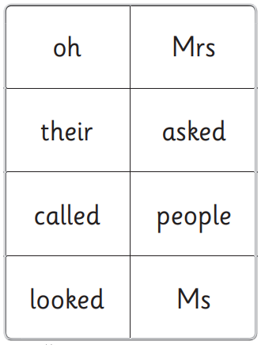
Tricky Words
Tricky words can not be broken down fully by sounds.
Notes:
The children learn the sounds in an order. Phonemes are taught in an order .Have a go at sorting the sounds into the order they learn.

Slide 9
Reading books are collected in on Mondays and sent out on Tuesdays. Inside the folder, you should find one sharing book, two books for your child to decode and a reading logbook for the grownup to write in.
Reading at home
Notes:
The children learn the sounds in an order. Phonemes are taught in an order .Have a go at sorting the sounds into the order they learn.

Slide 10
Children should be able to read, through sounding and blending, about 90% of the text. Before the books go home, the children will have read one of the books at school a few times. This is to develop the child’s decoding, comprehension and fluency skills. The focus sound which appears in the reading books is learnt by the children before the book goes home.
Reading at home
Notes:
The children learn the sounds in an order. Phonemes are taught in an order .Have a go at sorting the sounds into the order they learn.

Slide 11
How to read Bug club paper books.
Reading at home
Notes:
The children learn the sounds in an order. Phonemes are taught in an order .Have a go at sorting the sounds into the order they learn.

Slide 12
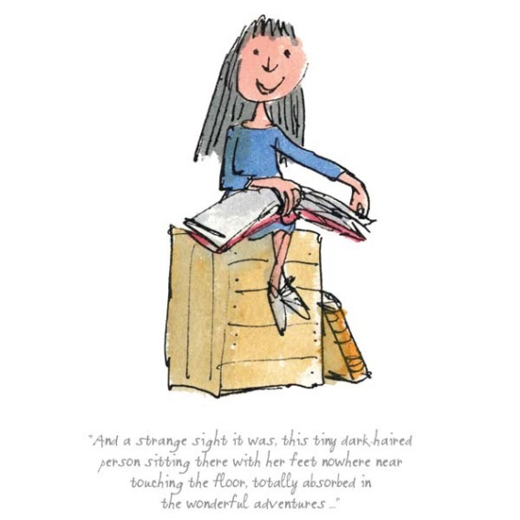
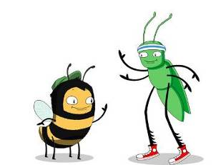
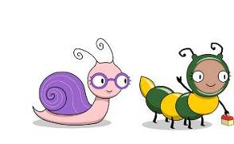
Read the inside of the front cover first.
.

Slide 13
Then let you child read at his/her pace. Sounding and blending the words on each page.
Reading at home
Notes:
The children learn the sounds in an order. Phonemes are taught in an order .Have a go at sorting the sounds into the order they learn.

Slide 14
Read bug club books at least 10 minutes, 5 days a week for phonics progression. We recommend your child repeat reads one of the books which goes home. This will improve decoding, comprehension and fluency skills.
Reading at home
Notes:
The children learn the sounds in an order. Phonemes are taught in an order .Have a go at sorting the sounds into the order they learn.

Slide 15
You will receive a reading log with your
reading book.
Please comment in your child’s reading log about your child’s reading. Please let us know about other books your child has read at home.
Reading at home
Notes:
Blending means putting together the sounds/phonemes to say the word. Have a go blending some of the words on your table.

Slide 16
How to find your way round the bug club programme and read e books.
Reading at home
Notes:
The children learn the sounds in an order. Phonemes are taught in an order .Have a go at sorting the sounds into the order they learn.

Slide 17
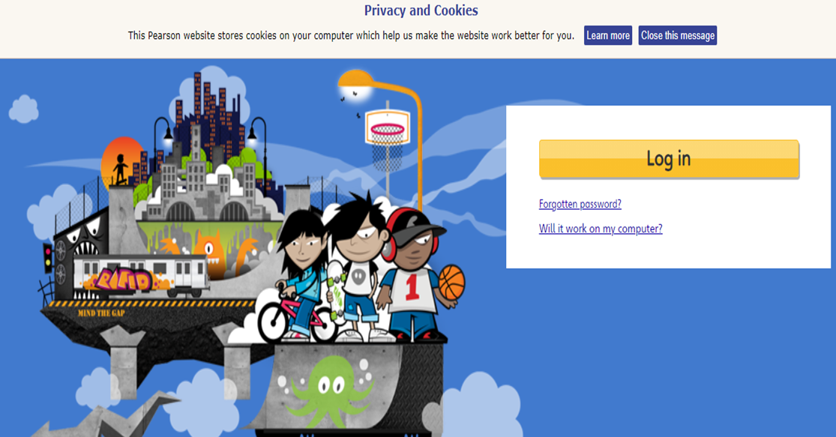
Reading
Bug Club online
To log on go to:
Type in bug club and the address below will appear.
.

Slide 18
Reading
Bug Club online
Type in your child’s login details
Once in your child’s account, go to ‘my stuff’ where
your child’s books are displayed. Select a book to
read. The book does not have to be completed in one go.
.

Slide 19
Bug Club online
When your child has finished a book, the book will move to ‘my library’ as long as all bug questions and the ratings emoji are answered.
Once the book is in ‘my library’, the class teacher can see the book is completed. The class teacher can see how many books have been read and how many are available in ‘my stuff’. A new set of books can be allocated by the class teacher when needed.
.

Slide 20
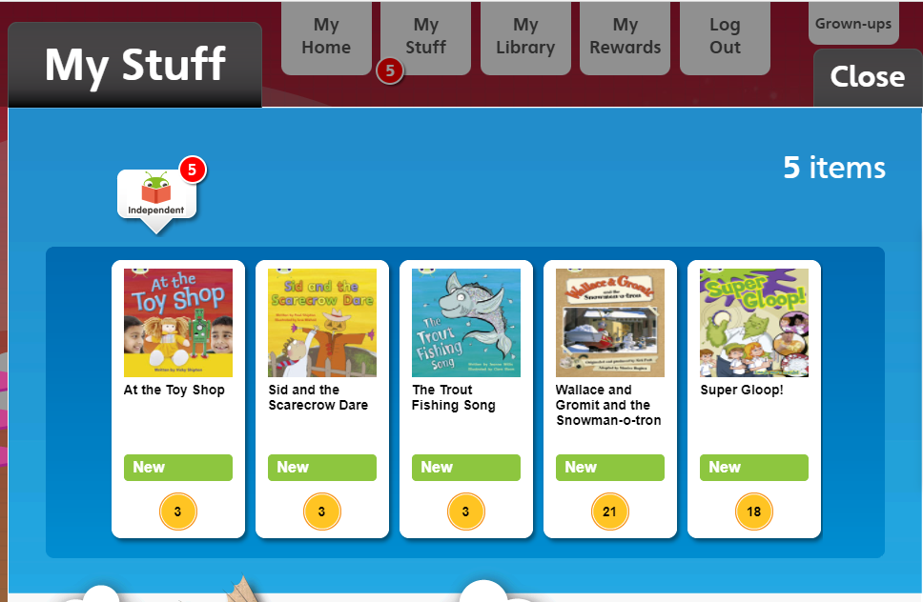
Reading
Bug Club online
.

Slide 21
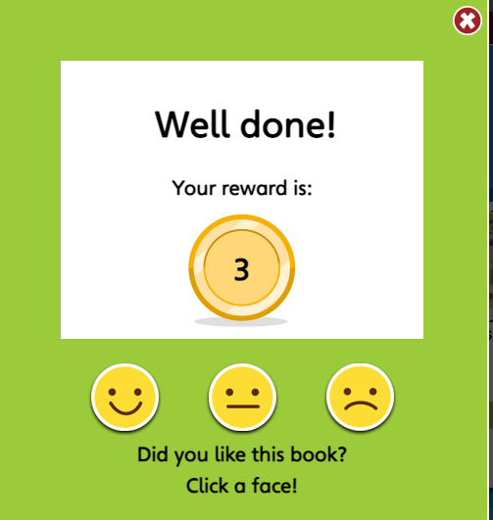
Reading
Bug Club online – always rate the book at the end so the book goes to ‘my library’ and a new
One appears in ‘my stuff’.
.

Slide 22
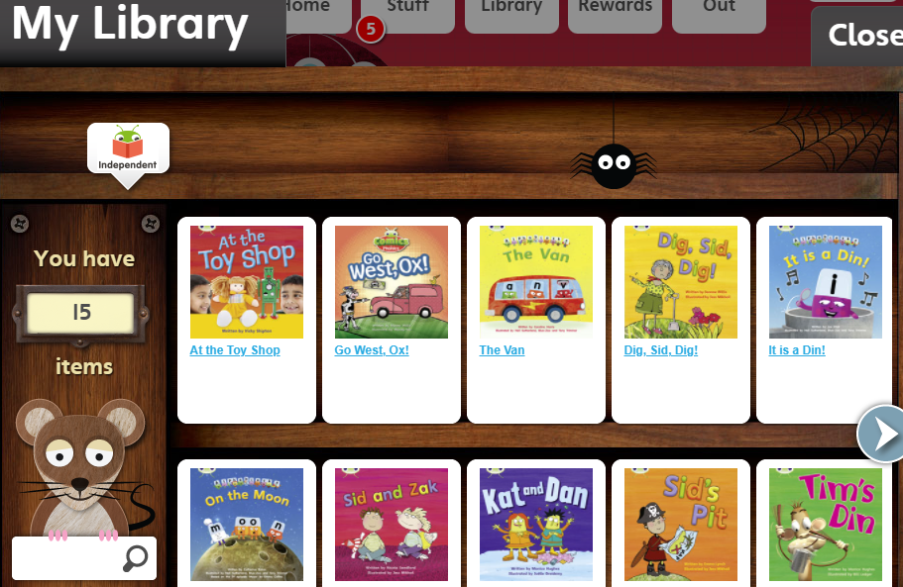
Reading
Bug Club online
.

Slide 23
In Year One after the spring half term break at
the beginning of June, children in Year One
carry out a statutory phonic screening check with
their teacher.
It is constructed of 20 real words
and 20 pseudo words. Pseudo words are
included because they will be new to all children.
The purpose is to check to see if the child has
reached the age expected standard for decoding
words.
Phonics Screening
check
Notes:
Blending means putting together the sounds/phonemes to say the word. Have a go blending some of the words on your table.

Slide 24
Every year the pass mark is set, this is not known
until after the check. So far, the pass mark has
been set at 32 out of 40 words.
If a child does not pass the check, he/she has to
retake the following year.
How can you help at home?
Support your child to read his/her Bug club books
daily to reach their full potential in reading.
Phonics Screening
check
Notes:
Blending means putting together the sounds/phonemes to say the word. Have a go blending some of the words on your table.

Slide 25
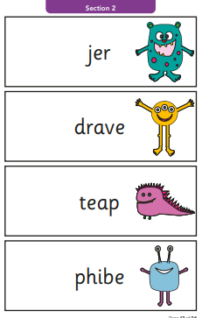
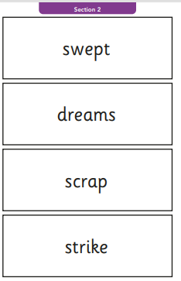
Phonics Screening
check
Notes:
Blending means putting together the sounds/phonemes to say the word. Have a go blending some of the words on your table.

Slide 26
Thank you for listening.
We hope the workshop helps with supporting your child to learn to read at home.
Notes:
Blending means putting together the sounds/phonemes to say the word. Have a go blending some of the words on your table.

