Slide 1

Welcome to Meet the Teacher

Slide 2
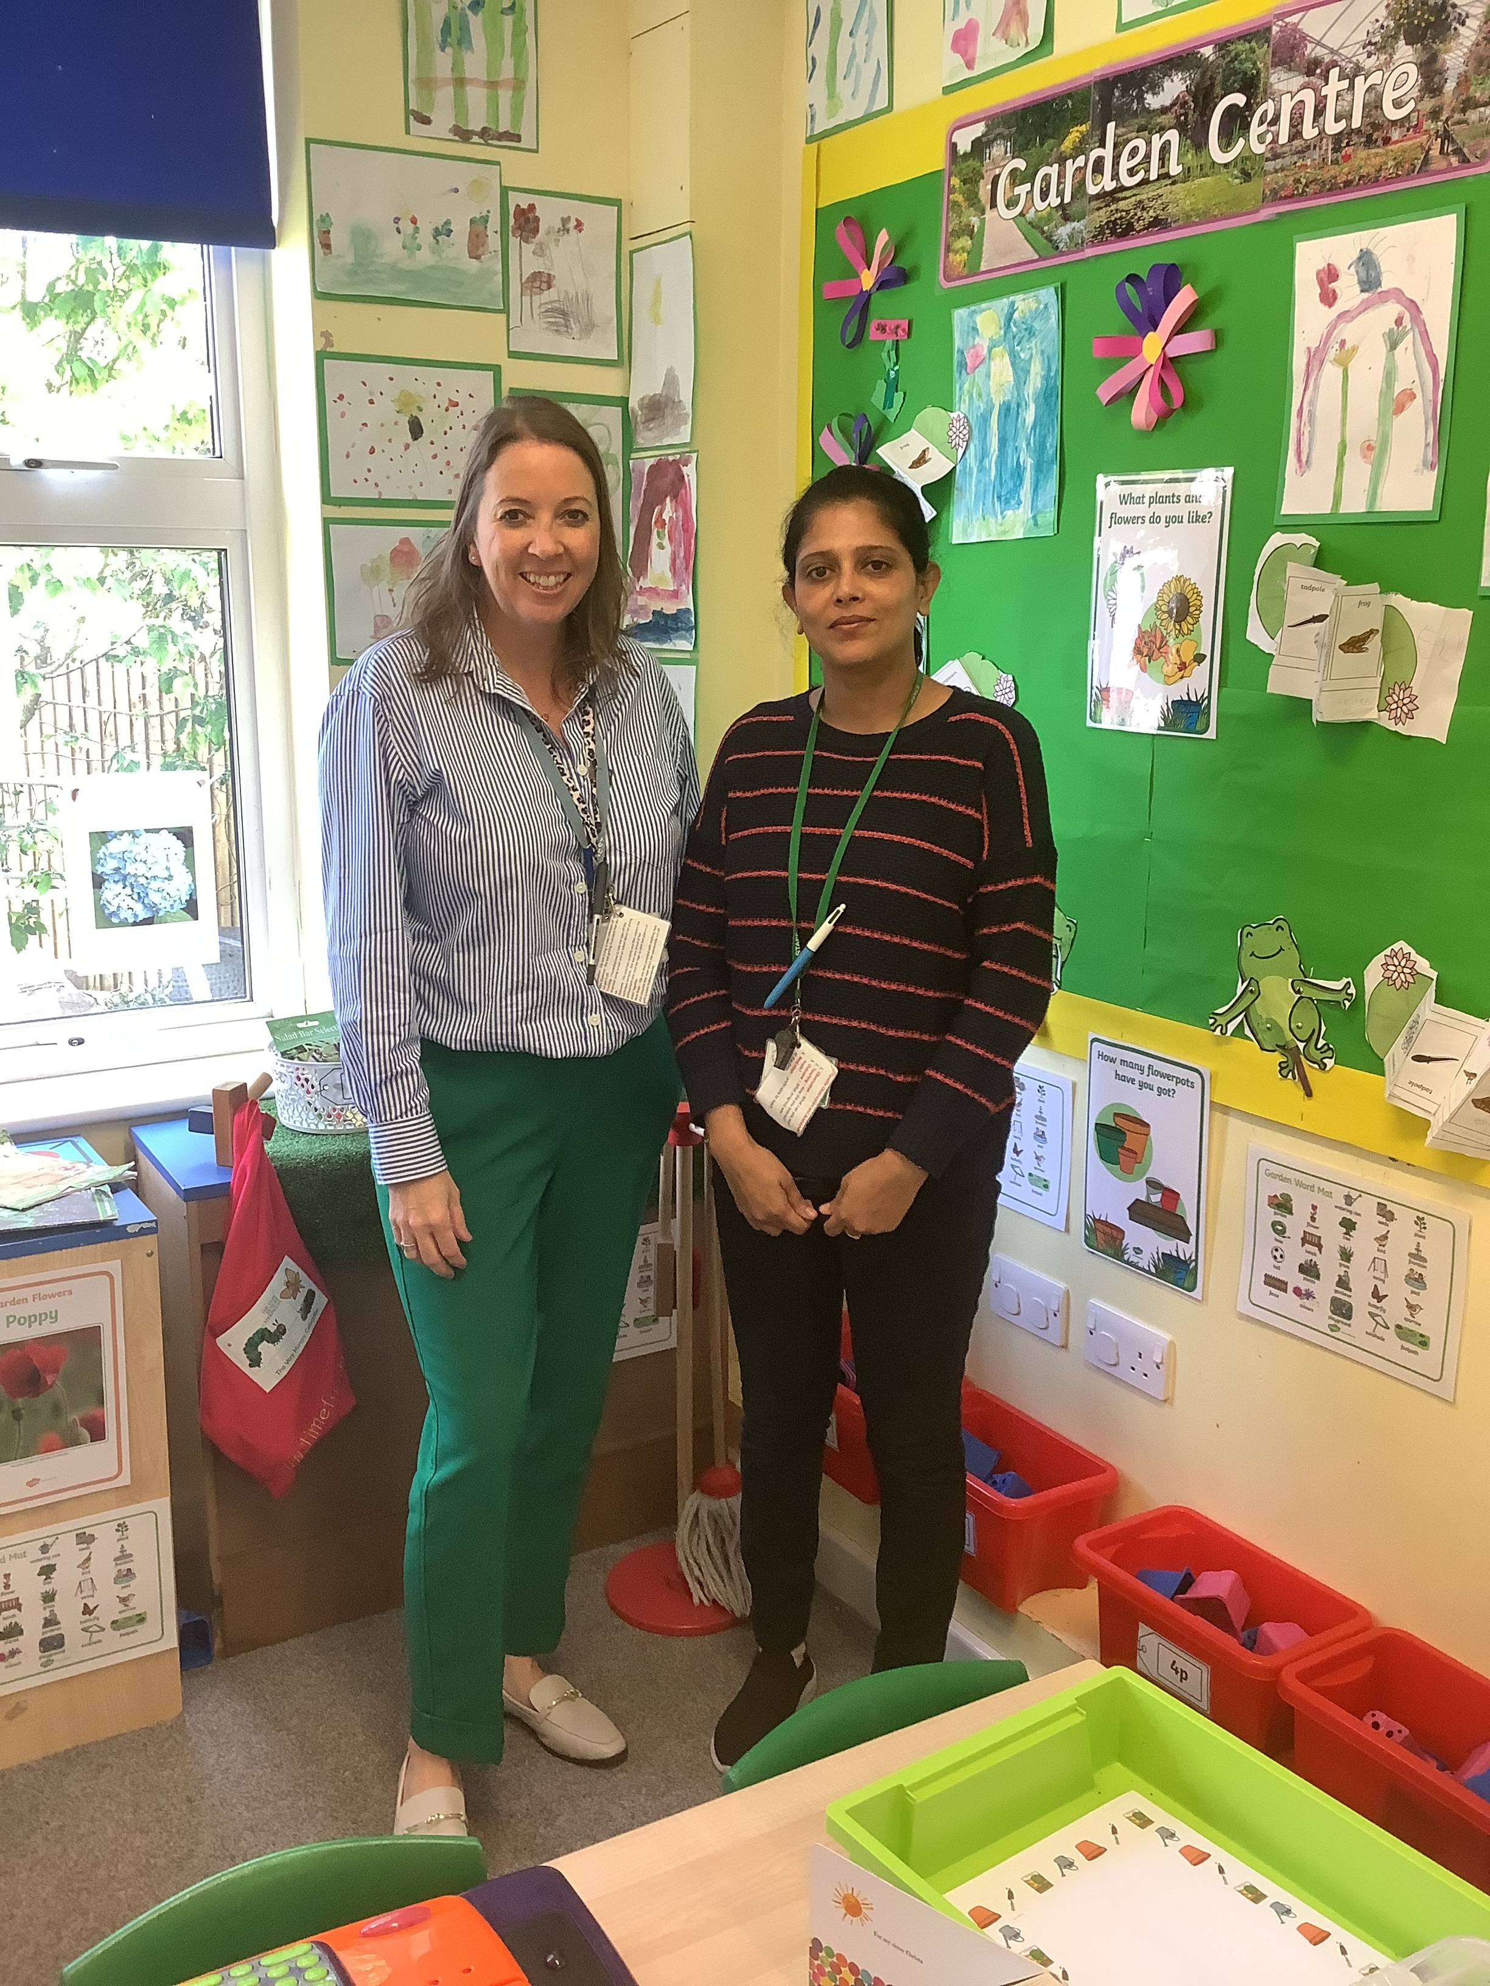
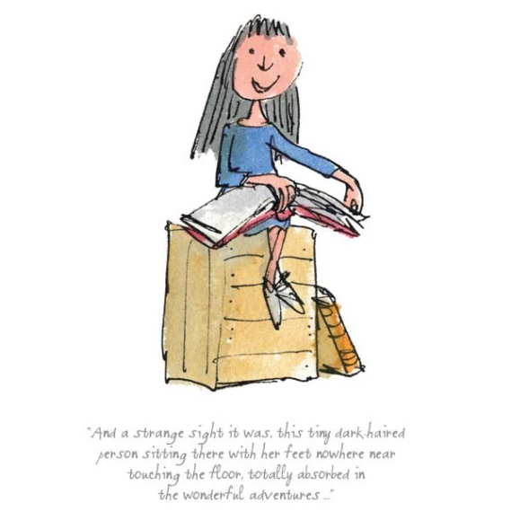
Miss Spreckley
Mrs Dhar
The Reception Team

Slide 3

Timings of the day
School gate opens at 8.40am
Register is taken at 8.50am
Pick up is 3.10pm
Lunchtime 11.45 am – 1 pm
( menu available on-line )
Pick up at 3.10pm

Slide 4
Uniform Standards
Polo shirt
Sweatshirt
Shorts, skirt or pinafore dress
Grey socks
White or grey tights
Black shoes
Tracksuit on P.E / Forest School days
Small green / red bows in hair

Slide 5
Name, name, name everything!
Please name all school uniform, P.E kits, plimsolls, packed lunch boxes and school bags.
We do try to encourage children to take responsibility for their belongings and it is much easier when everything is named.

Slide 6
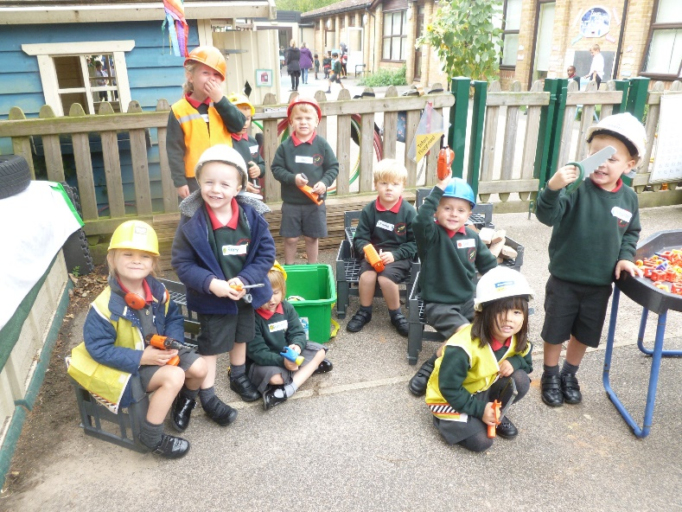
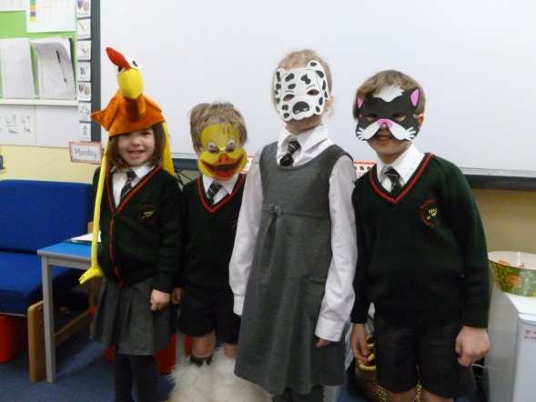
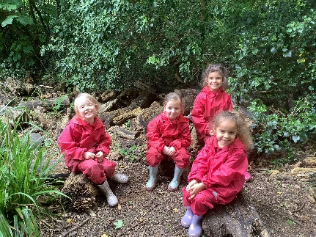
What is the EYFS?
Early Years Foundation Stage
E.Y.F.S. is the stage of education for children from birth to the end of the Reception year.
It is based on the recognition that children learn best through play and active learning.
All learning takes place in both the inside and outside classrooms.

Slide 7
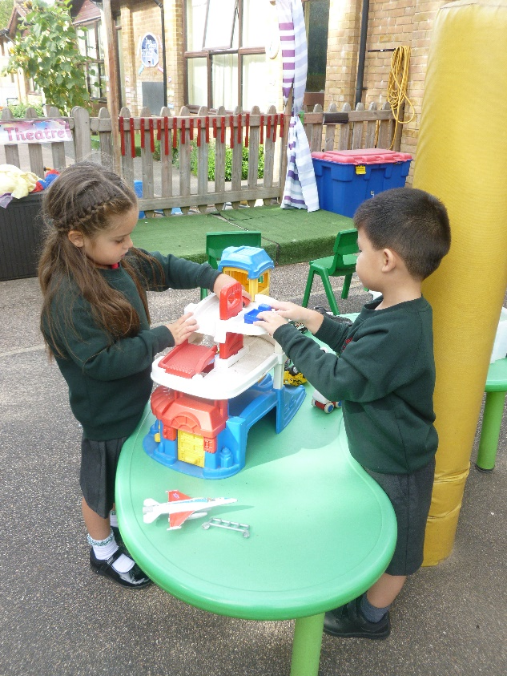
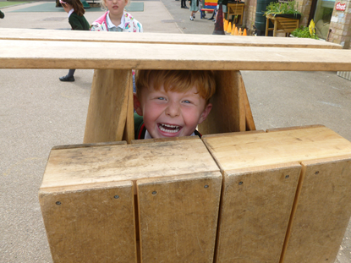
Prime Areas
These are considered to be fundamental to children’s development
Personal, Social and Emotional Development
Physical Development
Communication and Language

Slide 8
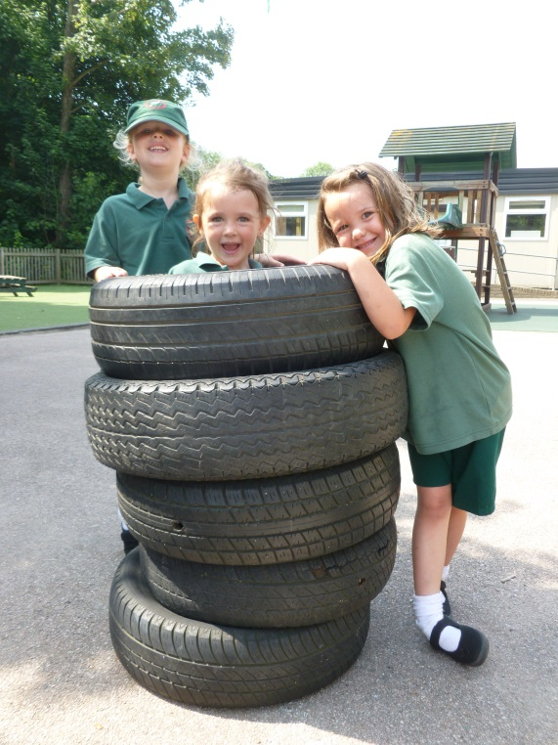
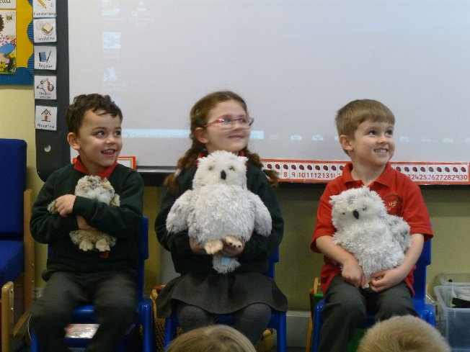
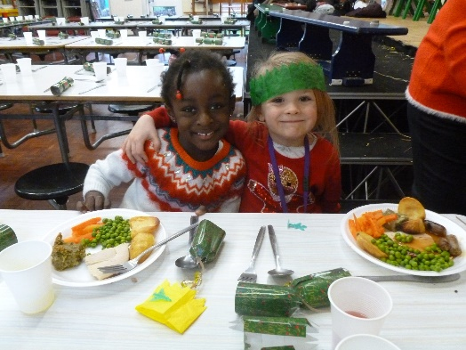
PSED
Personal, Social and Emotional Development
Forming positive relationships with adults and children
Playing co-operatively with others
Developing confidence and becoming more independent
Understanding and following
the rules

Slide 9
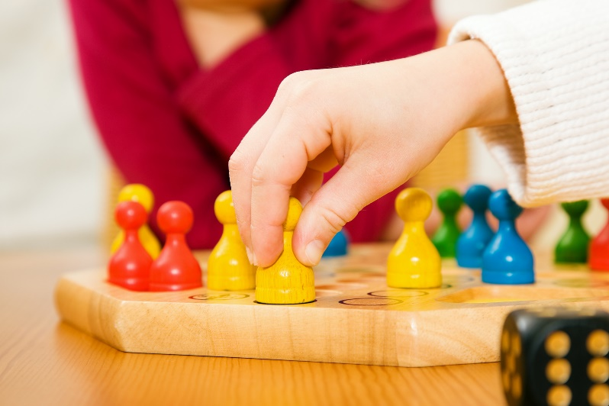
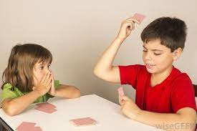
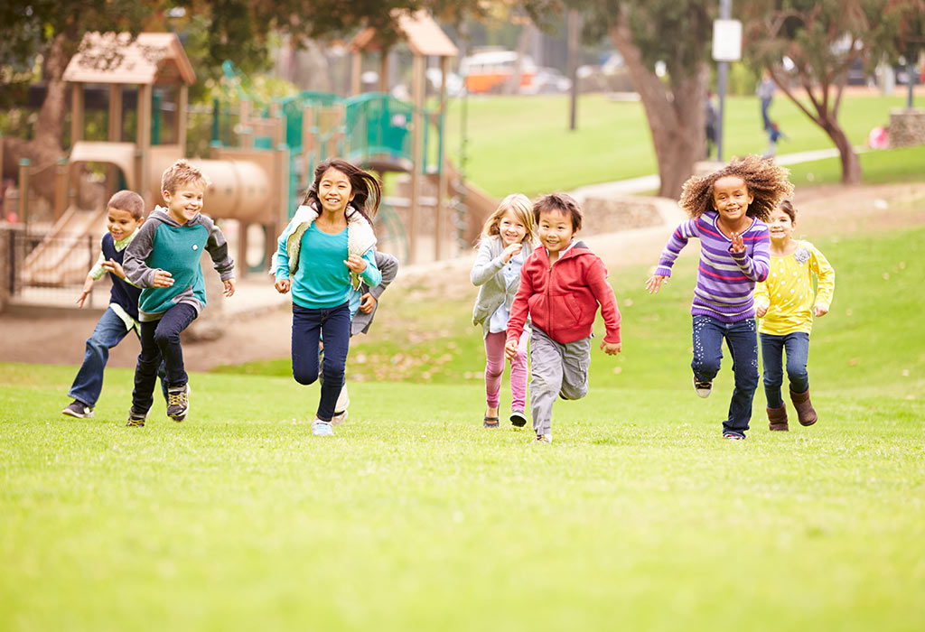
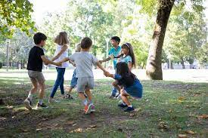
Personal, Social and Emotional activities for home:

Slide 10
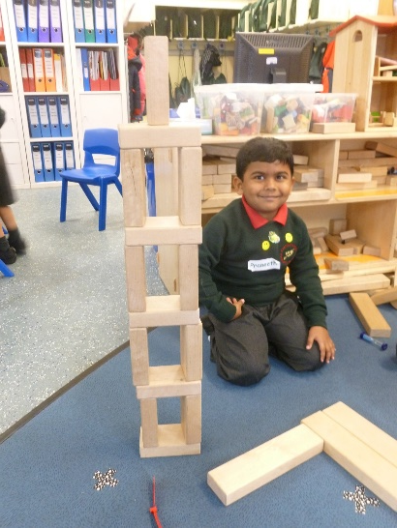
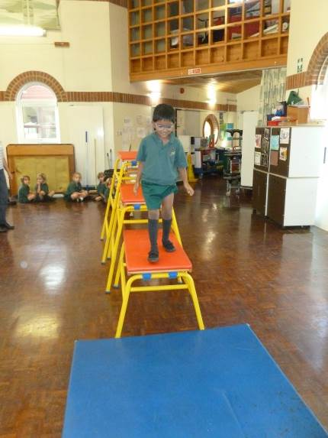
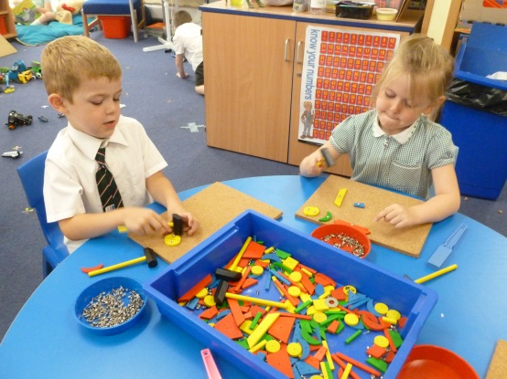
Physical Development
Gross and fine motor skills
Developing good control and co-ordination in large and small movements
Handling equipment and tools effectively, including pencils for writing
Independently getting dressed and undressed

Slide 11
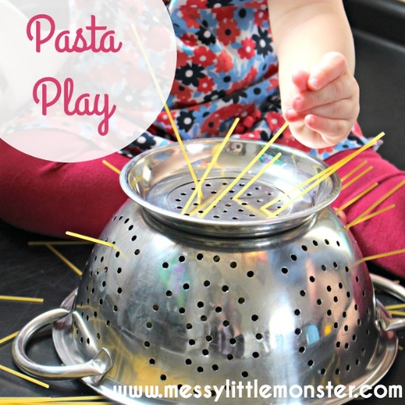
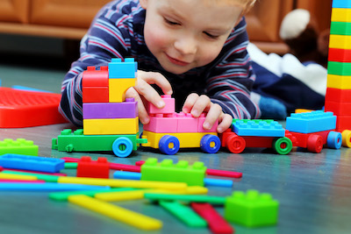
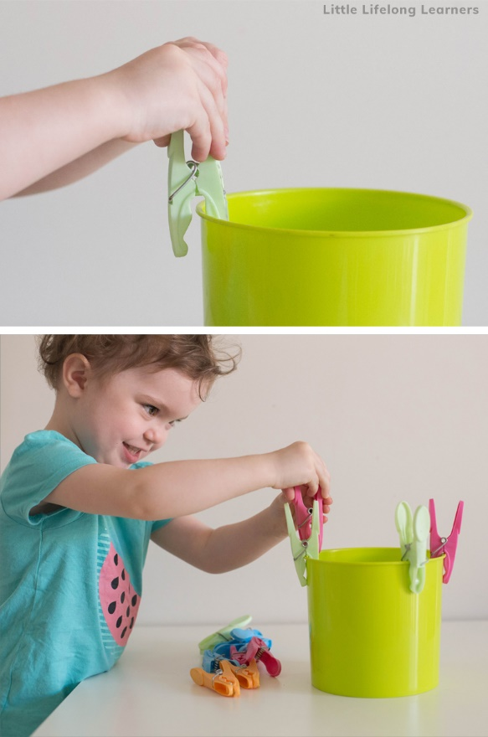
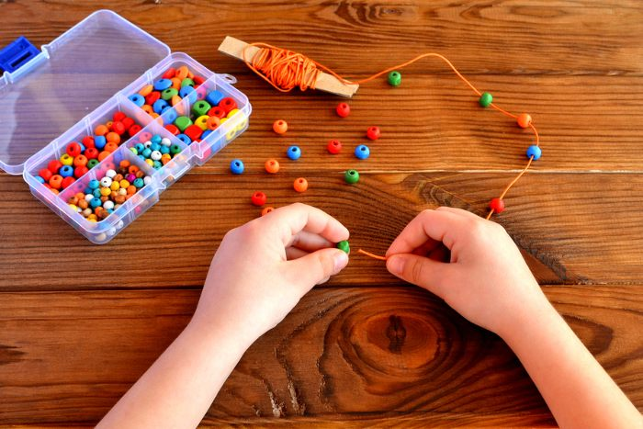
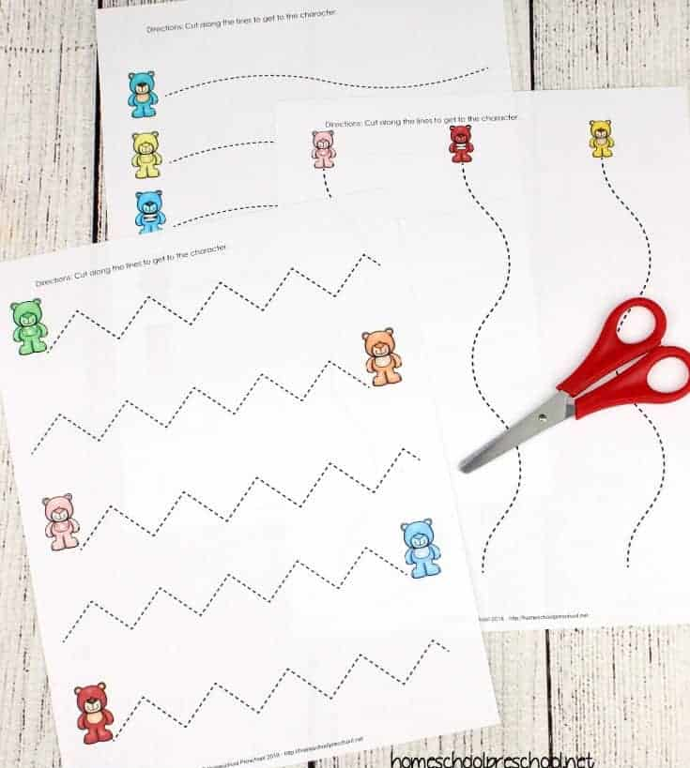
Physical Play activity suggestions for home:

Slide 12
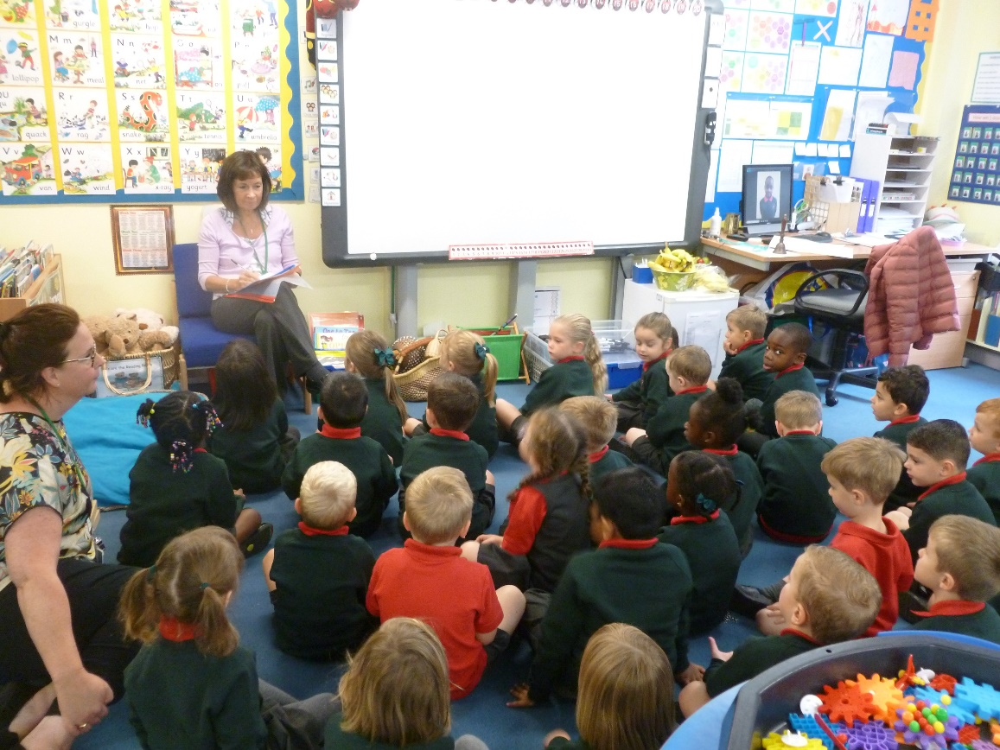
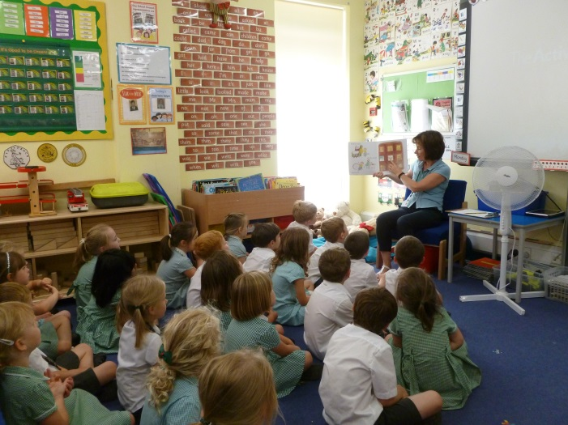
Communication and Language
Understanding and acting on instructions
Developing language and communication
Developing listening and attention skills

Slide 13
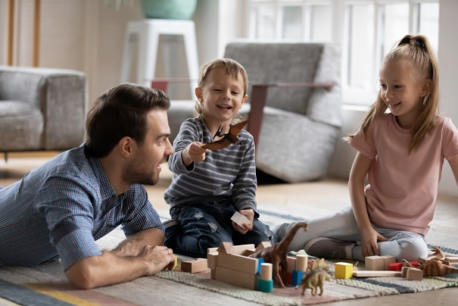

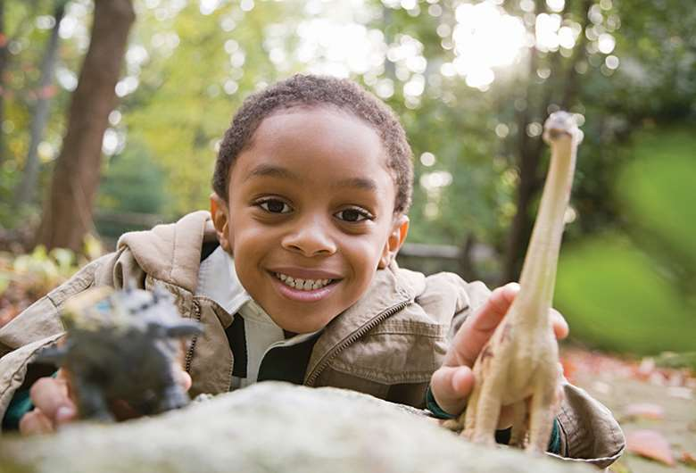
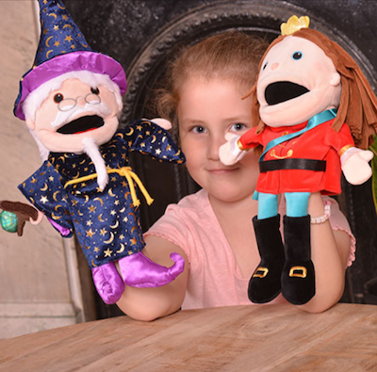
Communication and Language activities for home:

Slide 14
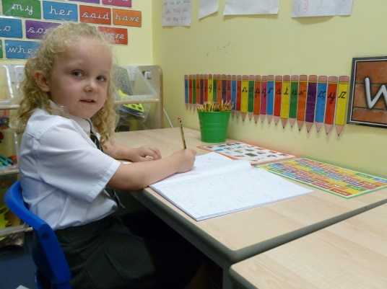
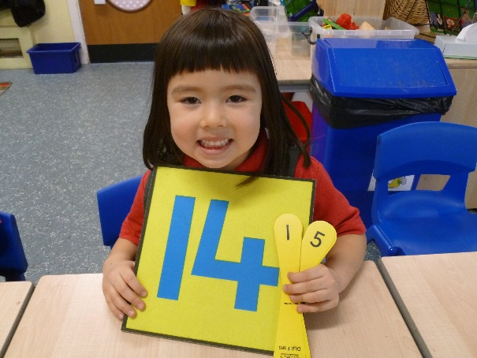
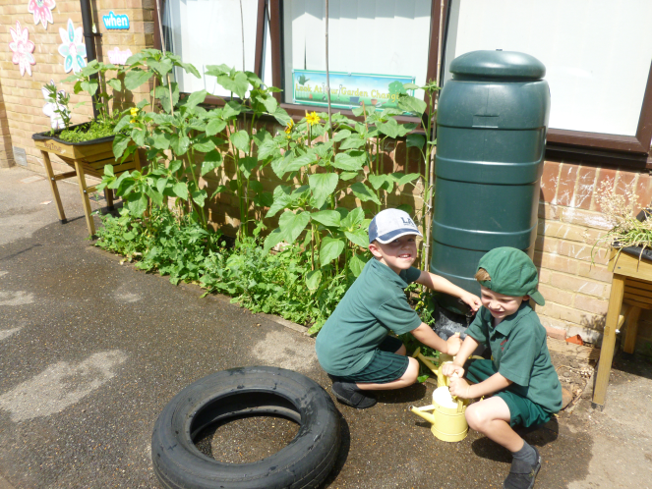
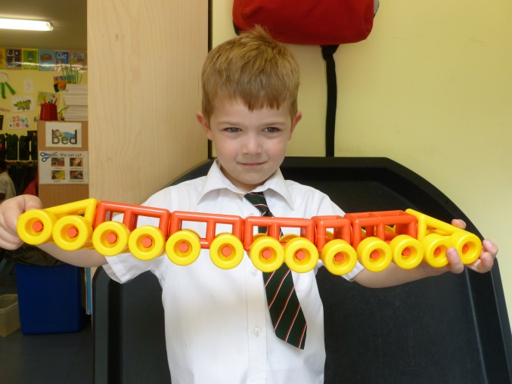
Specific Areas
- essential skills and knowledge
            Literacy
            Mathematics
            Understanding the World
            Expressive Arts and Design

Slide 15
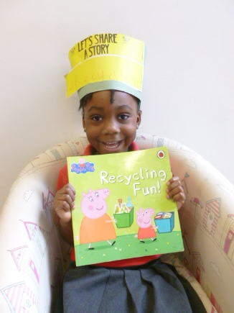
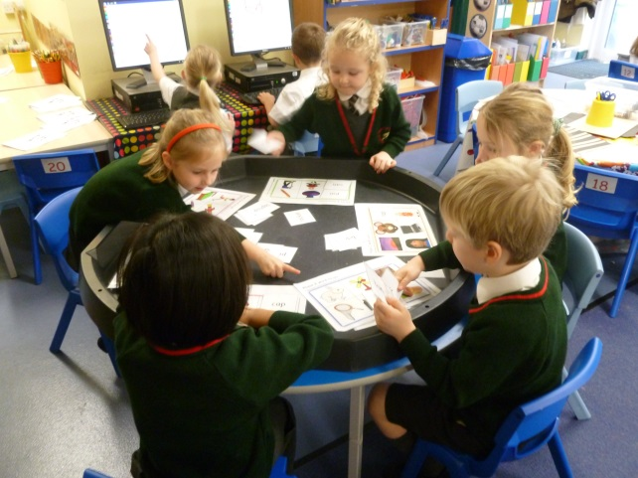
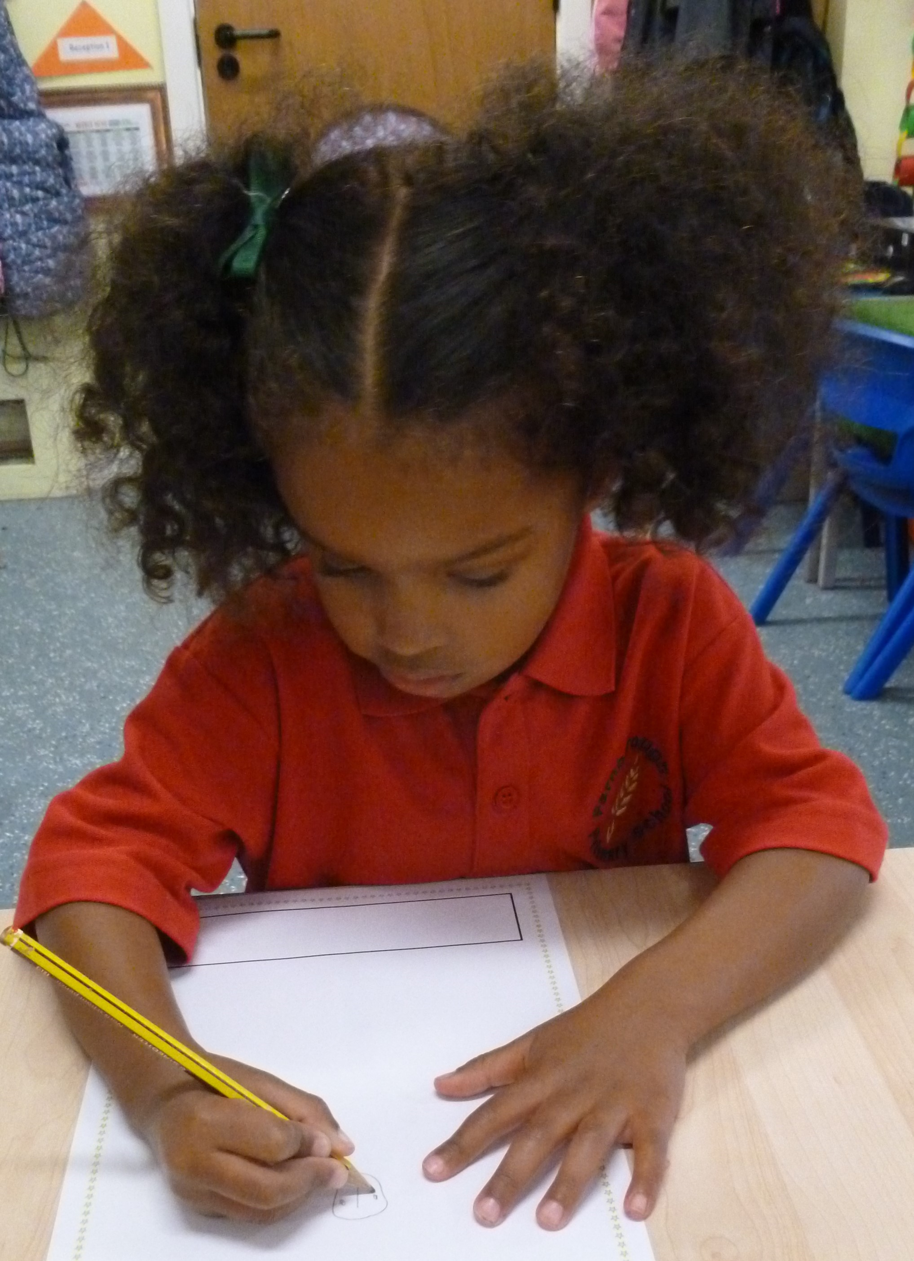
Literacy
Reading
Linking sounds to letters
Segmenting sounds in words and blending them together
Reading words and simple sentences
Writing
Developing pencil control
Beginning to form identifiable letters
Attempting to write simple words
and sentences

Slide 16

Phonics
We follow the scheme for phonics.
Phonics sessions take place daily.
Once your child is familiar with a range of letters and associated sounds then we will start to send you sets of CVC words for your child to practise blending sounds together to make words.
After half-term we will send home Bug Club log-ins with your child’s reading folder.

Slide 17
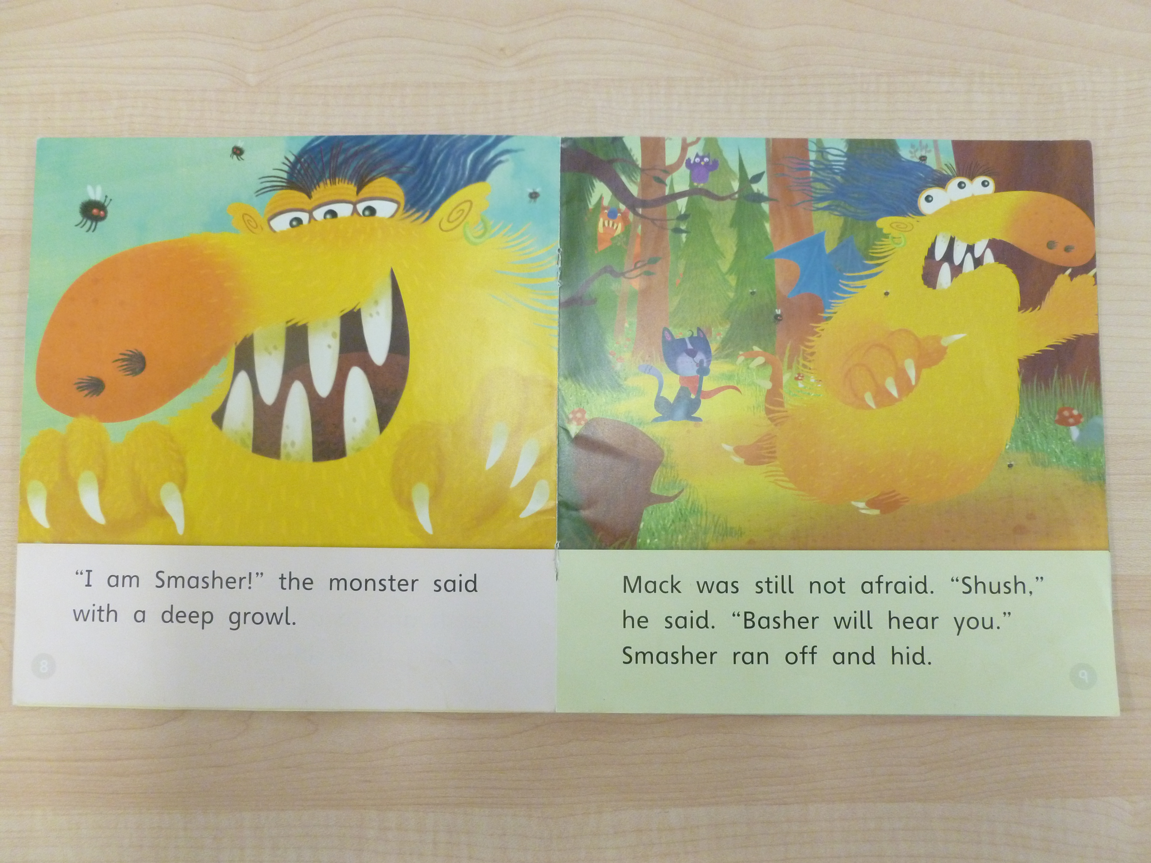
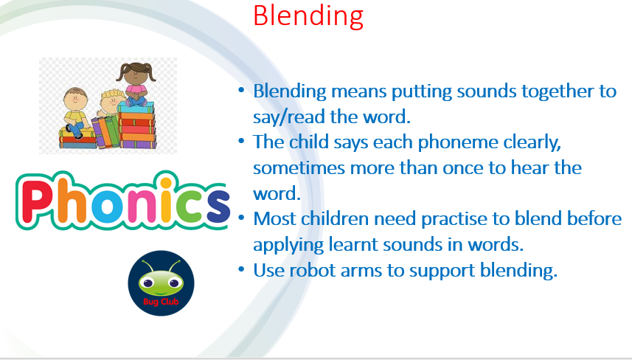
Blending when reading:

Slide 18


Slide 19
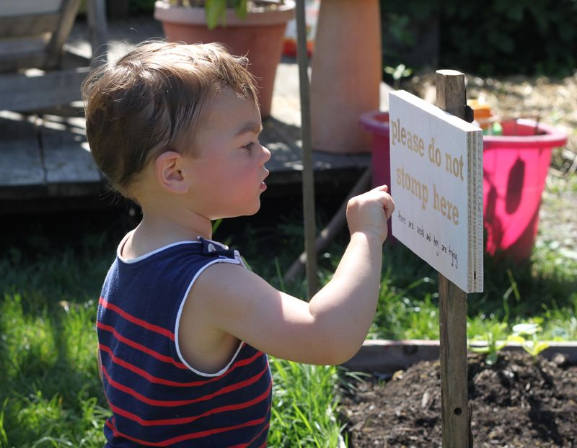
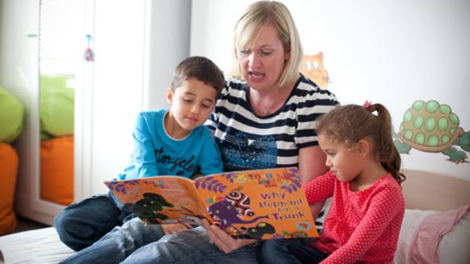
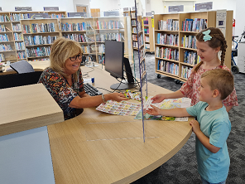
Reading activities for home:

Slide 20

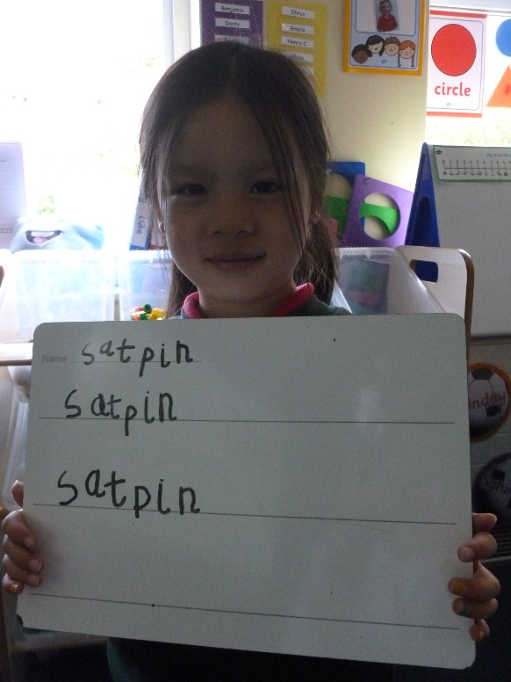
Writing
The children are taught letter formation as they learn the sounds of the alphabet during a daily handwriting session.
We teach a catchy phrase to help letter formation.

Slide 21
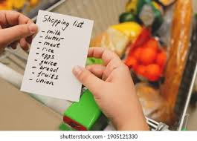
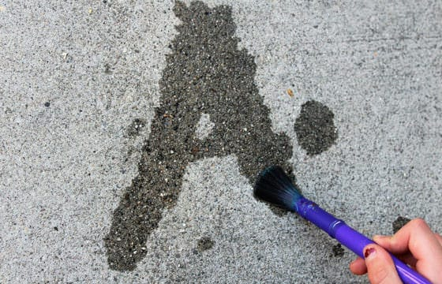
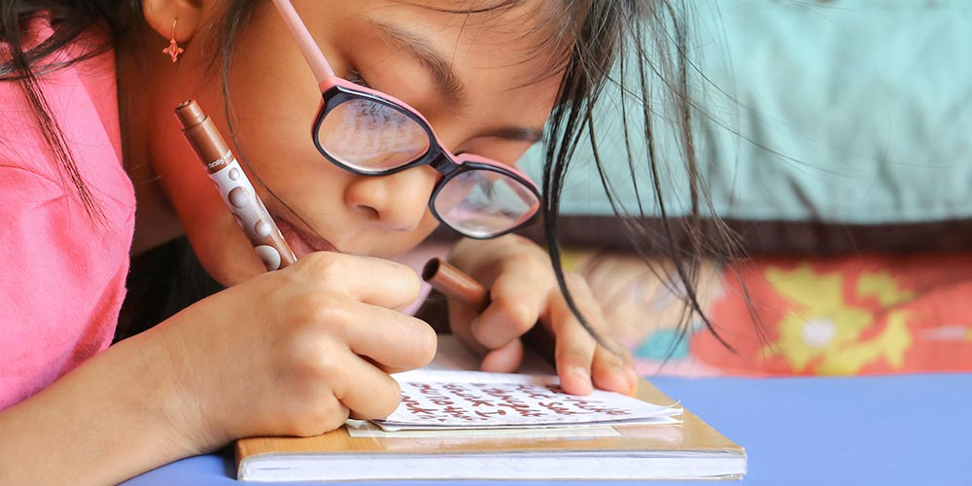
Writing activities for home:

Slide 22
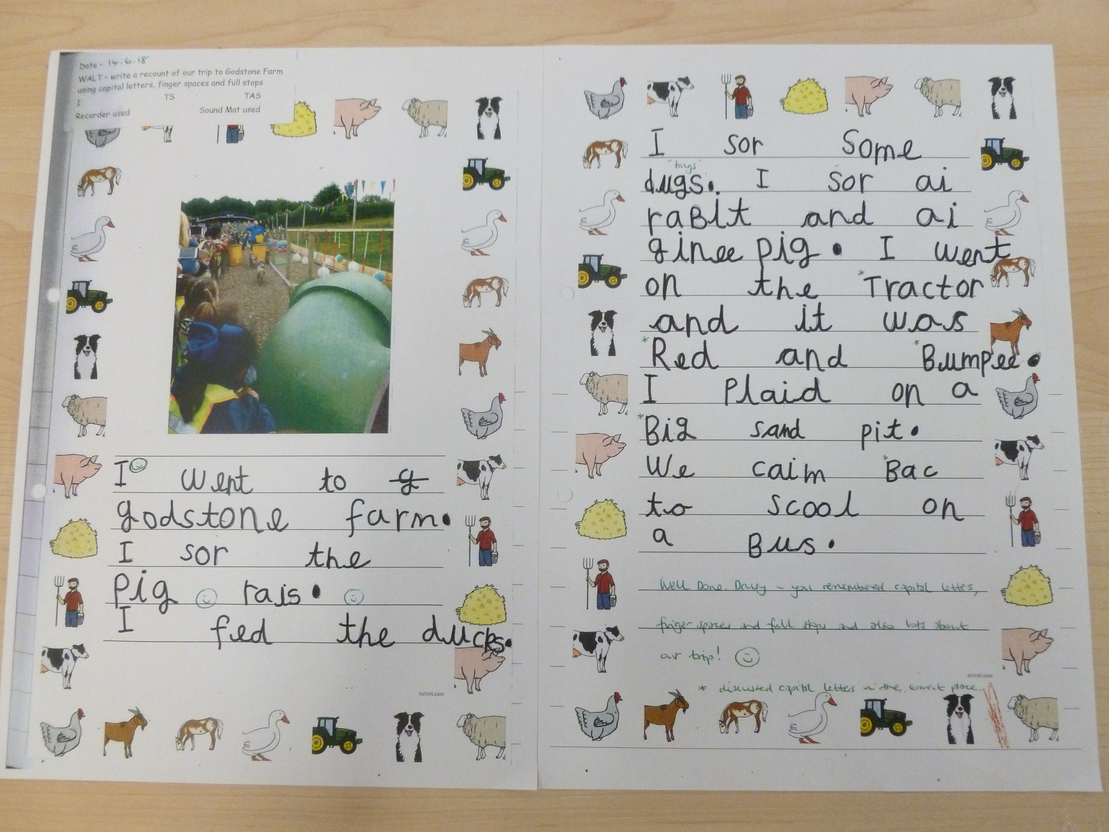
Writing example

Slide 23
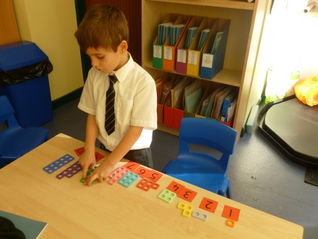
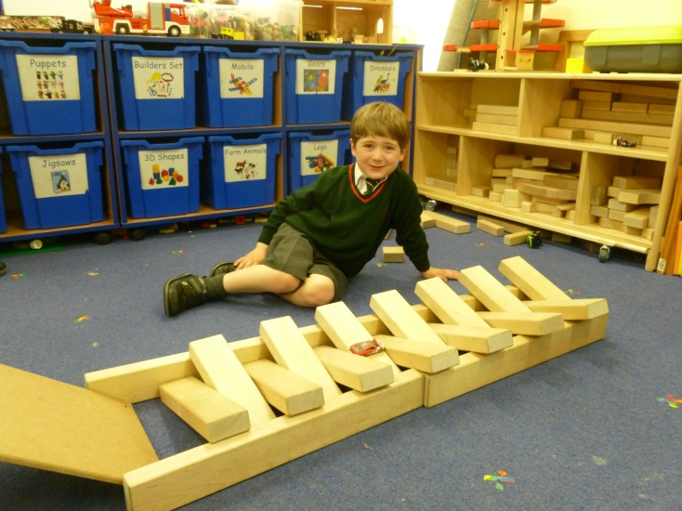
Mathematics
Number
Helping children to count, recognise and order
numbers to twenty and beyond and introducing addition and subtraction.
Practical problem solving
Shape,space and measure
Encouraging the use of mathematical language
Exploring size, weight, capacity, position, distance,
time money and patterns
Supporting children’s
understanding of shape and size
including 2D and 3D shapes.

Slide 24
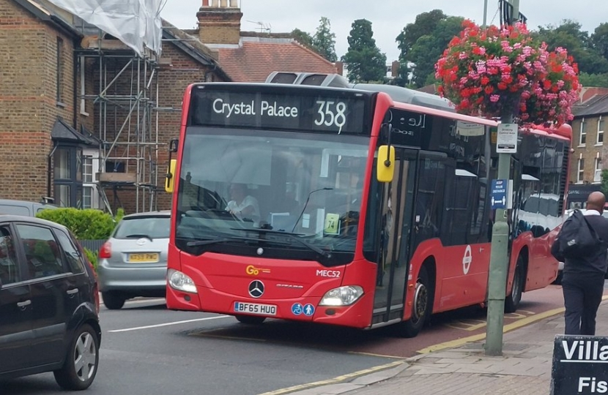
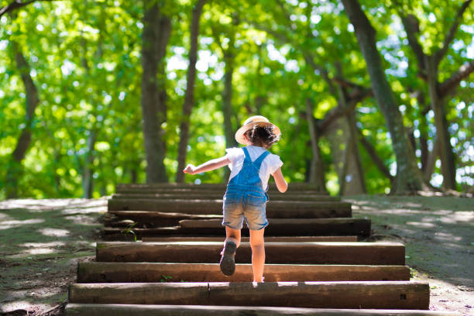
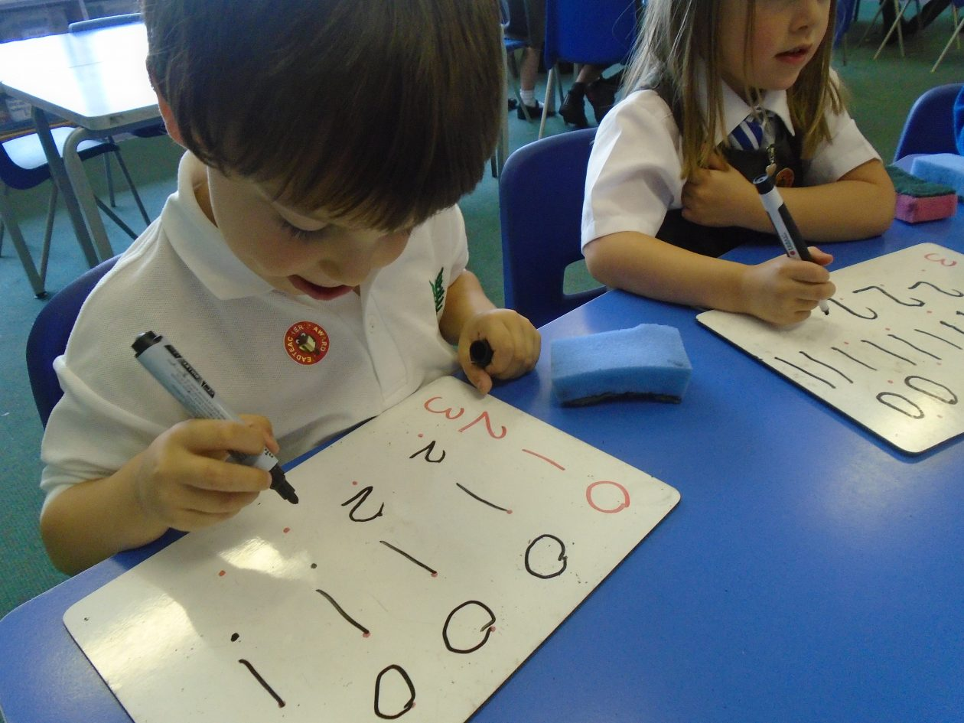
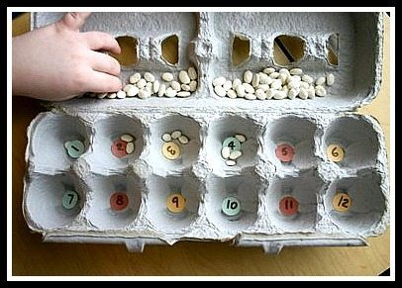
Maths activities for home:

Slide 25






Understanding the World
Learning about traditions and other cultures
Exploring and investigating the environment
Looking at change and life cycles

Slide 26





Understanding the World activities for home:

Slide 27



Expressive Arts and Design
Developing confidence and imagination
Exploring music and dance
Experimenting with a variety of materials, tools and techniques
Introducing narratives in role play

Slide 28




Expressive Arts and Design activities at home:

Slide 29


Forest School
Forest School will start on the first Monday after half term and will take place in all weather conditions with the possible exception of extremely high winds.
Children should wear the green tracksuit on Forest School days, and will need red waterproof trousers and jacket and a pair of wellies which will all remain at school.
Please provide a named bag that is easy for your child to identify to hold the waterproofs.
Please bring your child’s forest school kit and wellies on Monday 30th October (The first day back after half term).

Slide 30
Homework
A homework task will be issued every Friday to be completed by Monday.
These could be Maths or Literacy/phonics based or could be a task linked to the other areas of learning or our topic.
Please encourage your child to complete any homework as independently as possible.

Slide 31

How should we behave?
GOING FOR GREEN!!!

Slide 32

The Weekly Timetable

Slide 33
Thank you for listening
Any Questions?

