Slide 1
Welcome to Year 6!
Mrs Roberts & Mrs Brett

Slide 2
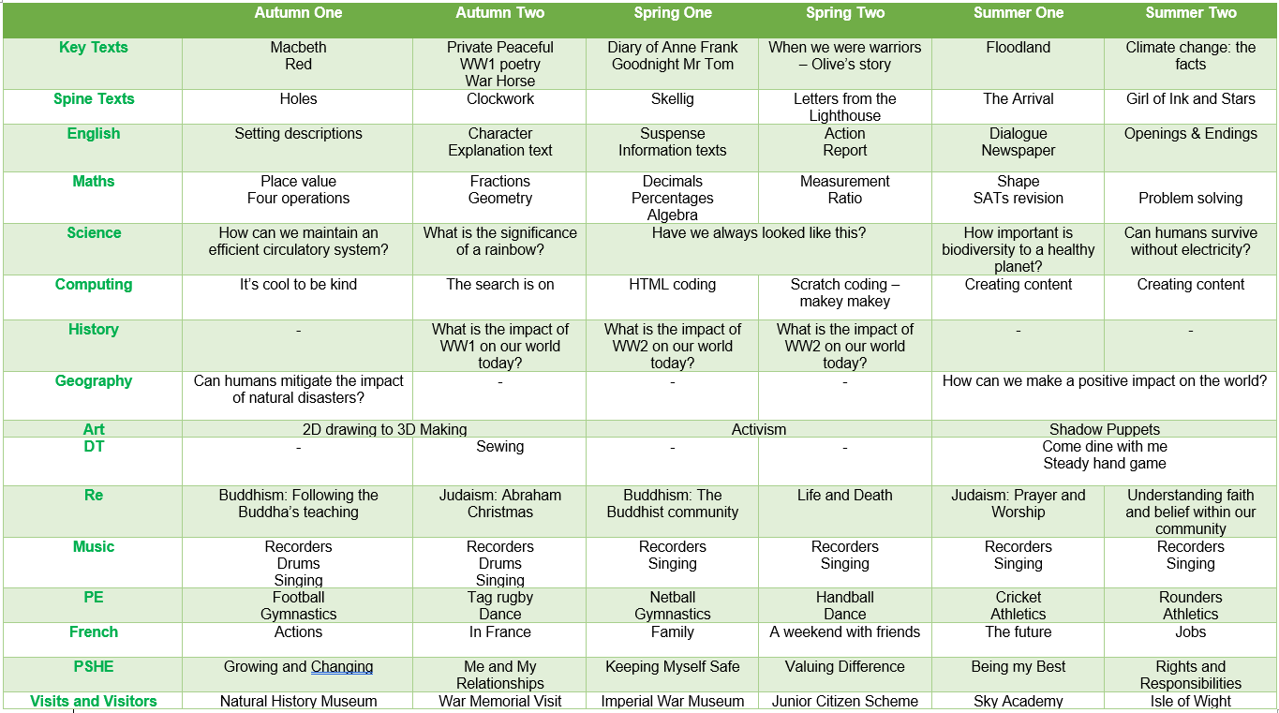

Slide 3
Weekly timetable
Every morning, children will complete maths and English lessons, including arithmetic practise, reasoning work, guided reading, writing and grammar.
Children will be taught French, music and some P.E. lessons by specialist teachers.
Children need their P.E. kit in school every day, as P.E. lessons might be changed due to weather/other school events taking place but usually our P.E. days are Mondays and Fridays.

Slide 4
Reading
In school, children will have guided reading sessions three times a week. In these sessions, we will focus on different skills (vocabulary, inference, prediction, explaining, retrieval and summarising) that the children need to develop to become fluent readers.
Children should read at home everyday. Reading is an important life skill and can also be an incredibly enjoyable activity. Many children last year identified reading as a mindfulness tool they used to help their wellbeing.
Children should read a variety of text types which interest them and gives them pleasure to read.
Children might also use appropriate texts to support them in learning to read, which will be sent home with them if required.

Slide 5
Reading Spine
These are the books we will be reading for pleasure during the year with the children. We will read to the children every afternoon.
To help encourage reading for pleasure, you could: read books to and with your child, visit the library and let them choose books; let children re-read favourite books; create artwork etc linked to their favourite stories; complete the reading challenge, have discussions with your child about what they are reading etc.
Notes:
Non-fiction: newsround articles, DK find out

Slide 6
Writing
We use Talk for Writing, which is a scheme of work which aims to teach the children to become fluent writers.
One of the key elements is the model text, which is a short piece of writing which we learn together as a class. It models key grammar, sentence structure and style features that we be explicitly taught.
In lessons, we use ‘short burst writing’ and shared writing to practise the key skills. These are short writing activities which are completed within a lesson. Over a series of lessons, the children build up these skills before then applying them in longer pieces of work.

Slide 7
Spelling
Each week, we will focus on a different spelling pattern (e.g. –ing on words ending in ‘e’. We will study these patterns in class during the week, with a spelling test on Friday.
There will be two lists of spellings: one which focuses on the spelling pattern with familiar words and another which uses slightly higher-level vocabulary. It is vital that your child knows the meaning of any of the words on the second list if they choose to learn them so that they can apply and use them in their own writing independently.
Spelling test results are useful, but the main way spelling is assessed is through correct use of the taught spelling patterns within independent writing.

Slide 8
Maths
We follow the White Rose Maths scheme. This is a scheme that has been created by maths professionals with the aim to teach children mastery of maths – both the skills and the ability to reason using these skills.
Each maths lesson will focus on the next step the children need to master a topic and will involve practising of skills and reasoning.
Children’s homework will practise the skills to build fluency. In addition to this, you can really help your child’s learning by practising mental skills with them, e.g. times tables, number bonds, mental arithmetic questions e.g. 93 – 57, discussing practical issues with them using numbers, e.g. shopping, cooking recipes, petrol prices.

Slide 11
Maths
There are many resources online that can help. Some of the ones that we think you may find useful:
White Rose example questions - https://whiterosemaths.com/parent-resources
White Rose videos explaining topics - https://whiterosemaths.com/homelearning?year=year-6-new
Tips about helping your child - https://www.risingstars-uk.com/blog/january-2022/5-tips-to-help-parents-support-children-preparing

Slide 12
Homework
Homework is designed to support and consolidate the learning in class. We will be sending home homework books with the work set.
Maths homework: Set Thursday, due in Tuesday.
English/Topic homework: Set Thursday, due in Tuesday
Please focus on supporting the children with their presentation, grammar and spelling. This will support their writing in class.
Spelling homework: Termly spellings sent out at start of each term, Test on Fridays.
Notes
- 30 minutes maximum should be spent on a task, reasonably independently. Please comment if you have any struggles or speak to me on the playground after school.
- Sometimes a project may be set for homework and the children will be given two or three weeks to complete this.

Slide 13
Topics (history and geography)
Natural world
World War 1
World War 2
Making a difference
Rivers & Seas
Can humans mitigate the impact of natural disasters?
What is the impact of WW1 on our world today?
Rivers or seas: which have had a bigger impact on civilisation?
Is the world a safer place because of WW2?
How can we make a postive impact on the world?

Slide 15
Science topics
Animals including humans
Light
Evolution & Inheritence
Classification
Electricity
How can we maintain an efficient circulatory system?
What is the significance of a rainbow?
Have we always looked like this?
How important is biodiversity to a healthy planet?
Can humans survive without electricity?

Slide 16
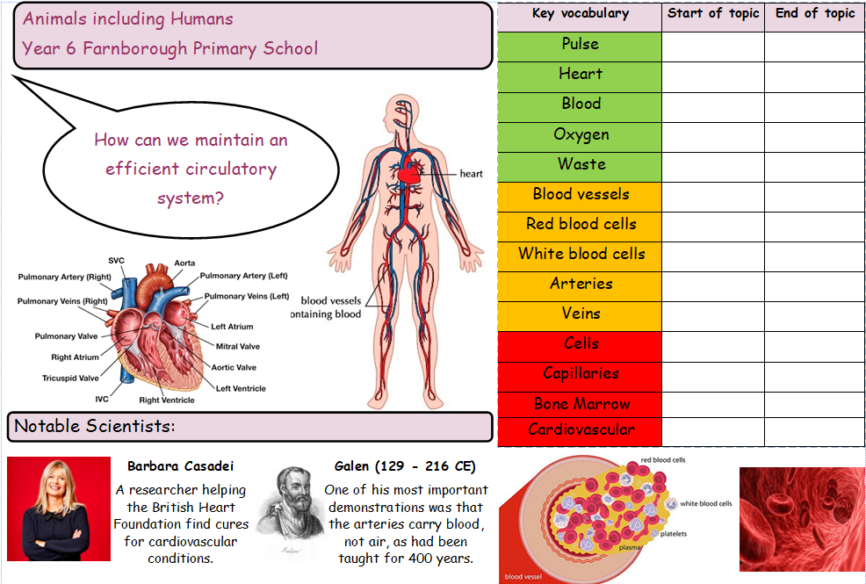

Slide 17
Supporting all children
Within every lesson, we teach children using many different strategies and use a number of resources based on each child’s needs
We ensure that extra groups to support a child / children take place to progress their learning further and confidence within lessons. This support might be during lessons and/ or separately, when appropriate.
Lessons are always differentiated so that every child can access learning, make progress and be challenged further.

Slide 18
Visits and Visitors
Natural History Museum
War memorial visit
Isle of Wight
Wednesday 4th October
Friday 10th November
Monday 10th June – Friday 14th June
We will be organising further visits and visitors throughout the year

Slide 19
Year 6 information
Children may bring their phones into school. They must be off and in school bags/pockets once children have entered school grounds (at the front gate) and not used until they have left the school through the front gate. Children will be given named plastic wallets and all class phones will be centrally stored during the day.
Children can walk to and from school. Before they can do this, please fill out a consent form which you can get from the office. As a reminder, once children have been dismissed from the classroom they will not be supervised by a school adult.
Children will be completing end of KS2 SATs in May 2024. Further information about this will be sent out closer to the time, as well as a meeting to give you more details.

Slide 20
Year 6 information
VIP (Very Independent Person)
The children will be working towards achieving their VIP badges this year.
Some attributes of a VIP include: being a role model to the rest of the school; independently solving problems and challenging yourself in lessons; learning from mistakes and acting responsibly.
Thinking about Secondary Schools:
https://www.bromley.gov.uk/secondary-school-admissions/secondary-school-places
It is important to visit the schools you are interested in and keep an open mind. Consider which school will be the best fit for your child.
Deadline: 31st October 2023

Slide 21
Let’s make it an incredibly positive experience by being the best we can be.
This is our last year at Farnborough.

