Slide 1
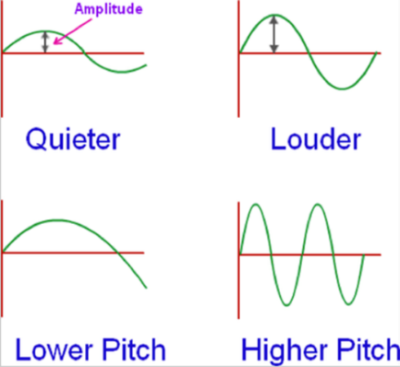
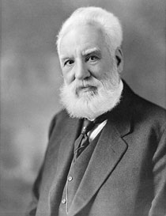
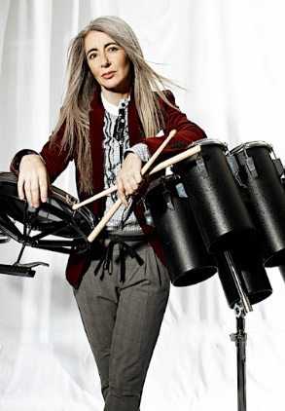
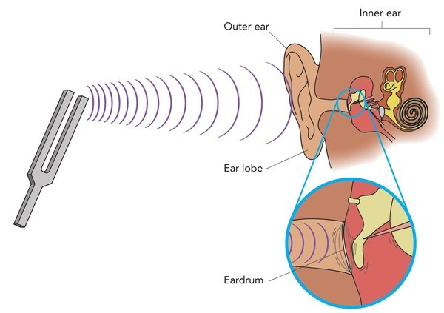
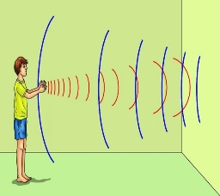
Key Vocabulary
Sound | Vibrations that travel through a medium and can be heard when they reach the ear. | Sound wave | How sound/ vibrations travel through the air.
Vibration | Movement back and forth. | Amplitude | A measure of the strength of a soundwave.
Pitch | Frequency of a sound wave. | Decibel | A measure of how loud a sound is.
Volume | How loud or quiet a sound is. | Ear | An organ used for hearing.
Insulation | Substance that stops heat, electricity or sound from passing. | Distance | A measurement of length between two points.
Fainter | A sound gets harder to hear further away you get from the sound source. | Absorb Sound | To take in sound energy,. Absorbent materials have the effect of muffling sound.
Cochlea | In the inner ear, translates vibrations to electrical signals | Frequency | A measure of how many times per second the sound wave cycles
Ear drum | A thin sheet in the ear. | Continuous | any sound that exists without interruption
Soundproofing | A way to reduce the movement of sound | Source | Where something comes from.
Repeating | A sound used multiple times in short succession | Anvil, stirrup and Hammer | 3 small bones in the ear
Why do some sounds, sound better than others?
VOLUME (amplitude) describes how loud or quiet a sound is.
Alexander Graham Bell was an influential scientist, engineer and inventor.
He is widely credited with the invention of the first practical telephone.
Bell’s mother and wife were both deaf, this had a major influence on his work
Dame Evelyn Glennie is the world’s premier solo percussionist, performing worldwide with the greatest orchestras, conductors and artists. Leading 1000 drummers, Evelyn had the honour of a prominent role in the Opening Ceremony of the London 2012 Olympic Games. Evelyn Glennie is almost completely deaf, which means she listens to music with her body, not her ears.
PITCH describes how low or high a sound is.
Sound that has been reflected is called an echo.

