Slide 1
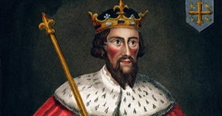
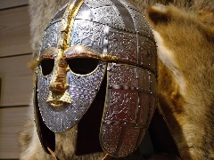
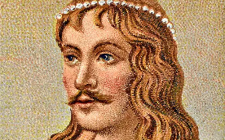
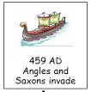
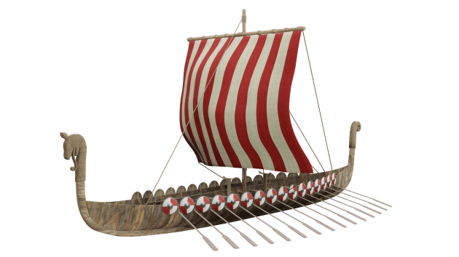
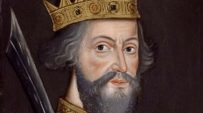
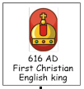
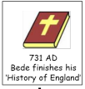
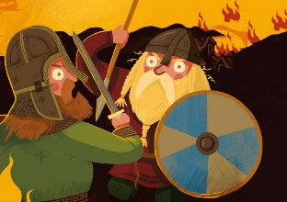
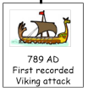
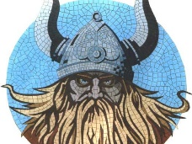
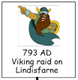
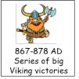
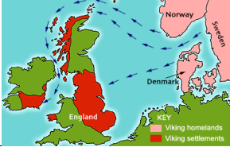
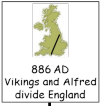
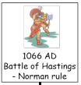
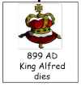
Is it fair to say the Vikings were raiders and the Anglo-Saxons settlers?
Key Vocabulary
Anglo-Saxons | The inhabitants of England from the 5th Century up to the Norman Conquest. | Vikings | Seafaring pirates and traders who raided and settled in north-western Europe.
Conquer | Get something by force. | Danelaw | The area of Britain the Vikings ruled.
Lindisfarne | This is where the Irish monks settled and is one of the first landing sites of the Vikings. | Danegeld | A tax raised to pay tribute to the Viking raiders to save the land from being destroyed.
Monastery | A building where people worship. | Exile | To be sent away.
Raid | A surprise attack on an enemy. | Kingdom | An area ruled by a King.
Scandinavia | An area including Denmark, Sweden and Norway. | Longship | A long, wooden, narrow boat used by the Vikings.
Invade | To enter and occupy a land. | Outlawed | Having property taken away and no longer being able to live in the community.
Settlement | A place where people have come to live. | Pagan | A religion where many gods and goddesses are worshiped.
Jorvik | A Viking name given to what is now York. | Rune | A letter from the alphabet used by the Vikings.
Treaty | A written agreement between two states. | Heptarchy | A name applied to the 7 Kingdoms of Anglo-Saxon England.
Thanes | A man who held land granted by the King. | Great Heathen Army | A combination od Scandinavian warriors who were mainly Danish, but included warriors from Norway and Sweden.
Pillaged | To violently steal something. | Wergild | A payment system used to settle disputes between a criminal and the victim.
King Alfred the Great (AD 849-899)
King Canute(AD 995-1035)
William the Conqueror (AD 1028-1087)

