Slide 1

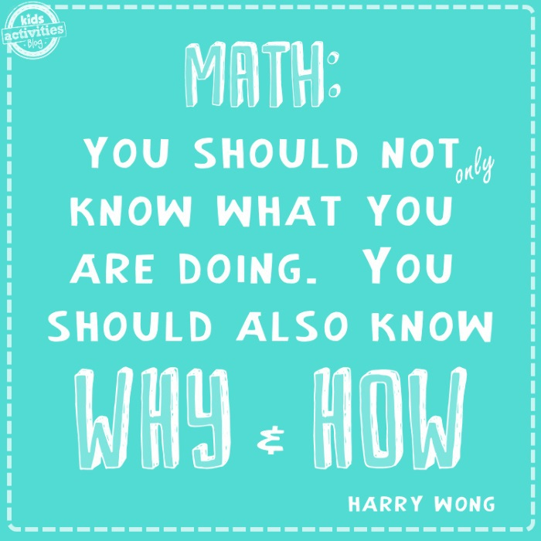
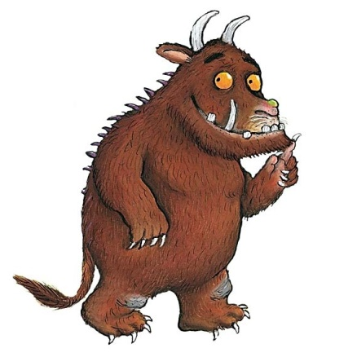
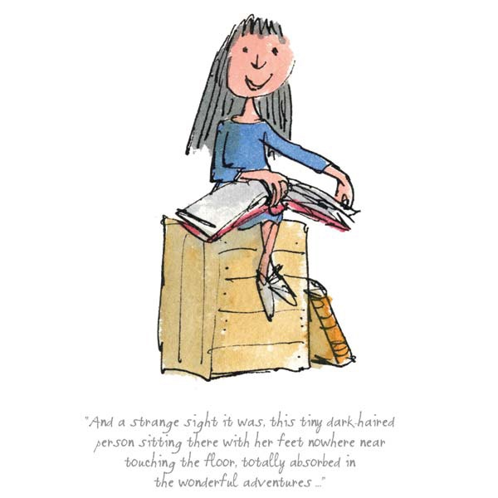

Slide 2


Welcome to our
Maths workshop
EYFS and KS1
Notes:
Phonics is a process of teaching children to correlate its individual sound (phoneme) with its corresponding letter or letter group (grapheme). It teaches children how to decode letters into their respective sounds. A skill which is essential for children to read unfamiliar words by themselves. Keep in mind that most words are unfamiliar to early readers in print, even if they have spoken knowledge of the word.

Slide 3
Session Aims
What does maths look like in EYFS and KS1?
How is maths taught at Farnborough?
How can children be supported at home?

Slide 4

What does Maths learning look like at Farnborough?
Our curriculum is based on the national curriculum and White Rose Maths and other materials that support the delivery of the curriculum.
These include, Power Maths, NCETM, NRich, Third Space Learning, Primary Stars, Classroom Secrets, NACE– these are used across KS1 and KS2 allowing children to be exposed to a variety of different types of learning and to ensure coverage of fluency, problem solving and reasoning in different formats to ensure that our maths curriculum is rich and varied.
Notes:
What do we want to achieve with each child when the children start in Reception in terms of reading. Thinking about their journey from Reception to Year 6 and beyond.

Slide 5

The link below will take you to the programmes of study for each year group. This shows you what your child will be learning when at school and what a child of that age is expected to achieve by the end of the year (Age Related Expectations).
What are the National Curriculum Programmes of Study?
National Curriculum Programmes of Study for Key Stage 1 and Key Stage 2
Notes:
What do we want to achieve with each child when the children start in Reception in terms of reading. Thinking about their journey from Reception to Year 6 and beyond.

Slide 6
What does Maths learning look like in EYFS and KS1?
Here are examples of children’s work in EYFS and KS1.
Notes:
Phonics is a process of teaching children to correlate its individual sound (phoneme) with its corresponding letter or letter group (grapheme). It teaches children how to decode letters into their respective sounds. A skill which is essential for children to read unfamiliar words by themselves. Keep in mind that most words are unfamiliar to early readers in print, even if they have spoken knowledge of the word.

Slide 7
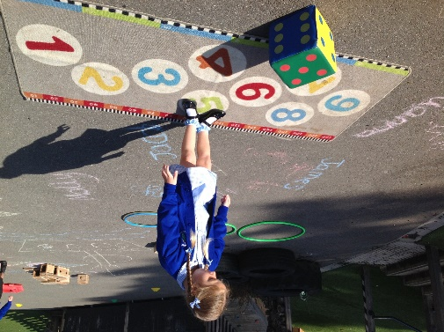
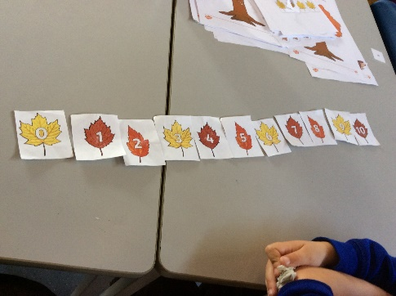
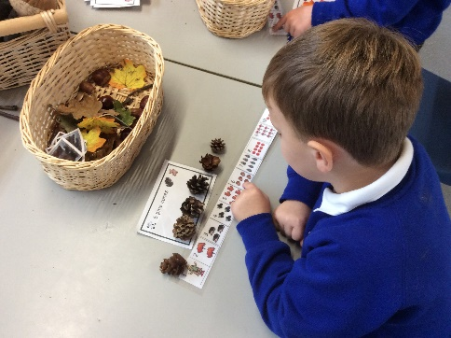
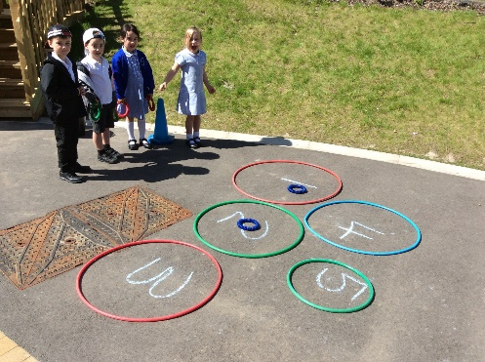
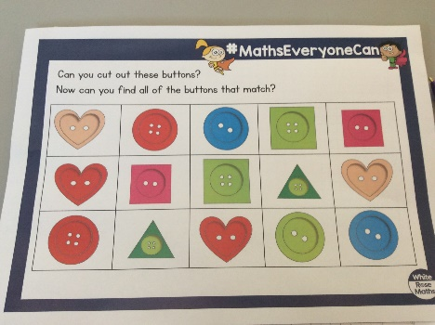
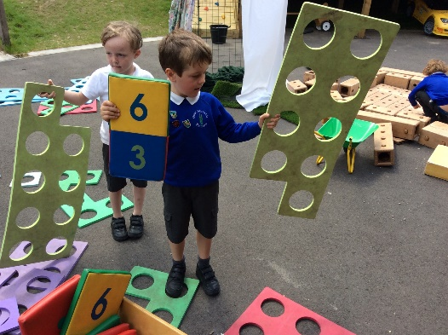
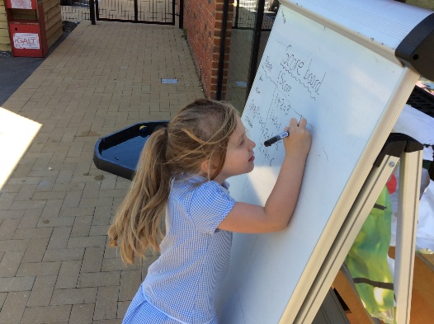
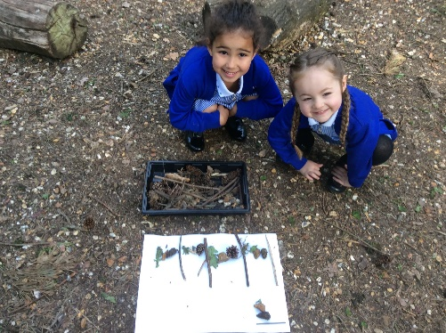
What does Maths looks like in EYFS?
Learning through play.
Outdoor activities.
Counting, counting and more counting!
Pattern spotting
Number recognition and ordering to 10.
Learning numbers bond up to 10.
Shape recognition, 2D and 3D.
Addition and subtraction using single digit numbers.

Slide 8
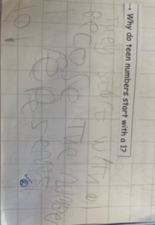
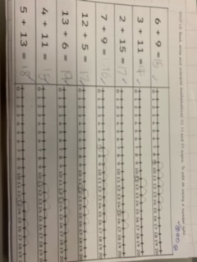
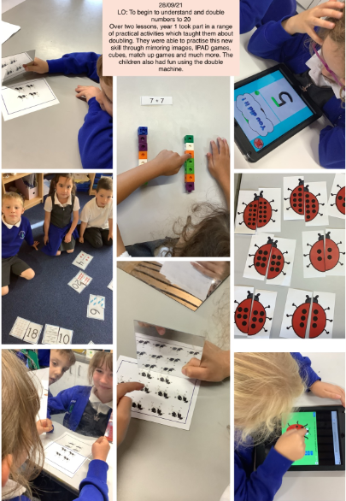
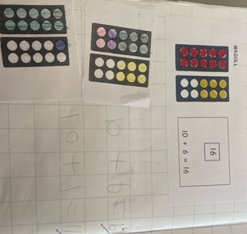
What does Maths look like in Year 1?
Number bonds to 10 and within 10.
Compose numbers to 10 from 2 parts, and partition numbers to 10 into parts, including recognising odd and even numbers.
To read time to O'clock and Half Past.
To double numbers to 10.
Count forwards and backwards in multiples of 2, 5 and 10.
Read, write and interpret equations containing +, - and = symbols.
Recognise common 2D and 3D shapes presented in different orientations, and know that rectangles, triangles, cuboids and pyramids are not always similar to one another.
Count within 100, forwards and backwards, starting with any number.

Slide 9
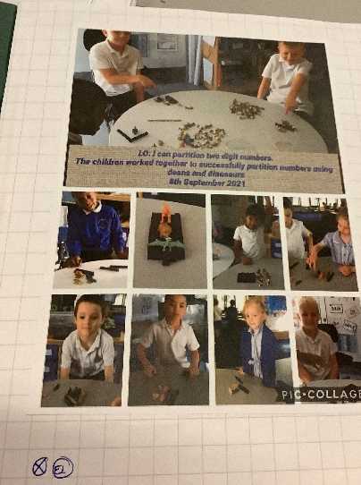
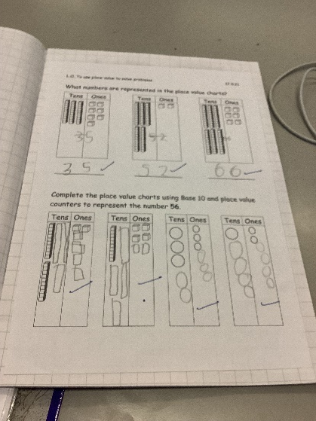
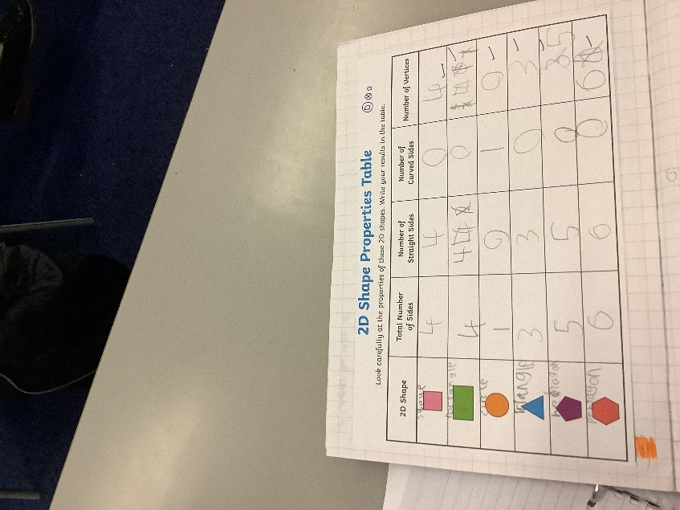
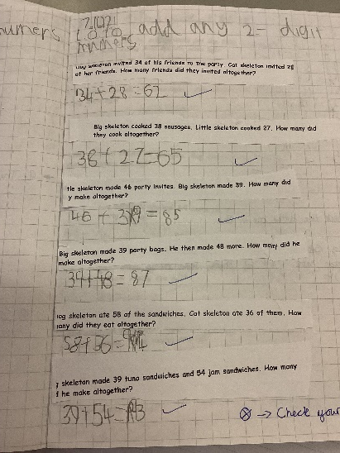
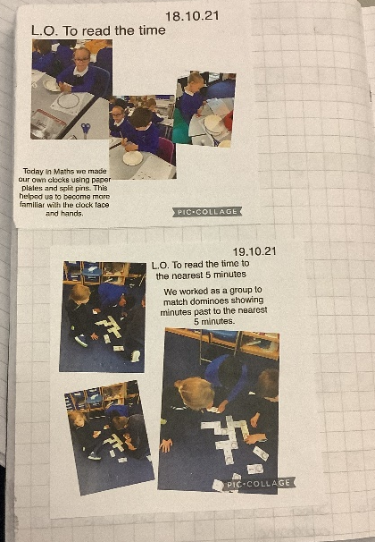
What does Maths look like in Year 2?
Add and subtract within 100 by applying one-digit addition and subtraction facts. To add and subtract any 2 two-digit numbers.
Practical learning using a variety of resources.
To read the time to the nearest five minutes
Recognise the place value of each digit in two-digit numbers.
To describe the properties of 2D and 3D shapes and compare shapes by their properties
Recognise the subtraction structure of ‘difference’ and answer questions such as “How many more…?”.
Secure fluency in addition and subtraction facts within 10.

Slide 10
Calculation Policy
Our calculation policy is in line with the programmes of study taken from the National Curriculum for Mathematics (2014). It is designed to be challenging, focussing on essential core subject knowledge and skills. This document guides you through the appropriate calculation methods within each year group and the progression of skills throughout the school.
The content of this document is set out in year group blocks under the following headings: addition, subtraction, multiplication and division.
White-Rose-calculation-policy
Primary Maths Dictionary
Notes:
Phonics is a process of teaching children to correlate its individual sound (phoneme) with its corresponding letter or letter group (grapheme). It teaches children how to decode letters into their respective sounds. A skill which is essential for children to read unfamiliar words by themselves. Keep in mind that most words are unfamiliar to early readers in print, even if they have spoken knowledge of the word.

Slide 12

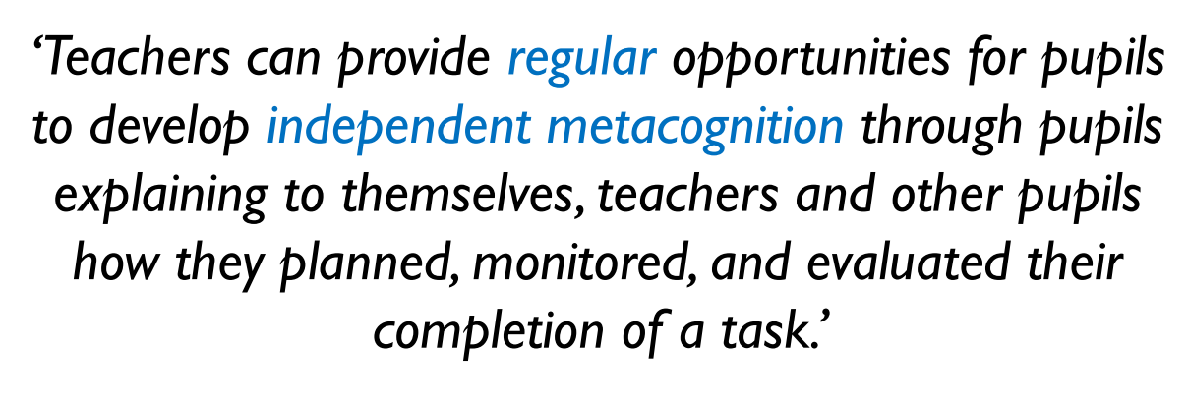
Questioning and Talk

Slide 13
Questioning and Talk
Your turn now

Slide 14
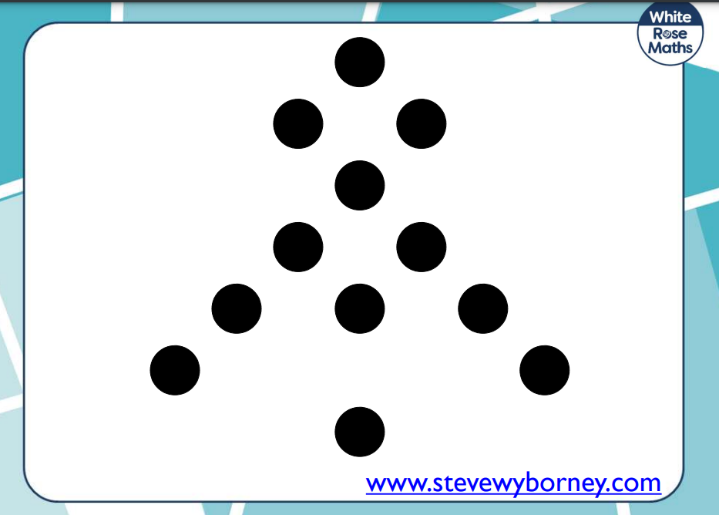
Working with the person next to you can you make this formation and write a number sentence to go with the dotted formation?
How many more number sentences can you make?

Slide 15
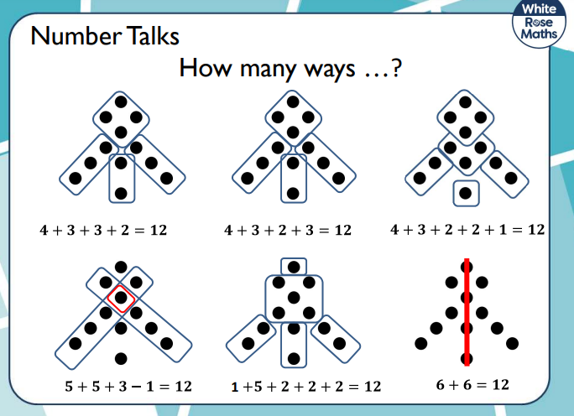

Slide 16
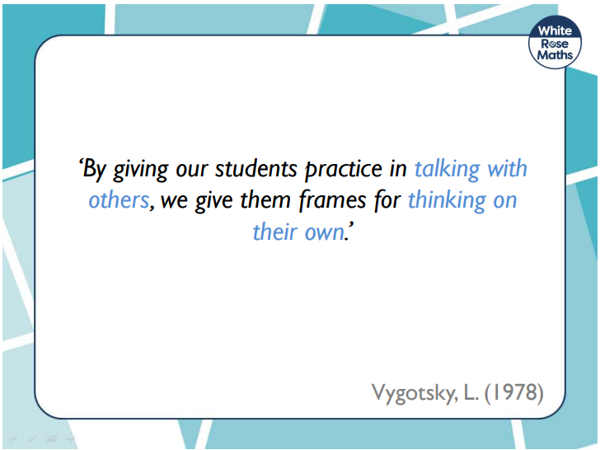

Slide 17
Reasoning and Problem Solving

Slide 18
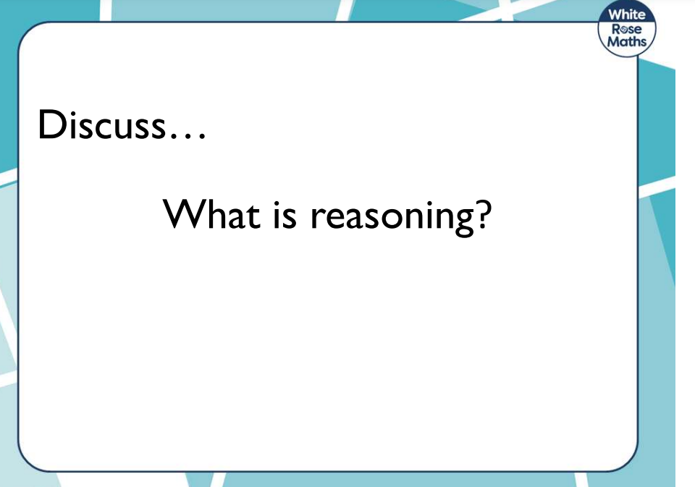

Slide 19
Reasoning is…
The action of thinking about something in a logical, sensible way

Slide 20
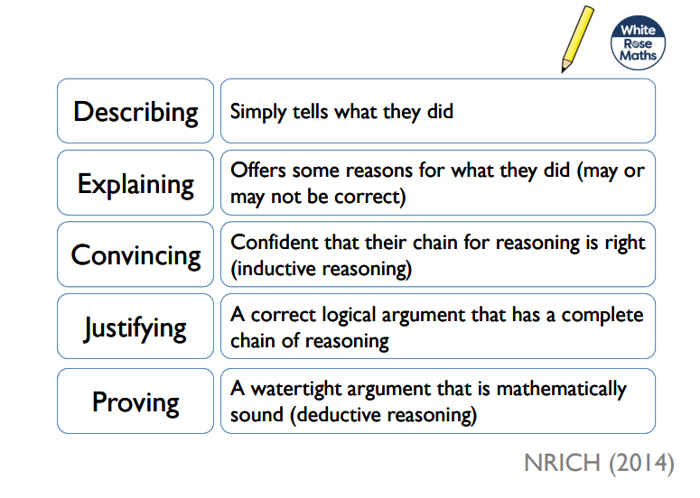
Progression in Reasoning

Slide 21











How many different ways can the objects be grouped?

Slide 22
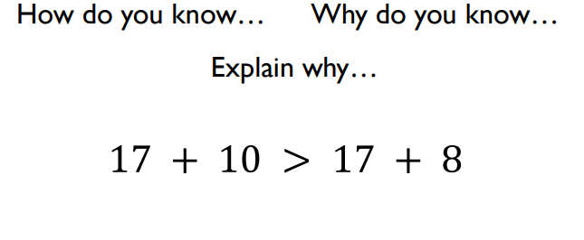
What is the same? What is different?

Slide 23
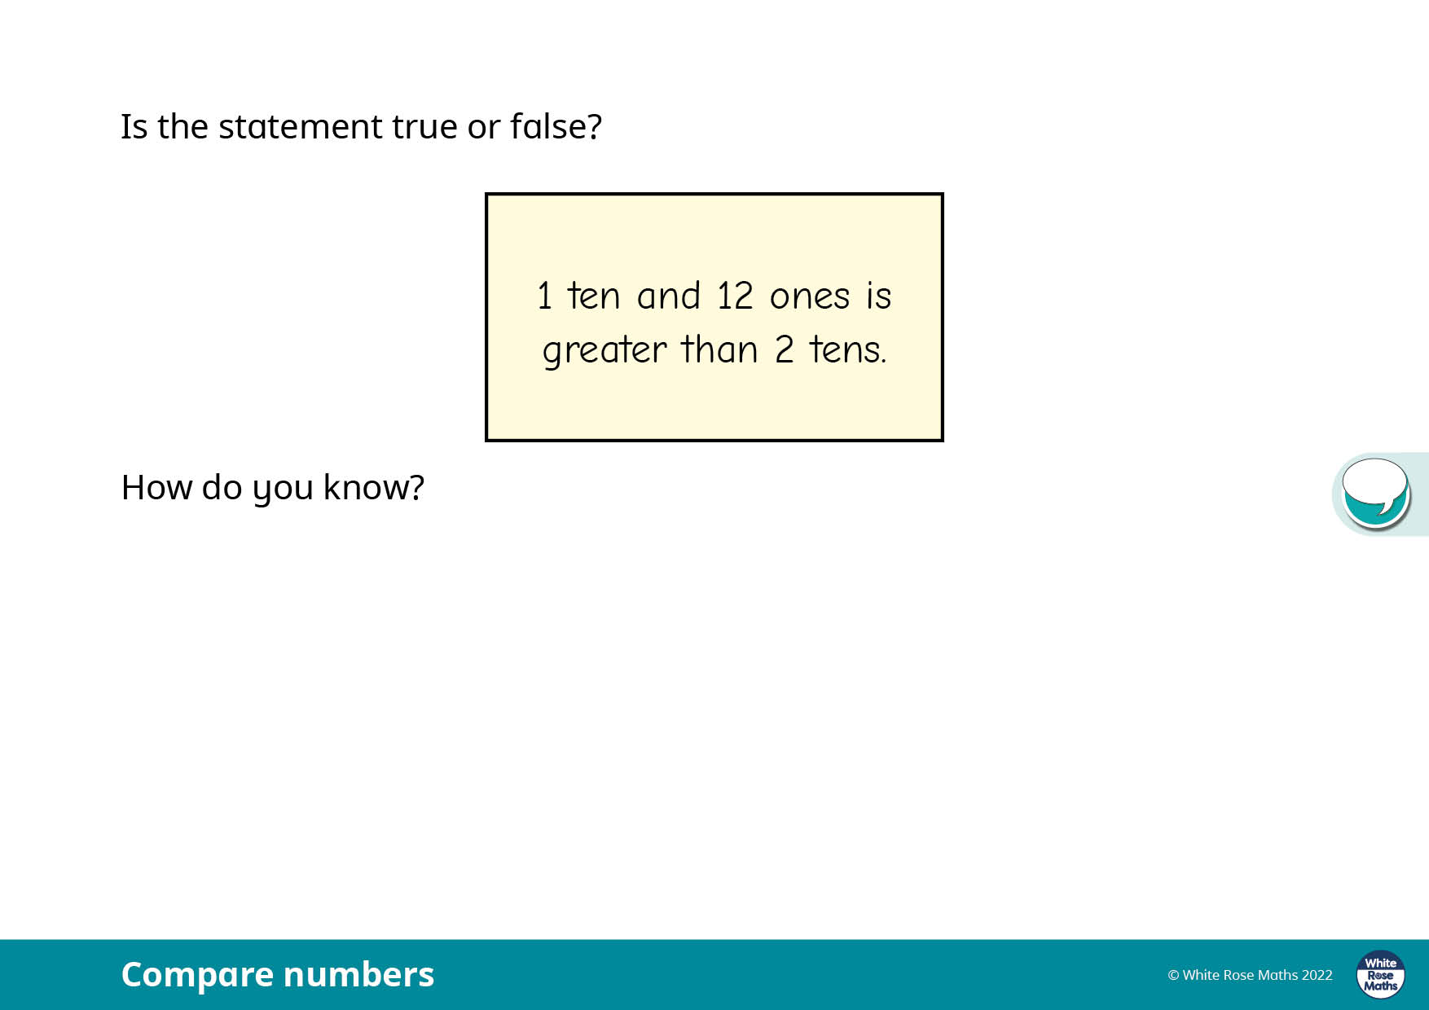

Slide 24
How can you help your child with Maths at home?
Take away their fear.
Reassure and praise whenever possible. Positive mindset…
Let them see you using Maths in your everyday routines – portioning meals between the family, chopping vegetables into halves and quarters etc.
Play with numbers and shapes through games.
Seeing mistakes as an opportunity to learn and using them as a discussion point.
Recognising the importance and value of Maths in our everyday lives e.g. managing money and telling the time.

Slide 25
Count - steps up the stairs, money into a money box etc
• Ask children to say how many without counting (5 or fewer)
• Play games using dice/dominoes and encourage child to say how many spots without counting.
• Ask children to set the table with enough knives, forks and plates for everyone.
• Spot numbers in the environment – on phones, microwaves, clocks, registration plates, doors.
• Ask children to think of their own representations for numbers eg one of them, two hands, three bears, four wheels on a car, five toes, six sides on a dice, seven dwarves, eight legs on an octopus etc
• Deliberately make mistakes. Children need to understand mistakes are normal and everyone makes them eg get mixed up when counting, muddle two numbers when ordering them.
• Watch Numberblocks on Cbeebies. This programme is written by maths specialists to model maths concepts and represents number brilliantly. Also, Numberjacks is excellent for solving problems.
• Hide numbers around the house or garden for children to find.
• Play outdoor maths games like hopscotch and skittles. Even better, let children make up their own games and decide how to score points.
• Read books with maths concepts eg The Very Hungry Caterpillar, One is a snail, ten is a crab, What’s the time, Mr Wolf? The doorbell rang.
• Draw attention to more and less.

Slide 26

Maths at Farnborough
Resources that I can use at home to support my child’s maths understanding and learning.

Slide 27
Importance of Resources
Resources can be powerful tools to support sense making, mathematical thinking and reasoning skills.
They help our children to be able to practically engage with new learning and to support their ability to visualise new concepts and knowledge.
We apply a CPA approach to Maths learning which embeds the importance of using physical resources to support learning opportunities.
Read on to find out more about this approach.

Slide 28
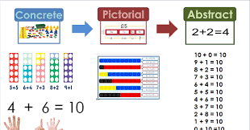

CPA Approach

Slide 29
What is CPA?
C is for concrete. New concepts are introduced through the use of physical objects or practical equipment. These can be physically handled, enabling children to explore different mathematical concepts. These are sometimes referred to as maths manipulatives and can include ordinary household items such as straws or dice, or specific mathematical resources such as dienes or Numicon.
P is for pictorial. Once children are confident with a concept using concrete resources, they progress to pictorial representations. By doing this, they are no longer manipulating the physical resources, but still benefit from the visual support the resources provides.
A is for abstract. Once children have a secure understanding of the concept through the use of concrete resources and visual images, they are then able to move on to the abstract stage. Here, children are using symbols to solve problems. To be able to access this stage effectively, children need access to the previous two stages alongside it.

Slide 30

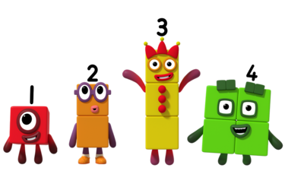
Resources you can use at home
Notes:
Maths dictionary for parents is really useful!

Slide 31

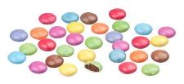
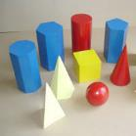

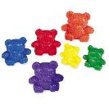
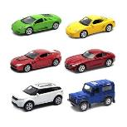
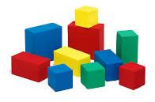

Alternatives to maths resources
Counters or you could use…… Smarties
3D shapes or you could use…… groceries
Counting Bears or you could use…… anything you have a lot of!
Notes:
Maths dictionary for parents is really useful!

Slide 32
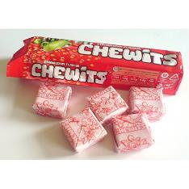
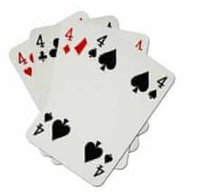
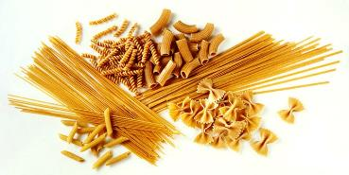
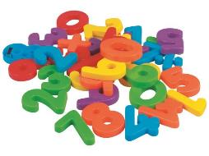
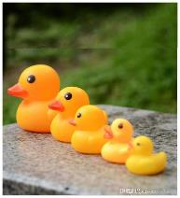
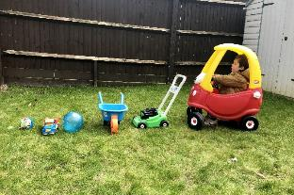
You can use anything you have around the house
Cards for number
recognition and counting
Chewits for counting
Pasta for counting
Toys to put in size order
Magnetic numbers for
number recognition
Notes:
Maths dictionary for parents is really useful!

Slide 33
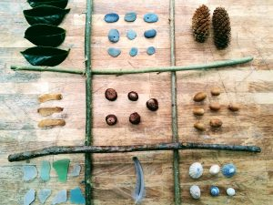
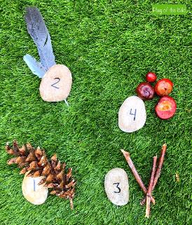
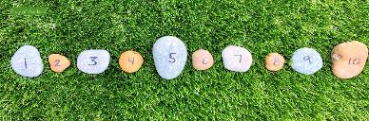
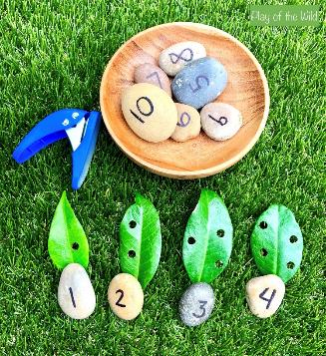
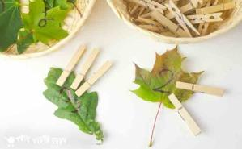
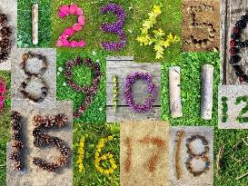
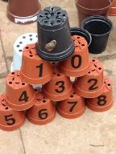
Don’t Forget Outside
Notes:
Maths dictionary for parents is really useful!

Slide 34

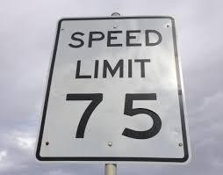

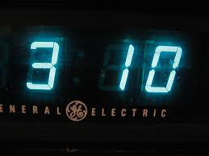


Numbers are all around us!
Notes:
Maths dictionary for parents is really useful!

Slide 35





Counting in 2s and 10s
Numicon or you could use…… socks
Numicon or you could use…… gloves
Notes:
Maths dictionary for parents is really useful!

Slide 36




Numbers
100 Square or you could use 100 square splat online game
Games you could play:
Cover Up: Cover up one or more squares using counters. The child has to guess which numbers are hidden under the counter/s.
Patterns: Cover the multiples of 2, 3, 5 and 10 etc (one multiple at a time). Use the patterns to predict which numbers will be in the sequence.
Dice or you could use an Online Dice
Games you could play:
Use dice to help your child recognise numbers at speed.
Knock Out: Each player chooses a “knock out number” – either 6, 7, 8, or 9. More than one player can choose the same number. Players take turns throwing both dice, once each turn. Add the number of both dice for the score. If a player throws a 6, 7, 8 or 9, they are knocked out of the game until the next round.

Slide 37


Addition/ Subtraction using sweets instead of dienes
In Year 2 we use dienes for addition/ subtraction. Instead of tens and ones resource you could use sweets (such as Chewits). A whole pack of Chewits are the tens and individual Chewits are the ones. E.g. 18 = 1 tens and 8 ones

Slide 38






An example of an addition word problem being solved using dienes. This could be solved using sweets (e.g. Chewits)
Big skeleton goes to the shop to buy cakes. He buys 12 chocolate cakes and 10 cream cakes. How many does he buy altogether?
You could also use sticks as tens and stones as ones.

Slide 39




For greater or less than you could use…
For money work or problems you could use your own coins/ notes.

Slide 40
A quick guide to everyday Maths opportunities for your child
Practise spotting and recognising numbers in the environment. Add/multiply/subtract/divide door numbers, numbers on car registration plates, road signs and at the shop.
Flicking through the TV guide? Ask your child to calculate the length of their favourite programmes. How long is it until the next programme?
Use food packaging to discuss 2D and 3D shapes. What are the properties of these shapes e.g. how many faces, sides, vertices? Flatten the packaging out to find the net of the 3D shape too.
Measuring up for new furniture? Want to make sure the Christmas tree will fit in your living room? These are really good opportunities to encourage your child to see the value of careful measuring skills in everyday life.
Practise telling the time with your child. Can they read both the digital and analogue clock? Can they readily convert between the two and use the 24 hour clock? Can they also recognise Roman Numeral representations of the time too?
Board Games supply endless opportunities for Maths – Snakes and Ladders, Monopoly, Bingo, Connect Four, Battle Ships etc

Slide 41


Websites to support children’s Maths skills
CBeebies have lots of fun and interactive games and activities to help get our younger children excited about Maths
I See Maths – a useful site with a plethora of ideas for fun games that all the family
Primary Games Arena - It is a free website that encourages children to play online maths games linked to their home learning. It breaks the games down into concepts which is really helpful.
Hit the Button – children love this game as it helps to increase confidence through practising times tables and number bonds.
Maths Zone – this site is jam-packed with fun ways to learn more about maths.
BBC Bitesize – lots of information alongside short videos help to make the learning enjoyable and accessible for all children.

Slide 42





Math workshop
.
One way to support your children is by using

Slide 43

Math workshop
.
EYFS & KS1 Maths App
We are excited to share a new, exciting app suitable for children in EYFS and Key Stage One to help them develop their mental arithmetic skills. White Rose Maths is used by many schools to support the planning and activities in class, and now they have developed 1 Minute Maths for children to use in school and at home.
The app can be downloaded through the Apple Store, Google Play or Amazon Kindle app stores and is currently free of charge.
Once in the app, children can select from subitising (recognising amounts without needing to count them), adding, subtracting and multiplying.
Within each section, children can select practice activities that they have been learning in class and use the quick-fire questions to help improve their recall of key number facts.

Slide 44




Math workshop
.
Select practice activities.
Quickfire questions

Slide 45



Math workshop
.
Another way to support your children is by using
When it comes to times tables, speed AND accuracy are important — the more facts your child remembers, the easier it is for them to do harder calculations. Times Table Rock Stars is a fun and challenging programme designed to help students master the times tables. World Famous musicians need to practice and so do children with their tables!

Slide 46
Math workshop
.
Another way to support your children is by using
For your child to be fully motivated and for them
to get the best out of the practice, they need your help - your praise, reminders and support will help your child feel confident and motivated.

Slide 47

Math workshop
.

Slide 48

Math workshop
.

Slide 49

Math workshop
.

Slide 50
Math workshop
.

Slide 51
Math workshop
.

Slide 52

Thank you for listening.
We hope the workshop helps you understand how you can support your child at home.

