Slide 1

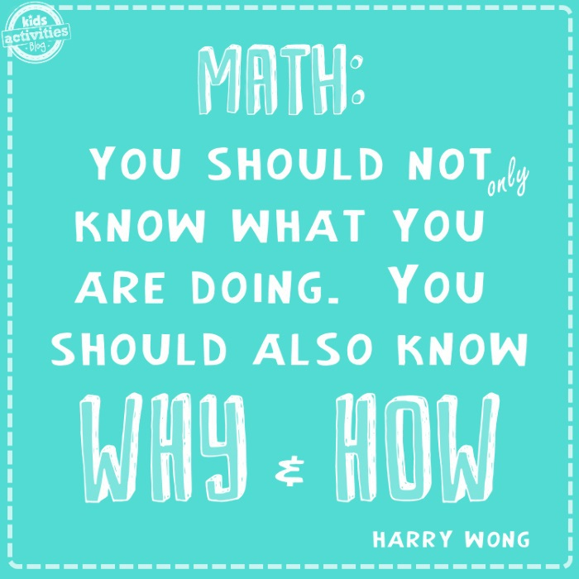
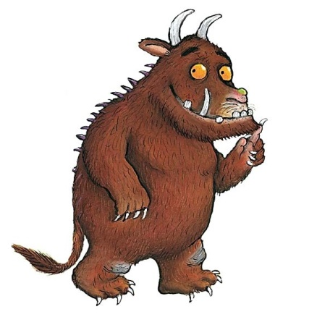
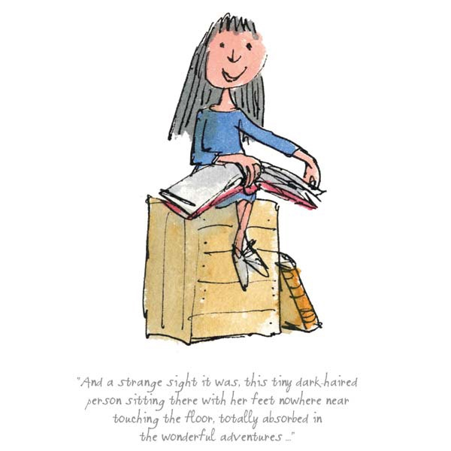

Slide 2


Welcome to our
Maths workshop
Year 5 and Year 6
Notes:
Phonics is a process of teaching children to correlate its individual sound (phoneme) with its corresponding letter or letter group (grapheme). It teaches children how to decode letters into their respective sounds. A skill which is essential for children to read unfamiliar words by themselves. Keep in mind that most words are unfamiliar to early readers in print, even if they have spoken knowledge of the word.

Slide 3
Session Aims
What does maths look like in Year 5 and Year 6?
How is maths taught at Farnborough?
How can children be supported at home?

Slide 4

What does Maths learning look like at Farnborough?
Our curriculum is based on the national curriculum and White Rose Maths and other materials that support the delivery of the curriculum.
These include, Power Maths, NCETM, NRich, Third Space Learning, Primary Stars, Classroom Secrets, NACE– these are used across KS1 and KS2 allowing children to be exposed to a variety of different types of learning and to ensure coverage of fluency, problem solving and reasoning in different formats to ensure that our maths curriculum is rich and varied.
Notes:
What do we want to achieve with each child when the children start in Reception in terms of reading. Thinking about their journey from Reception to Year 6 and beyond.

Slide 5

The link below will take you to the programmes of study for each year group. This shows you what your child will be learning when at school and what a child of that age is expected to achieve by the end of the year (Age Related Expectations).
What are the National Curriculum Programmes of Study?
National Curriculum Programmes of Study for Key Stage 1 and Key Stage 2
Notes:
What do we want to achieve with each child when the children start in Reception in terms of reading. Thinking about their journey from Reception to Year 6 and beyond.

Slide 6
What does Maths learning look like in Year 5 and 6?
Here are examples of children’s work in Year 5 and Year 6.
Notes:
Phonics is a process of teaching children to correlate its individual sound (phoneme) with its corresponding letter or letter group (grapheme). It teaches children how to decode letters into their respective sounds. A skill which is essential for children to read unfamiliar words by themselves. Keep in mind that most words are unfamiliar to early readers in print, even if they have spoken knowledge of the word.

Slide 7
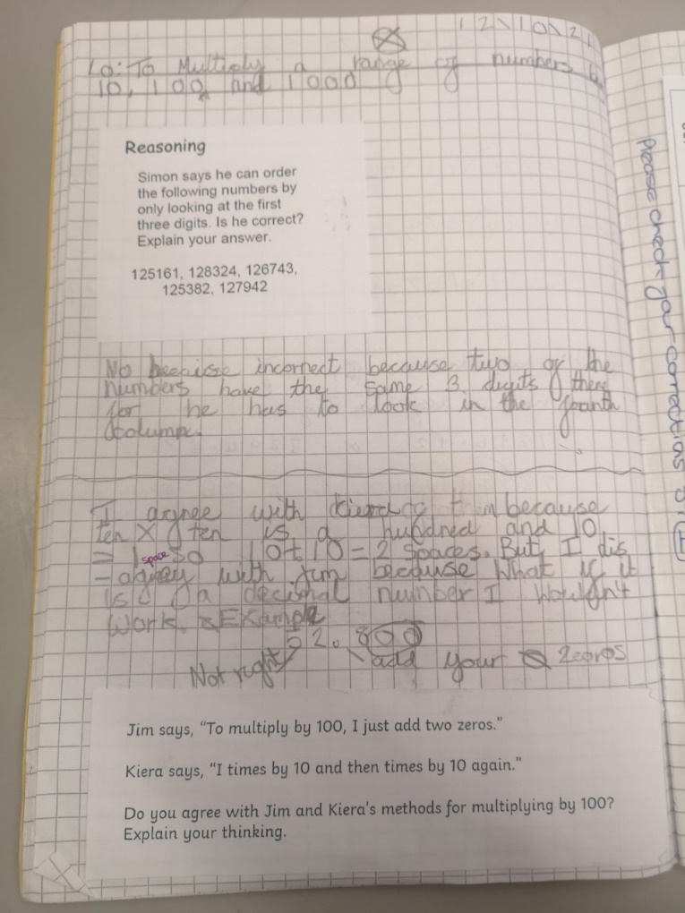
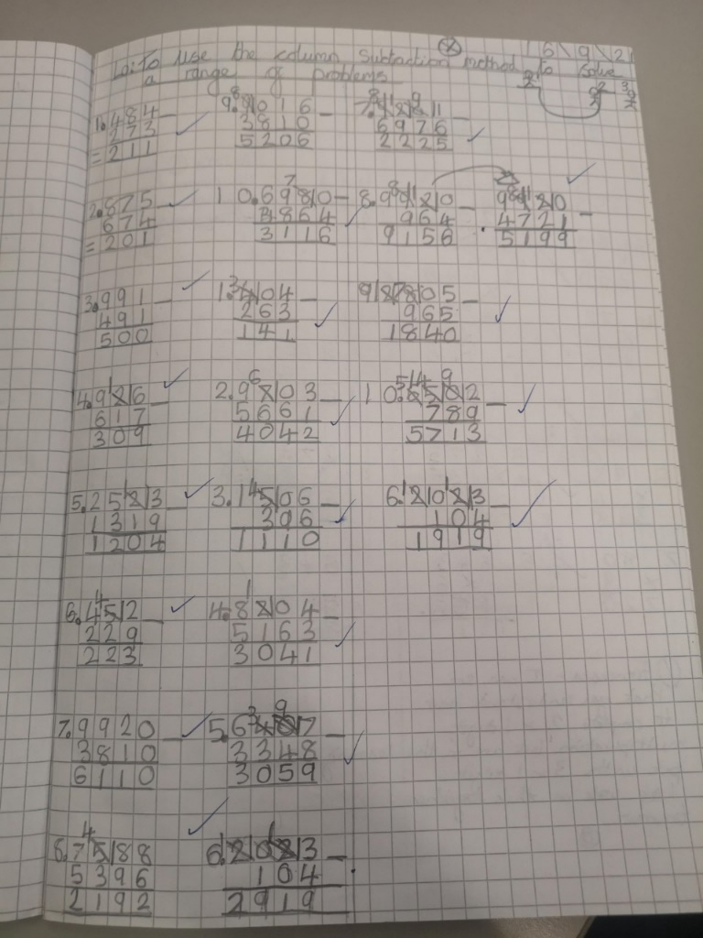
What does Maths look like in Year 5?
Measure angles in degrees (°) and draw angles of a given size.
Recognise the place value of each digit in numbers with up to 2 decimal places
Secure understanding of fractions including simplifying, equivalent fractions and calculating with fractions (+ - and x by integers)
To use the formal written methods for all four operations (addition, subtraction, division and multiplication)
Convert between units of measure e.g. grams to kilograms
Rapid and accurate recall of ALL times tables and related division facts
To solve number problems using reasoning to justify my answers and to prove and disprove.
Find non-unit fractions of quantities.
Draw upon a variety of mental maths strategies to support arithmetic skills

Slide 8
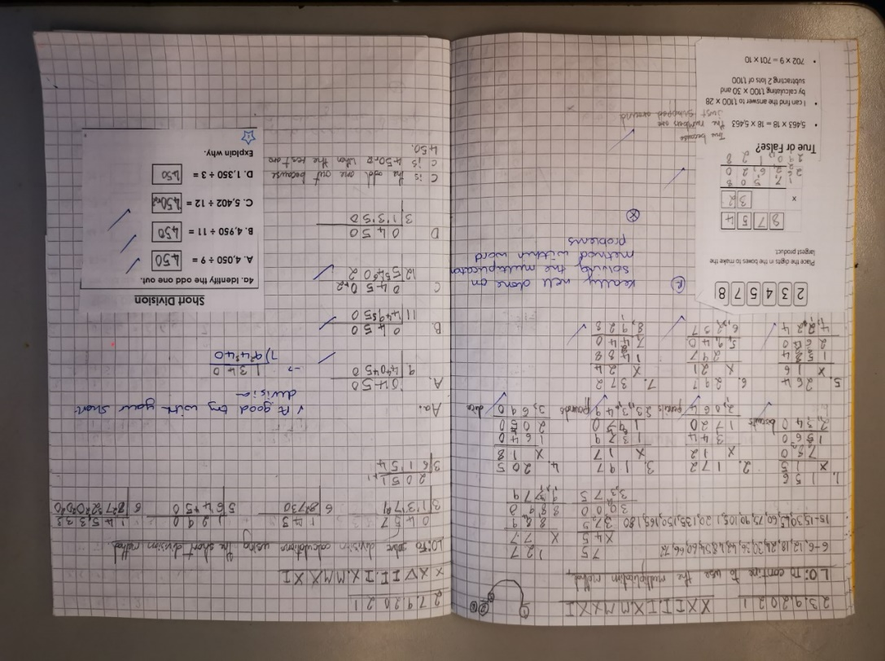
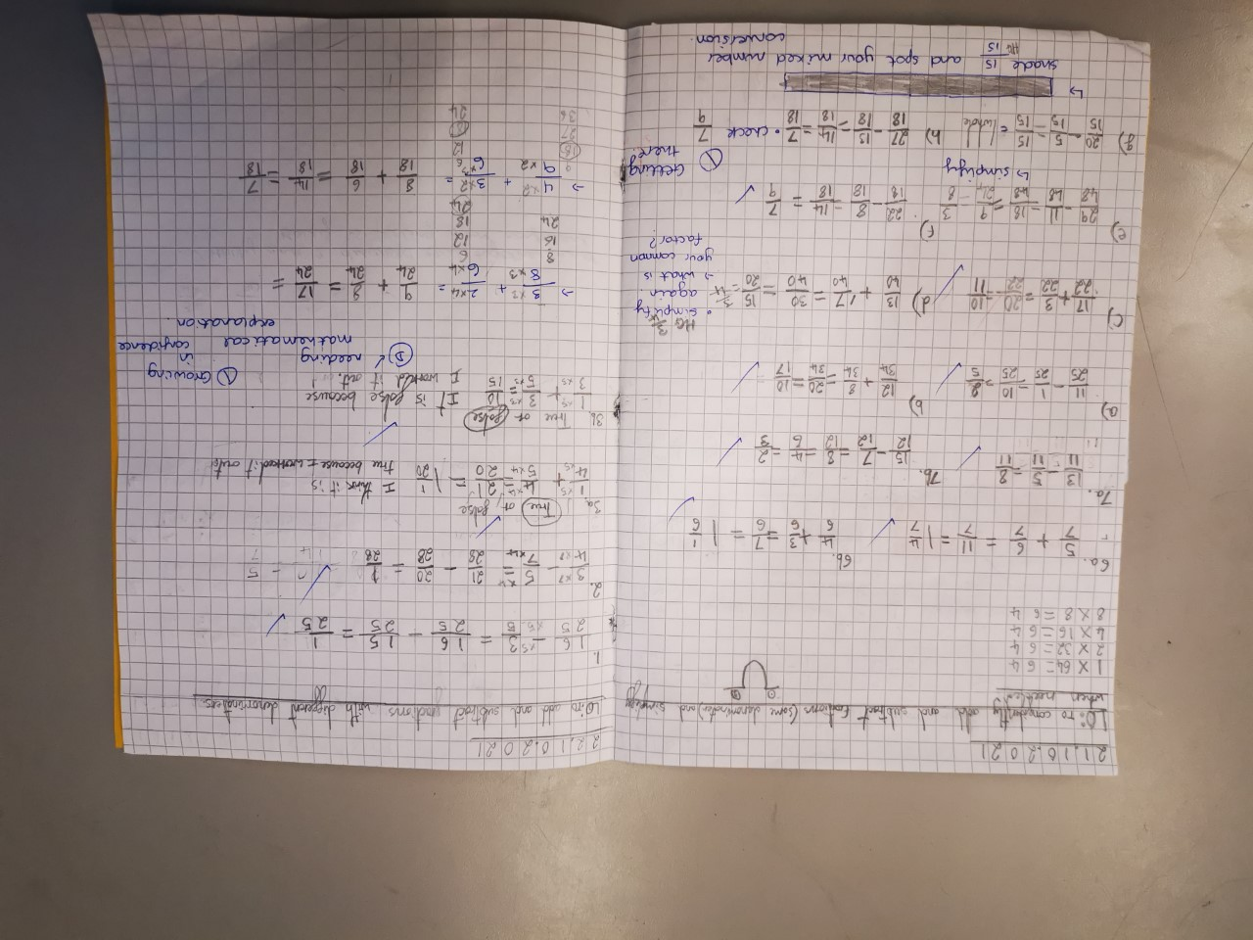
What does Maths look like in Year 6?
Rapid and accurate recall of ALL times tables
Draw, compose and decompose shapes according to given properties, including dimensions, angles and area
Find equivalent fractions, decimals and percentages
Solve problems involving ratio relationships
Solve multi-step word problems
Recognise the place value of each digit in numbers up to 10 million, including decimal fractions
Algebra
To consolidate the formal written methods and use alongside efficient mental strategies
Use common factors and multiples to simplify fractions. To securely use all four operations when calculating with fractions (+ - x ÷)
Working with numbers beyond 6 and 7 digits
Systematic and methodical workings
Draw upon a variety of mental maths strategies to support arithmetic skills

Slide 9
Calculation Policy
Our calculation policy is in line with the programmes of study taken from the National Curriculum for Mathematics (2014). It is designed to be challenging, focussing on essential core subject knowledge and skills. This document guides you through the appropriate calculation methods within each year group and the progression of skills throughout the school.
The content of this document is set out in year group blocks under the following headings: addition, subtraction, multiplication and division.
White-Rose-calculation-policy
Primary Maths Dictionary
Notes:
Phonics is a process of teaching children to correlate its individual sound (phoneme) with its corresponding letter or letter group (grapheme). It teaches children how to decode letters into their respective sounds. A skill which is essential for children to read unfamiliar words by themselves. Keep in mind that most words are unfamiliar to early readers in print, even if they have spoken knowledge of the word.

Slide 11

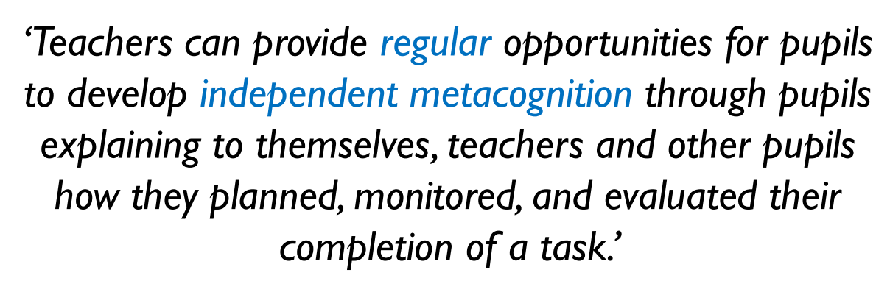
Questioning and Talk

Slide 12
Questioning and Talk
Your turn now

Slide 13
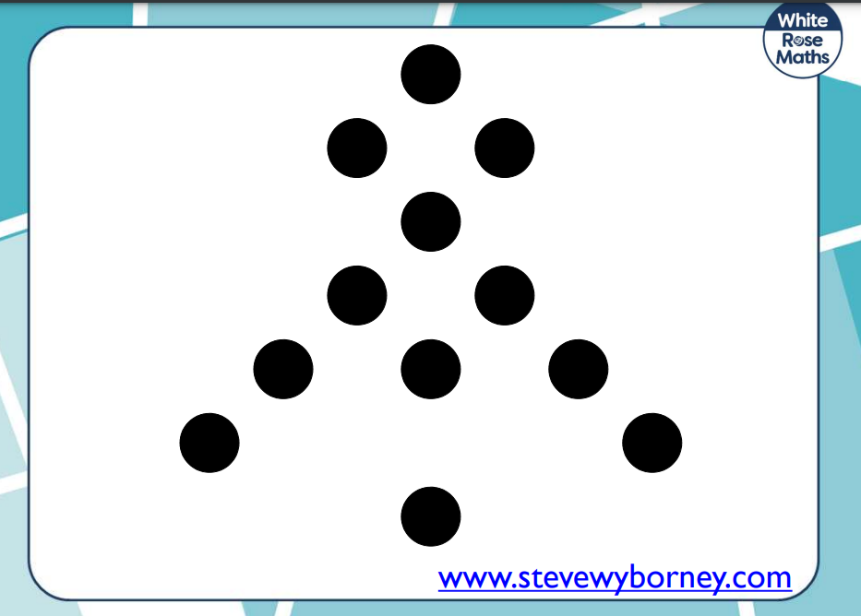
Working with the person next to you can you write a number sentence to go with the dotted formation?

Slide 14
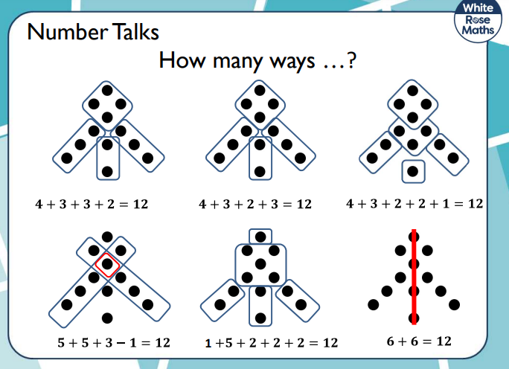

Slide 15

Good questions, and equally important, good listening can help children make
sense of mathematics, build their confidence, and encourage mathematical
thinking and communication. A good question opens up a problem and supports
different ways of thinking about it. Some questions to try while helping a child
might include:
➢What do you already know about this?
➢ What do you need to find out?
➢ How might you begin?
➢ How can you organise your information?
➢ Can you draw a picture to explain your thinking?
➢ Are there other possibilities?
➢ What would happen if …?
➢ What do you need to do next?

Slide 16
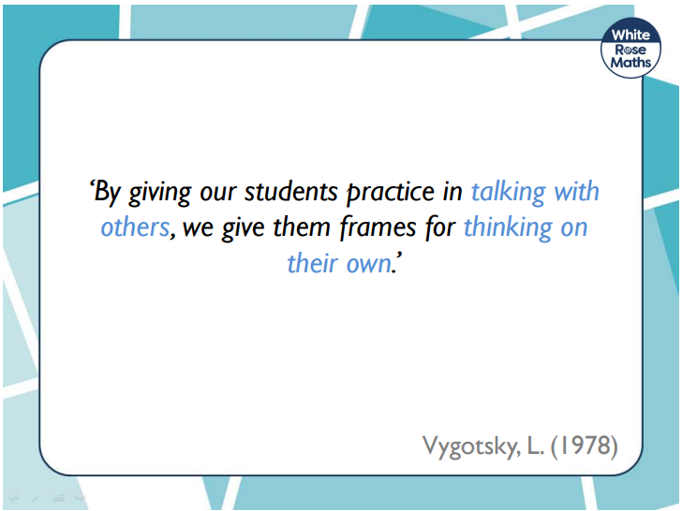

Slide 17
Reasoning and Problem Solving

Slide 18
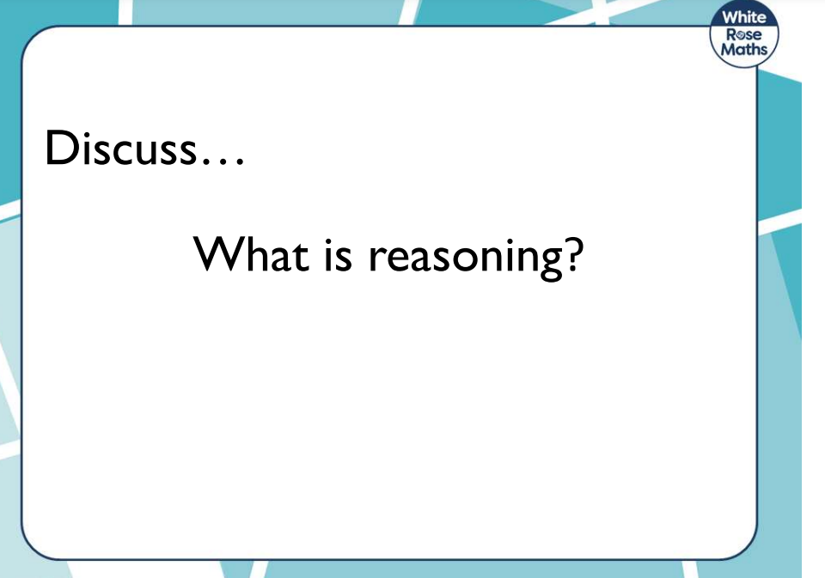

Slide 19
Reasoning is…
The action of thinking about something in a logical, sensible way

Slide 20
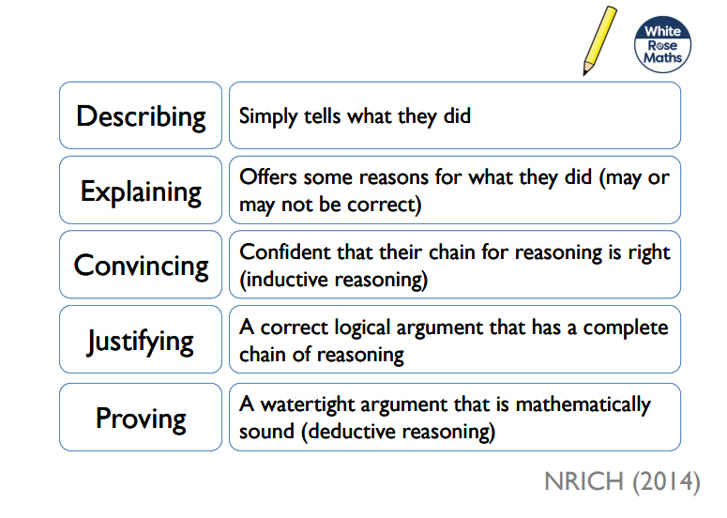
Progression in Reasoning

Slide 21
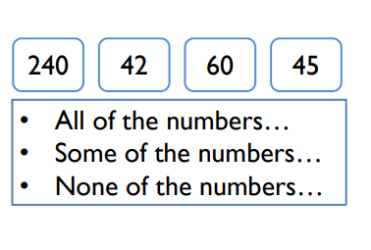

Slide 22

What did you have to know to solve that problem?

Slide 23

Imagine if you did not have those skills or strategies….. How hard would it have been to solve those questions.
Importantly, in preparation for not only their SATs but their Secondary Schools they will go to, it is important that children know by heart:

Slide 24


Timetables and their related division facts – encourage them to use TTRockstars to improve their rapid recall skills of multiplication and division facts.
This will help them to solve problems that involve…
Long multiplication
Fractions
Percentages

Slide 25
Children need to be able to…

Slide 26
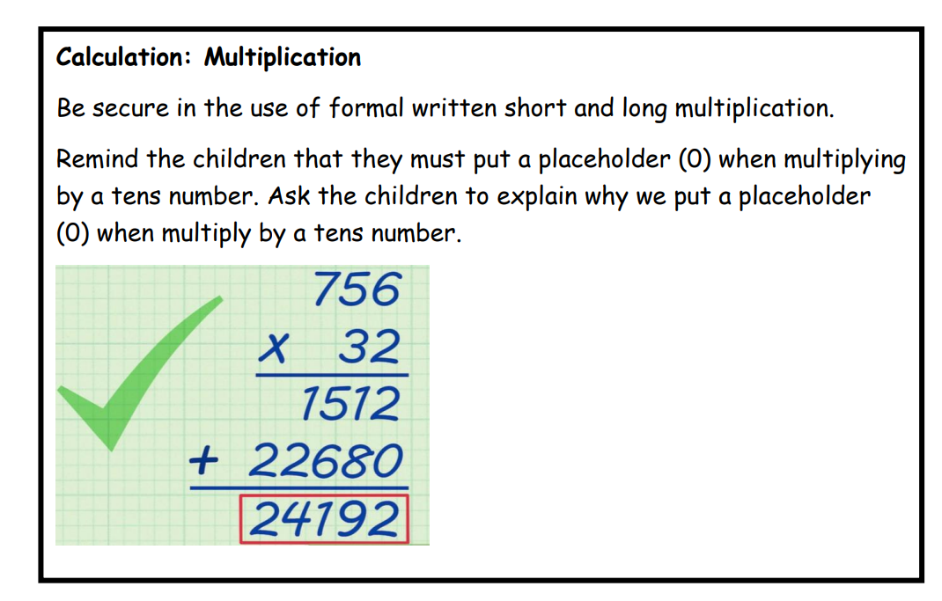

Slide 27
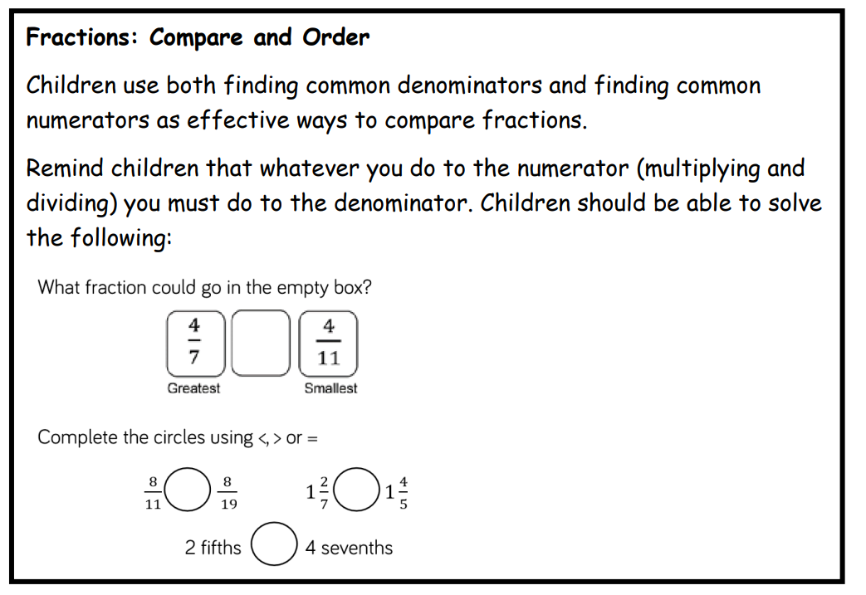

Slide 28
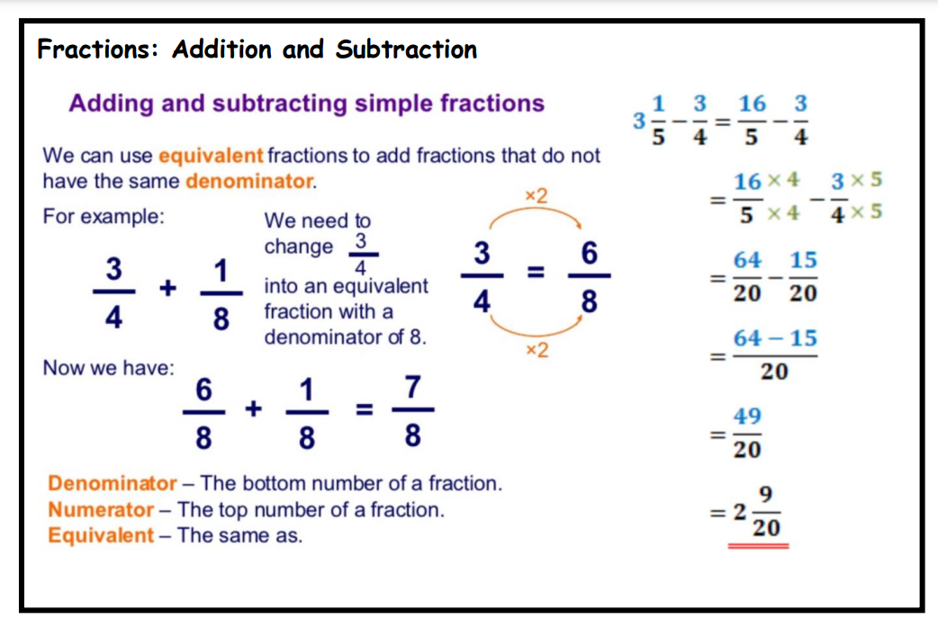

Slide 29
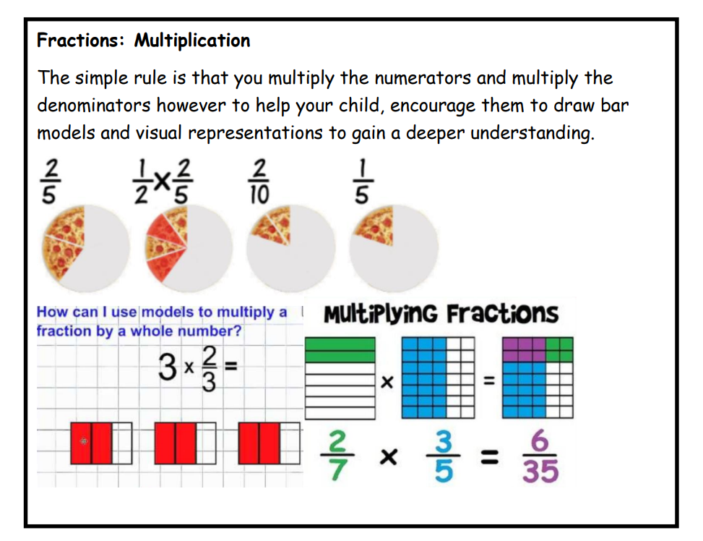

Slide 30
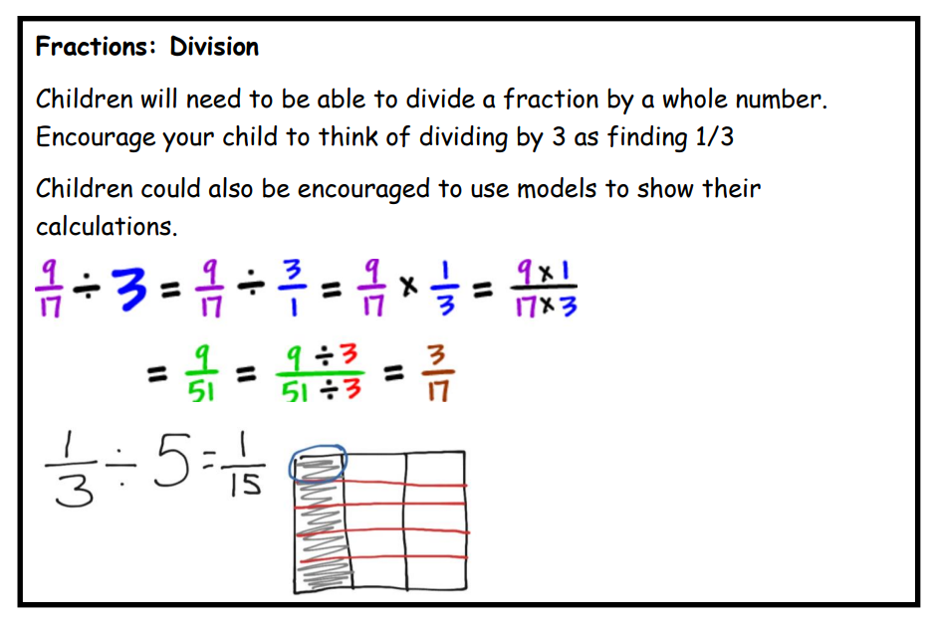

Slide 31

Percentages
It is important your child understands that decimals and percentages are just other ways to show fractions.
Your child will be expected to use equivalences between simple fractions, decimals, and percentages (for example, 0.5, 1/2, and 50%). To practise, encourage them to point out fractions, decimals, and percentages in real life and convert between the different forms where possible.

Slide 32
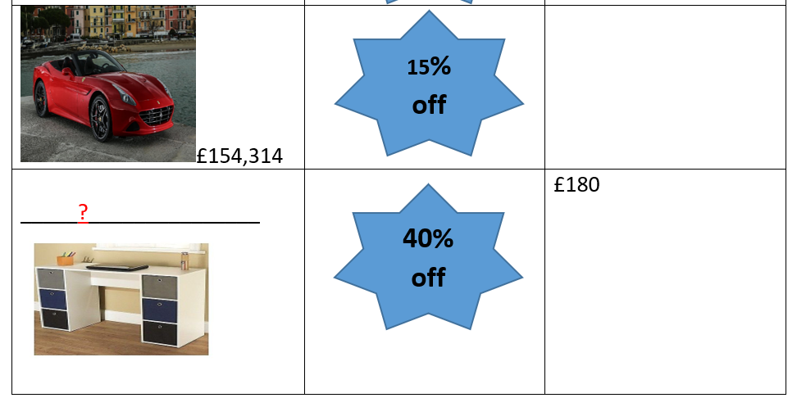
Percentages
Talk about how ‘percent’ means ‘number of parts per hundred’.
Talk about numbers that are represented in percentages. For example, you could work out what proportion of your child’s class at school are girls. Ask them to tell you how to represent the percentage as a fraction and decimal (for example, 55% = 55/100 = 0.55).
Sales at the shops can provide great real-life opportunities to work with percentages. For example, you could ask your child to help you work out the sale price of an item. If there is 30% off a T-shirt and the full price is £9.99, what is 30% of the full price and what is the sale price?
https://cdn.oxfordowl.co.uk/2013/08/13/10/57/39/683/Fraction_Decimal_and_Percentage_Treasure_Hunt.pdf

Slide 33
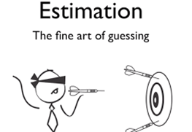

Slide 34
Encourage children to estimate answers before working out the answer.
It is important that your child is able to use estimation in their work. Estimation is used to get a rough idea of a calculation. Rounding the numbers to make it easier.
Then do the calculation. If it's really different to the estimation, a mistake has been made.
25, 567 x 24
How would you solve this problem using rounding and estimation?

Slide 35
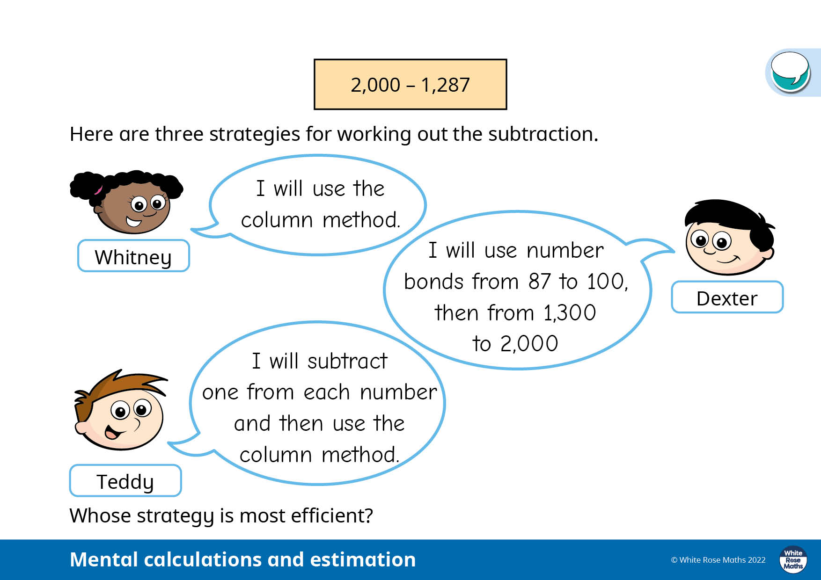
Using estimation and number bond knowledge will help your child solve this problem.

Slide 36
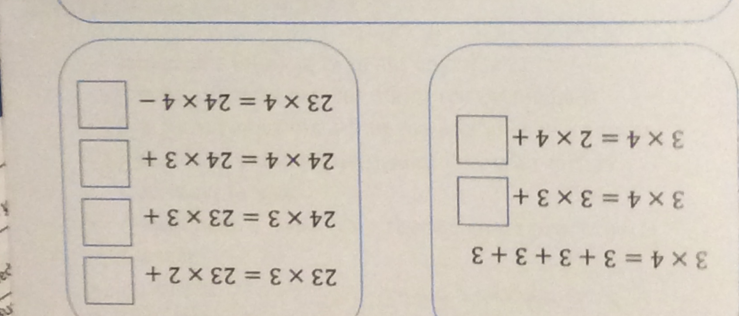
What is the same? What is different?
What else have you noticed?

Slide 37
How can you help your child with Maths at home?
Take away their fear.
Let your child know you believe they can be successful in maths
Encourage and support risk taking and celebrate perseverance.
Encourage your children to solve problems with you.
Help them identify different methods or strategies to use in finding solutions and resist the temptation to provide the answer or method.
There is usually more than one way to solve a problem, and simpler strategies are often effective.
Provide opportunities for your child to explain and justify their thinking.
Seeing mistakes as an opportunity to learn and using them as a discussion point.

Slide 38
How can you help your child with Maths at home?
Connect mathematics to real life experiences. Emphasising the mathematics around us helps to make mathematics education relevant.
Recognising the importance and value of Maths in our everyday lives e.g. managing money when shopping if I buy … estimate how much it will be. How much change would you get from…? Comparing prices at petrol stations. Is it cheaper to buy 9 litres of petrol at £1.69 or 9 litres of petrol at £1.71? How much saving could be made if over a year?

Slide 39
A quick guide to everyday Maths opportunities for your child
Practise spotting and recognising numbers in the environment. Add/multiply/subtract/divide door numbers, numbers on car registration plates, road signs and at the shop.
Flicking through the TV guide? Ask your child to calculate the length of their favourite programmes. How long is it until the next programme?
Use food packaging to discuss 2D and 3D shapes. What are the properties of these shapes e.g. how many faces, sides, vertices? Flatten the packaging out to find the net of the 3D shape too.
Measuring up for new furniture? Want to make sure the Christmas tree will fit in your living room? These are really good opportunities to encourage your child to see the value of careful measuring skills in everyday life.
Practise telling the time with your child. Can they read both the digital and analogue clock? Can they readily convert between the two and use the 24 hour clock? Can they also recognise Roman Numeral representations of the time too?
Board Games supply endless opportunities for Maths – Snakes and Ladders, Monopoly, Bingo, Connect Four, Battle Ships etc

Slide 40


Websites to support children’s Maths skills
CBeebies have lots of fun and interactive games and activities to help get our younger children excited about Maths
I See Maths – a useful site with a plethora of ideas for fun games that all the family
Primary Games Arena - It is a free website that encourages children to play online maths games linked to their home learning. It breaks the games down into concepts which is really helpful.
Hit the Button – children love this game as it helps to increase confidence through practising times tables and number bonds.
Maths Zone – this site is jam-packed with fun ways to learn more about maths.
BBC Bitesize – lots of information alongside short videos help to make the learning enjoyable and accessible for all children.

Slide 41



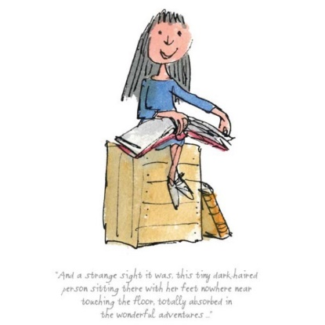
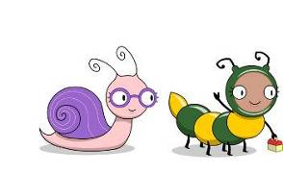
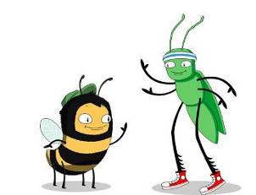
Math workshop
.
Another way to support your children is by using
When it comes to times tables, speed AND accuracy are important — the more facts your child remembers, the easier it is for them to do harder calculations. Times Table Rock Stars is a fun and challenging programme designed to help students master the times tables. World Famous musicians need to practice and so do children with their tables!

Slide 42
Math workshop
.
Another way to support your children is by using
For your child to be fully motivated and for them
to get the best out of the practice, they need your help - your praise, reminders and support will help your child feel confident and motivated.

Slide 43
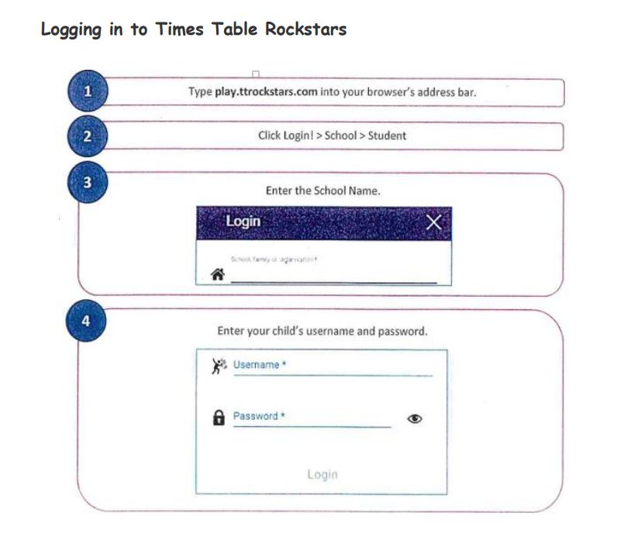
Math workshop
.

Slide 44
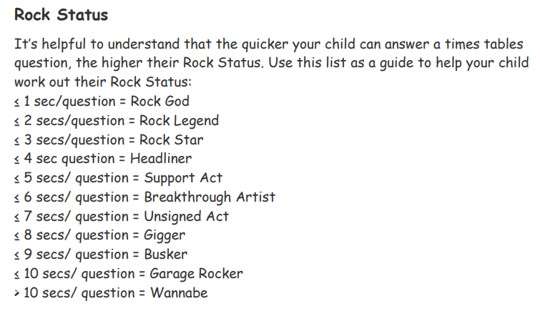
Math workshop
.

Slide 45
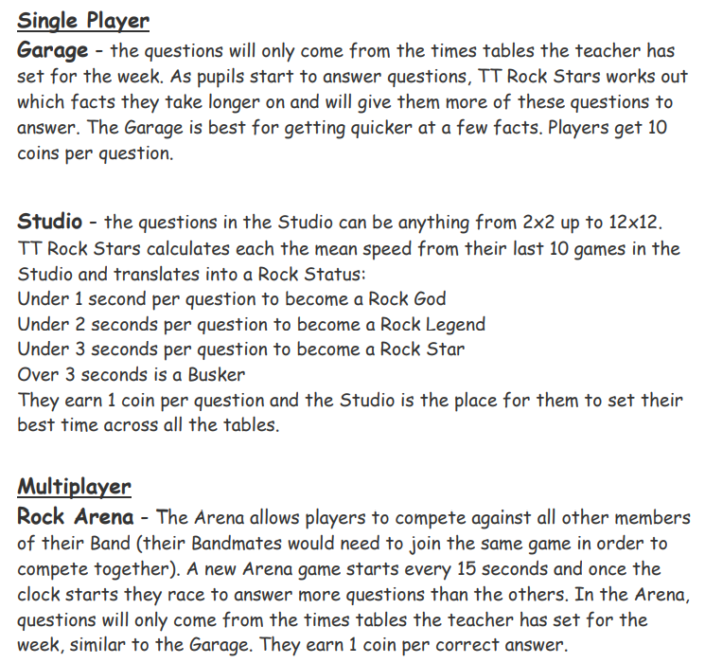
Math workshop
.

Slide 46
Math workshop
.

Slide 47
Math workshop
.

Slide 48
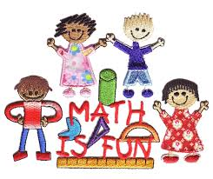
Thank you for listening.
We hope the workshop helps you understand how you can support your child at home.

