Slide 1

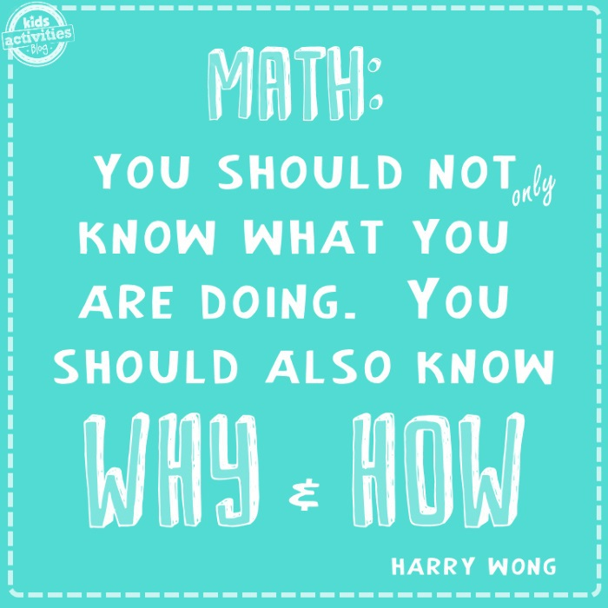
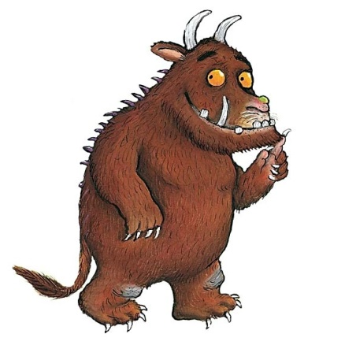
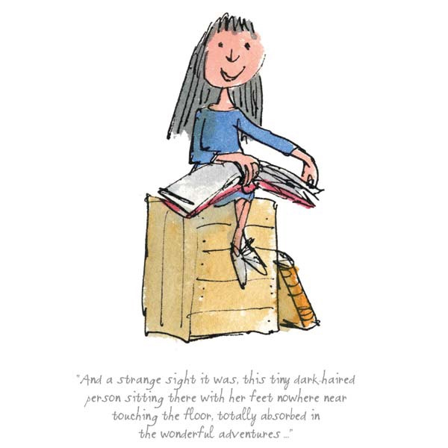

Slide 2


Welcome to our
Maths workshop
Year 3 and Year 4
Notes:
Phonics is a process of teaching children to correlate its individual sound (phoneme) with its corresponding letter or letter group (grapheme). It teaches children how to decode letters into their respective sounds. A skill which is essential for children to read unfamiliar words by themselves. Keep in mind that most words are unfamiliar to early readers in print, even if they have spoken knowledge of the word.

Slide 3
Session Aims
What does maths look like in Year 3 and Year 4?
How is maths taught at Farnborough?
How can children be supported at home?

Slide 4

What does Maths learning look like at Farnborough?
Our curriculum is based on the national curriculum and White Rose Maths and other materials that support the delivery of the curriculum.
These include, Power Maths, NCETM, NRich, Third Space Learning, Primary Stars, Classroom Secrets, NACE– these are used across KS1 and KS2 allowing children to be exposed to a variety of different types of learning and to ensure coverage of fluency, problem solving and reasoning in different formats to ensure that our maths curriculum is rich and varied.
Notes:
What do we want to achieve with each child when the children start in Reception in terms of reading. Thinking about their journey from Reception to Year 6 and beyond.

Slide 5

The link below will take you to the programmes of study for each year group. This shows you what your child will be learning when at school and what a child of that age is expected to achieve by the end of the year (Age Related Expectations).
What are the National Curriculum Programmes of Study?
National Curriculum Programmes of Study for Key Stage 1 and Key Stage 2
Notes:
What do we want to achieve with each child when the children start in Reception in terms of reading. Thinking about their journey from Reception to Year 6 and beyond.

Slide 6
What does Maths learning look like in Year 3 and 4?
Here are examples of children’s work in Year 3 and Year 4.
Notes:
Phonics is a process of teaching children to correlate its individual sound (phoneme) with its corresponding letter or letter group (grapheme). It teaches children how to decode letters into their respective sounds. A skill which is essential for children to read unfamiliar words by themselves. Keep in mind that most words are unfamiliar to early readers in print, even if they have spoken knowledge of the word.

Slide 7
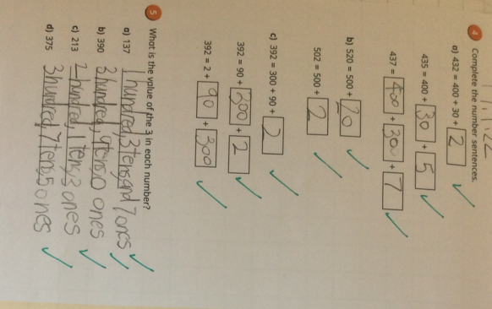
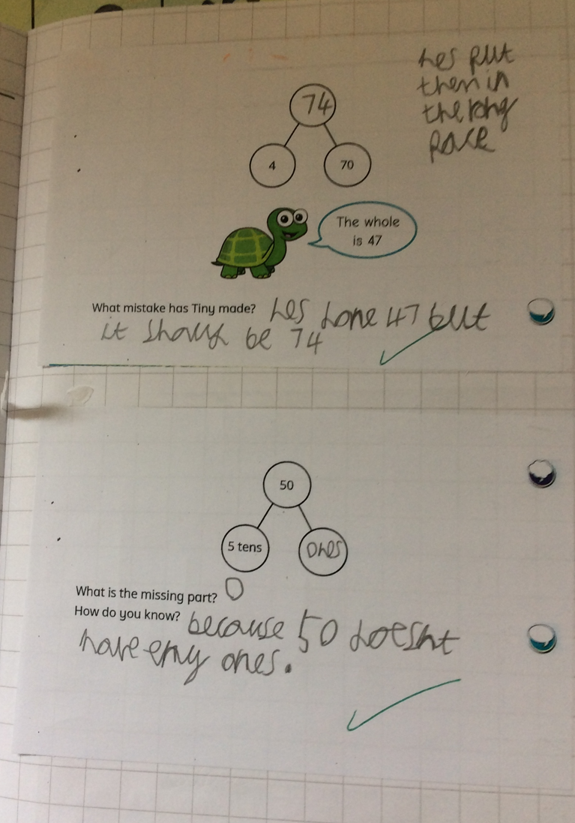
What does Maths look like in Year 3?
To choose strategies to help me answer questions such as partitioning, number lines, counting on, counting back, bar models and eventually formal methods such as the column method.
Consistently use the correct number formation (0-9).
To recognise the place value of each digit in a three-digit number (hundreds, tens and ones).
To read and write numbers up to 1,000
To identify angles greater than or less than a right angle
To add and subtract mentally and scaling these by 10 e.g. 6 + 3 = 9, 60 + 30 = 90.
To understand the inverse relationship between add and subtract
To solve number and practical problems, including reasoning using my number knowledge.
To recall my 2, 5, 10s, 3, 4 and 8 times tables and related division facts.

Slide 8
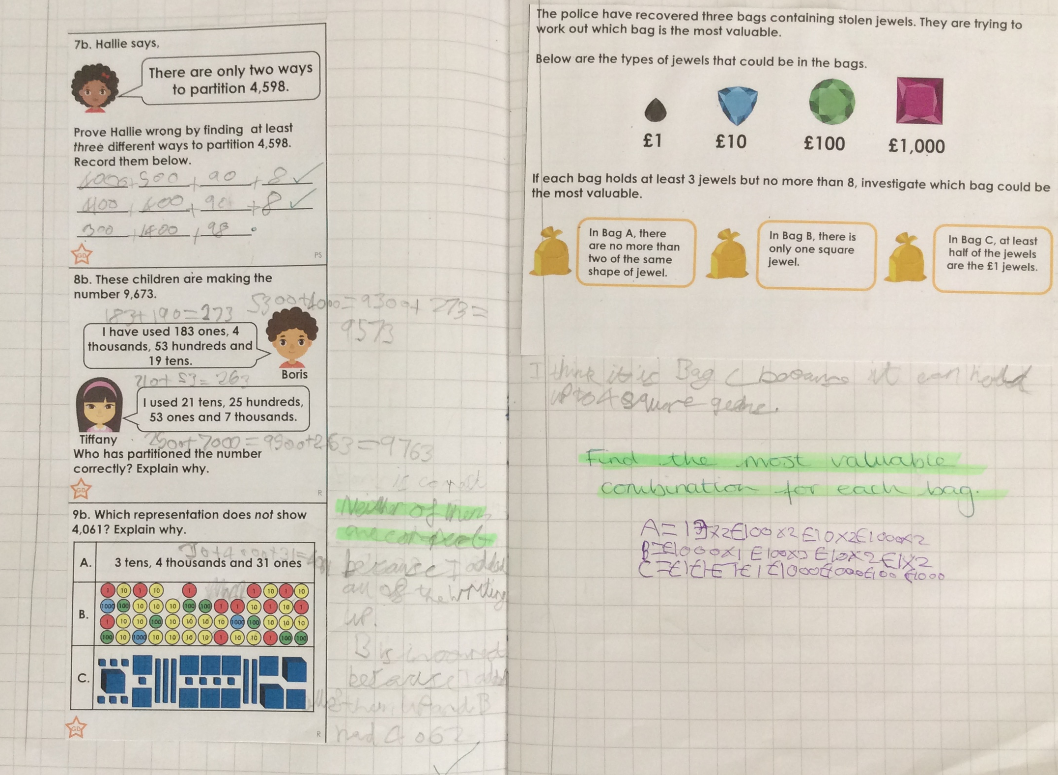
What does Maths look like in Year 4?
Find the perimeter of regular and irregular polygons
Convert mixed numbers to improper fractions and vice versa
Begin to use expanded formal methods for addition and subtraction.
Solve addition and subtraction two-step problems deciding which operations and methods to use and why
Have a secure understanding of number: confidently identifying the value of each digit in a 4 digit number E.g. 2378 the 3 represents 300.
Recognise common groups of equivalent fractions and finding the corresponding decimal.
To solve practical and number problems using reasoning to justify answers.
To confidently and securely know times tables facts, including the inverse up to 12x12
Multiply two-digit and three-digit numbers by a one-digit number using formal written layout

Slide 9
Calculation Policy
Our calculation policy is in line with the programmes of study taken from the National Curriculum for Mathematics (2014). It is designed to be challenging, focussing on essential core subject knowledge and skills. This document guides you through the appropriate calculation methods within each year group and the progression of skills throughout the school.
The content of this document is set out in year group blocks under the following headings: addition, subtraction, multiplication and division.
White-Rose-calculation-policy
Primary Maths Dictionary
Notes:
Phonics is a process of teaching children to correlate its individual sound (phoneme) with its corresponding letter or letter group (grapheme). It teaches children how to decode letters into their respective sounds. A skill which is essential for children to read unfamiliar words by themselves. Keep in mind that most words are unfamiliar to early readers in print, even if they have spoken knowledge of the word.

Slide 11

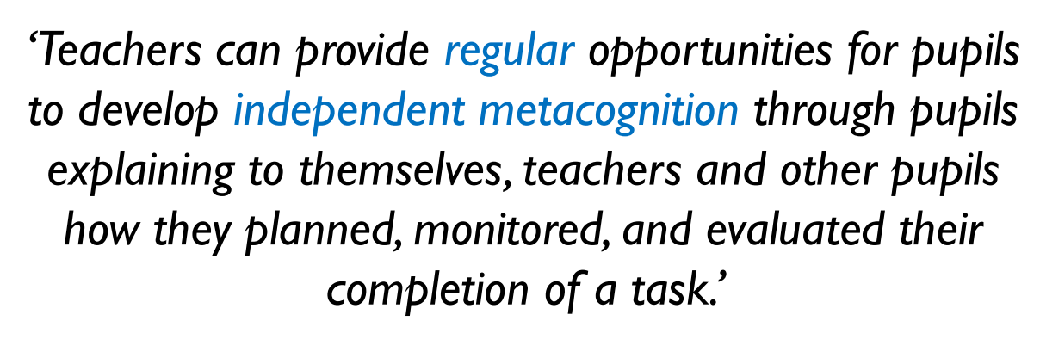
Questioning and Talk

Slide 12
Questioning and Talk
Your turn now

Slide 13
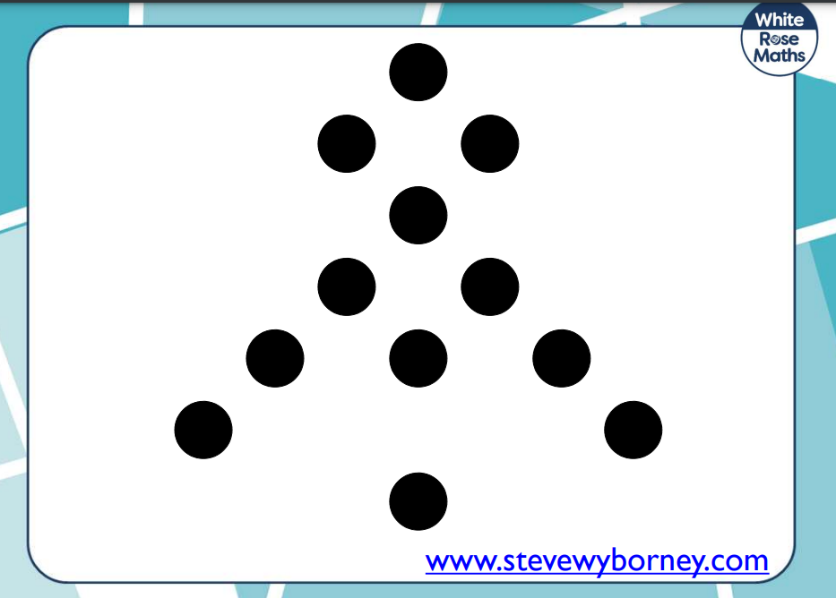
Working with the person next to you can you write a number sentence to go with the dotted formation?

Slide 14
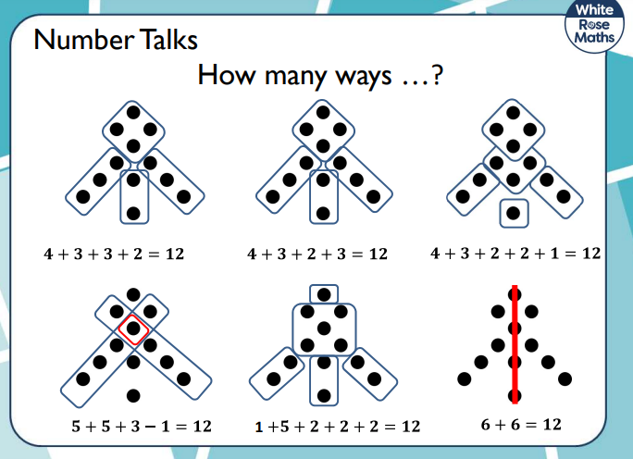

Slide 15
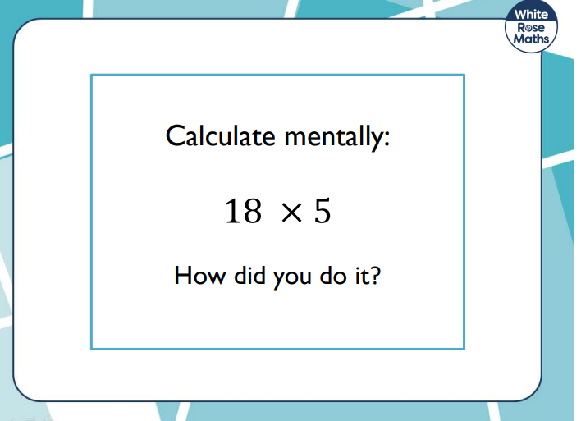

Slide 16
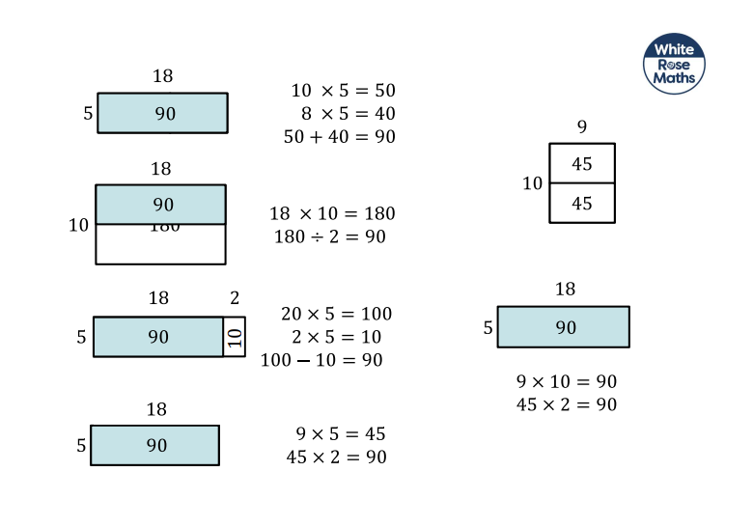

Slide 17
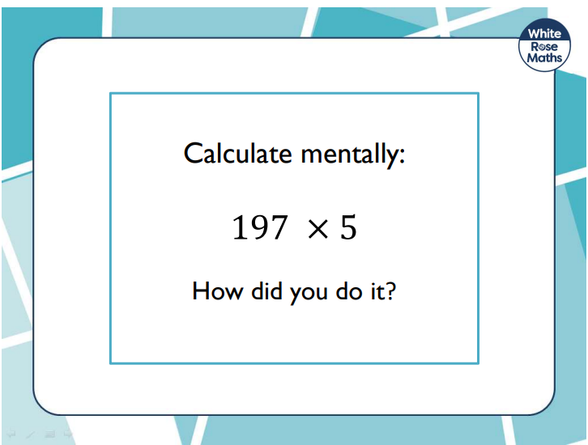

Slide 18
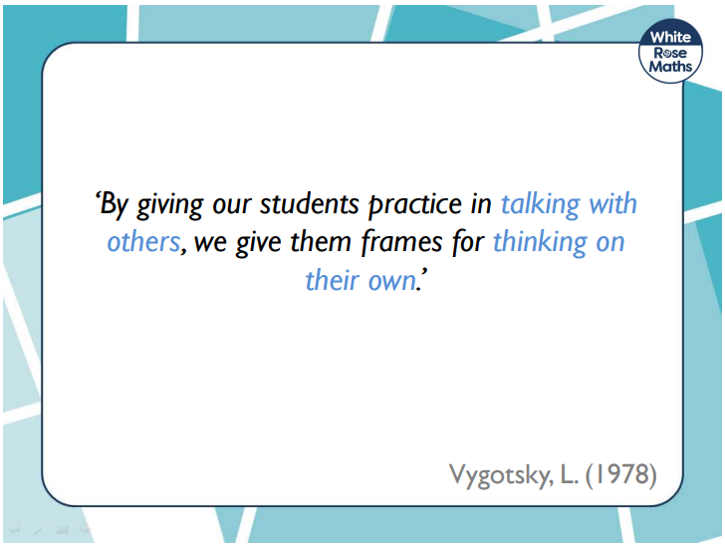

Slide 19
Reasoning and Problem Solving

Slide 20
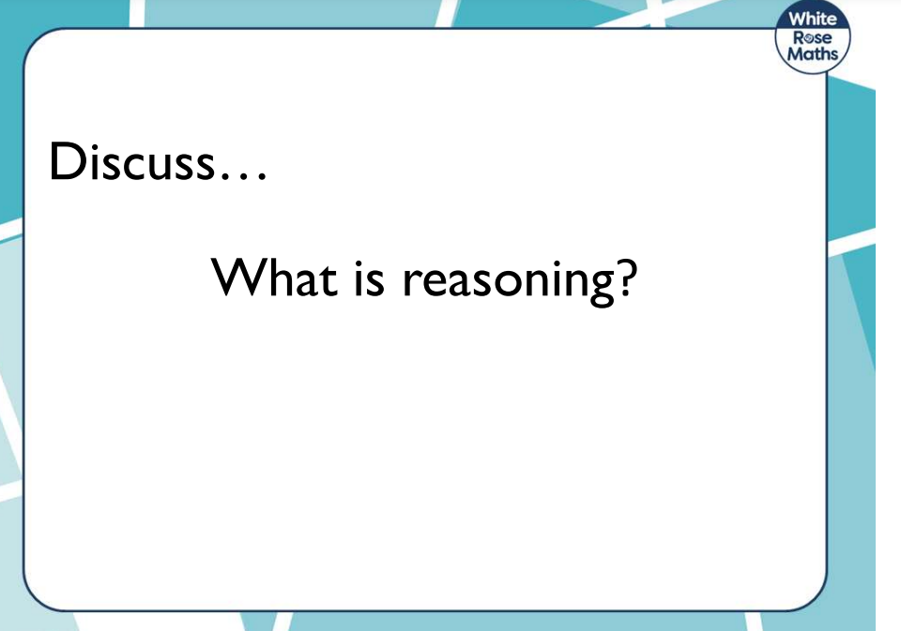

Slide 21
Reasoning is…
The action of thinking about something in a logical, sensible way

Slide 22
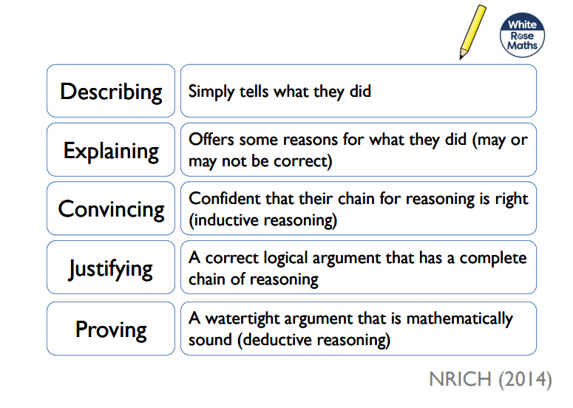
Progression in Reasoning

Slide 23
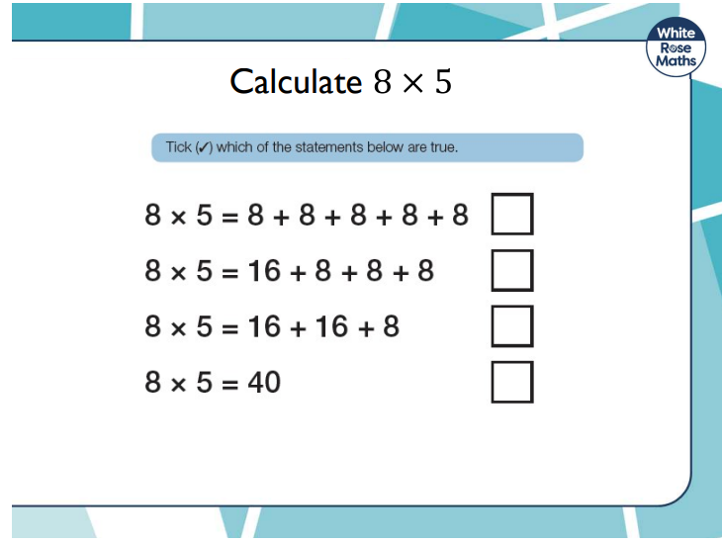

Slide 24
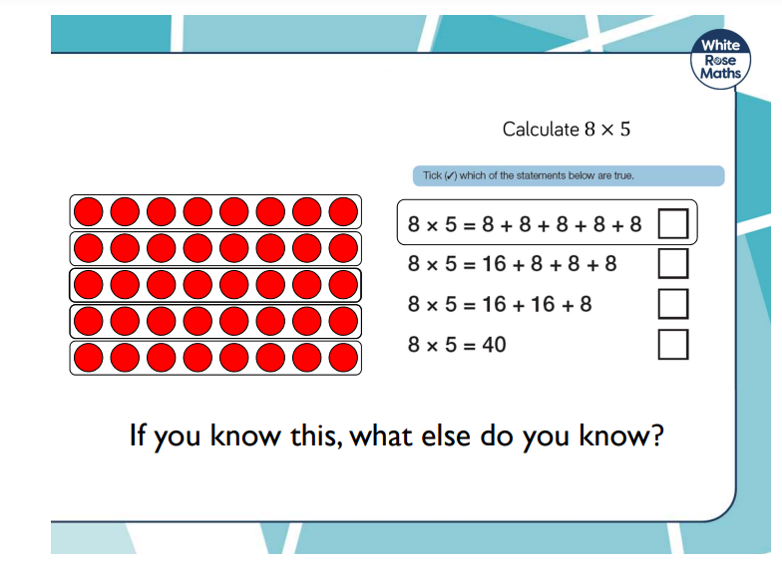

Slide 25
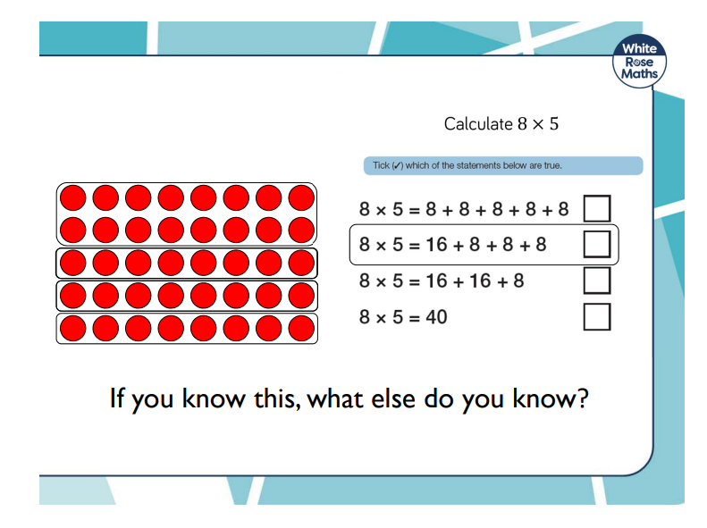

Slide 26
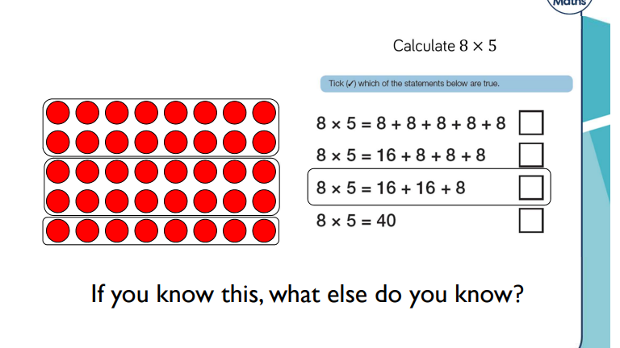

Slide 27
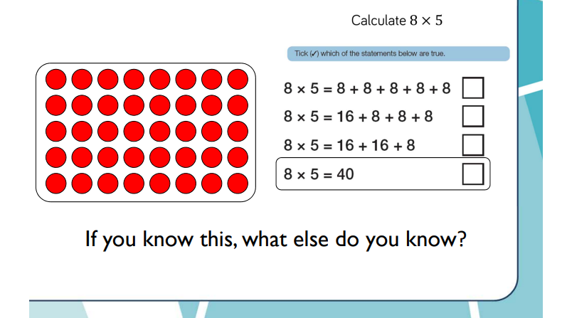

Slide 28
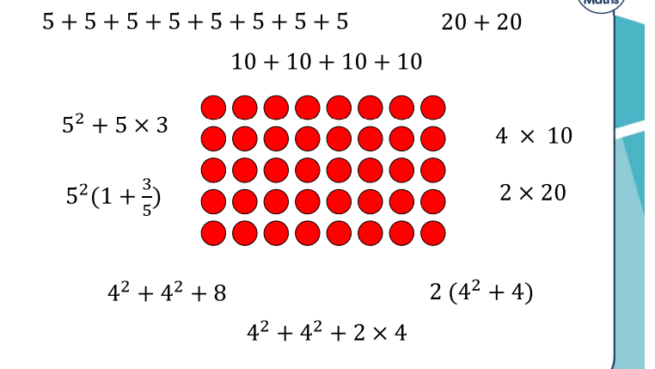

Slide 29
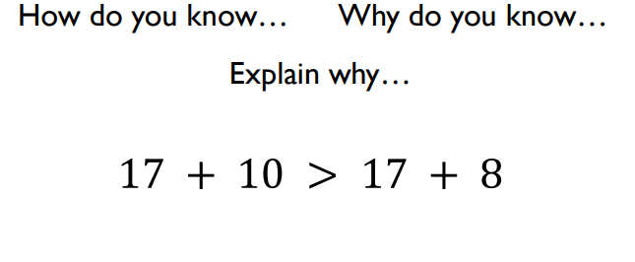
What is the same? What is different?

Slide 30
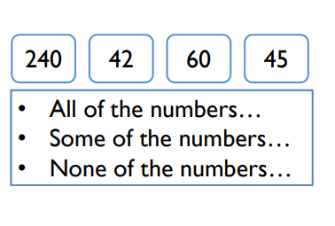

Slide 31
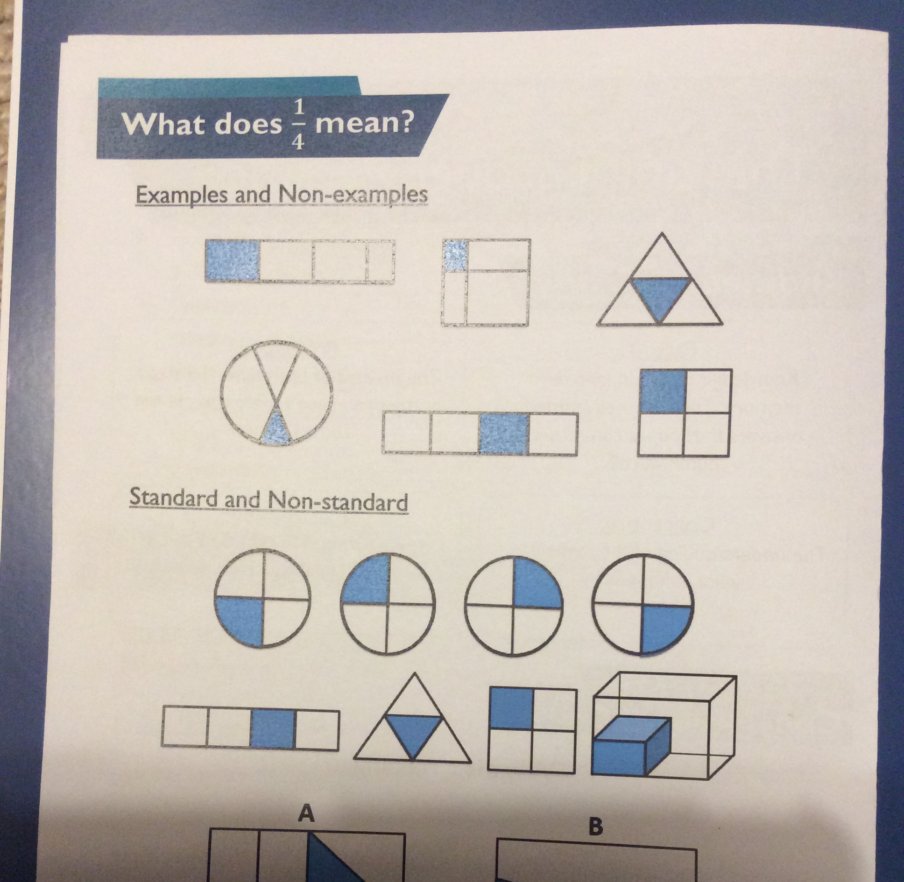
What does ¼ mean?

Slide 32
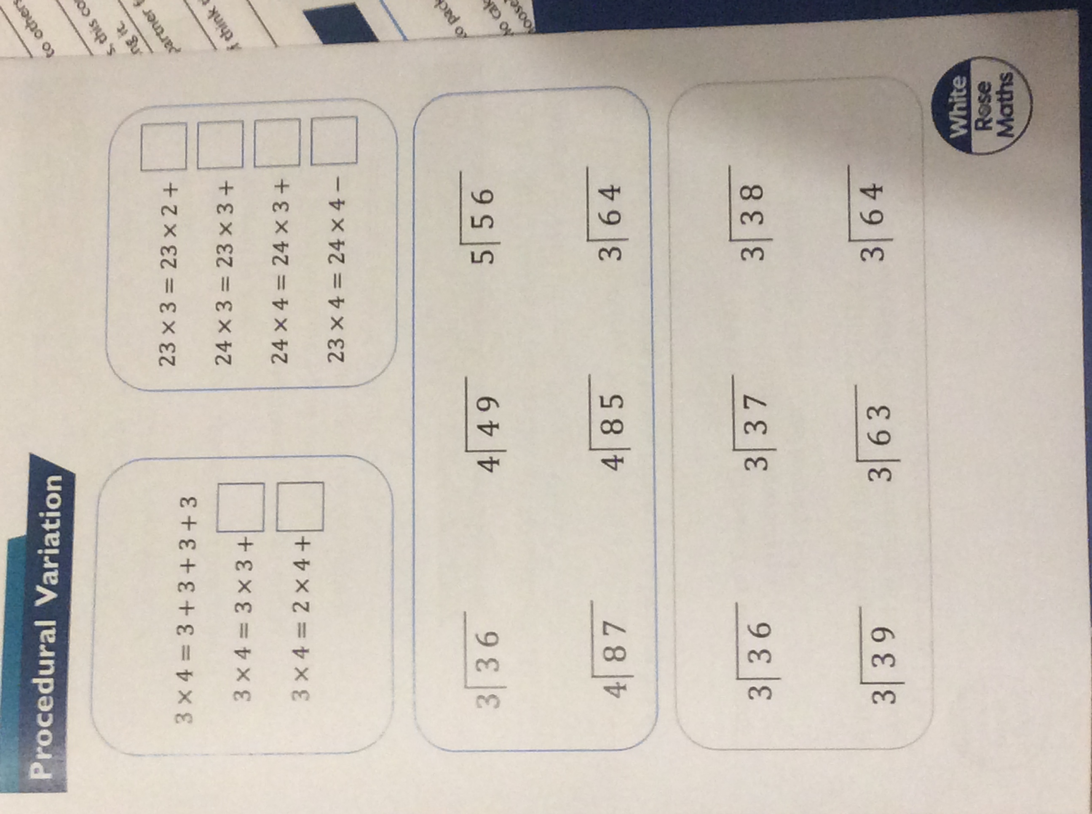

Slide 33
What is the same? What is different?
What else have you noticed?

Slide 34
How can you help your child with Maths at home?
Take away their fear.
Reassure and praise whenever possible. Positive mindset…
Let them see you using Maths in your everyday routines – portioning meals between the family, chopping vegetables into halves and quarters etc.
Play with numbers and shapes through games.
Seeing mistakes as an opportunity to learn and using them as a discussion point.
Recognising the importance and value of Maths in our everyday lives e.g. managing money and telling the time.

Slide 35
A quick guide to everyday Maths opportunities for your child
Practise spotting and recognising numbers in the environment. Add/multiply/subtract/divide door numbers, numbers on car registration plates, road signs and at the shop.
Flicking through the TV guide? Ask your child to calculate the length of their favourite programmes. How long is it until the next programme?
Use food packaging to discuss 2D and 3D shapes. What are the properties of these shapes e.g. how many faces, sides, vertices? Flatten the packaging out to find the net of the 3D shape too.
Measuring up for new furniture? Want to make sure the Christmas tree will fit in your living room? These are really good opportunities to encourage your child to see the value of careful measuring skills in everyday life.
Practise telling the time with your child. Can they read both the digital and analogue clock? Can they readily convert between the two and use the 24 hour clock? Can they also recognise Roman Numeral representations of the time too?
Board Games supply endless opportunities for Maths – Snakes and Ladders, Monopoly, Bingo, Connect Four, Battle Ships etc

Slide 36


Websites to support children’s Maths skills
CBeebies have lots of fun and interactive games and activities to help get our younger children excited about Maths
I See Maths – a useful site with a plethora of ideas for fun games that all the family
Primary Games Arena - It is a free website that encourages children to play online maths games linked to their home learning. It breaks the games down into concepts which is really helpful.
Hit the Button – children love this game as it helps to increase confidence through practising times tables and number bonds.
Maths Zone – this site is jam-packed with fun ways to learn more about maths.
BBC Bitesize – lots of information alongside short videos help to make the learning enjoyable and accessible for all children.

Slide 37



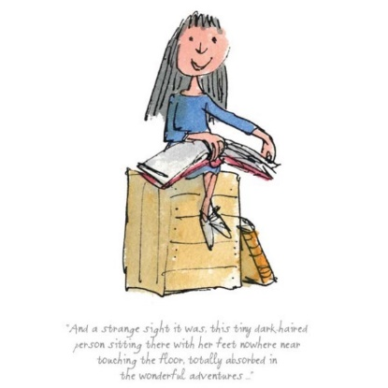
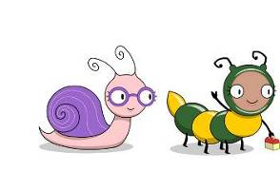
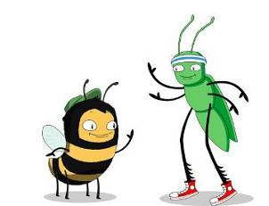
Math workshop
.
Another way to support your children is by using
When it comes to times tables, speed AND accuracy are important — the more facts your child remembers, the easier it is for them to do harder calculations. Times Table Rock Stars is a fun and challenging programme designed to help students master the times tables. World Famous musicians need to practice and so do children with their tables!

Slide 38
Math workshop
.
Another way to support your children is by using
For your child to be fully motivated and for them
to get the best out of the practice, they need your help - your praise, reminders and support will help your child feel confident and motivated.

Slide 39
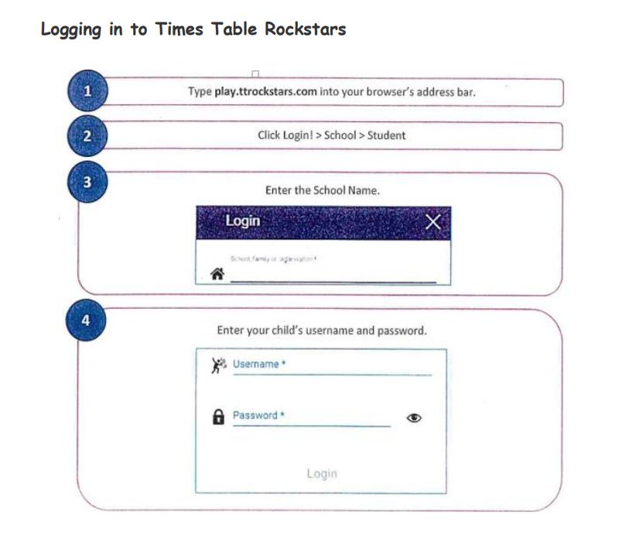
Math workshop
.

Slide 40
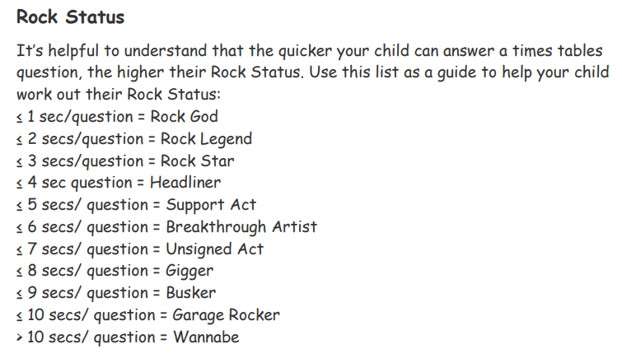
Math workshop
.

Slide 41
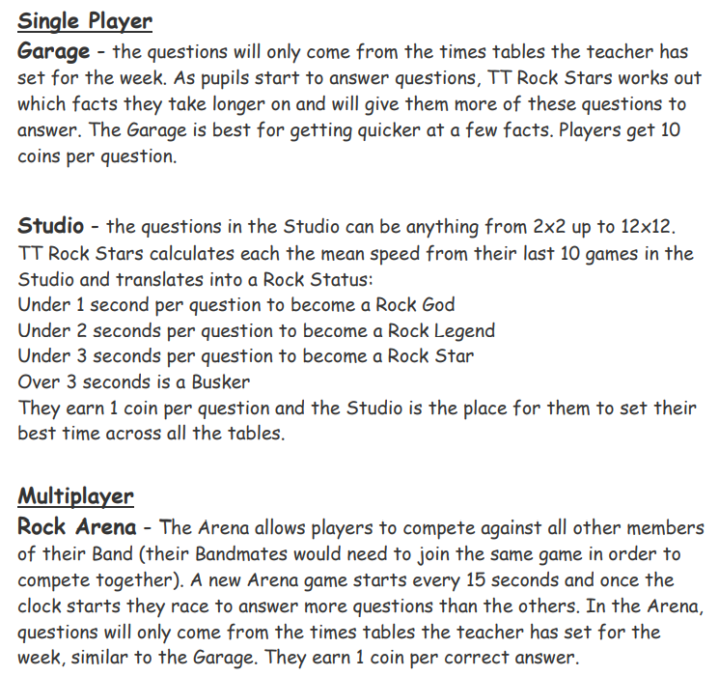
Math workshop
.

Slide 42
Math workshop
.

Slide 43
Math workshop
.

Slide 44
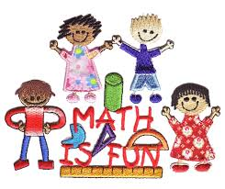
Thank you for listening.
We hope the workshop helps you understand how you can support your child at home.

