Slide 1
Notes:
Limp, jump, champ, thump, shrimp / lomp, bamp, gighmp, yoimp, seemp

Slide 6
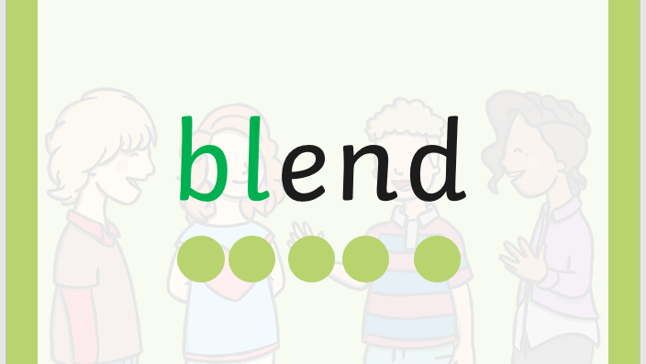

Slide 18
like

Slide 19
so

Slide 20
so
do

Slide 30
She is bleeding.

Slide 31
What floats?

Slide 32
I am glad, I am out.

