Slide 1
PGL Little Canada – Isle of Wight
Monday 13th June
to
Friday 17th June 2022

Slide 2
Why are we going?
To be out of the classroom and be with friends.
To try new activities and challenges, taking us out of our comfort zone
To increase independence
To improve organisational skills
To further develop team work skills
To immerse and enjoy ourselves in a contrasting outdoor environment which includes a creek and a beach
To have fun!

Slide 3
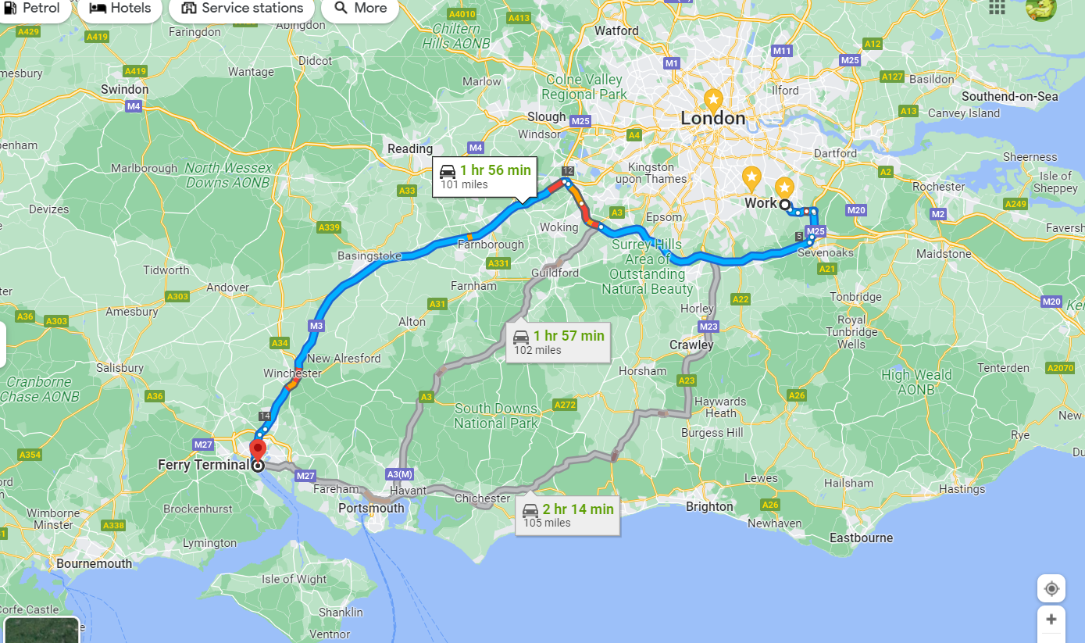
Where are we going?

Slide 4
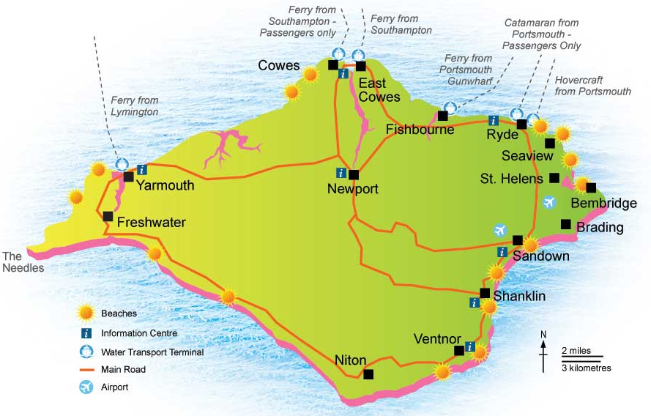
The Isle of Wight

Slide 5
Outward Journey We will meet at the school gates at 6.15am – please, no earlier! The coach WILL leave at 6.45am So do not be late, we will not be able to wait. We will be catching the 10am ferry and are expected to arrive at PGL at 11.30am. We will send a message when we arrive. Please ensure that your child has eaten something in the morning. All children will need a packed lunch and a snack. The snack will be eaten on the ferry and lunch after we have had a tour of the site and a health and safety talk. If your child suffers from travel sickness, please inform the school and please make sure they have taken travel pills in good time. We will make sure the magic newspaper is ready!

Slide 6
Medications Medication should be handed to the School Office by Thursday 9 June 2022 if possible. If the medication is needed over the weekend, a member of staff will collect the medicines on Monday morning before we depart. Parents/carers MUST complete a medication form prior to the visit. This states the child’s name and all the instructions for the staff to follow including timings and dosage. You can collect this form from the school office or download it from the website. Please remember to collect the medication on Friday at the end of the school trip. Any illness within 48 hours before departure MUST be informed to the school. No child is to keep any medication – this must be given to staff.

Slide 7
Luggage One case/bag per child - please ensure your child can carry it comfortably. We may have to carry the bags quite a long way to our accommodation and usually up a small flight of steps. Please bring one piece of hand luggage for the coach to contain lunch, snack, a named water bottle and journey activities, e.g. book, fiddle toy, travel board games (remember, no electronics!).

Slide 8
Please DO NOT bring the following items:
Any electrical equipment
Aerosol deodorants (they set off the fire alarms)
Mobile phones
Chewing gum
Sweets – these will be provided by the adults

Slide 9
Cameras
The staff will take photographs of every activity and these will be shared with the children when we return to school.
If you wish for your child to bring a cheap digital camera, this will be your child’s responsibility. The adult will look after it when the activity takes place and will take any pictures when they are participating in the activities.
Alternatively, some children bring along a disposable camera for the week. They do need reminding, however, that they only have a finite number of pictures and lots taken on the journey down to the Isle of Wight on the coach and ferry may not leave much room for all the exciting activities!
Any camera brought will need to be clearly named.

Slide 10
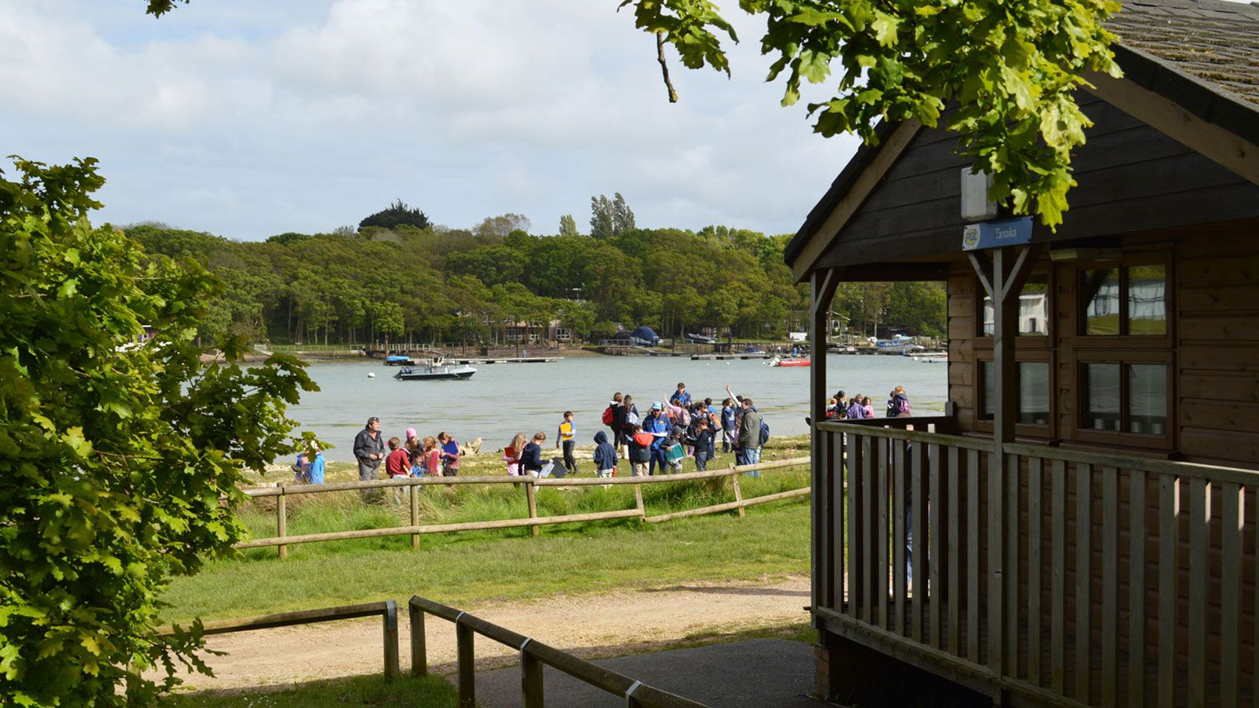
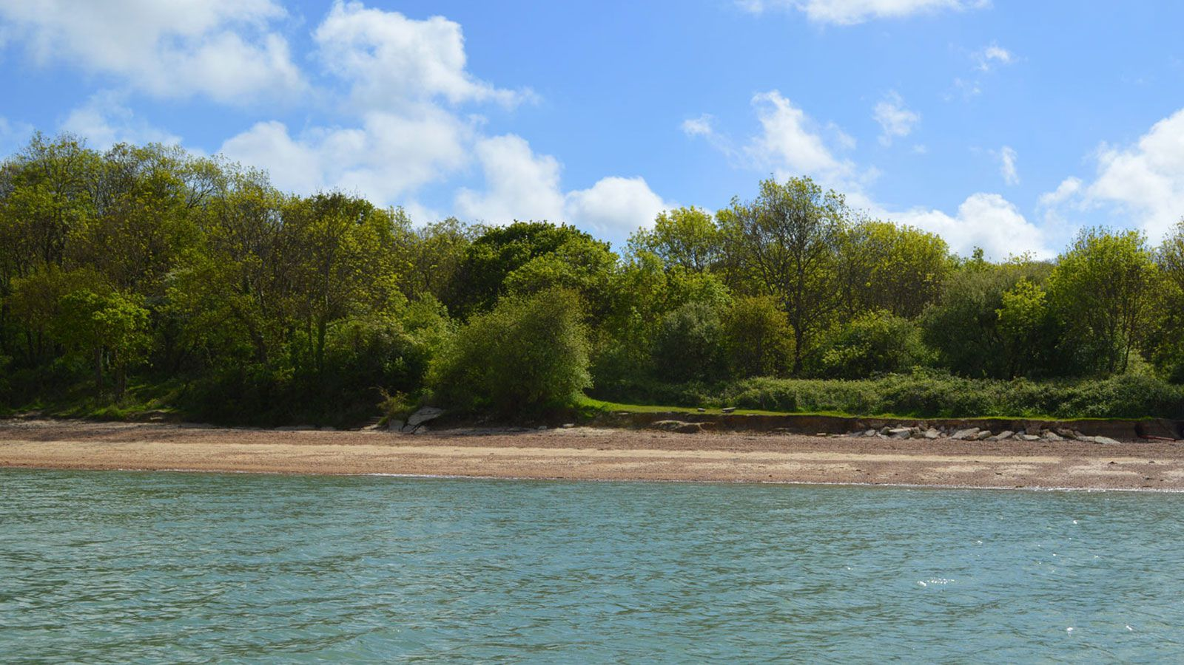
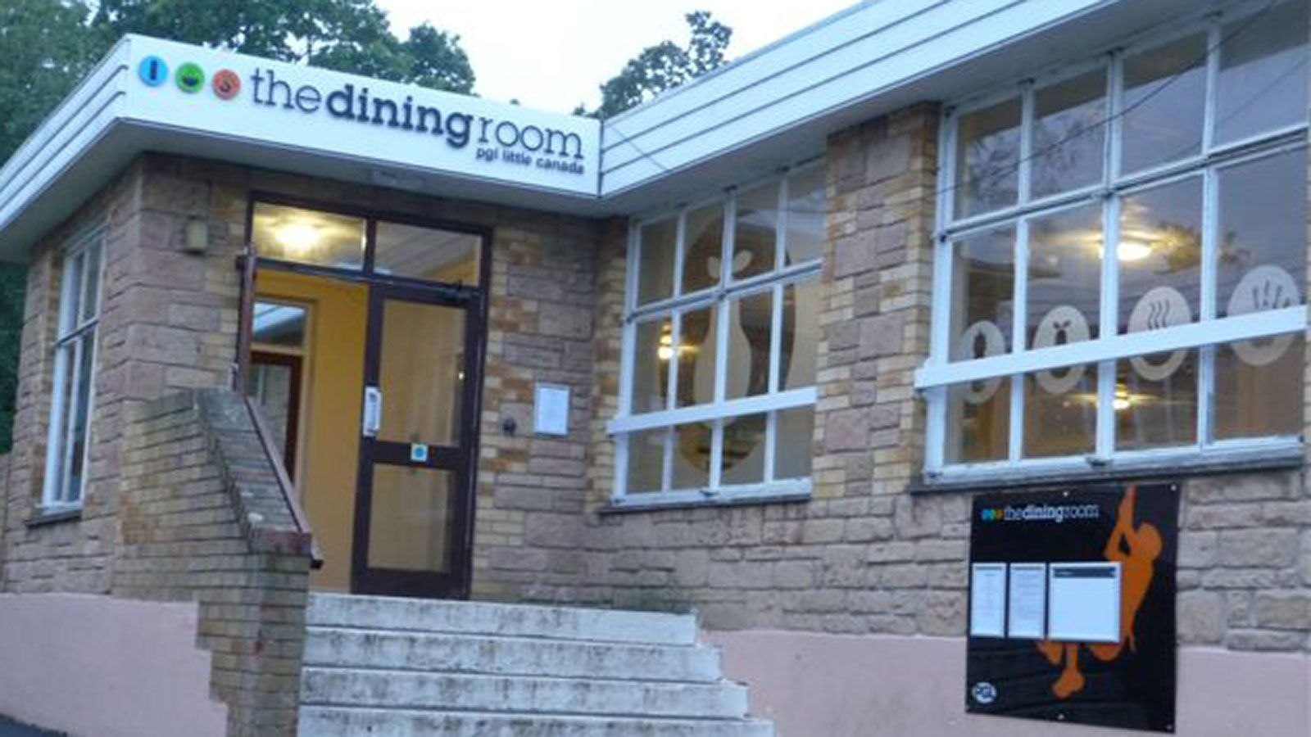
Little Canada - PGL
Set in 48 acres of woodland on the water’s edge at Wootton Creek on the Isle of Wight, Little Canada is the perfect location to try out a range of activities on land and water. The centre is only about a twenty minute drive from the ferry. It has one of the largest range of activities of any PGL site.

Slide 11
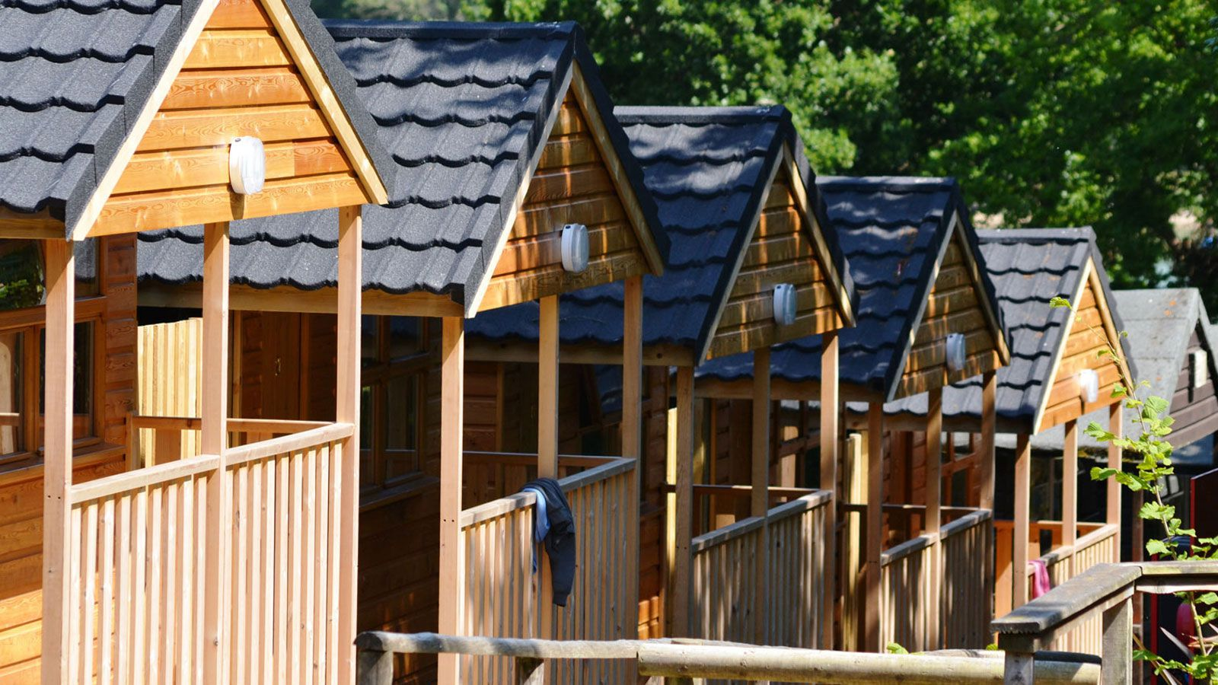
Our accommodation

Slide 12
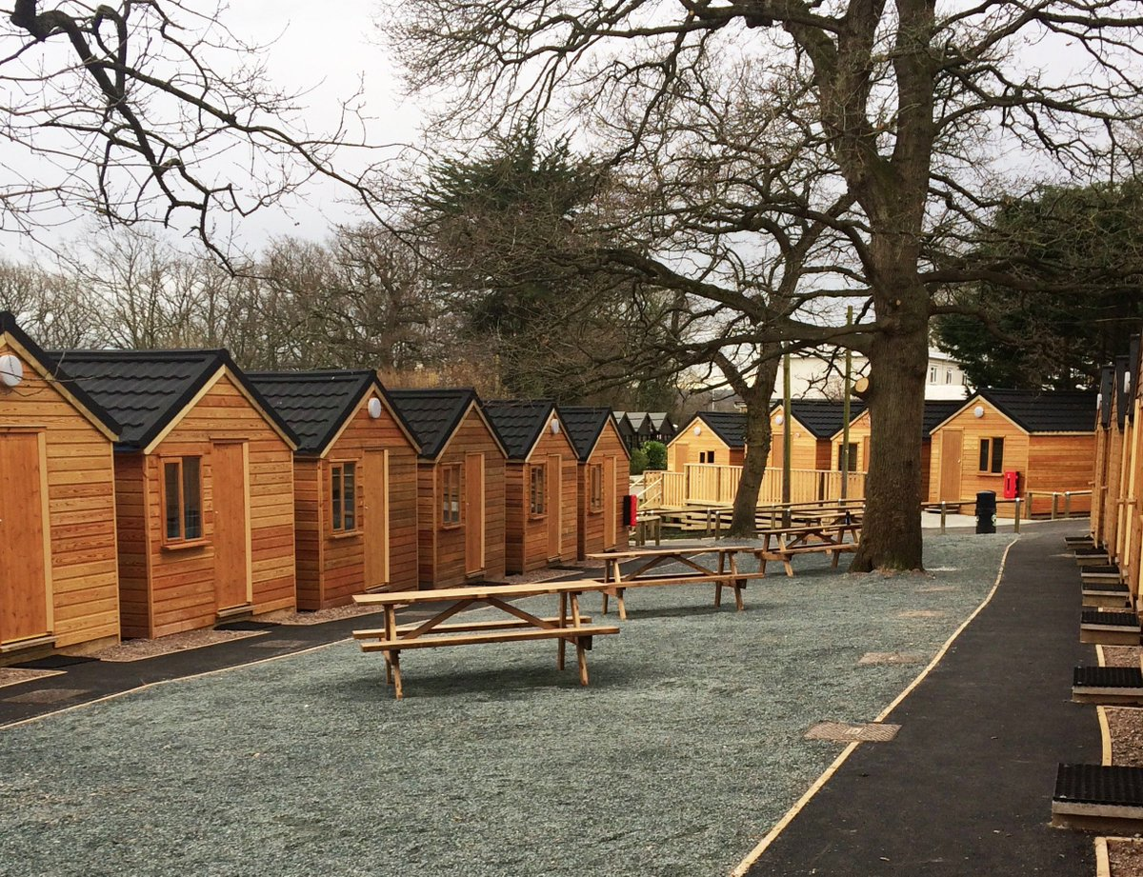
The lodges have all been recently refurbished

Slide 13
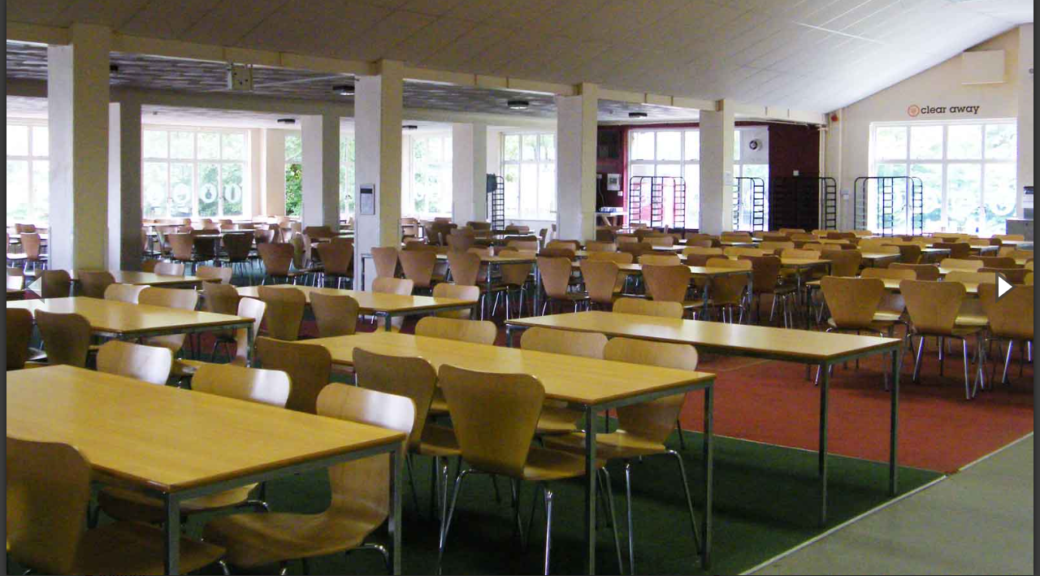
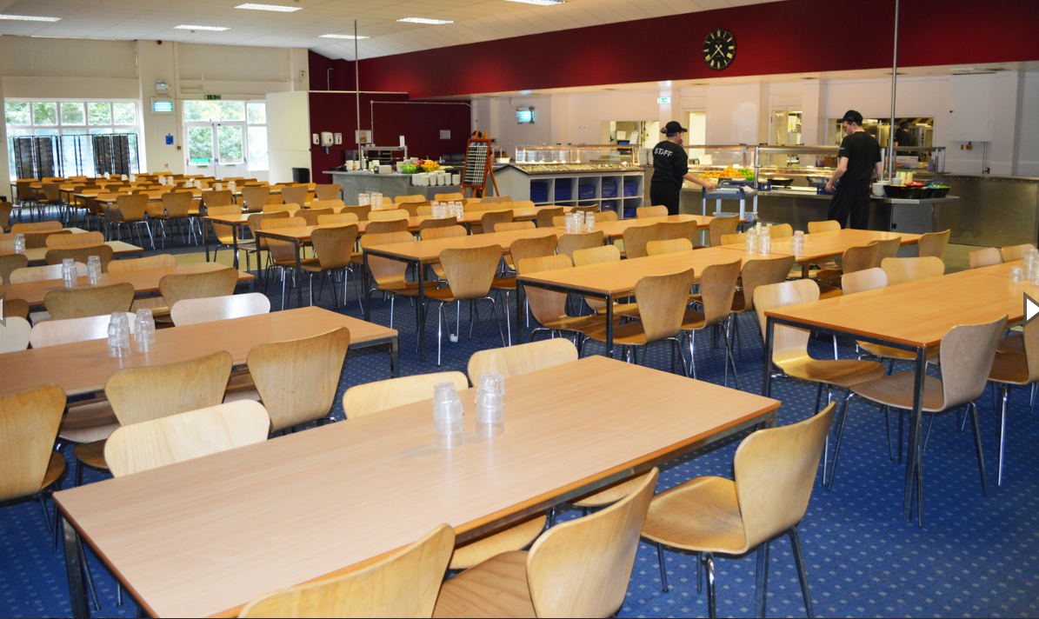
The dining room.
We are allocated the same space in the hall all week. We have the same meal times for breakfast, lunch and dinner every day.
The food is actually quite tasty! There is a large range to choose from and all dietary requirements are catered for.

Slide 15
Sample Activities
Daytime | Evening
Climbing Giant swing Orienteering Sensory trail Challenge course Survivor Outside climbing Zip wire Problem solving Canoes and kayaks Trapeze Aeroball | Campfire Capture the flag Passport to the world Disco on last evening

Slide 16
Instructors and activities
All Activities are led by Qualified Instructors
Farnborough pupils will be in 5 groups and all groups will participate in all the activities.
There are 5 members of Farnborough Staff accompanying the trip –
Mrs Browne, Mr Atkinson, Mrs Roberts, Mr James, Mr Vallois
All Farnborough adults carry first aid kit with them at all times plus there is a trained first aider on site at all times.
The site is secure and is patrolled by PGL staff.
All pupils are told at the Instruction briefing the behaviour that will be expected at all times. No second chances will be given. If the children do not do as they have been instructed or have not listened they will NOT participate in the activity.

Slide 17
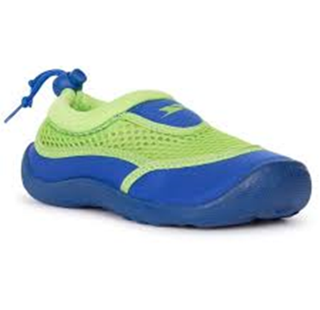
Clothing
Old, casual and easily washable clothing.
Night clothes and slippers
Several changes of underwear
Socks (must include long socks needed for some activities)
At least 2 thick jumpers/fleece
At least 3 pairs of old trousers/ joggers
Shorts
Several T-shirts
Water proof jacket
Sun hat
2 pairs of trainers (one for wet activities)
Strong shoes for walking
Old plimsolls or for kayaking. Please don’t bring any form of open-toed shoe for the water sports as these will not be allowed. You can buy cheap aqua shoes for this instead.
The disco – smart clothes can be worn for this social event.

Slide 18
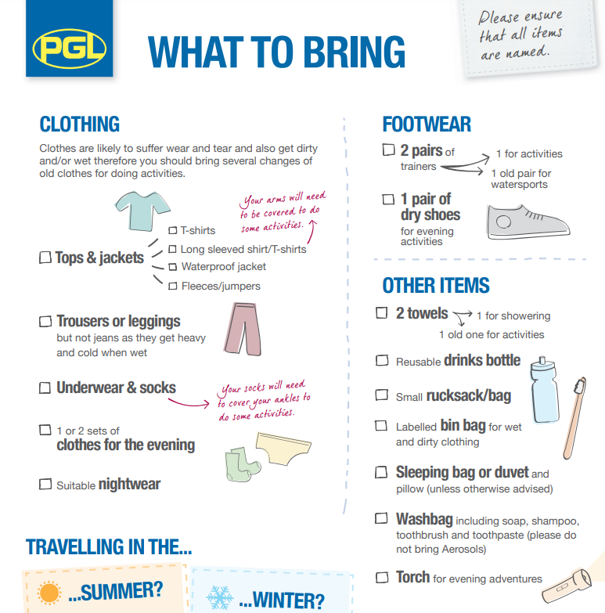

Slide 19
Other Items
A ruck sack – to hold a change of clothes
A wallet or purse
Slippers/Soft shoes for indoors
Suntan lotion
Reusable plastic bottle for water
Wash bag –tooth brush, soap, deodorant etc.
Two towels
A book to read
A teddy or similar
Notebook, pencil and a rubber
Two large bin liners for wet and dirty clothes
PLEASE name all items!! Lost property will only be held by the school for 2 weeks after the trip.

Slide 20
Sample Itinerary
07.00 - wake up the group
08.00 - Breakfast (English or Continental, cereal, toast and drinks)
09.00- First activity session
10.30 - Break
10.45 - Second activity session
12.15 - Hot lunch or packed lunch
13.45 - Third activity session
15.15 - Break
15.30 - Fourth activity session
17.00 - Supervised free time/showers
17.30 - 19.00 - 2 course evening meal
19.30 – 21:00 - Evening activity
From 21.00 – 22:00 there will be PGL staff on active night duty.
Throughout the night, there will always be a senior PGL staff member on call.

Slide 21
Return Journey
We will leave at 11:45 on Friday 17th June
Our ferry departs at approximately 12.30 pm
We will return to school at approximately 4.00pm
A text message will be sent if we are going to be more than 15 minutes late.
Children (and the teachers) will be EXHAUSTED!

Slide 22
https://www.pgl.co.uk/en-gb/school-trips/resources/parent-guide/about
https://www.pgl.co.uk/en-gb/school-trips/primary-schools/centres/little-canada

Slide 23
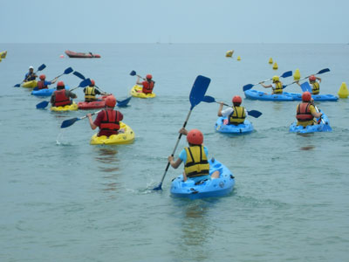
Kayaking
A real test of resilience, listening skills,
co-ordination and teamwork. Children work together to encourage and support. The sense of achievement is amazing.

Slide 24
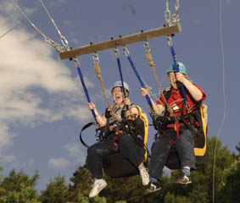
Giant Swing
The ultimate test of decision making, this activity involves two people being hauled 10 metres into the air by the rest of the group. When both participants agree, they pull the ripcord and swing towards the ground at high speed.

Slide 25
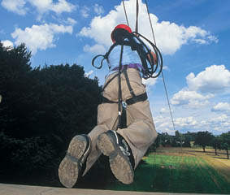
Zip Wire
Travelling at high speed, maybe even through a forest or over a lake, suspended and harnessed from an overhead cable isn't something forgotten easily! Determination, courage and exceeding limitations are qualities often observed.

Slide 26
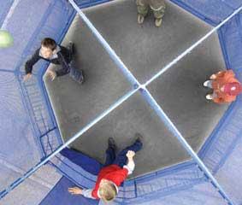
Aeroball
A cross between trampolining and volleyball! Use the bounce from the trampoline to stop your opponents scoring goals whilst trying to score some yourself. Very energetic!

