Slide 1
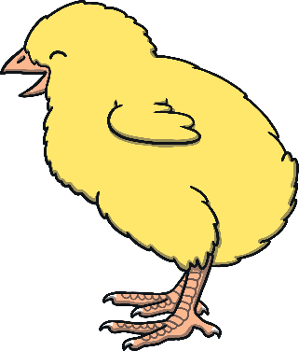
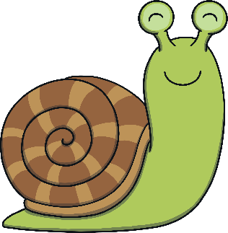
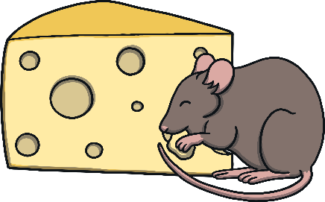
Revisit and Review
Let’s practise Sam’s Sounds and Tricky Words!
air
ure
ai
ear
ng
ow
oi
er
oa
qu
ch
th
ur
ee
oo
w
z
v
j
y
x
ar
igh
sh
or
zz
th
oo
be
my
you
here
are
she
they
me
all
we
was
he
said
so

Slide 2
Notes:
Limp, jump, champ, thump, shrimp / lomp, bamp, gighmp, yoimp, seemp

Slide 12
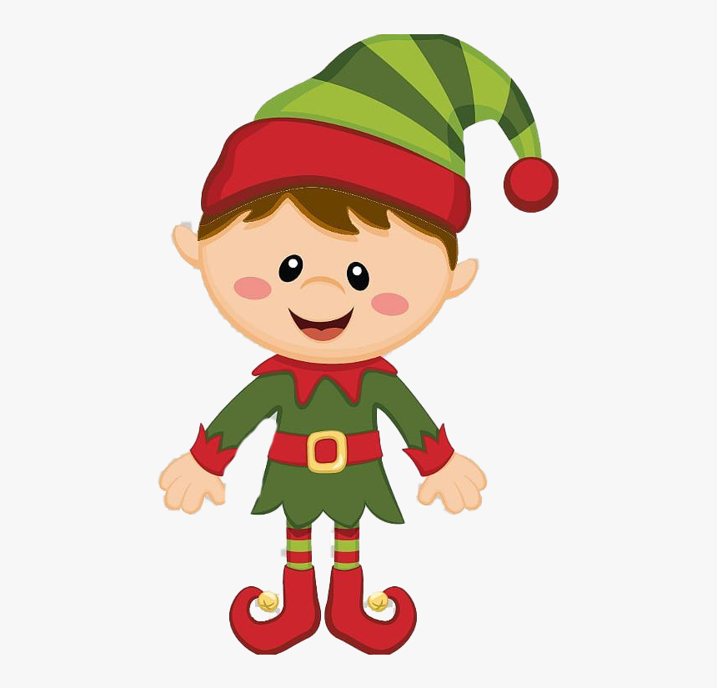

Slide 13
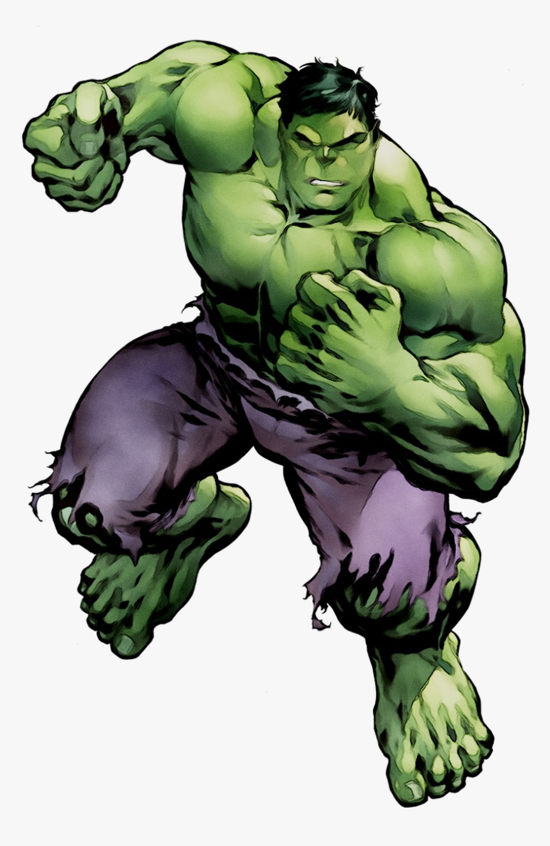

Slide 17
like

Slide 18
so

Slide 19
so
do

Slide 21
Some milk

Slide 22
I like golf.

