Slide 1
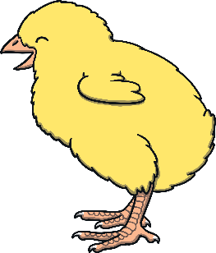
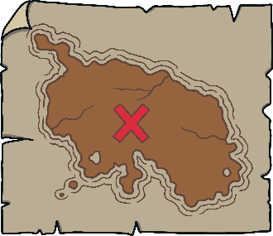
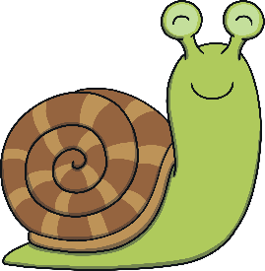
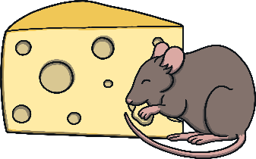
Revisit and Review
Let’s practise Sam’s Sounds and Tricky Words!
w
zz
er
v
ure
air
qu
ng
th
j
ch
z
ar
x
ee
ow
ur
ai
sh
igh
y
th
or
oo
oa
ear
oi
oo
here
they
was
you
she
are
my
me
we
all
he
be

Slide 2
Notes:
rust, must, tusk, helpdesk, chest / kist, thust, wusk, hunsk, shosk

Slide 12
For lunch I had toast.

