Slide 1
Welcome to Meet the Teacher
Pixie Class 2021

Slide 2
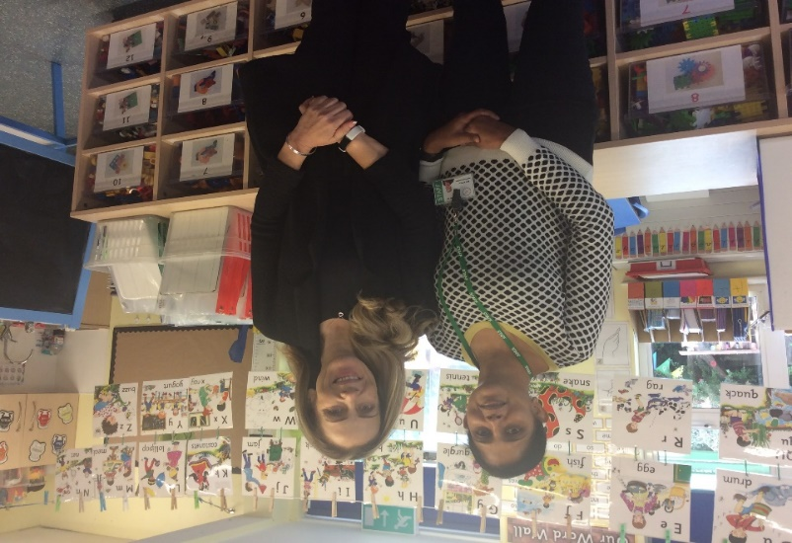
Miss Parker Mrs Dhar
The Reception Team
September 2021
Miss McDonell
Mrs Fairley
(Thursday)

Slide 3
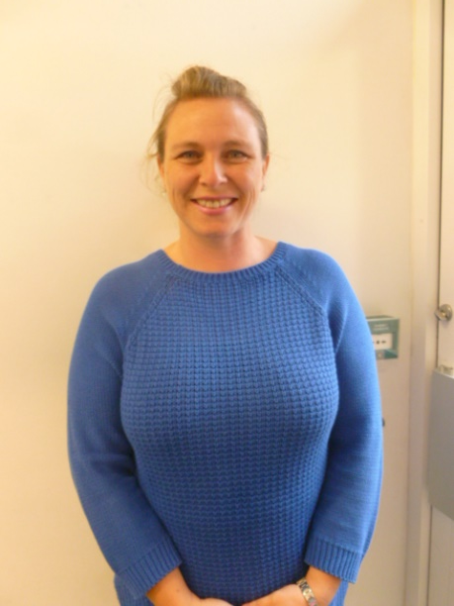
Mrs Wood Lunch Time Supervisor

Slide 4
Timings of the day
School gate opens at 8.30am
Door opens at 8.40am
Register is taken at 8.50am
Pick up is 3.00pm
Lunchtime 11.45 am – 1.00pm
( menu available on-line )

Slide 5
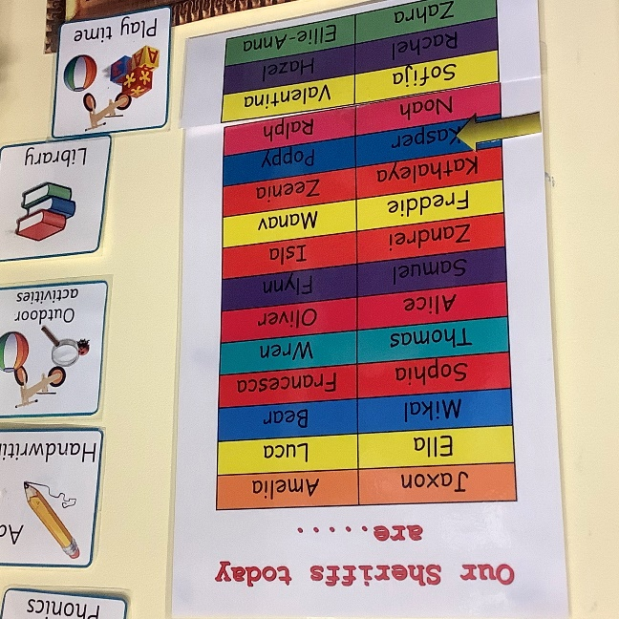
Typical day in Reception
8.40-8.50 self registration
9.00-five a day and sheriffs of the day
9.05-phonics
9.25-activities and adult led challenges
10.15-snack time and story
10.30-outdoor learning and 1:1 reading
11.20-tidy up and get ready for lunch
11.45-lunch
1.00-register and maths meeting
1.20-independent learning and 1:1 reading
2.20-tidy up
2.30-playtime or visit to the trim trail
2.45-story time and good bye song
3.00-home time

Slide 6
Uniform
Polo shirt
Sweatshirt
Shorts, skirt or pinafore dress
Grey socks
White or grey tights
Black shoes
Tracksuit on P.E / Forest School days
Small green / red bows in hair

Slide 7
How you can help us
Please name all school uniform, P.E kits, plimsolls, packed lunch boxes and school bags.
Name, name, name everything!
We do try to encourage children to take responsibility for their belongings and it is much easier when everything is named.

Slide 8
What is the EYFS? Early Years Foundation Stage
The EYFS curriculum is from 0-5. From September 2021 there is a new statutory curriculum in place and this is the same for all nurseries and schools.
There will be more time for adults to be in play, developing and extending children’s learning and following their interests
It is a play based curriculum with lots of opportunities to learn through exploration although some aspects such as phonics are taught directly.
Children have the opportunities to lead their own learning by selecting the resources that they would like and topics that interest them while the adults ensure they are gaining coverage across all areas and challenged in their play.
Baseline statutory – you may have heard of this in news. We piloted it a few years ago and it is nothing to worry about. The baseline is made up of simple tasks which the children enjoy and ask to do as they love the 1:1 time with adults.

Slide 9
Main changes from curriculum previously
Maths is focused on a deeper understanding of numbers to 10 and how they are comprised, including number bonds.
There is no longer any shape and Measure in the end of year assessment, however, we will still be teaching this as it is a vital skill which is built upon in their following school years.
Technology is no longer a separate area but is intertwined in all subjects.
Lots of language and learning through stories.
A greater focus on self regulation.

Slide 10
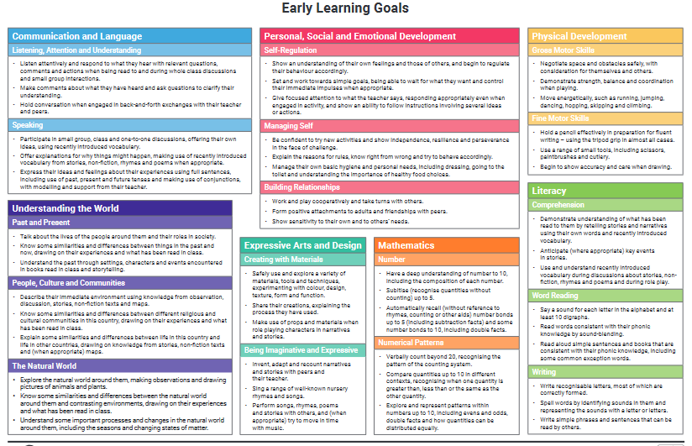
The Early Years Foundation Stage Curriculum 2021
The EYFS curriculum is split into 7 areas:
Prime areas
Communication and Language |  | Personal, Social and Emotional development |  | Physical development
Listening, attention and understanding Speaking |  | Self-Regulation Managing Self Building Relationships |  | Gross Motor Skills Fine Motor Skills
Specific Areas
Literacy | Mathematics |  | Understanding of the world |  | Expressive arts and design
Comprehension Word Reading Writing | Number Numerical Patterns |  | Past and Present People, Cultures and Communities The Natural World |  | Creating with Materials Being Imaginative and Expressive

Slide 11
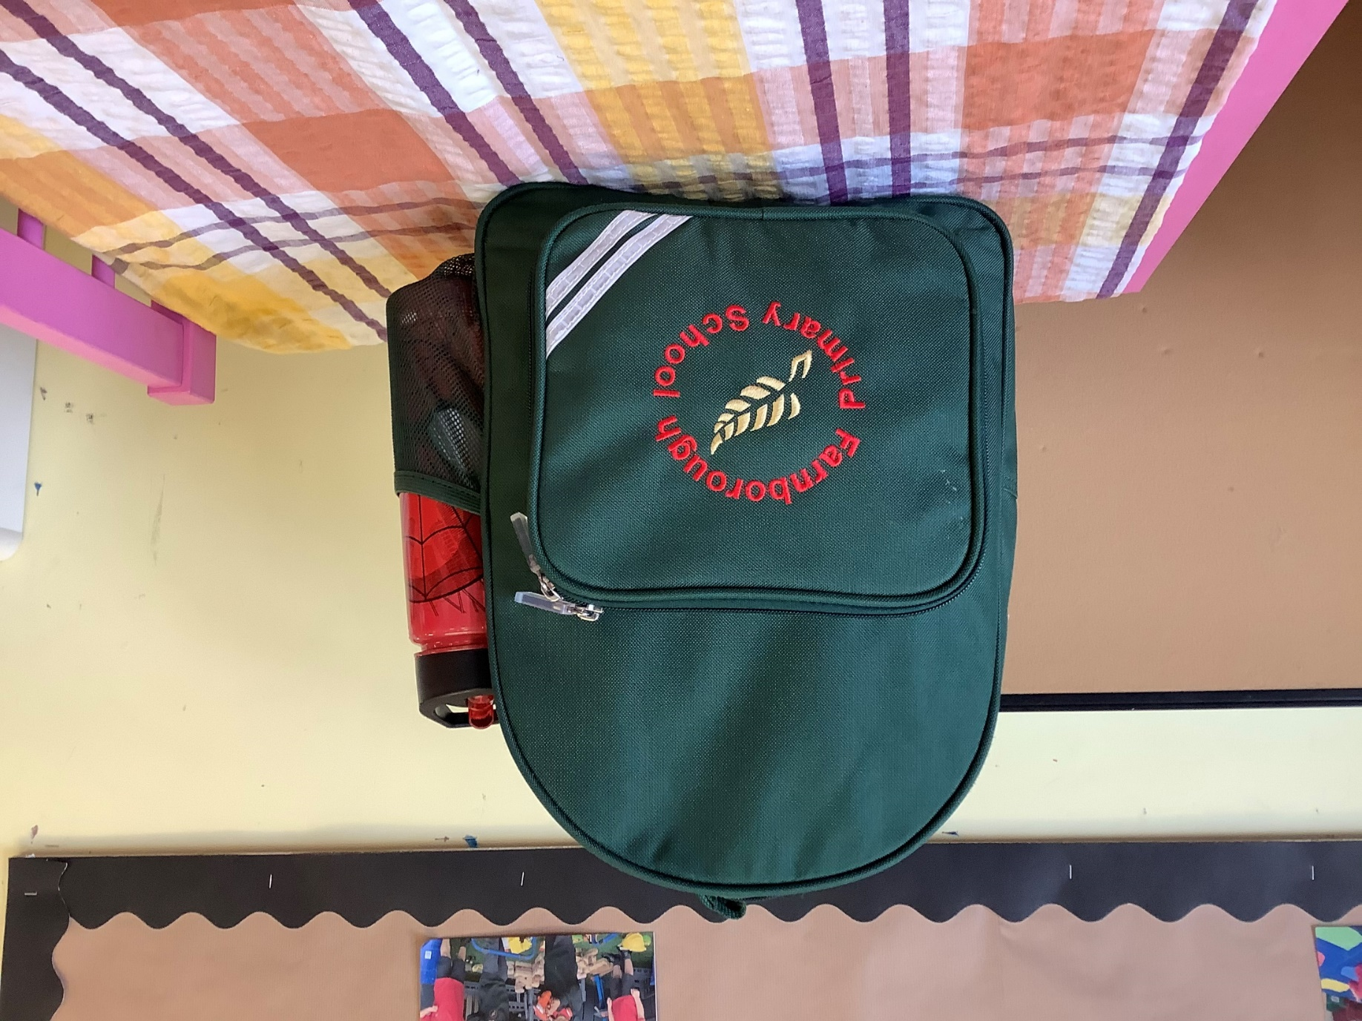
My back pack ready to be filled with lots of knowledge and skills!

Slide 12
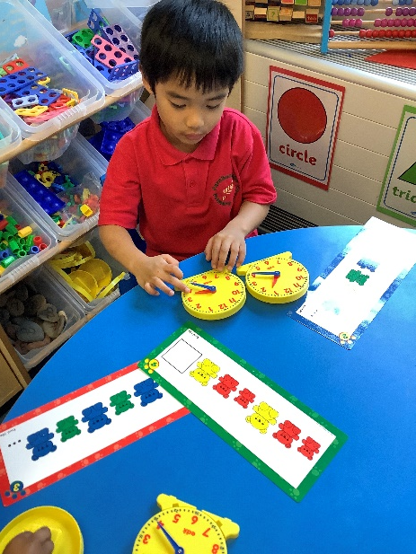
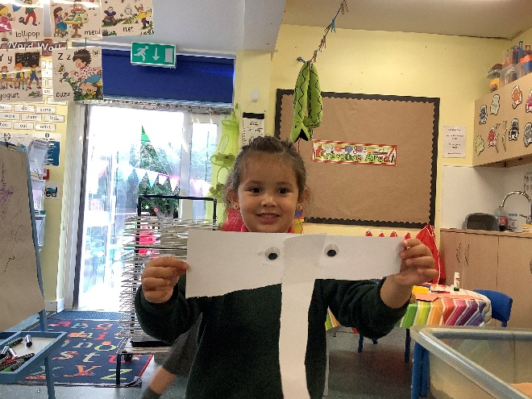
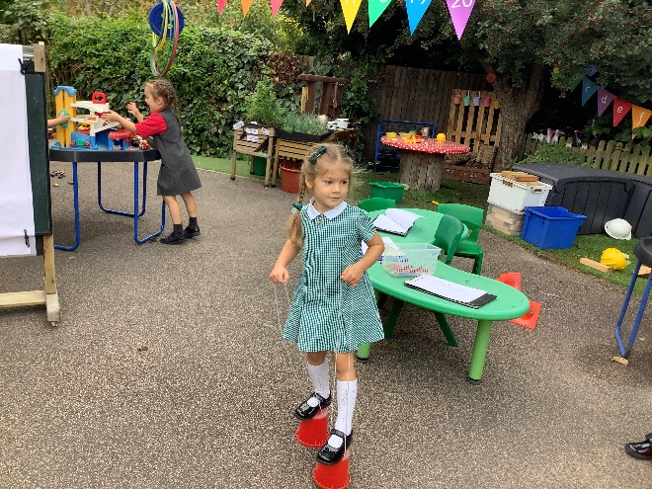
Learning and Development
‘Each area of learning and development must be implemented through planned, purposeful play and through a balance of adult-led and child-initiated activity. Play is essential for children’s development, building their confidence as they learn to explore, to think about problems and relate to others.’ (Framework EYFS)

Slide 13
Assessment
Children are formally assessed at regular intervals through the year in order for us to be able to plan their next steps. This is done in an informal way through observations and simple tasks.
We observe the children through the day whilst playing alongside them. We are then able to challenge the children further and to support them in their next steps.
At the end of the year we make a final assessment where we report on how well the children have met the early learning goals.

Slide 14
At the end of the EYFS we report on how well each child has met the early learning goals.

Slide 15
Phonics
We follow the scheme for phonics as well as
Phonics sessions take place daily. There is an action and a song to go with each sound.
Once your child is familiar with a range of letters and associated sounds then we will start to send you sets of CVC words for your child to practise blending sounds together to make words.
The children are taught letter formation as they learn the letter names and sounds of the alphabet.
We teach a catchy rhyme to help letter formation.

Slide 16
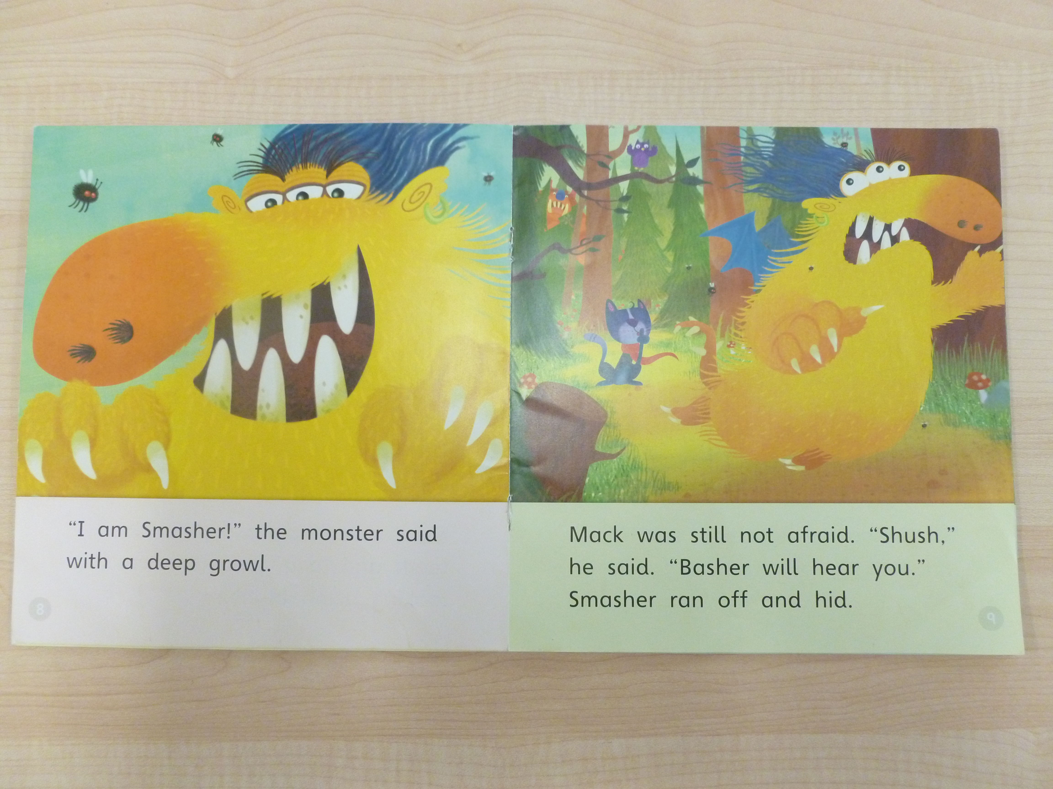
Reading
3 reading books will be issued each week.
Please read and make a comment about how your child got on in their reading record.
Children read with an adult once a week at school.
The you are given may not have any words in – please encourage your child to talk about what’s happening in the pictures. We will then introduce blending CVC words and then reading books when your child is ready.
Online reading programme Bug Club will be introduced and logins will be issued next term.
Children will also visit our lending library each week.

Slide 17
Homework
A homework task will be issued every Friday to be completed by Monday.
These could be Maths or Literacy based or could be a task linked to the other areas of learning or our topic.
Please encourage your child to complete any homework as independently as possible.
Your child’s first homework will be once we start phonics next term.

Slide 18
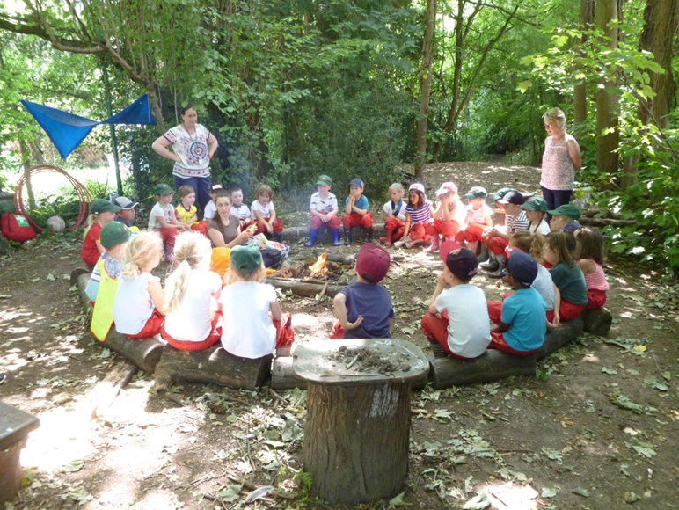
Forest School
Forest School will start on the Monday after half term and will take place in all weather conditions with the possible exception of extremely high winds.
Children should wear the green tracksuit on Forest School days , and will need red waterproof trousers and jacket and a pair of wellies which will all remain at school.
Please provide a named bag that is easy for your child to identify to hold the waterproofs.

Slide 19
Reminders
Parents Evenings – Next half term date tbc
Homework issued every Friday and returned by Monday
Forest school is on Mondays
PE is on a Friday
Evidence me observations will be shared every half term
Parent voice forms by entrance

Slide 20
Thank you for listening
Any Questions?

