Slide 1
Phonics Recap

Slide 2
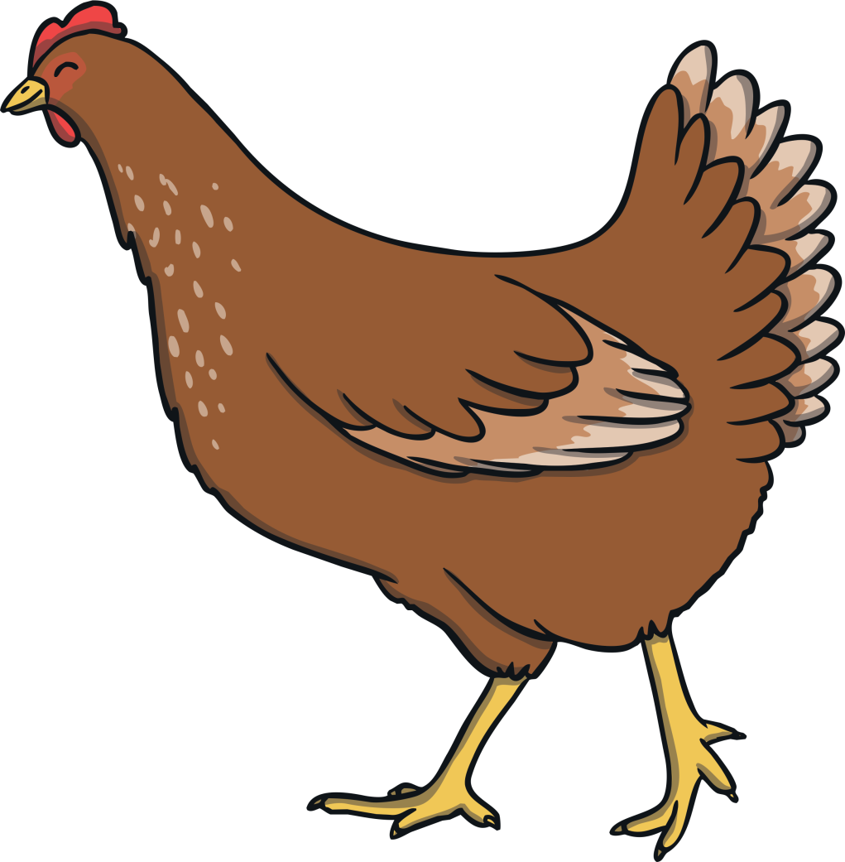
ch

Slide 3
sh

Slide 4
th

Slide 5
ng

Slide 6
ai

Slide 7
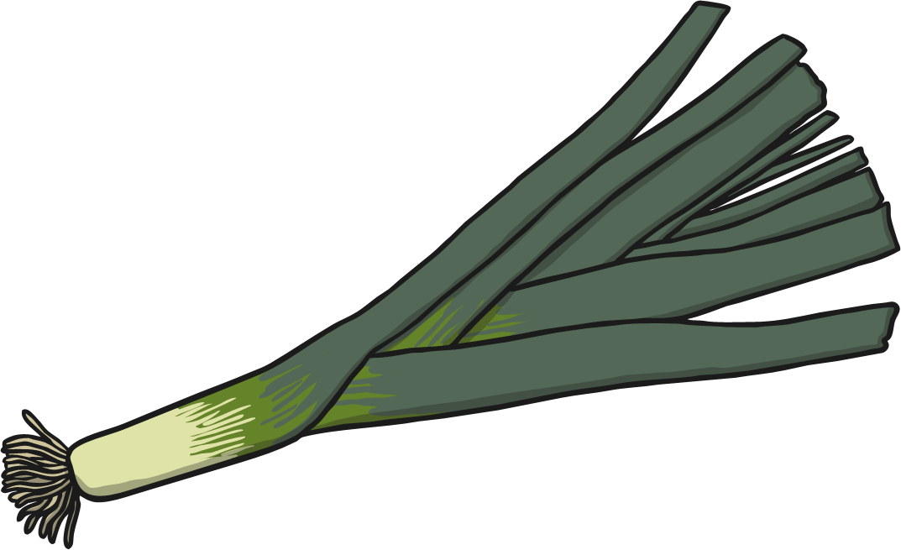
ee

Slide 8
igh

Slide 9
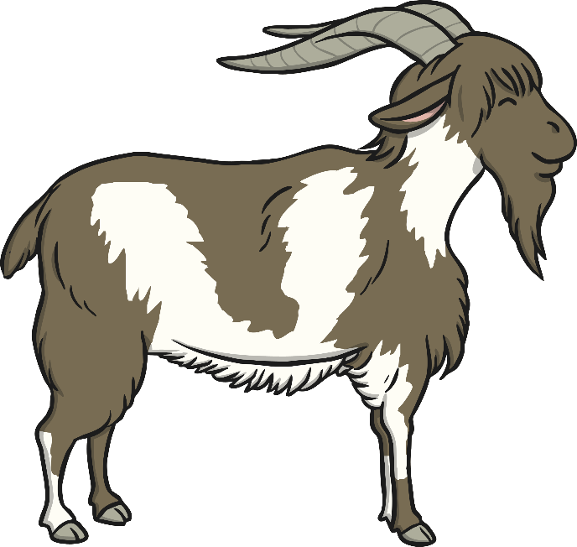
oa

Slide 10
oo

Slide 11
oo

Slide 12
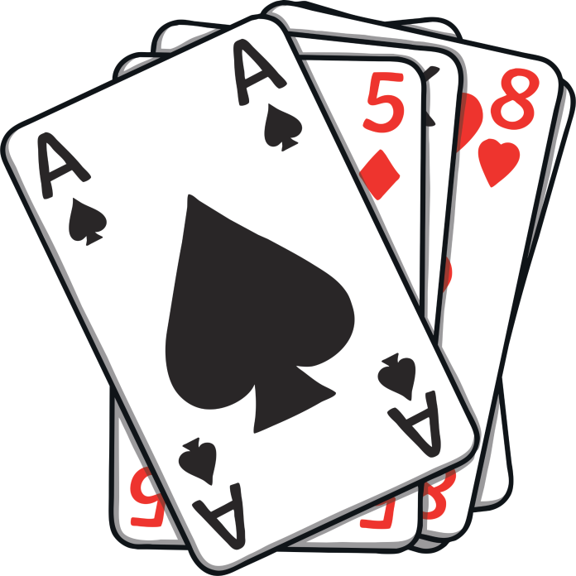
ar

Slide 13
or

Slide 14
ur

Slide 15
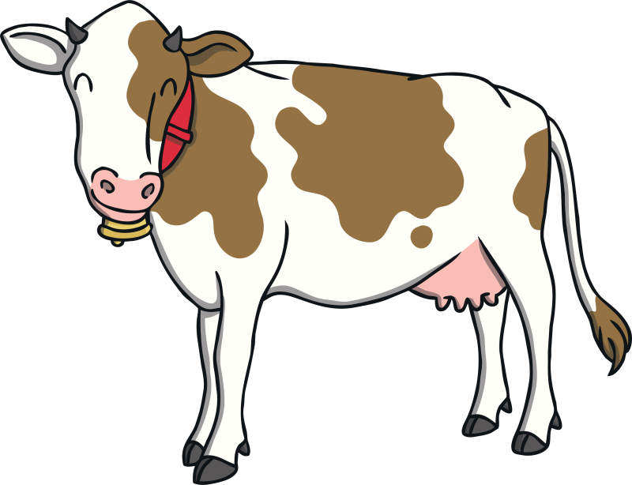
ow

Slide 16
oi

Slide 17
ear

Slide 18
er

Slide 19
air

Slide 20
the

Slide 21
to

Slide 22
I

Slide 23
no

Slide 24
go

Slide 25
into

Slide 26
he

Slide 27
she

Slide 28
we

Slide 29
me

Slide 30
be

Slide 31
was

Slide 32
you

Slide 33
they

Slide 34
all

Slide 35
are

Slide 36
my

Slide 37
her

Slide 39
thick
thick

Slide 40
thin
thin

Slide 41
path
path

Slide 42
bath
bath

Slide 43
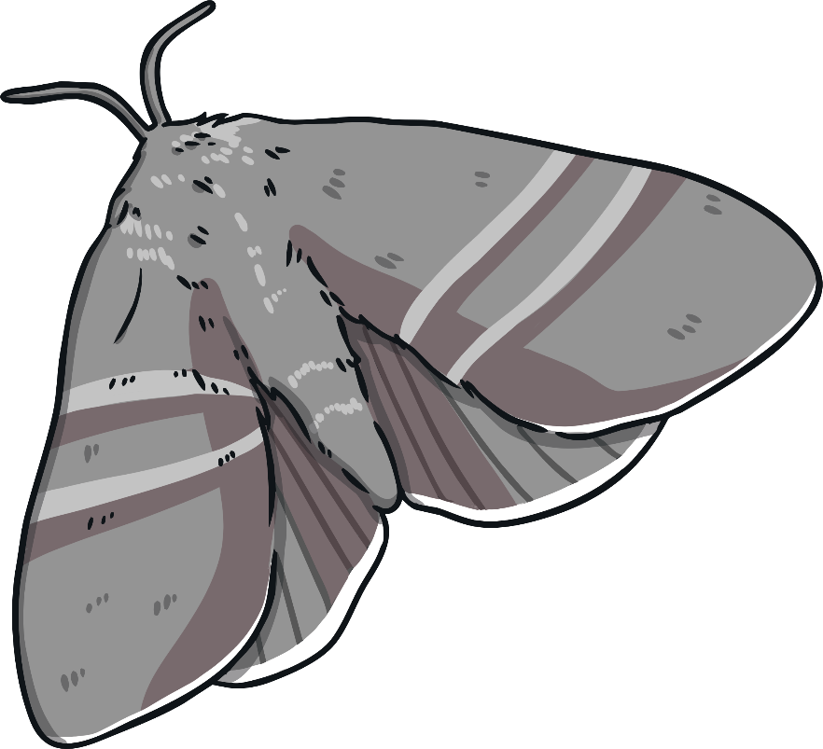
moth
moth
?
Next

Slide 45
ring
ring

Slide 46
sing
sing

Slide 47
song
song

Slide 48
wing
wing

Slide 49
ding
ding

Slide 50
dong
dong

Slide 51
ping
ping

Slide 52
thing
thing

Slide 53
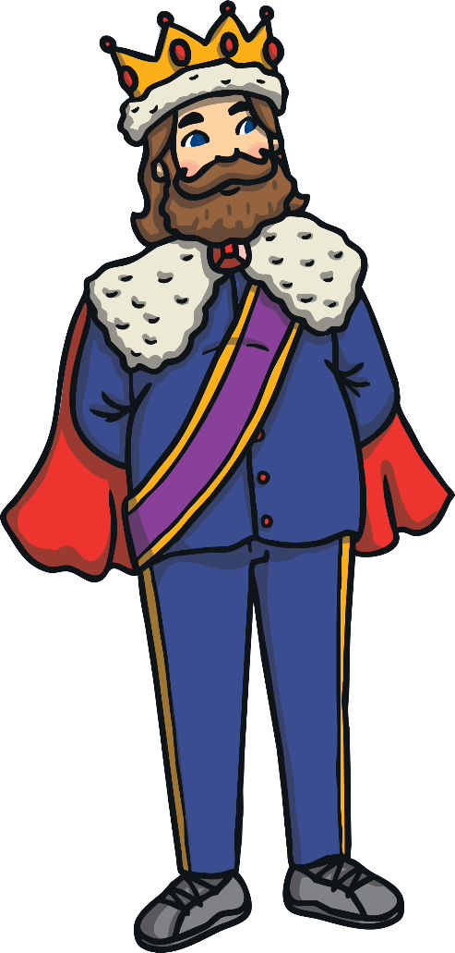
king
king
?
Next

Slide 55
no

Slide 56
Well Done!

