Slide 1
Phonics Recap

Slide 2
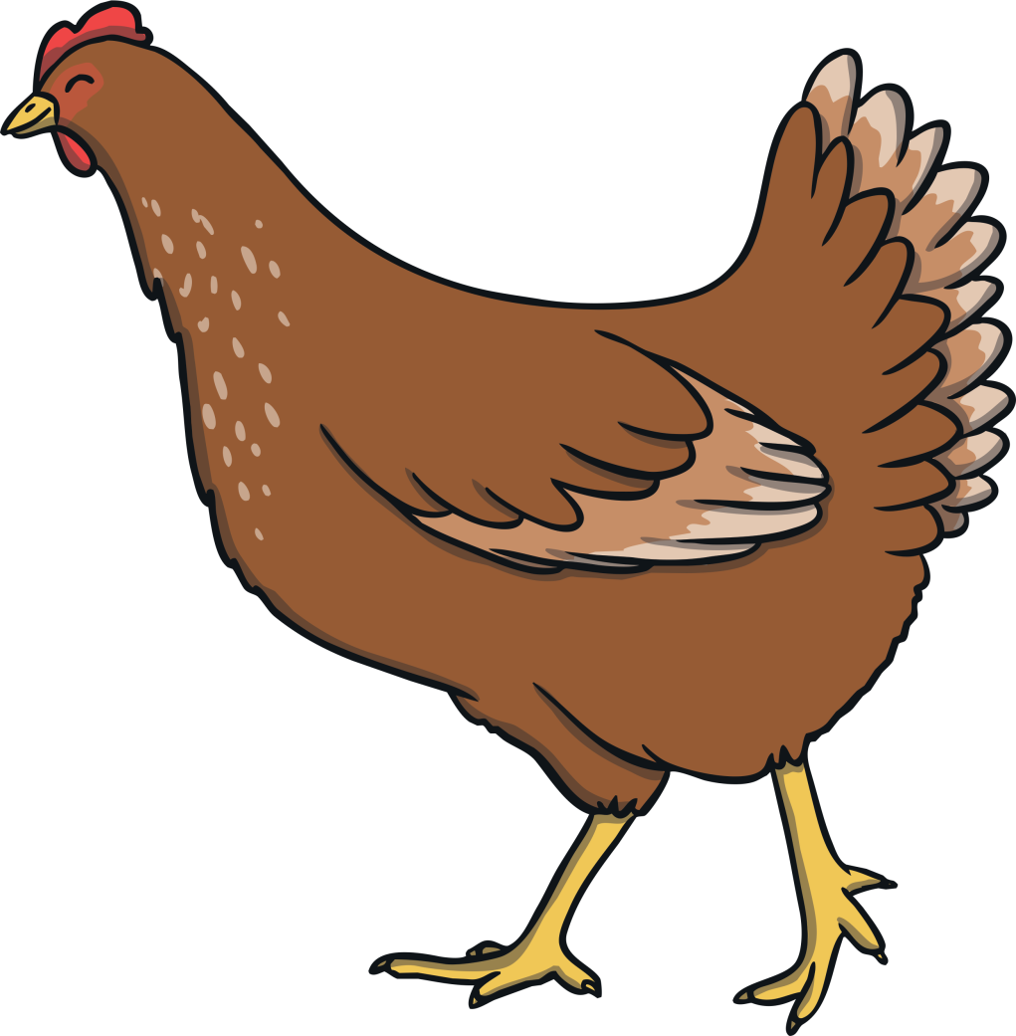
ch

Slide 3
sh

Slide 4
th

Slide 5
ng

Slide 6
ai

Slide 7
ee

Slide 8
igh

Slide 9
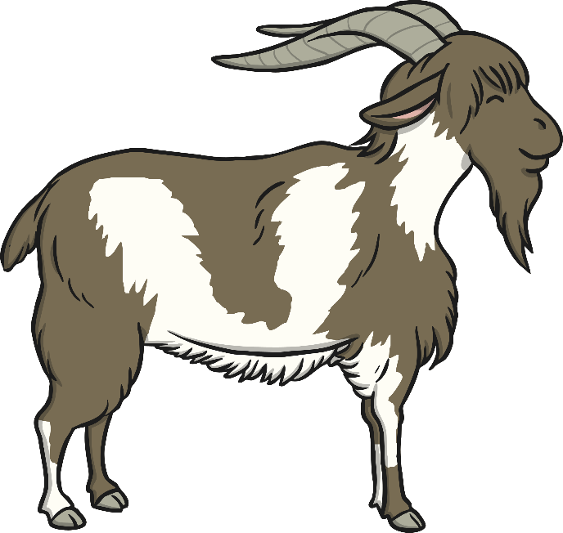
oa

Slide 10
oo

Slide 11
oo

Slide 12
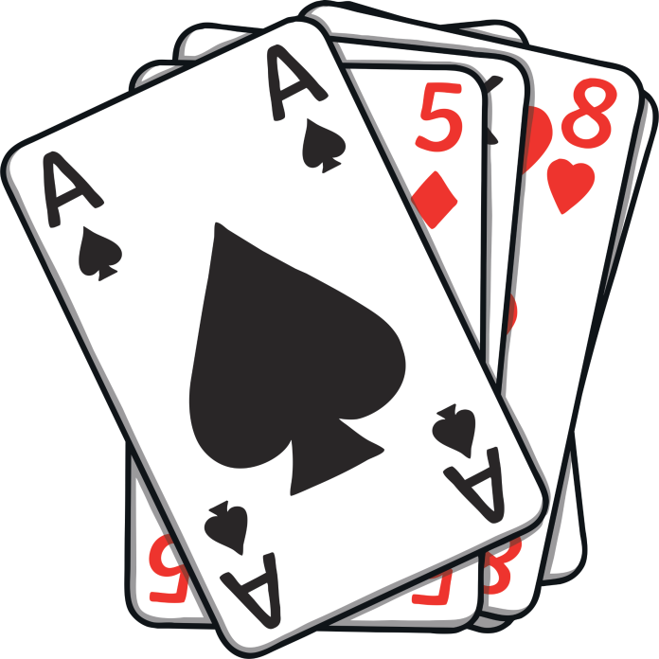
ar

Slide 13
or

Slide 14
ur

Slide 15
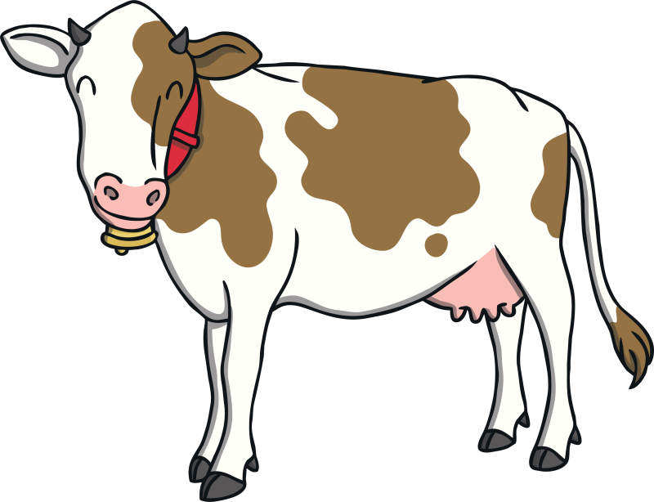
ow

Slide 16
oi

Slide 17
ear

Slide 18
er

Slide 19
air

Slide 20
the

Slide 21
to

Slide 22
I

Slide 23
no

Slide 24
go

Slide 25
into

Slide 26
he

Slide 27
she

Slide 28
we

Slide 29
me

Slide 30
be

Slide 31
was

Slide 32
you

Slide 33
they

Slide 34
all

Slide 35
are

Slide 36
my

Slide 37
her

Slide 39
oil
oil

Slide 40
soil
soil

Slide 41
boil
boil

Slide 42
foil
foil

Slide 43
join
join

Slide 44
coil
coil

Slide 45
coin
coin
?
Next

Slide 47
kerb
kerb

Slide 48
farmer
farmer

Slide 49
river
river

Slide 50
finger
finger

Slide 51
boxer
boxer

Slide 52
mixer
mixer

Slide 53
summer
summer

Slide 54
dinner
dinner

Slide 55
ladder
ladder

Slide 56
tower
tower

Slide 57
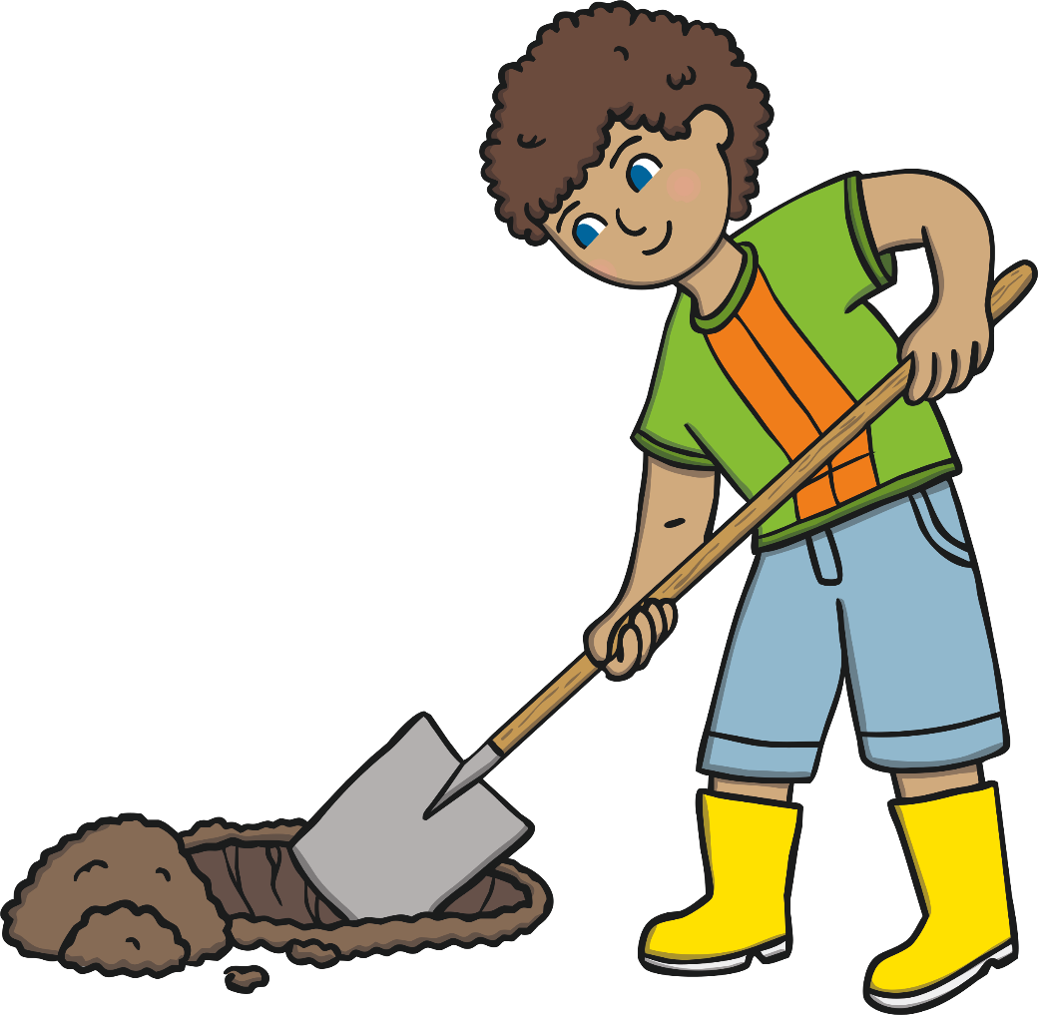
He is digging in the soil.

