Slide 1
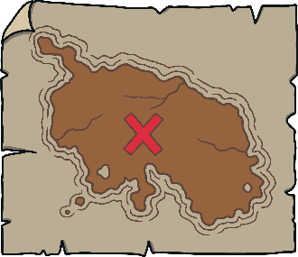
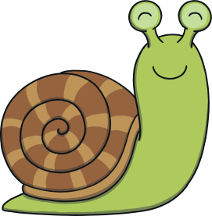
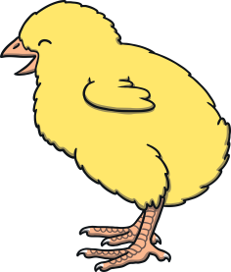
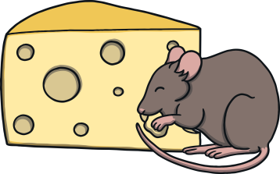
Revisit and Review
Let’s practise Sam’s Sounds and Tricky Words!
j
zz
oo
ar
oo
or
v
ch
ng
z
igh
y
qu
x
th
ai
ee
oa
w
th
sh
was
he
she
we
me
be
my

Slide 2
Today, we are learning…
urai

Slide 3
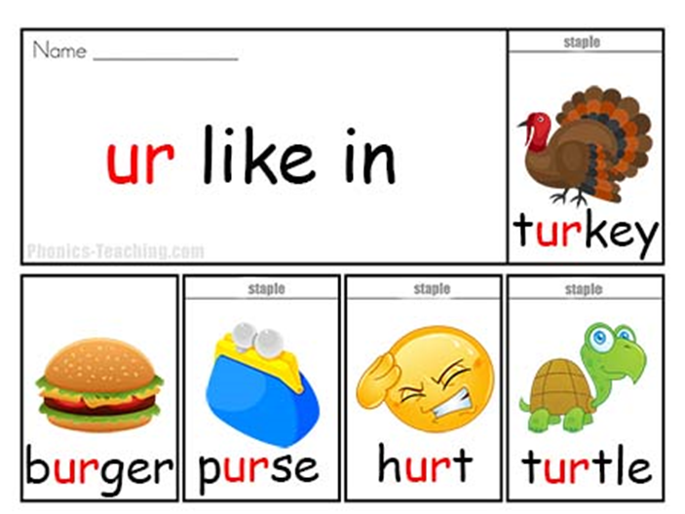
Jolly Phonics Song and action
Website link for all the songs – a-z order
https://vimeo.com/106231366
Action

Slide 4
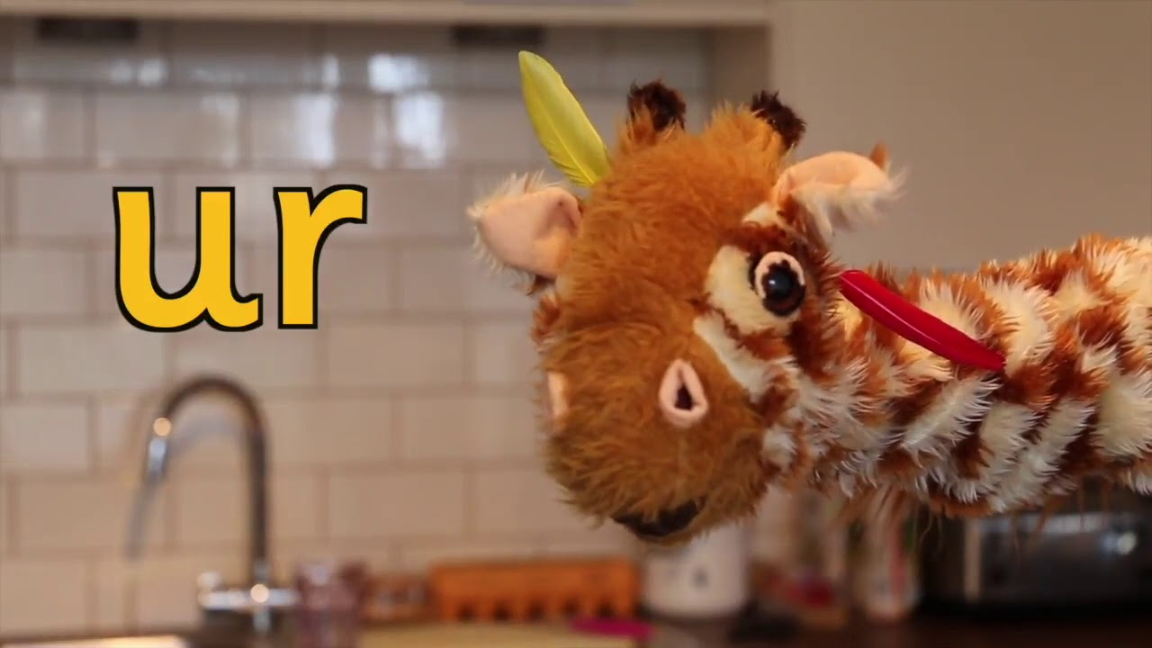
Let’s watch Geraldine the Giraffe tell us all about the sound ur
Copy and paste the link below
https://www.youtube.com/watch?v=0uVVJXbc870

Slide 5
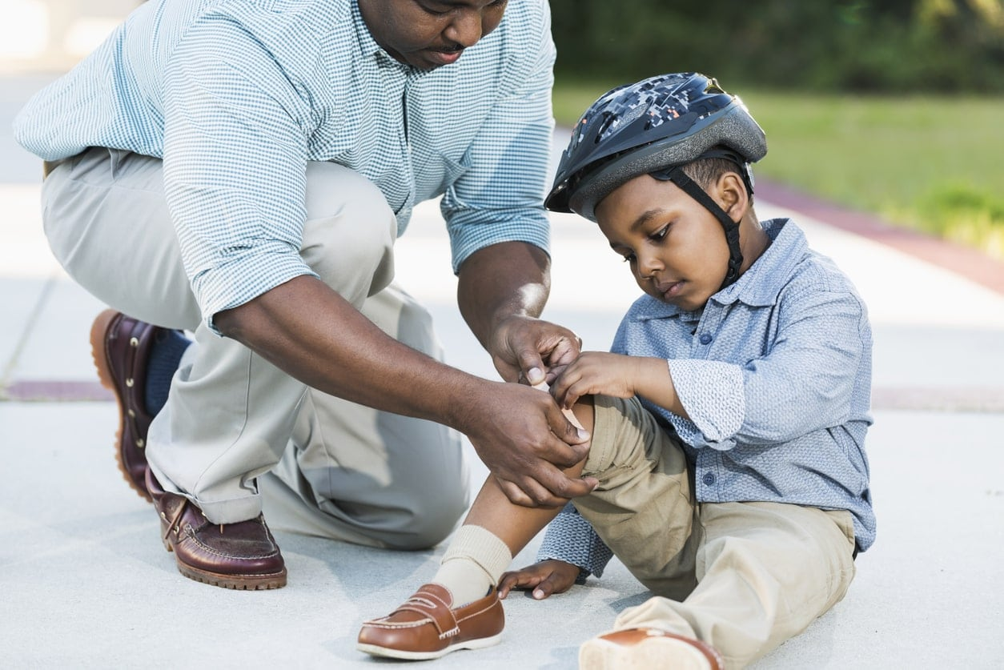
Can you think of anything that has the ur sound in it?

Slide 6
Spending Time
Practise
Sam is at the shop and she’s found some things she might spend her money on. Can you read the labels in the shop?

Slide 7
Practise
turnip
Show

Slide 8
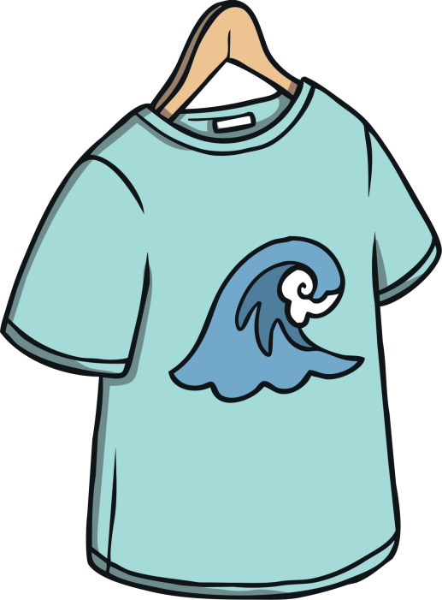
Practise
surf top
Show

Slide 9
Practise
Teah
urn
Show

Slide 10
Practise
fur coat
Show

Slide 11
Practise
turf
Show

Slide 12
Apply
Sentence Time
What happened when Sam threw the ball? Read the sentence then click ‘Show’ to reveal the answer!
X
Click ‘Sound Buttons On/Off’ to select whether you want to show sound buttons under the caption.
Click me for Kit’s teaching tips!

Slide 13
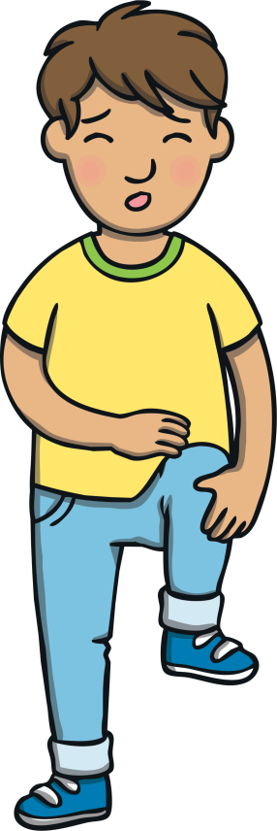
Apply
Kit got hurt on the foot.
Sound Buttons On/Off
Show

Slide 14
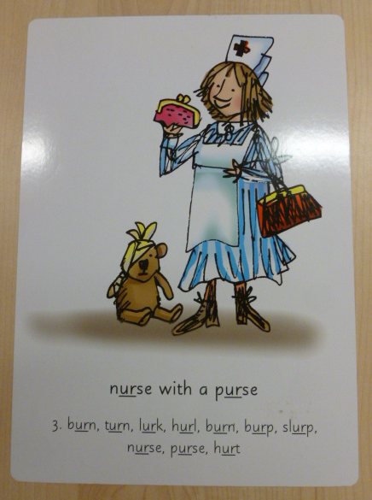
Can you try to write the sound ur?

Slide 15
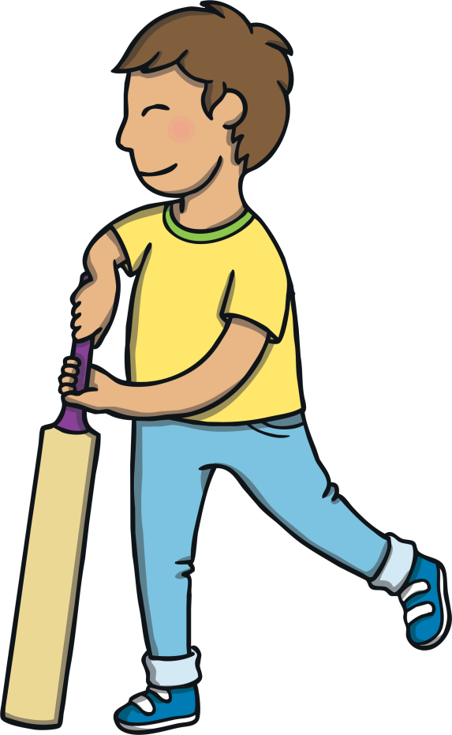
Today, we have learnt...
ur

