Slide 1
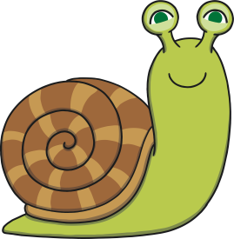
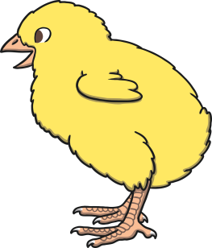
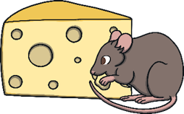
Revisit and Review
Let’s practise Sam’s Sounds and Tricky Words!
qu
zz
z
ai
x
th
ng
v
ar
w
j
y
oa
ch
ur
ee
ow
sh
oo
or
igh
you
my
be
was
we
he
she
me

Slide 2
Today, we are learning…
oi

Slide 3
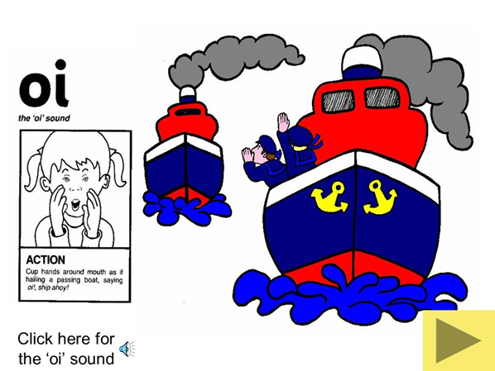
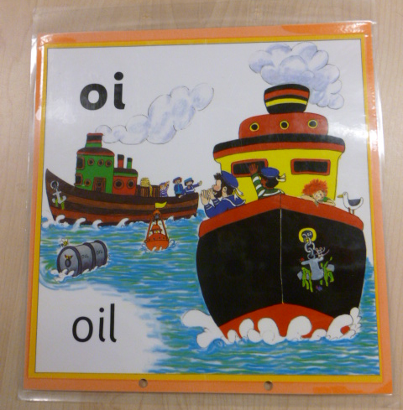
Jolly Phonics Song and action
Website link for all the songs – a-z order
https://vimeo.com/106231366
Action

Slide 4
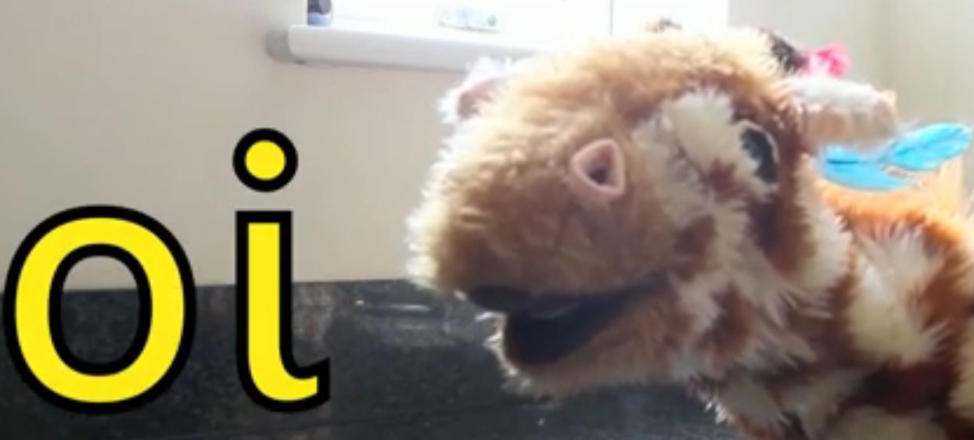
Let’s watch Geraldine the Giraffe tell us all about the sound oi
Copy and paste the link below
https://www.youtube.com/watch?v=IRTITdRL_cU

Slide 5
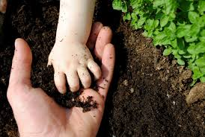
Can you think of anything that has the oi sound in it?

Slide 6
Coin Puzzle
Practise
As she looked through her purse, Sam realised that some of the oi words on her coins had rubbed away. Can you help Sam to work out what each word should say?
X
This is a great whiteboard activity!
Click me for Kit’s teaching tips!

Slide 7
Practise
b l
boil
Show Suggestion

Slide 8
Practise
s l
soil
Show Suggestion

Slide 9
Practise
tinf l
tinfoil
Show Suggestion

Slide 10
Practise
l
oil
Show Suggestion

Slide 11
Practise
c l
coil
Show Suggestion

Slide 12
Caption Time
Apply
What did Kit and Sam say to Gabi over the phone? Look at the picture and read the sentence to match.
X
Click ‘Sound Buttons On/Off’ to select whether you want to show sound buttons under the suggested sentence.
Click me for Kit’s teaching tips!

Slide 13
Caption Time
Apply
You can join in too.
Sound Buttons On/Off
Show

Slide 14
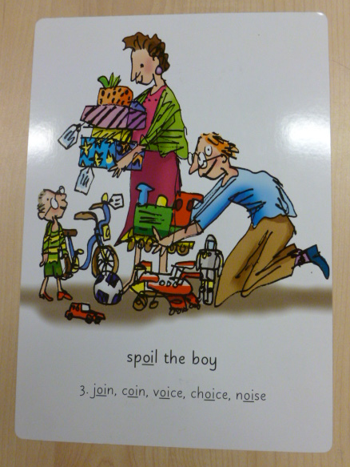
Can you try to write the sound oi?

Slide 15
Today, we have learnt...
oi

