Slide 1
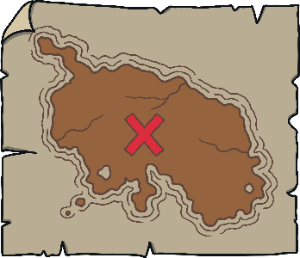
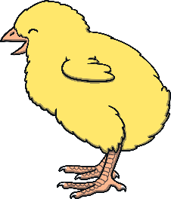
Revisit and Review
Let’s practise Sam’s Sounds and Tricky Words!
v
j
y
x
qu
ch
w
zz
z
ng
th
th
sh
be
me
she
we
he

Slide 2
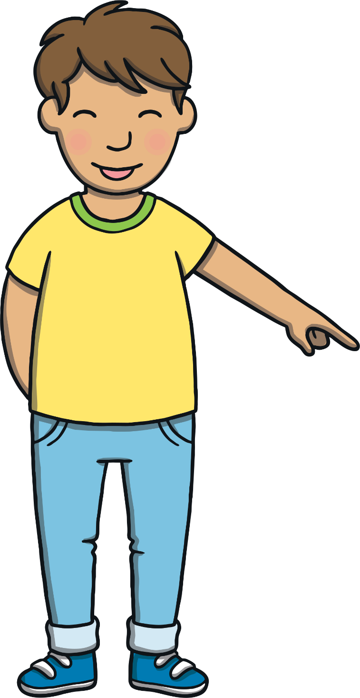
Today, we are learning…
ai

Slide 3
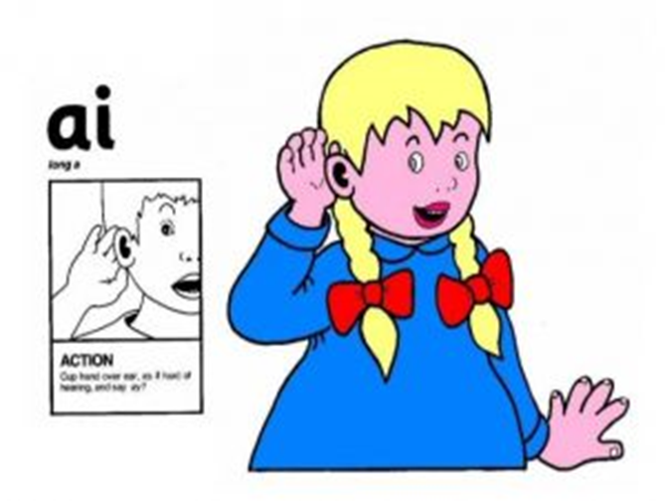
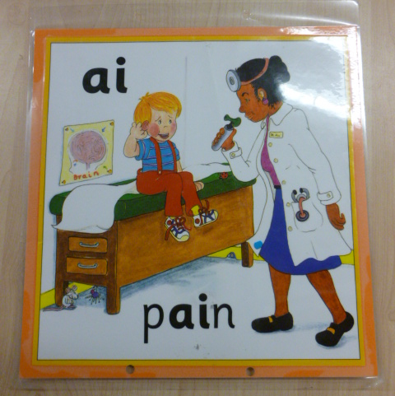
Jolly Phonics Song and action
Website link for all the songs – a-z order
https://vimeo.com/106231366
Action

Slide 4
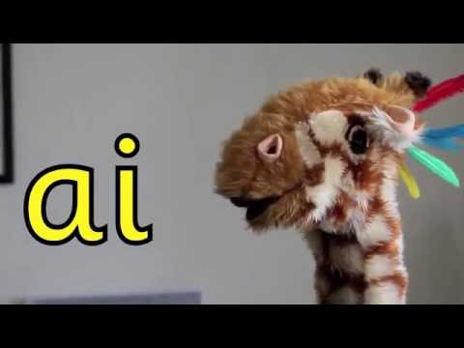
Let’s watch Geraldine the Giraffe tell us all about the sound ai
Copy and paste the link below
https://www.youtube.com/watch?v=LnXaN-CvR9s

Slide 5
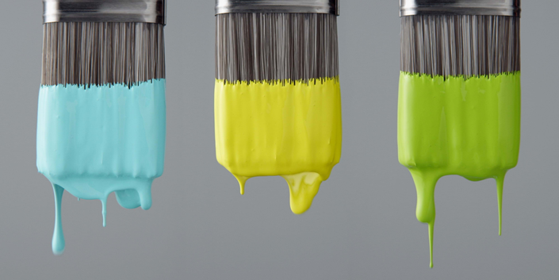
Can you think of anything that has the ai sound in it?

Slide 6
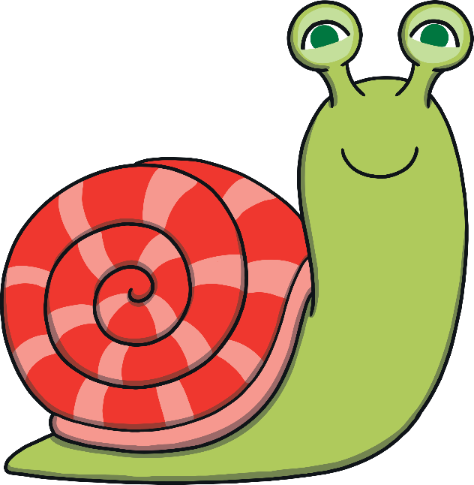
Snail Trails
Practise
Kit and Sam are looking at the snails in the garden. Their trails are making words! Can you read them?

Slide 7
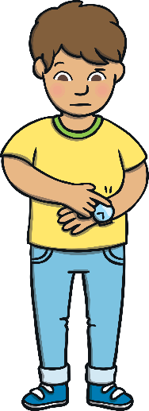
wait
Practise
Check

Slide 8
pain
Practise
Check

Slide 9
aim
Practise
Check

Slide 10
sail
Practise
Check

Slide 11
rain
Practise
Check

Slide 12
tail
Practise
Check

Slide 13
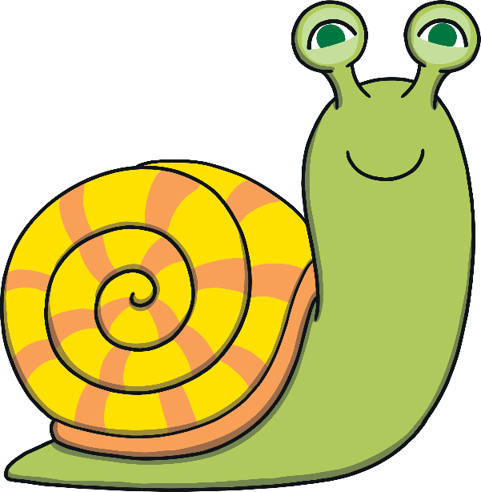
Sentence Time
Apply
Why do Kit and Sam need to be quick? Read the sentence then click ‘Show’ to reveal the answer!
X
Click ‘Sound Buttons On/Off’ to select whether you want to show sound buttons under the caption.
Click me for Kit’s teaching tips!

Slide 14
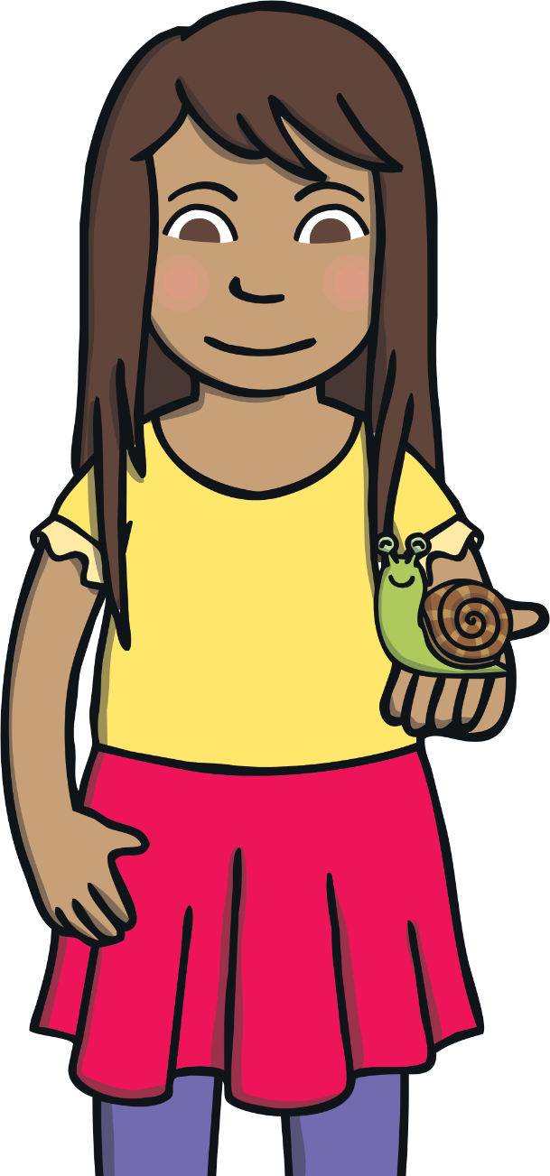
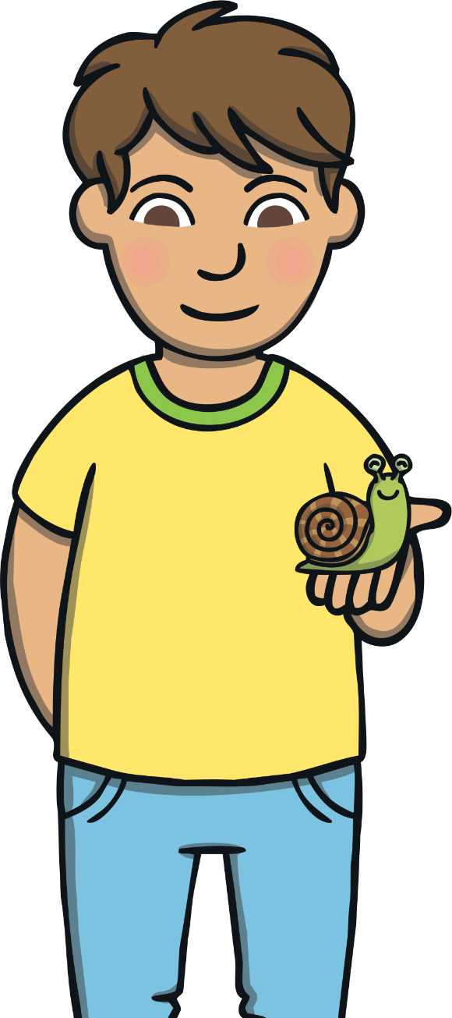
Apply
Kit and Sam got wet in the rain.
Sound Buttons On/Off
Show

Slide 15
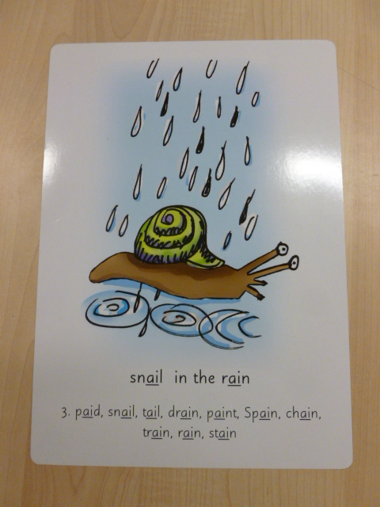
Can you try to write the sound ai?

Slide 16
Today, we have learnt…
ai

