Slide 1
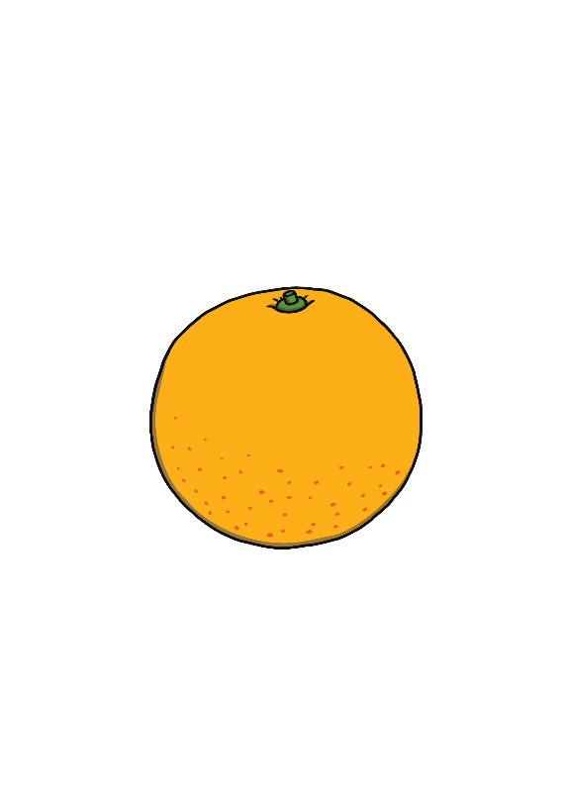
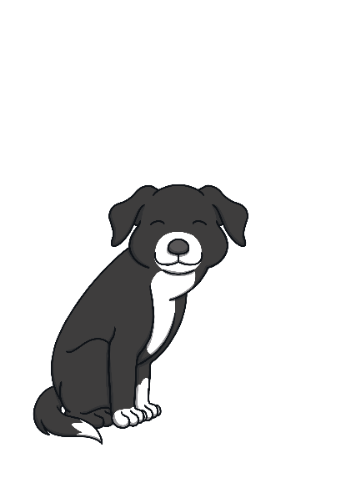
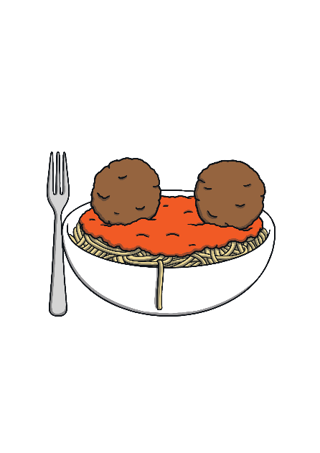
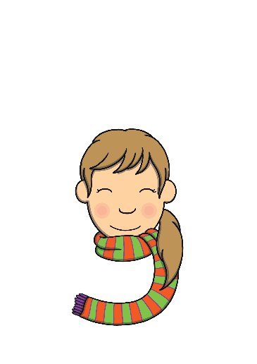
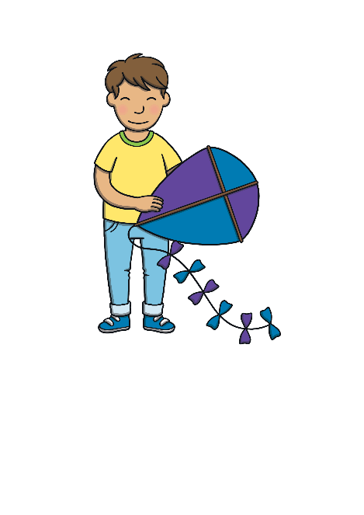
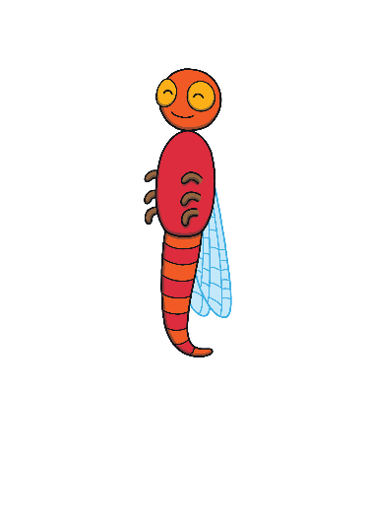
Revisit and Review
Let’s practise Sam’s Sounds and Tricky Words!
g
p
c
u
a
o
s
e
t
b
n
m
r
f
i
k
d
h
go
no
to
the
I

Slide 2
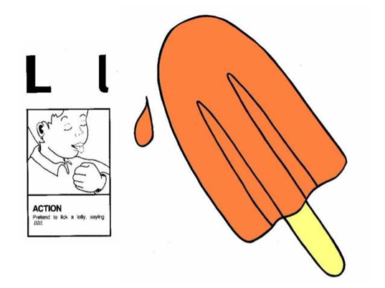
Jolly Phonics Song and action
Website link for all the songs – a-z order
https://vimeo.com/106231366
Action

Slide 3
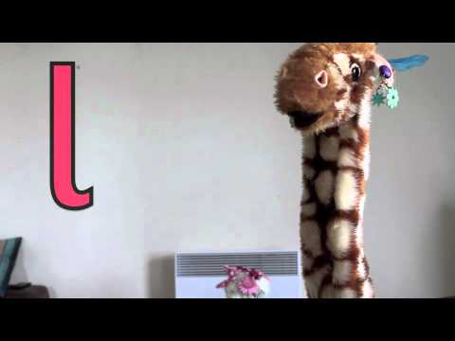
Let’s watch Geraldine the Giraffe tell us all about the sound l
Copy and paste the link below https://www.youtube.com/watch?v=sq-q2jzM78c

Slide 4
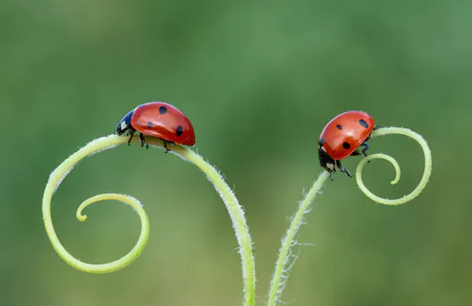
Can you think of anything that begins with the sound l?

Slide 5
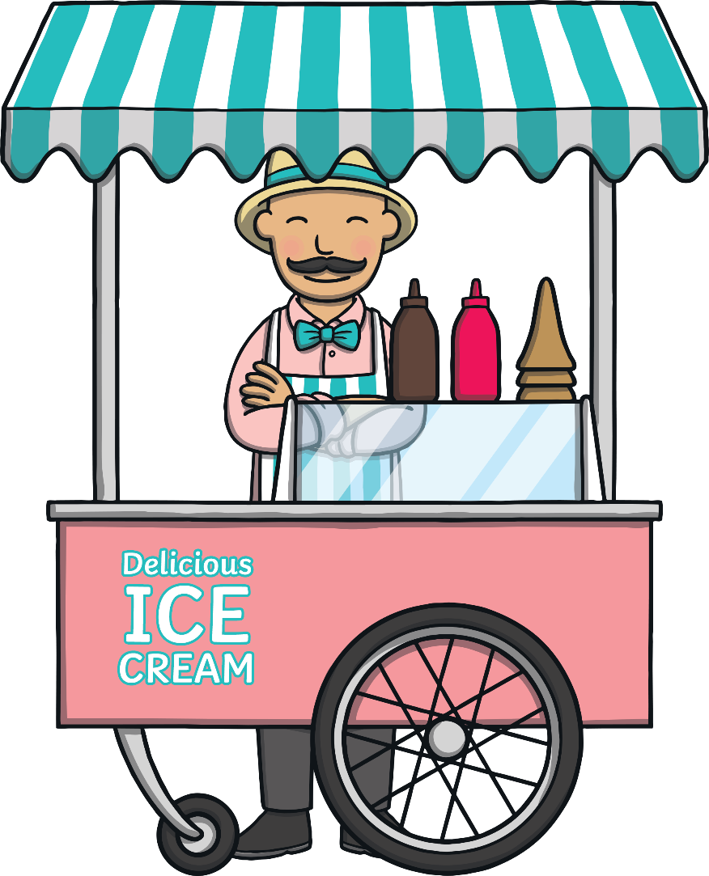
Ice Cream Sundae Maker
Practise
The man on the stall also sells ice cream sundaes. Listen to the word he says and then choose the right scoops to put into the bowl to spell the word.

Slide 6
Practise
ll
i
d
e
l
g
o

Slide 7
Practise

Slide 8
Practise
t
g
b
l
p
a
ll

Slide 9
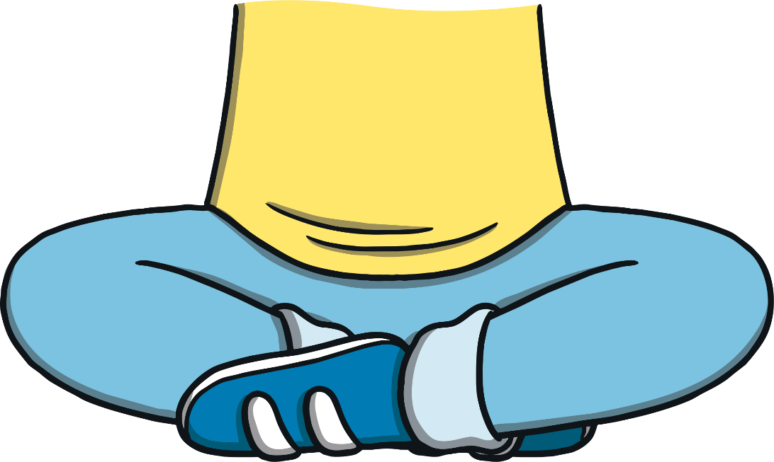
Practise

Slide 10
Practise
l
a
g
b
p
i
t

Slide 11
Practise

Slide 12
Practise
l
s
b
ll
a
i
e

Slide 13
Practise

Slide 14
Practise
l
d
o
s
a
ll
b

Slide 15
Practise

Slide 16
Practise
i
b
e
p
t
s
ll

Slide 17
Practise

Slide 18
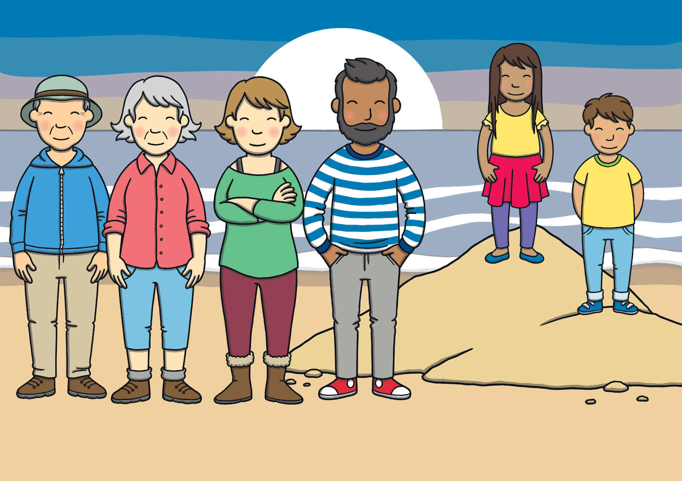
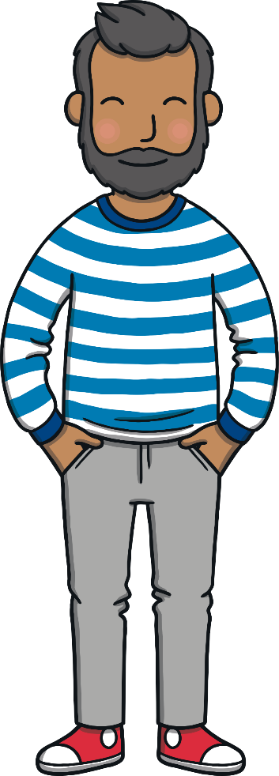
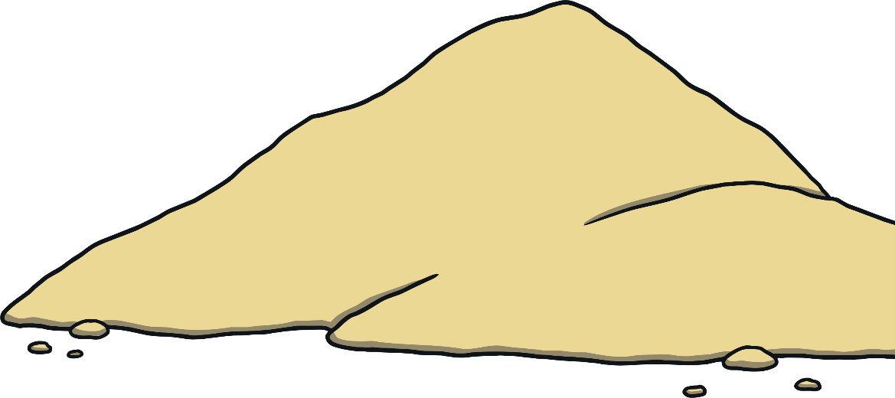
Apply
to the top of the hill
Sound Buttons On/Off
Show

Slide 19
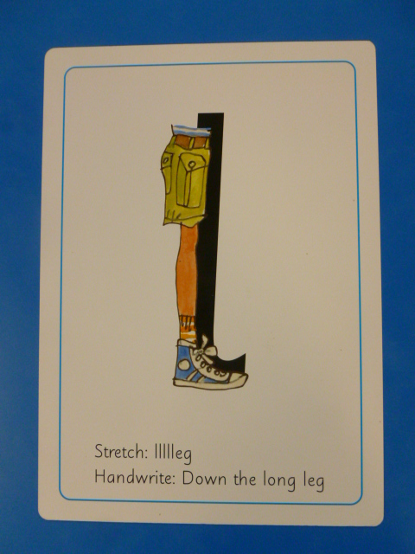
Can you try to write the sound l?

Slide 20
Today, we have learnt…
l,ll

