Slide 1
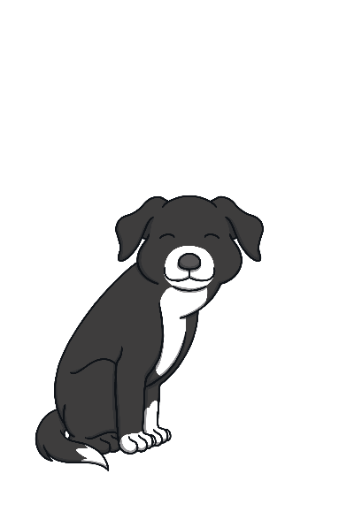
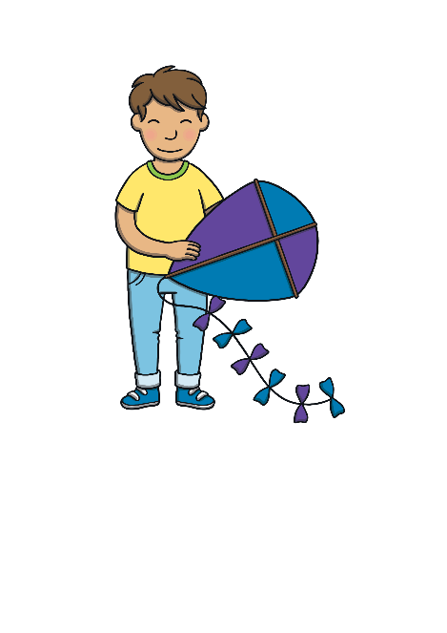
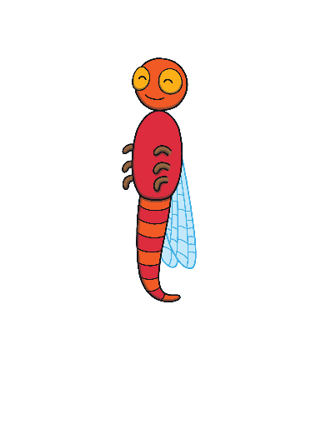
Revisit and Review
Let’s practise Sam’s Sounds and Tricky Words!
g
p
c
u
a
o
s
e
t
n
m
r
i
k
d
to
the

Slide 2
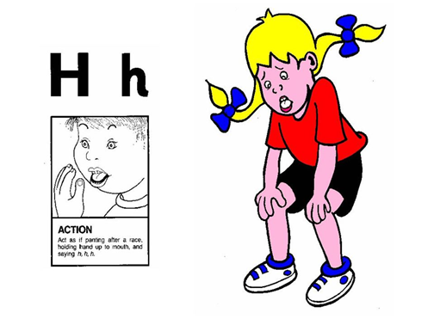
Jolly Phonics Song and action
Website link for all the songs – a-z order
https://vimeo.com/106231366
Action

Slide 3
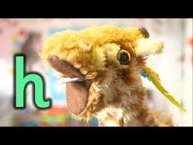
Let’s watch Geraldine the Giraffe tell us all about the sound h
Copy and paste the link below
https://www.youtube.com/watch?v=Oiu_YmW_Efk

Slide 4
Can you think of anything that begins with the sound h?

Slide 5
What’s in the House?
Teach
Kit and Sam are exploring Gran and Grandad’s new house. Read the word on the door to discover what is in each room!

Slide 6
Teach
hot

Slide 7
Teach

Slide 8
Teach
hut

Slide 9
Teach

Slide 10
Teach
hop

Slide 11
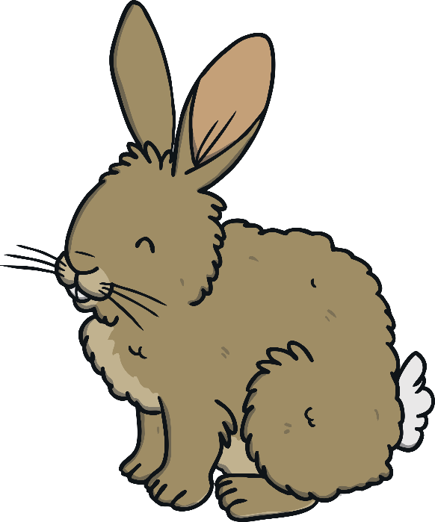
Teach

Slide 12
Teach
hit

Slide 13
Teach

Slide 14
Caption Time
Apply
What has Grandad got to show Kit and Sam? Read the caption, then click ‘Show’ to reveal the answer!
Click ‘Sound Buttons On/Off’ to select whether you want show sound buttons under the caption.
X
Click me for Kit’s teaching tips!

Slide 15
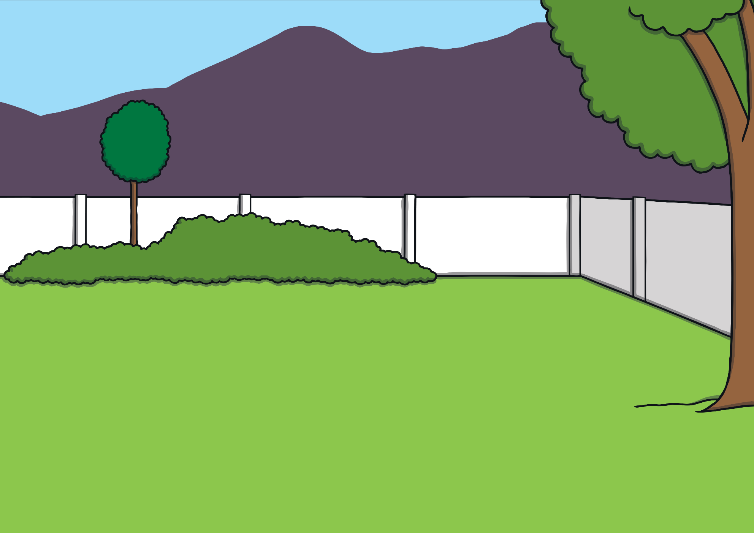
Apply
Go to the log hut.
Sound Buttons On/Off
Show

Slide 16
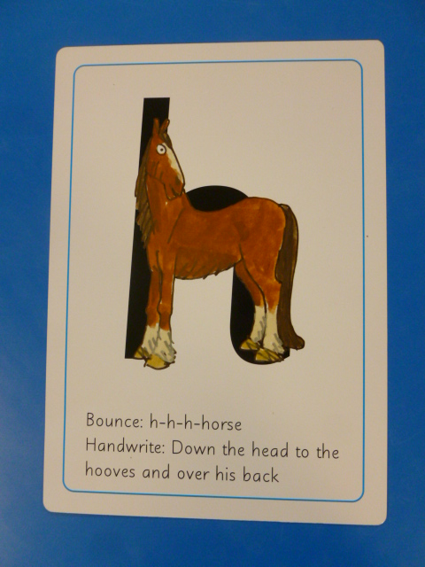
Can you try to write the sound h?

Slide 17
Today, we have learnt…
h

