Slide 1
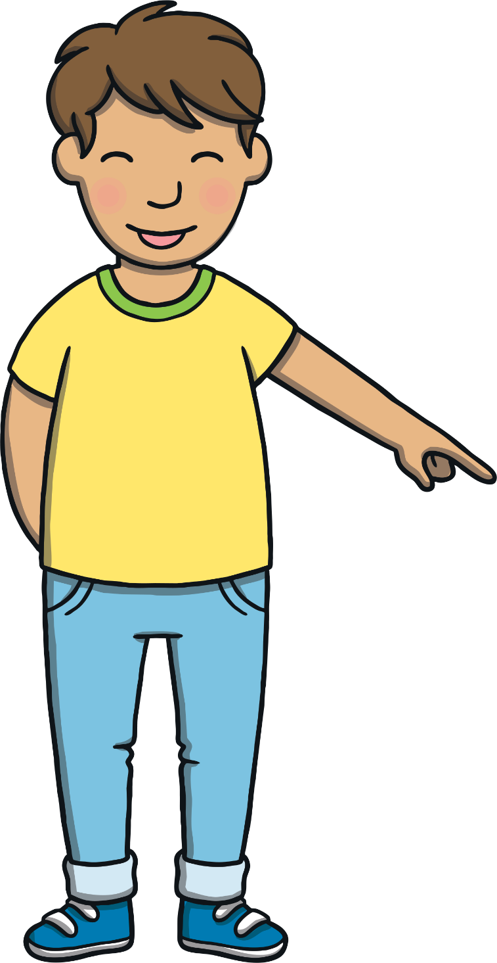
Today, we are learning…
s

Slide 2
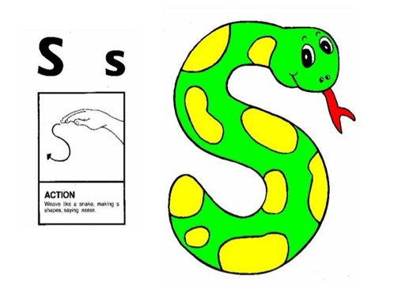
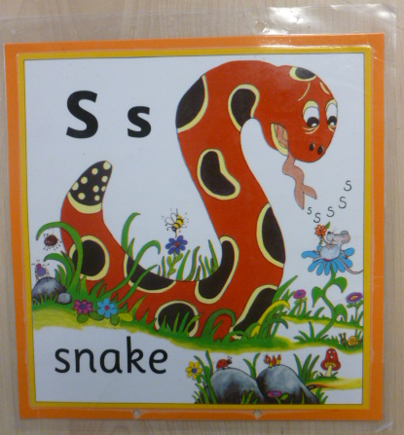
Jolly Phonics Song and action
Website link for all the songs – a-z order
https://vimeo.com/106231366
Action

Slide 3
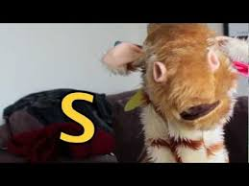
Let’s watch Geraldine the Giraffe tell us all about the sound s
Copy and paste the link below
https://www.youtube.com/watch?v=sUmUpf-JNoU

Slide 4
Can you think of anything that begins with the sound s?

Slide 5
Apply
Play

Slide 6
s
u
n

Slide 7
s
a
d

Slide 8
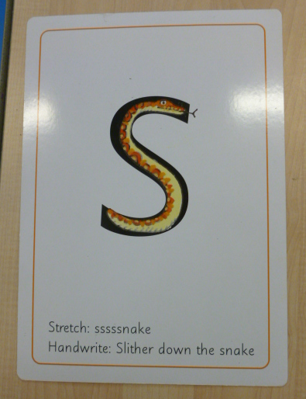
Can you try to write the sound s?

Slide 9
Today, we have learnt…
s

