Slide 1
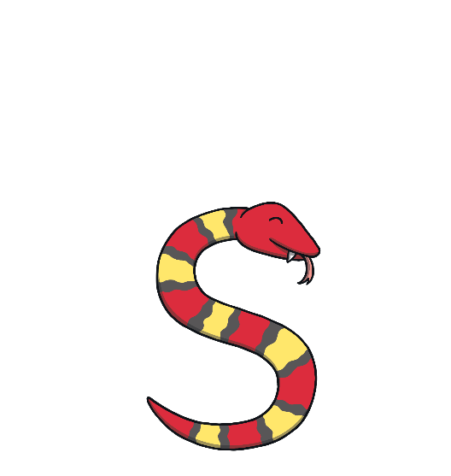
Revisit and Review
Let’s practise Sam’s Sounds!
g
p
n
a
s
t
m
d
i

Slide 2
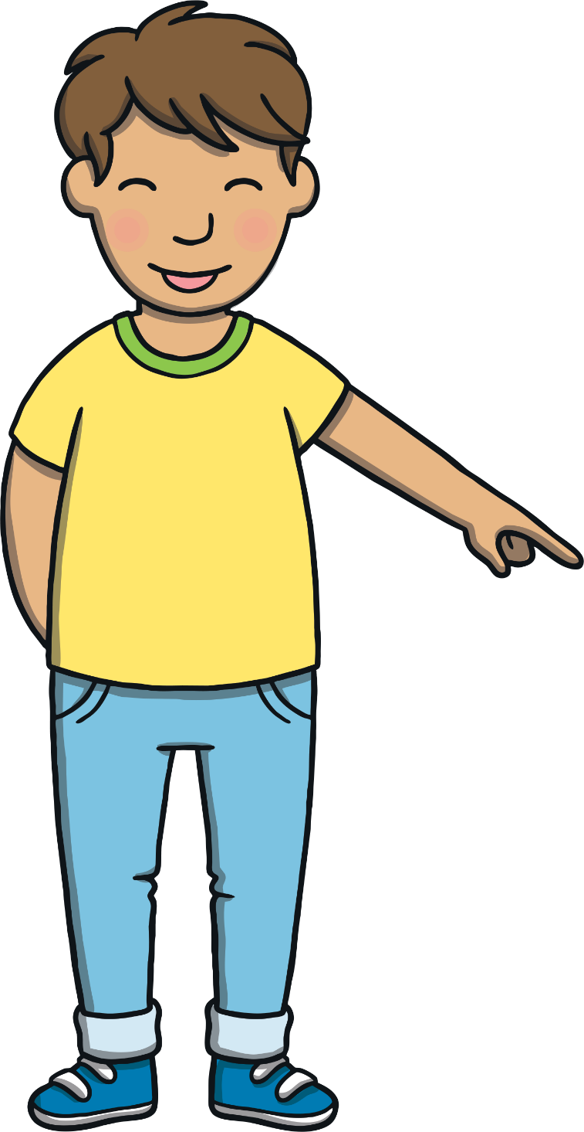
Today, we are learning…
oa

Slide 3
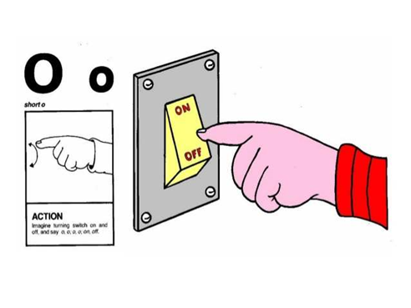
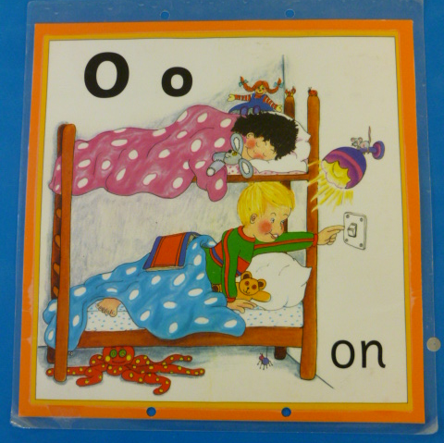
Jolly Phonics Song and action
Website link for all the songs – a-z order
https://vimeo.com/106231366
Action

Slide 4
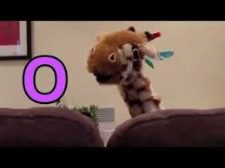
Let’s watch Geraldine the Giraffe tell us all about the sound o
Copy and paste the link below
https://www.youtube.com/watch?v=YIQQo9eYVqk

Slide 5
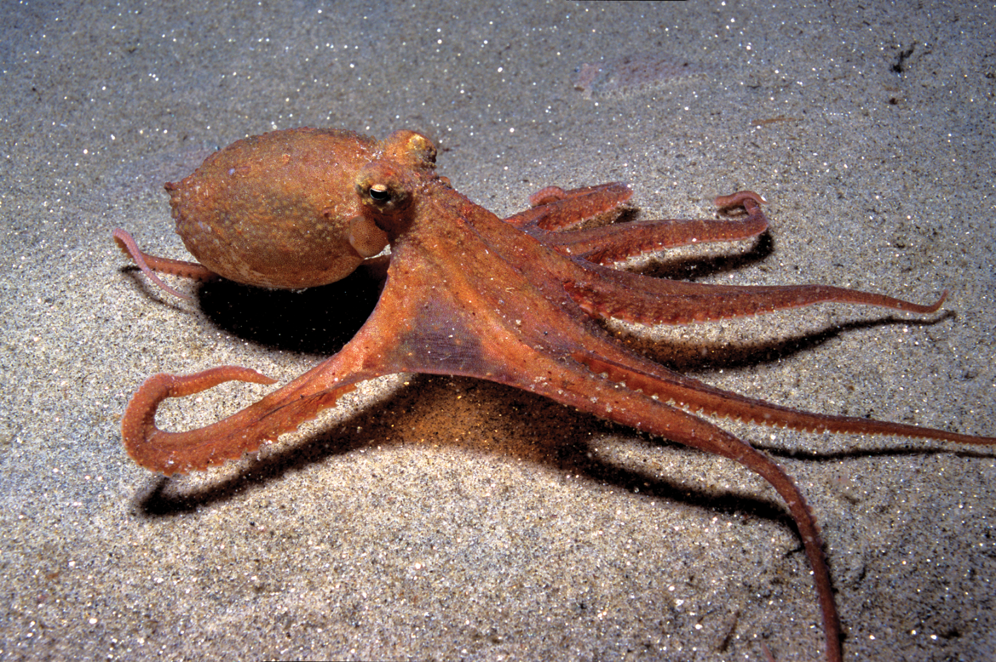
Can you think of anything that begins with the sound o?

Slide 6
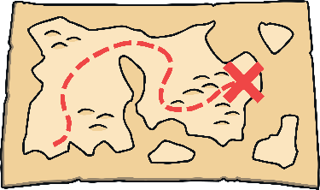
Which Picture?
Revisit and Review
Which picture matches the word that Sam’s robot is saying?

Slide 7
Orange Pips
Practise
Kit and Dad are squeezing oranges. Oops, the pips have fallen on to Kit’s book. Can you use the orange pips to help you sound out the words?
X
Today, we are using pips as sound buttons to help the children blend words!
Click me for Kit’s teaching tips!

Slide 8
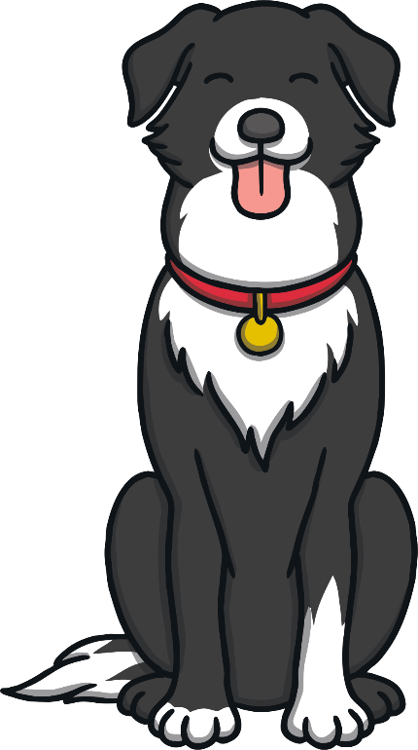
Practise
dog
Check

Slide 9
Practise
pot
Check

Slide 10
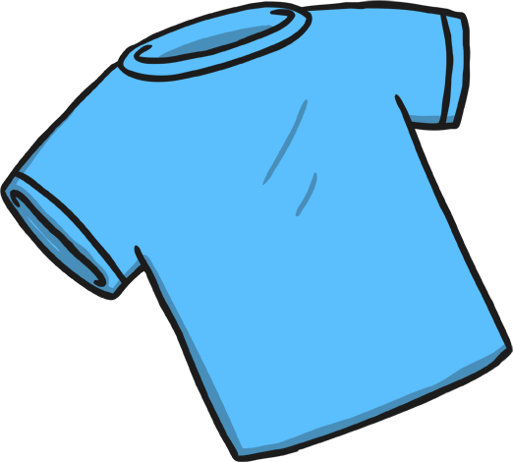
Practise
top
Check

Slide 11
Practise
pop
Check

Slide 12
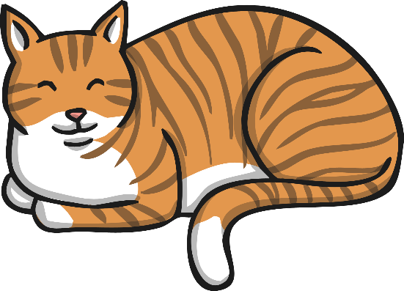
Practise
mog
Check

Slide 13
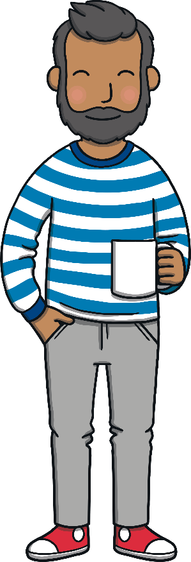
Caption Time
Apply
Dad and Kit are having lots of fun making orange juice. Read the caption then click ‘Show’ to reveal what they are using in the kitchen!
X
Click ‘Sound Buttons On/Off’ to select whether you want to show sound buttons under the caption.
Click me for Kit’s teaching tips!

Slide 14
Apply
pots and pans
Sound Buttons On/Off
Show

Slide 15
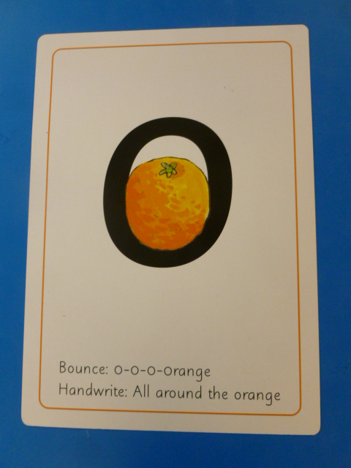
Can you try to write the sound o?

Slide 16
Today, we have learnt…
o

