Slide 1
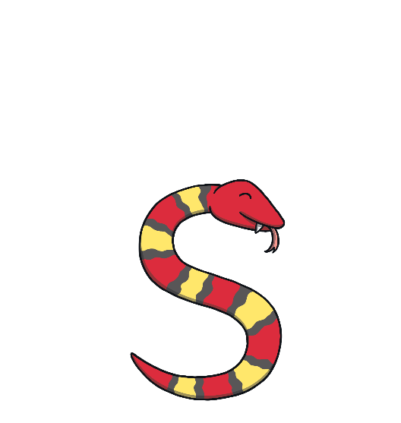
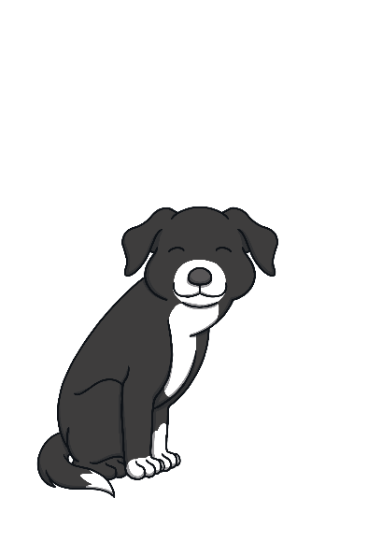
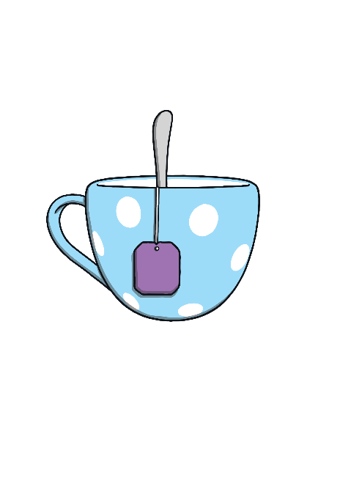
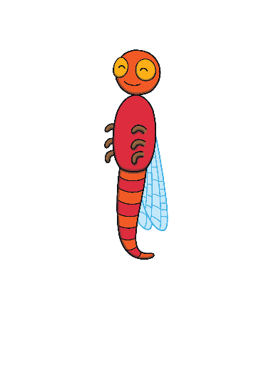
Revisit and Review
Let’s practise Sam’s Sounds!
p
a
s
t
i

Slide 2
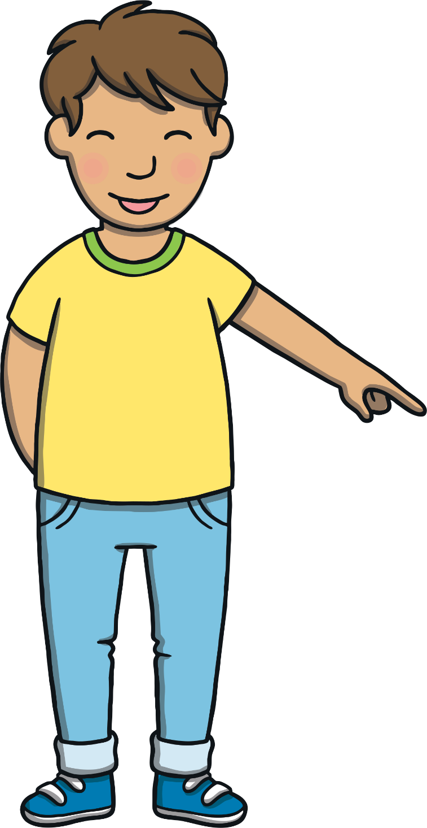
Today, we are learning…
n

Slide 3
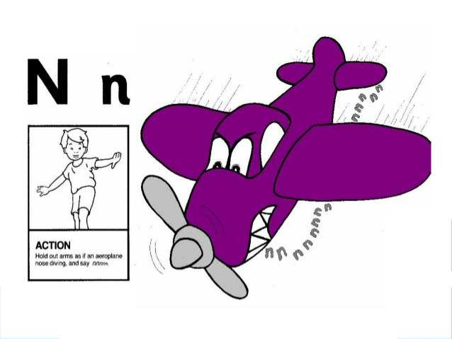
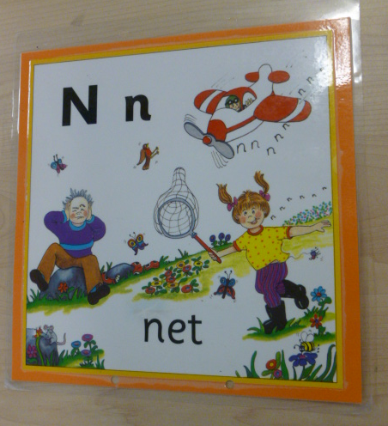
Jolly Phonics Song and action
Website link for all the songs – a-z order
https://vimeo.com/106231366
Action

Slide 4
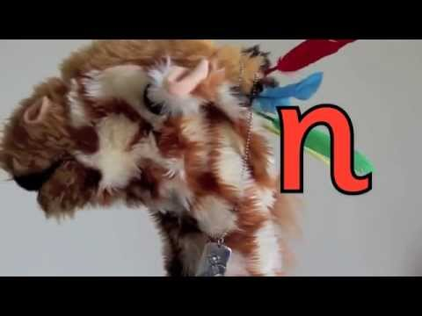
Let’s watch Geraldine the Giraffe tell us all about the sound n
Copy and paste the link below
https://www.youtube.com/watch?v=IQsCAyq-axU

Slide 5
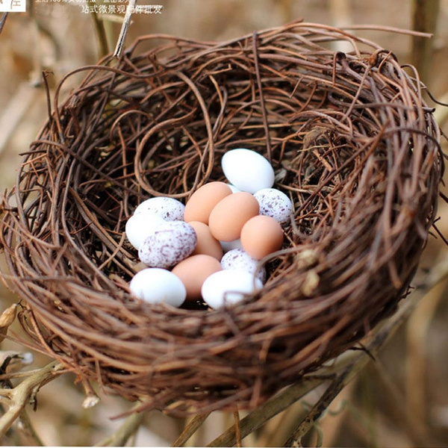
Can you think of anything that begins with the sound n?

Slide 6
Nut Sound Buttons
Practise
Click on the sound buttons to read the n words.
n
a
p
X
Sound buttons help children to differentiate between the separate phonemes in words.
Click me for Kit’s teaching tips!

Slide 7
Nut Sound Buttons
Practise
Click on the sound buttons to read the n words.
p
n
i

Slide 8
Nut Sound Buttons
Practise
Click on the sound buttons to read the n words.
a
n

Slide 9
Nut Sound Buttons
Practise
Click on the sound buttons to read the n words.
n
p
i

Slide 10
Nut Sound Buttons
Practise
Click on the sound buttons to read the n words.
n
i

Slide 11
Nut Sound Buttons
Practise
Click on the sound buttons to read the n words.
p
a
n

Slide 12
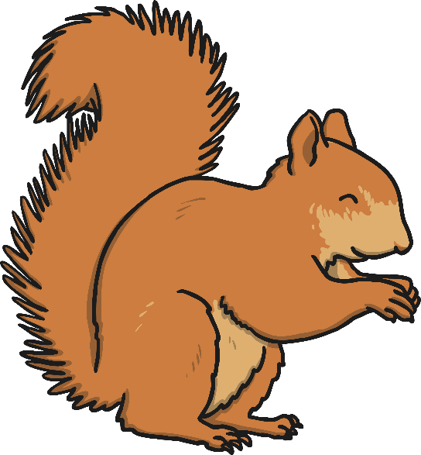
Apply
I am collecting nuts too!
I put the real word nuts in the nest and throw the others away!

Slide 13
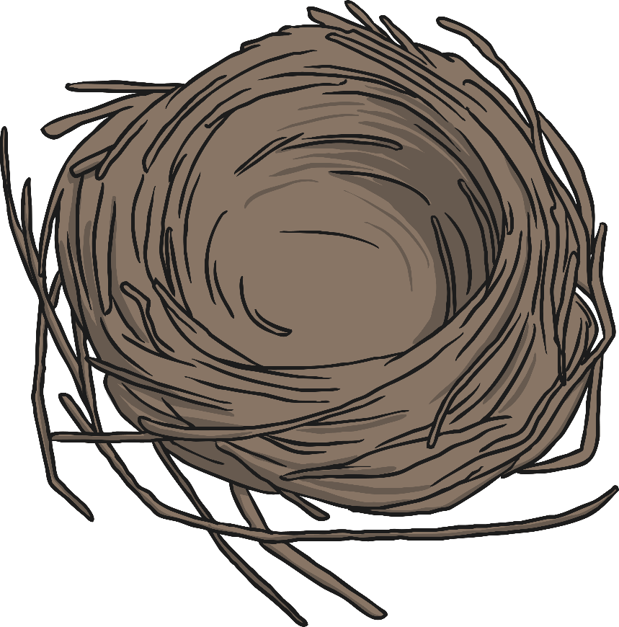
Apply
Thank you for helping me to collect the right acorns!
nap
pin
an
nas
san
nip
tan
ip

Slide 14
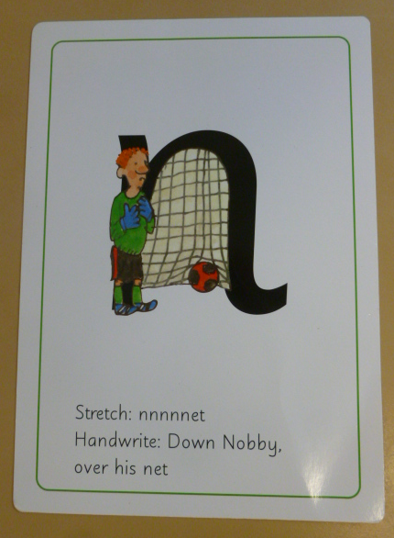
Can you try to write the sound n?

Slide 15
Today, we have learnt…
n

