Slide 1
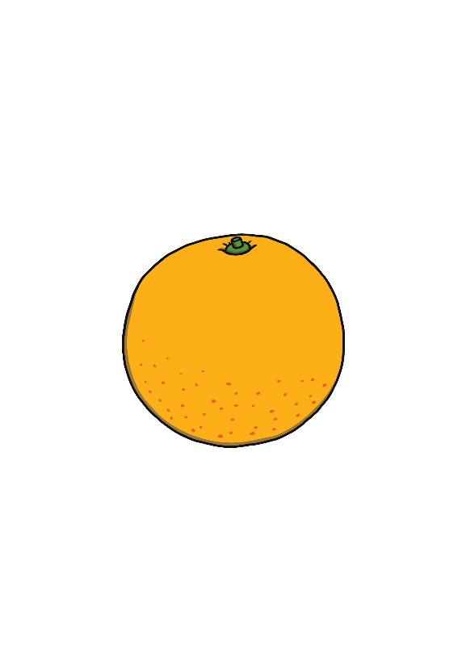
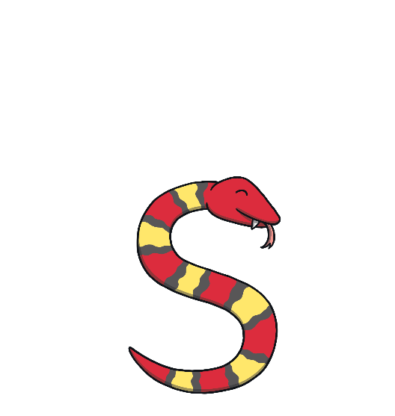
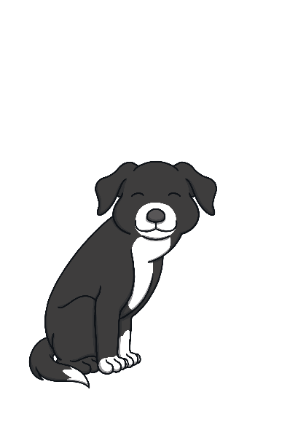
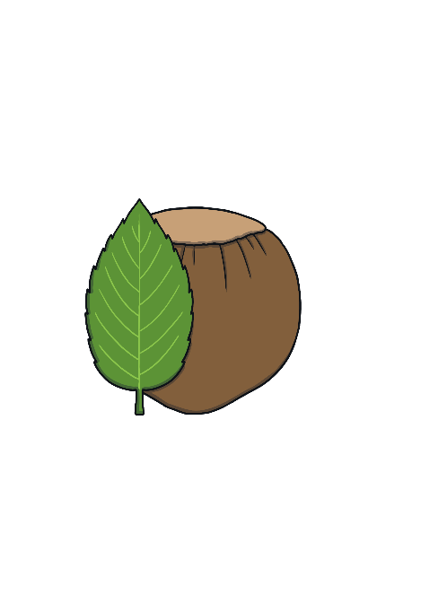
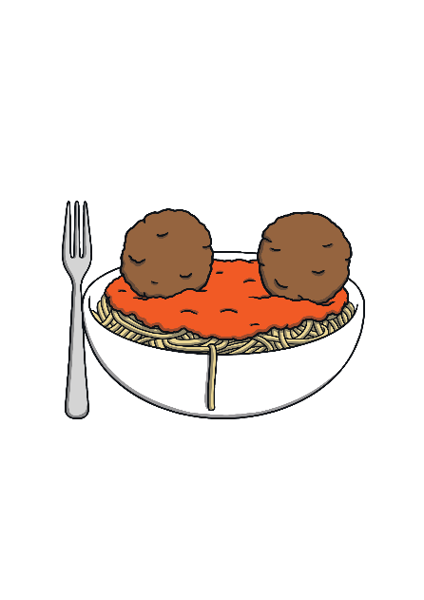
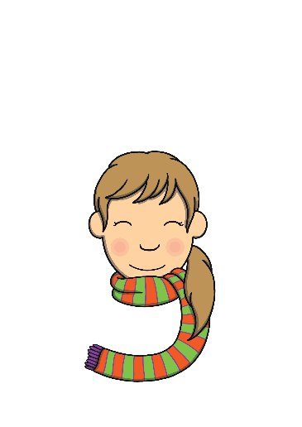
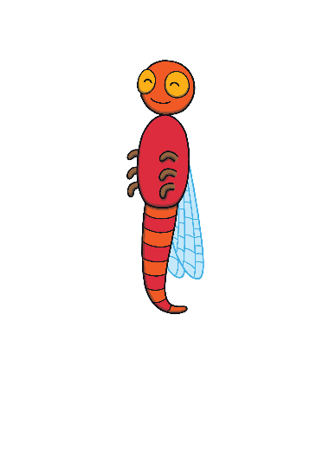
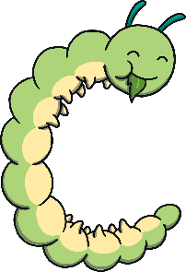
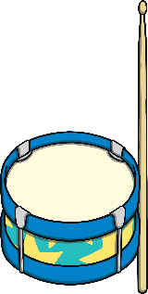
Revisit and Review
Let’s practise Sam’s Sounds!
g
p
c
a
o
s
t
n
m
i
d

Slide 2
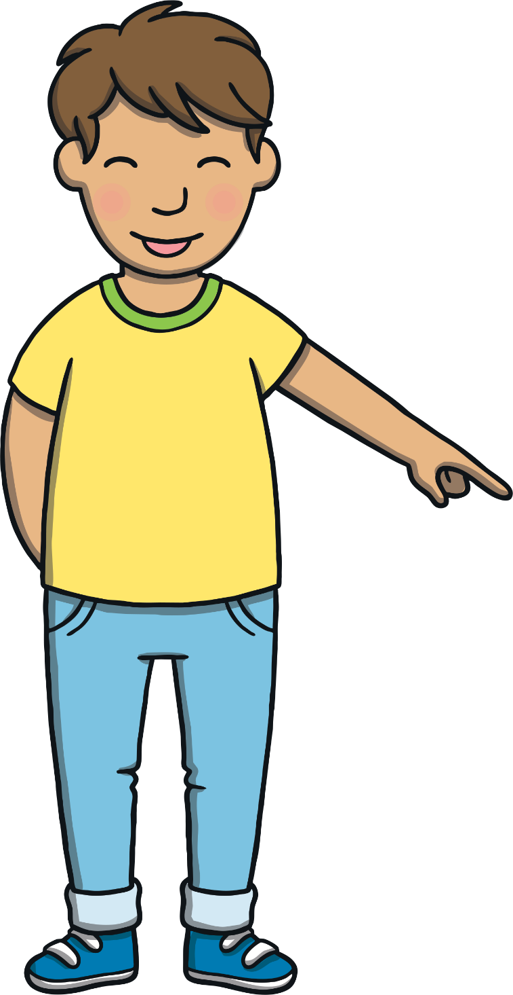
Today, we are learning…
k

Slide 3
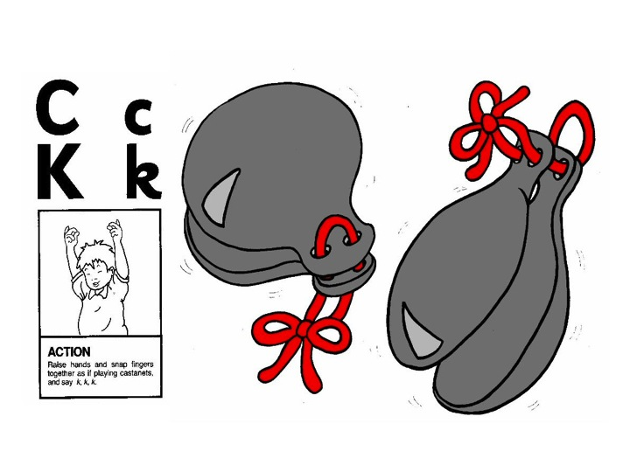
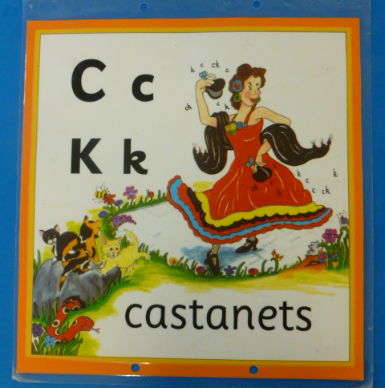
Jolly Phonics Song and action
Website link for all the songs – a-z order
https://vimeo.com/106231366
Action

Slide 4
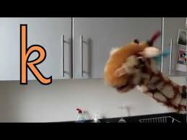
Let’s watch Geraldine the Giraffe tell us all about the sound k
Copy and paste the link below
https://www.youtube.com/watch?v=VE9ZYKGFx68

Slide 5
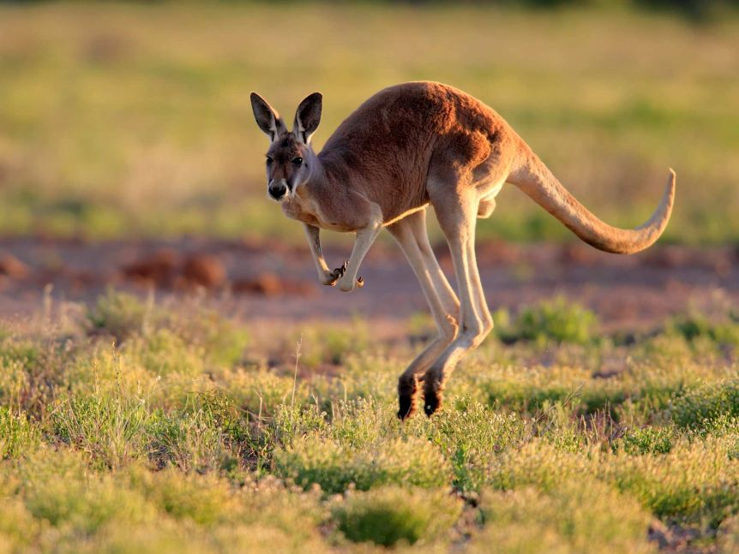
Can you think of anything that begins with the sound k?

Slide 6
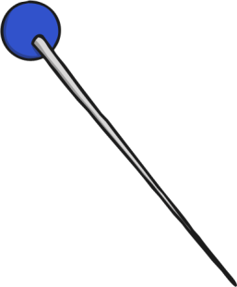
Robot Talk Time
Revisit and Review
Can you ‘robot talk’ each picture below?

Slide 7
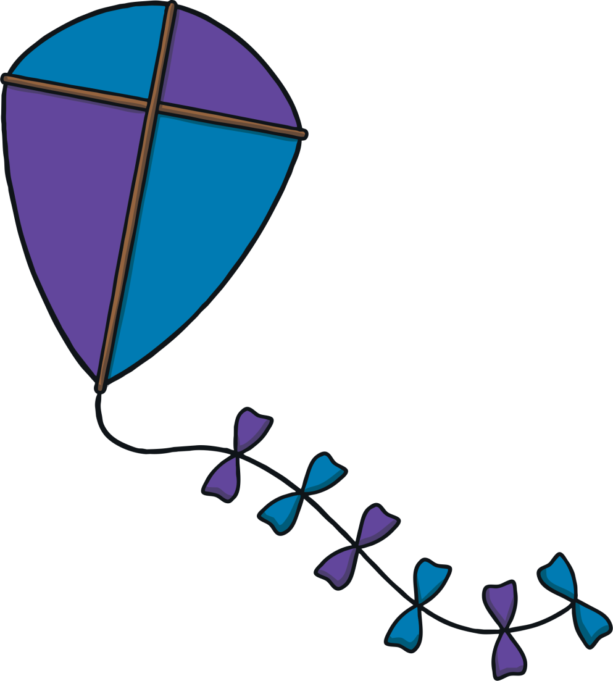
Kites in the Sky
Practise
There are lots of kites flying in the sky. Can you choose the correct kites to make a word that matches the picture?
You can make this activity easier by asking children to suggest only the first or last sound.
X
Click me for Kit’s teaching tips!

Slide 8
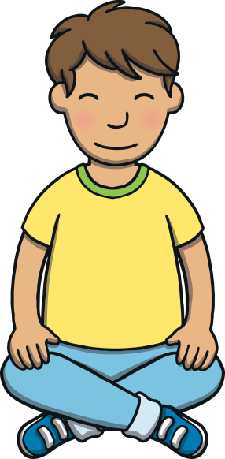
Practise
a
t
p
i
g
d
o
c
k

Slide 9
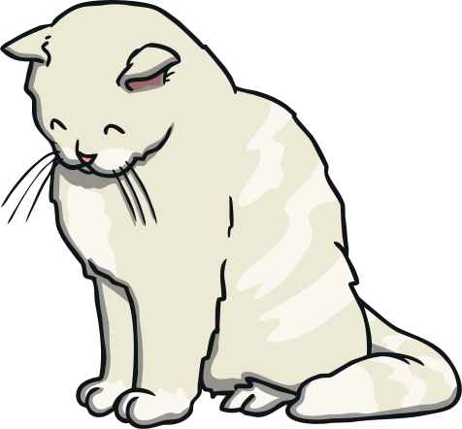
Practise
a
t
p
i
g
d
o
c
k

Slide 10
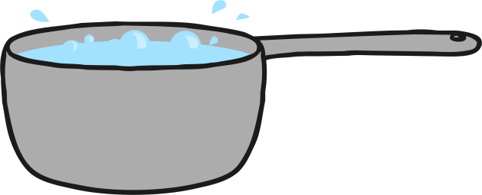
Practise
a
t
p
i
g
d
o
c
k

Slide 11
Practise
i
t
p
a
g
d
o
c
k

Slide 12
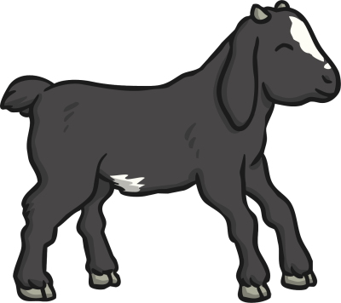
Practise
i
t
p
a
g
d
o
c
k

Slide 13
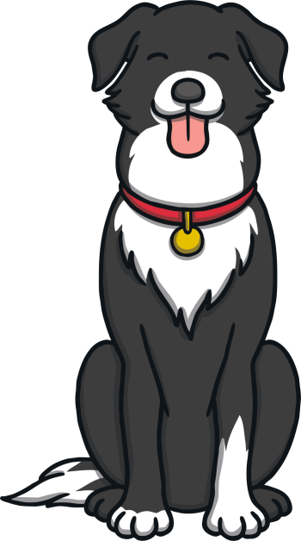
Caption Time
Apply
Who is excited about the kite? Read the caption then click ‘Show’ to reveal the answer!
Click ‘Sound Buttons On/Off’ to select whether you want to show sound buttons under the caption.
X
Click me for Kit’s teaching tips!

Slide 14
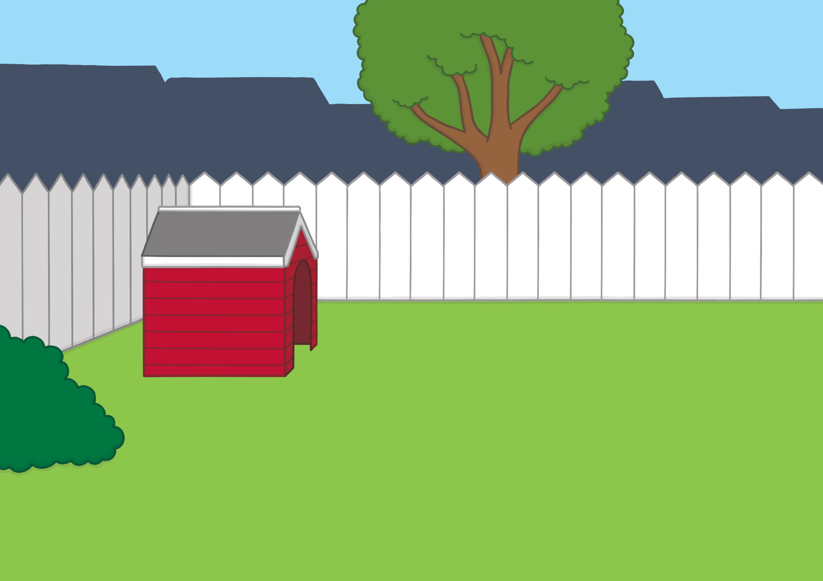
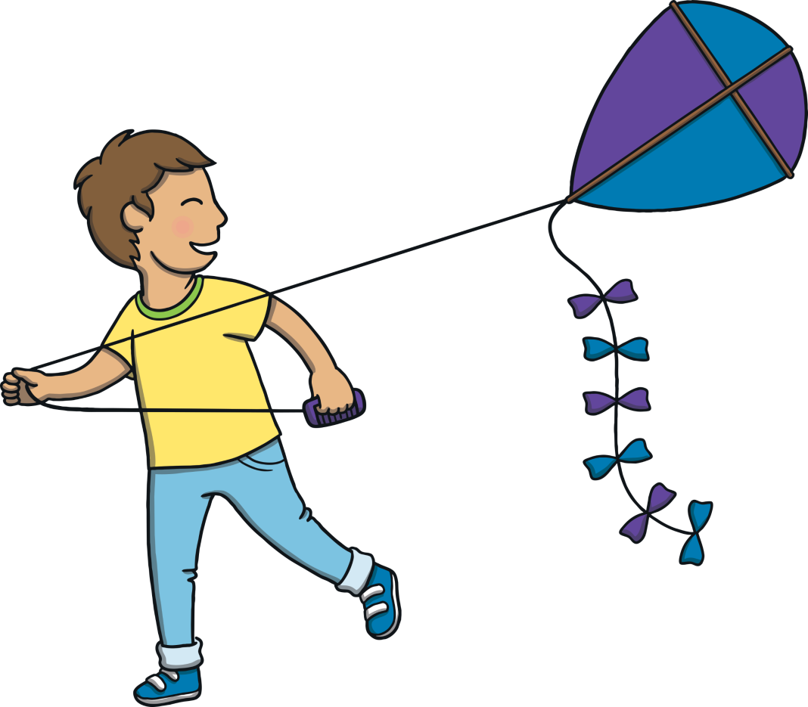
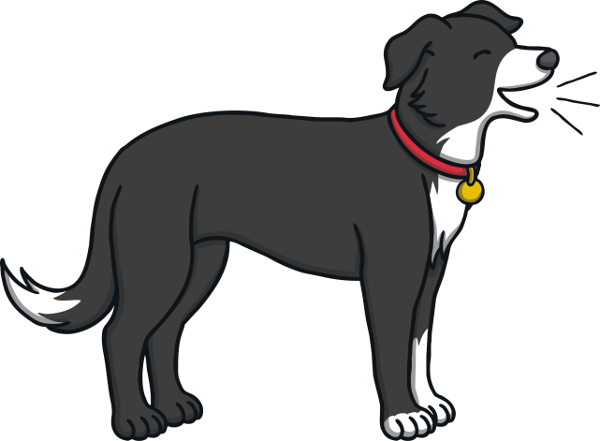
Apply
a kid and a dog
Sound Buttons On/Off
Show

Slide 15
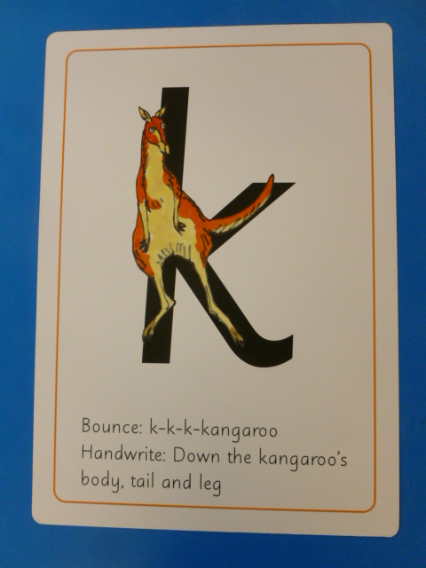
Can you try to write the sound k?

Slide 16
Today, we have learnt…
k

