Slide 1
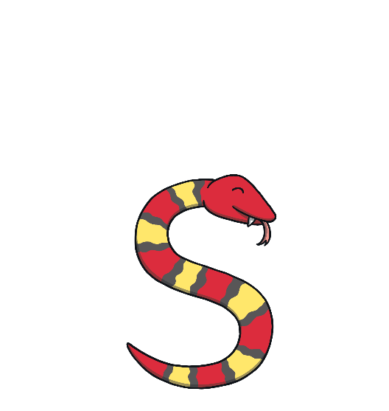
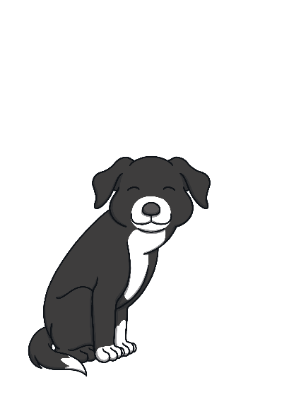
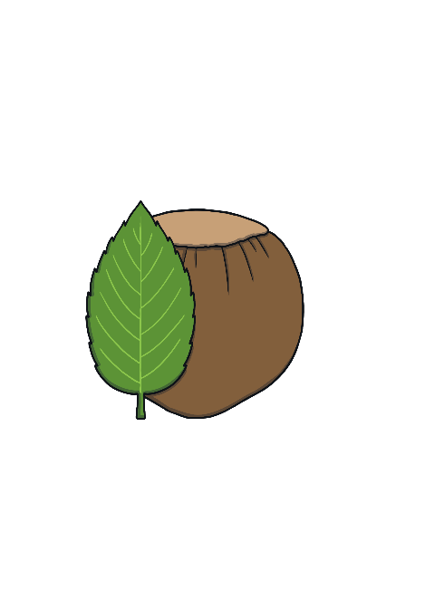
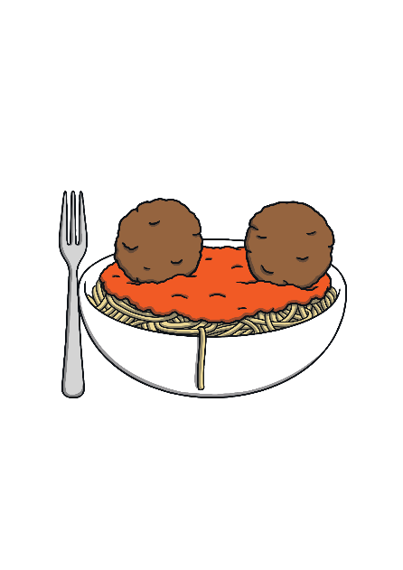
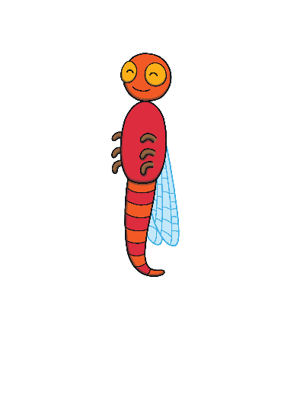
Revisit and Review
Let’s practise Sam’s Sounds!
p
a
s
t
n
m
i

Slide 2
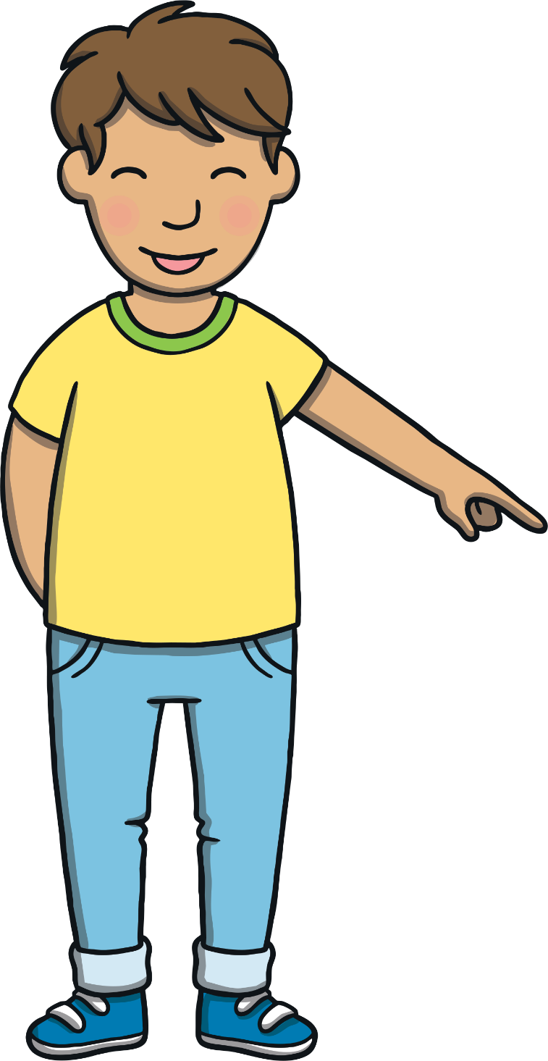
Today, we are learning…
d

Slide 3
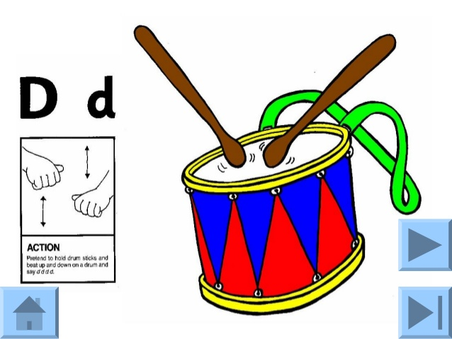
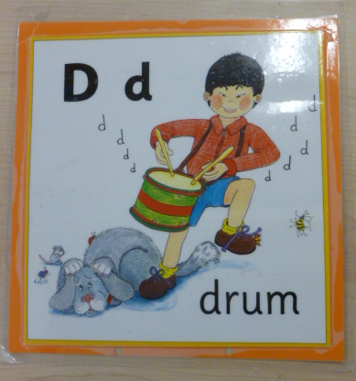
Jolly Phonics Song and action
Website link for all the songs – a-z order
https://vimeo.com/106231366
Action

Slide 4
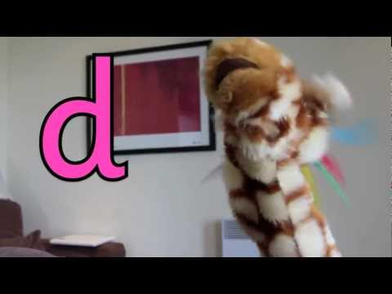
Let’s watch Geraldine the Giraffe tell us all about the sound d
Copy and paste the link below
https://www.youtube.com/watch?v=65b3vEfskZ4

Slide 5
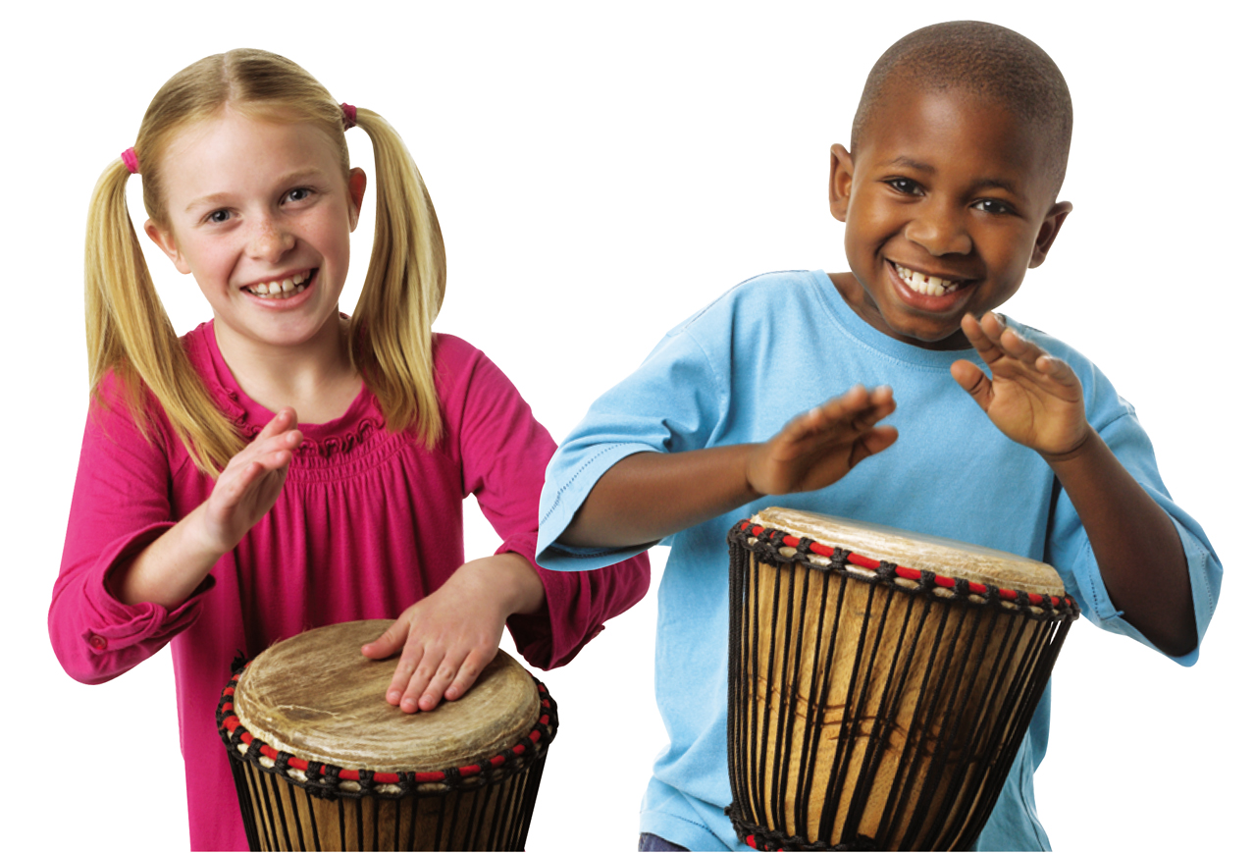
Can you think of anything that begins with the sound d?

Slide 6
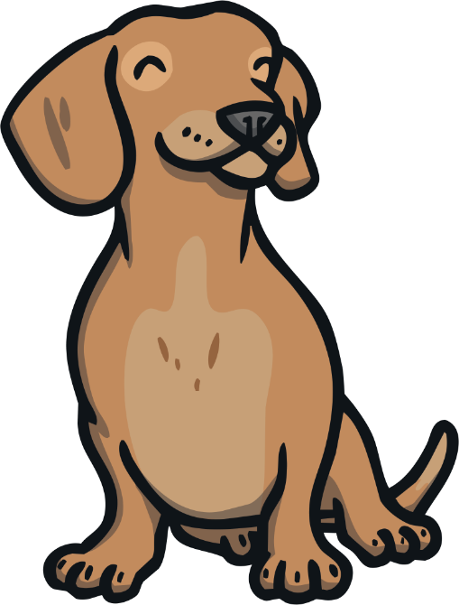
d
o
g

Slide 7
s
a
d

Slide 8
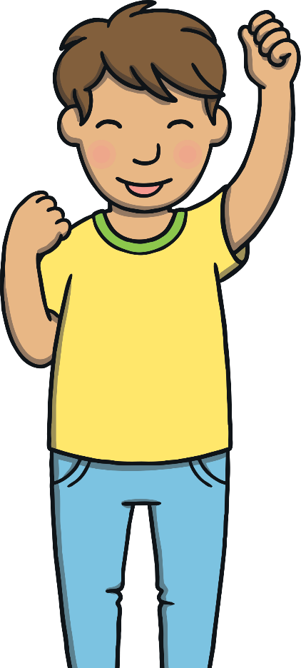
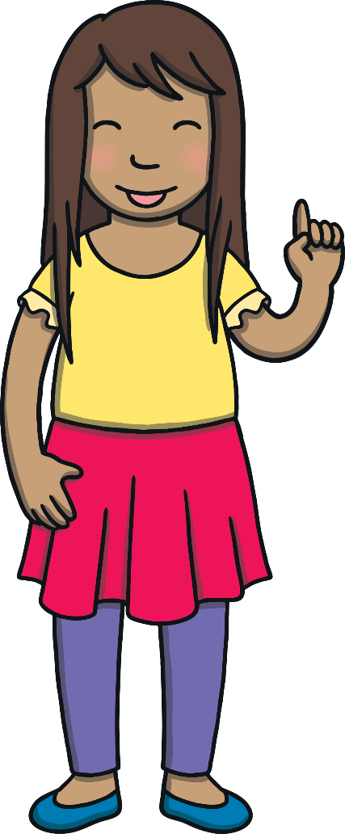
Music Fans
Apply
Look at the picture. Click on the phoneme fan to choose the right letters to make up the word.
X
You may wish to give phoneme fans to the children for this activity.
Click me for Kit’s teaching tips!

Slide 9
Apply
s
t
i
m
a
p
n
d

Slide 10
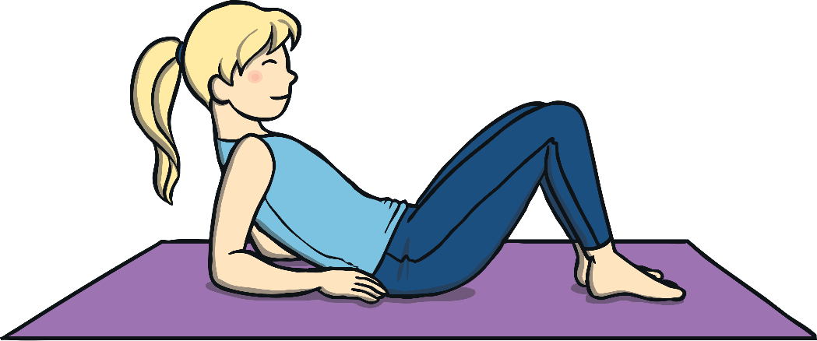
Apply
s
t
i
m
a
p
n
d

Slide 11
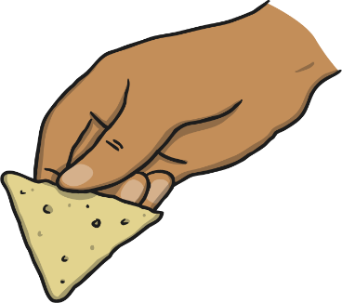
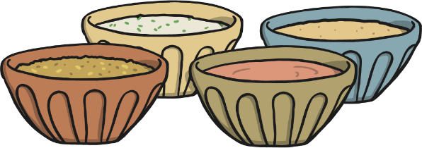
Apply
s
t
i
m
a
p
n
d

Slide 12
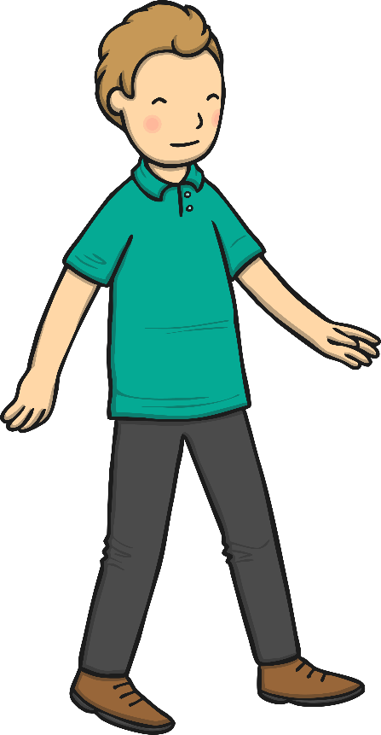
Apply
s
t
i
m
a
p
n
d

Slide 13
Apply
s
t
i
m
a
p
n
d

Slide 14
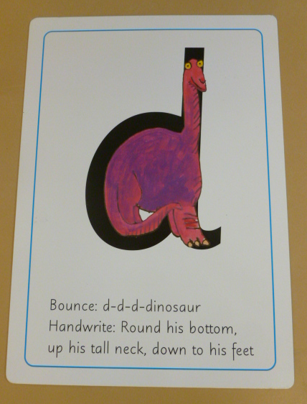
Can you try to write the sound d?

Slide 15
Today, we have learnt…
Apply
d

