Slide 1
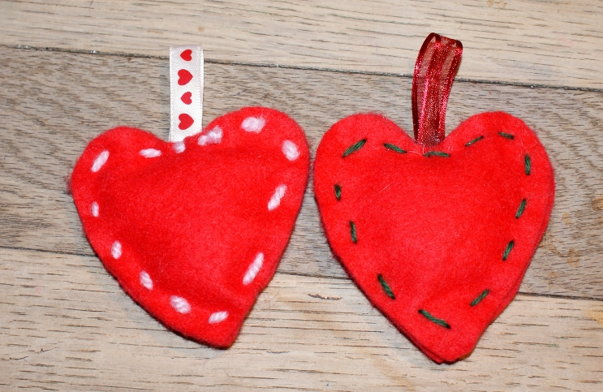
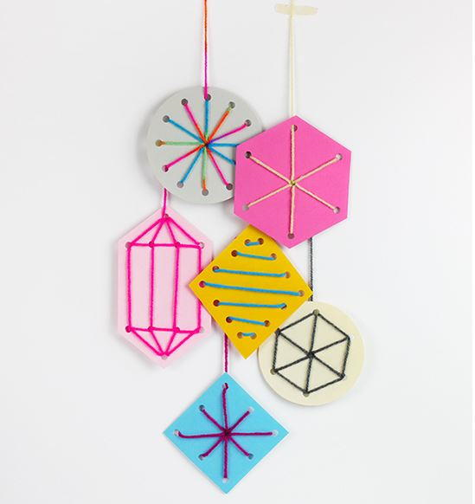
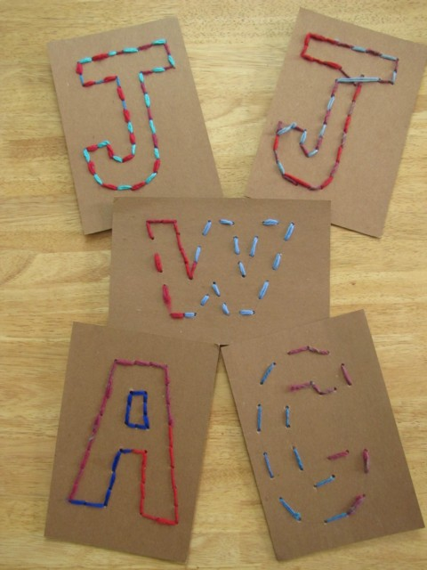
Farnborough’s Sewing Bee
Make a Wish

Slide 2
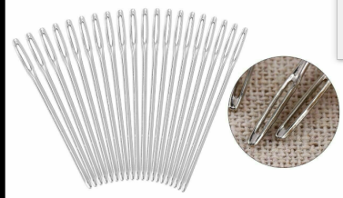
As explained in Miss James’ letter, materials for this challenge can be found in the small bags hidden around the village. In addition to this, your child will need a needle. Your child is provided with 2 pieces of thread and one piece of felt, if your child would like to add decorations or other thread to their creations please do!

Slide 3
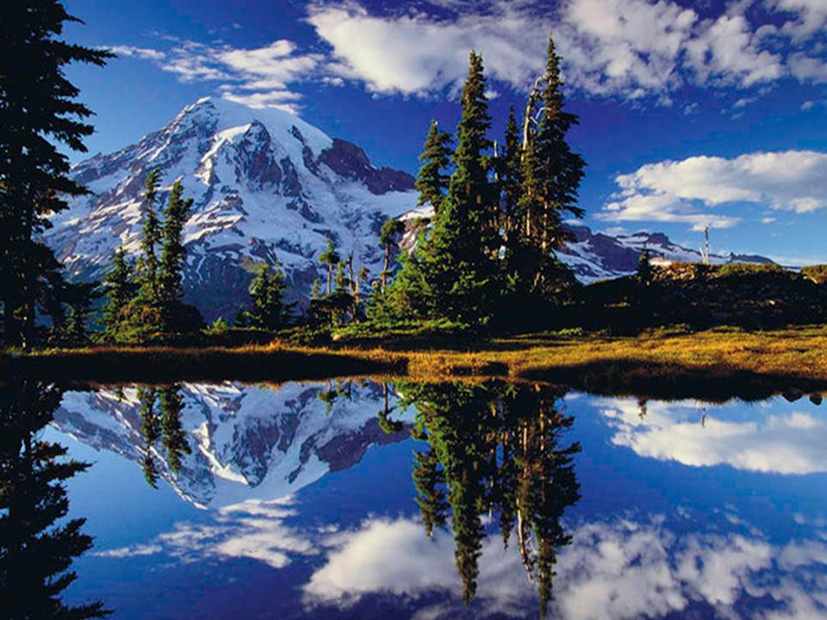
We are living in strange times. There are
many many important issues in our country and worldwide which are being spoken about at the moment. We are surrounded by these issues everyday. They are talked about in our schools, our homes, on the television, social media, everywhere.

Slide 4
What world issues have you heard about recently?
Which world issues are
important to you?
If you could make a wish to change the world into a better world, what would your wish be?

Slide 5
Can you write a few sentences about your wish for a better world.
I wish……..

Slide 6
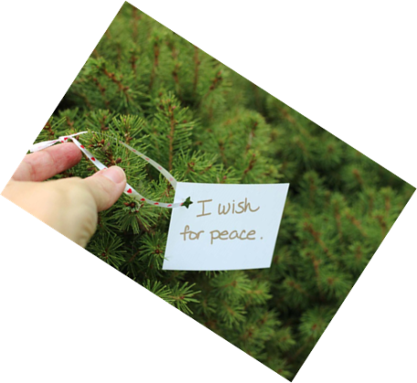
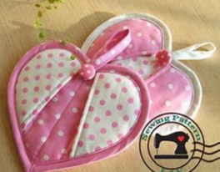
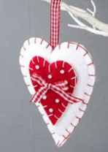
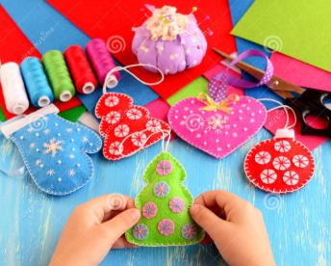
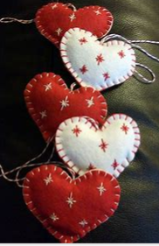
We are going to design and create a small hanging ornament to symbolise our wish for a better world.

Slide 7
Design a template.
Here are some examples……
Step One
Choose a template for your
design.
If your wish is for
people to be happy
living and working
together as
equals, you could
choose a heart to
symbolise love and
equality.

Slide 8
Design a template.
Step One
Choose a template for your
design.
If your wish is for
the world to
be cleaner and
sustainable
you could choose
a circle to symbolise
planet Earth.

Slide 9
Design a template
Step One.
If you choose to, you can select a different
template for your wish to make the world a better place.

Slide 10
Create a simple ornament.
Using your template you are going to begin to create your hanging ornament.
Step One
Draw an outline of your template onto your felt.
Draw two identical pieces (use the larger templates from the previous slides).

Slide 11
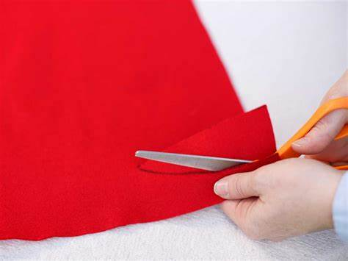
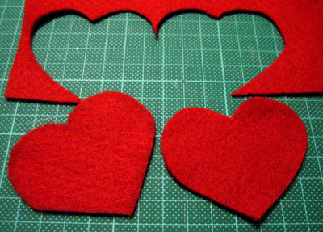
Create a simple ornament.
Using your template you are going to begin to create your hanging ornament.
Step Two
Very carefully, cut out the templates with a sharp pair of scissors. Ask a grown up to help you if needed.

Slide 12
Design a template
Step Two.
Using a colouring pencil, draw a simple design
with your initials on to your template. Remember you will be sewing, so keep it simple!
….

Slide 13
Create a simple ornament.
Using your template you are going to begin to create your hanging ornament.
Step Three
Before sewing, we need to thread a needle and tie a knot in the thread. Watch the following links to find out how.
https://www.youtube.com/watch?v=S6u173Ap2mc
https://www.youtube.com/watch?v=xM5n_gmpIrY

Slide 14
Create a simple ornament.
Using your template you are going to begin to create your hanging ornament.
Step Four
Using the design you have selected, start sewing your design on to one of your templates.
This may take time to do and several sittings.
So take your time, put on some happy or relaxing music and sew ……….
The following slides will demonstrate different
types of stitching you can try. Have a look
before you begin sewing.

Slide 15
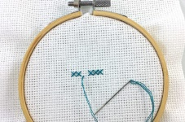
Sewing stitches to use for your design
1. A running stitch.
https://www.youtube.com/watch?v=i1-B01FB56s
You Tube running stitch
2. A cross stitch
https://www.youtube.com/watch?v=TYWxwveP8LU

Slide 16
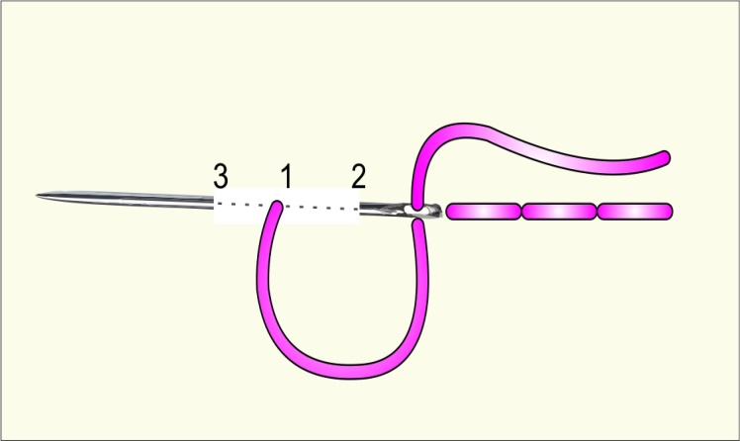
Sewing stitches to use for your design
1. A back stitch.
How to back stitch You Tube
https://www.youtube.com/watch?v=sjHm8CL9WDA

Slide 17
Sewing stitches to attach the templates.
Step One
It is time to attach the two pieces of felt together. The following slide shows two types of stitches you can use for this.
Select the stitch you prefer.

Slide 18
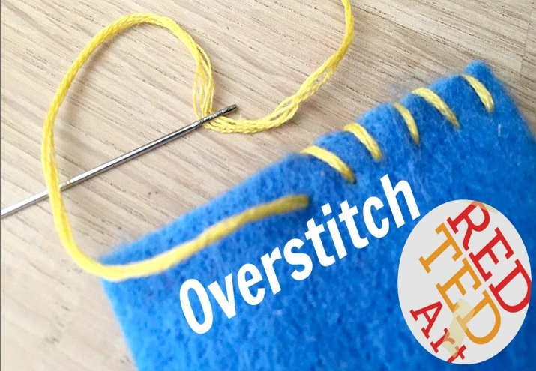
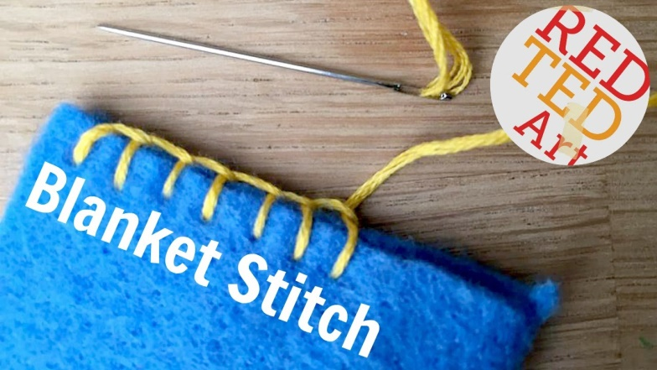
Sewing stitches to use
1. An overstitch
You tube Overstitch Red Ted Art
https://www.youtube.com/watch?v=gmD9vpo5Fso
2. A blanket stitch
You Tube Blanket Stitch
https://www.youtube.com/watch?v=S9zegUYdPmg

Slide 19
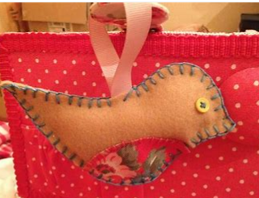
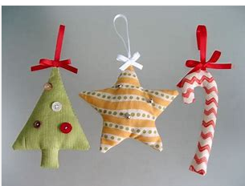
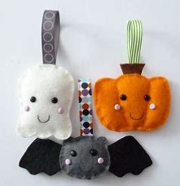
Attach the string
To complete your hanging ornament attach a piece of cotton or ribbon on the top of your piece.

Slide 20
Congratulations on completing your hanging ornament.
Please bring in your hanging ornament and hand it to your new teacher when you return to school. We will display your ‘wishes’ in a special place. We can’t wait to see them!

