Slide 1
Subject / Lesson | Time
Maths | 1 hour
Singing / Games - ZOOM | 30 minutes
English – My Island | 1 hour
Physical Activity | 30 minutes
Art | 1 hour

Slide 2
Maths Task | Time
Maths Playground – Fractions Games https://www.mathplayground.com/index_fractions.html | 15 minutes
Maths Challenges | 40 minutes

Slide 3

Try out these maths challenges:
http://farnboroughprimary.co.uk/wp-content/uploads/2020/07/ShapeProblemSolving.pdf
The questions get harder as you progress. See how far you can get.
You may find it helpful to draw a picture of the problem!

Slide 4

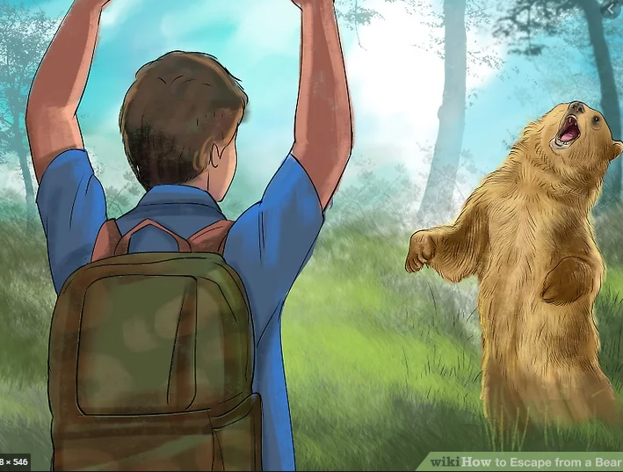
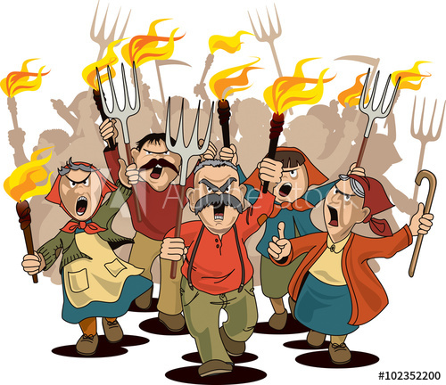
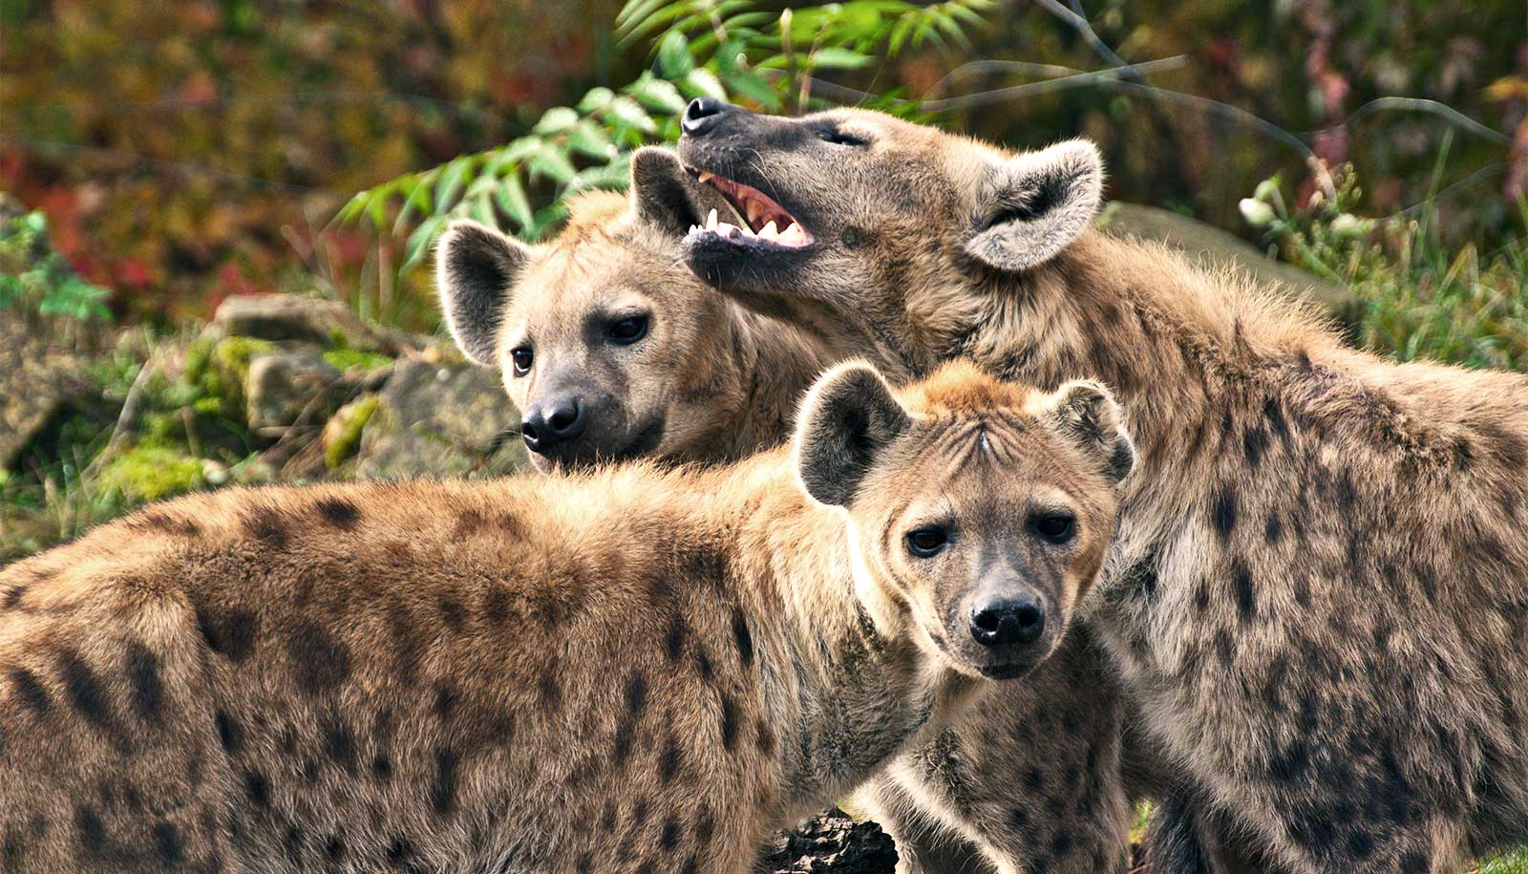
English project – My Island
Task 5
The noise and smell of food at the party attract some unwanted visitors. Write a description of the party explaining the events and the results. Use plenty of detail to give a really vivid description.

Slide 5
Physical activity – minimum 30 minutes each day | Link to resource
5 a day User Name: FPS53 / Password: JFz4XqG7 | https://player.5-a-day.tv/
Joe Wicks – PE sessions | https://www.youtube.com/channel/UCAxW1XT0iEJo0TYlRfn6rYQ
Cosmic Kids Yoga | https://www.youtube.com/user/CosmicKidsYoga
PE Hub Parents Portal | https://pehubportal.co.uk/
Go Noodle | https://www.gonoodle.com/good-energy-at-home-kids-games-and-videos/
Go for a walk/run. You must go with an adult from your home and make sure you stay 2 metres away from other people.

Slide 6
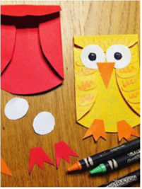
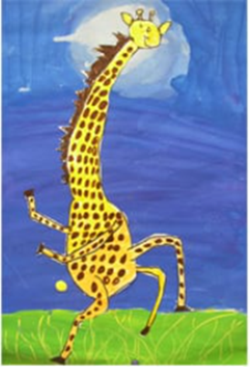
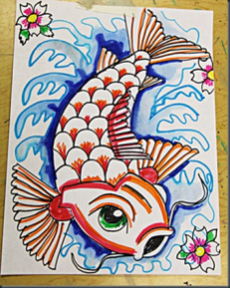
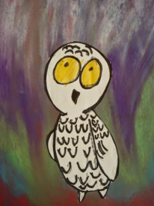
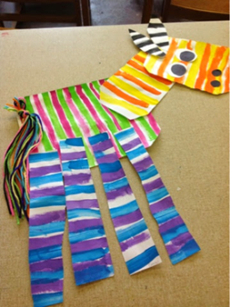
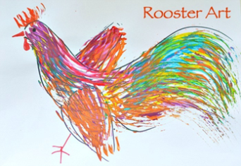
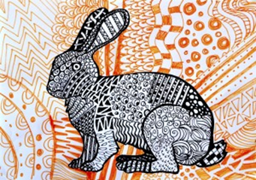
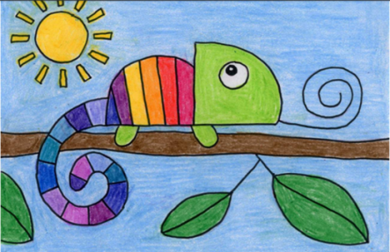
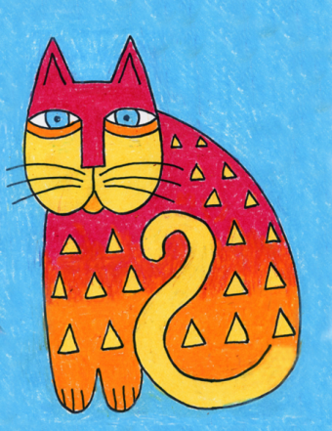
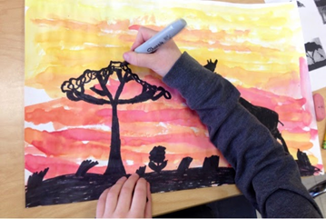
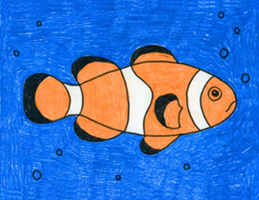
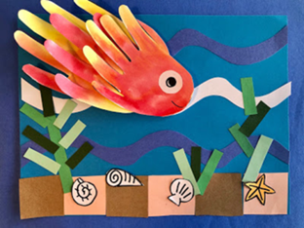
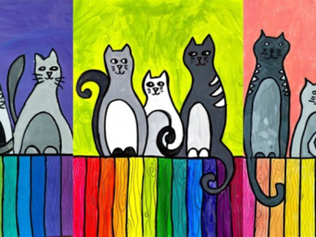
Carnival of the Animals - An Art festival
Hello
Over the last 6 weeks you been creating some great art on the theme of “Carnival of the Animals.”
We hope you have enjoyed the lessons and we have really enjoyed looking at your work. It’s been lovely to hear that family members have also joined in!
This week I am giving you a choice from my favourite websites….
There are so many nice ideas on these websites I found it difficult to choose, so take a look and decide yourself!
Enjoy ,relax, be creative this week and
over the summer.
We would love to see your artwork in September!
Take care
Miss Pattison
Thank you for sending in your fabulous artwork! Remember it’s not too late to send your art to your home learning page. We put up everything that is sent in on the website.

Slide 7



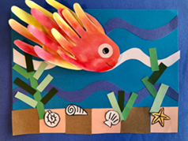




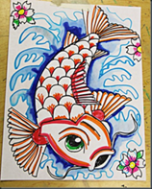

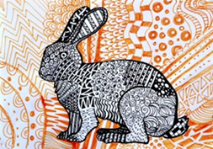
Dear Key Stage 2 children
You are all invited to Zoom on Tuesday 14th July at 1.35 pm. We would really like you to share your artwork from the past few weeks as if we are walking around our Farnborough Art Gallery!
You are also welcome to attend if you are happy just to watch and see your friends showing their artwork!
The meeting ID and password will be sent out on Friday as usual.
See you Tuesday!
Miss Pattison

Slide 8
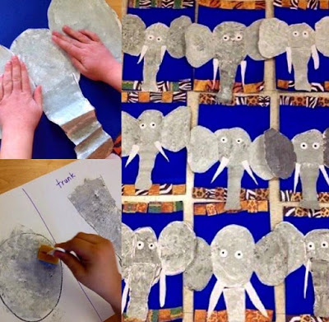
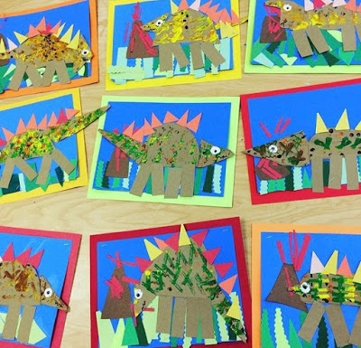
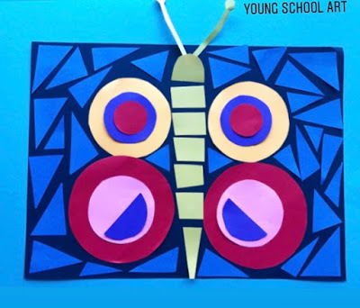
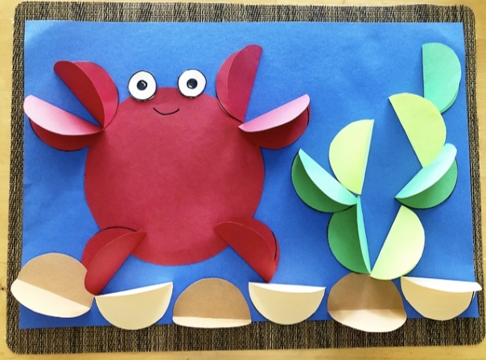
Young artists will enjoy this website
https://youngschoolart.blogspot.com/
https://youngschoolart.blogspot.com/2020/05/online-art-lessons-week-7.html
https://youngschoolart.blogspot.com/2020/06/
https://youngschoolart.blogspot.com/2020/05/online-art-lessons-week-10.html
https://youngschoolart.blogspot.com/2020/05/online-art-lessons-week-9.html

Slide 9
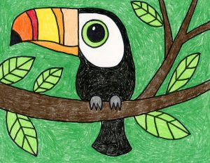
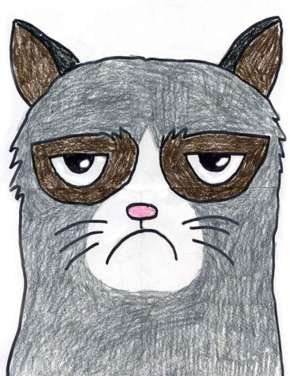
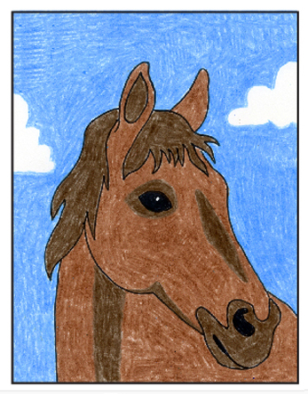
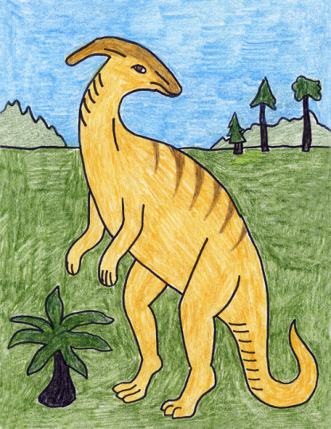
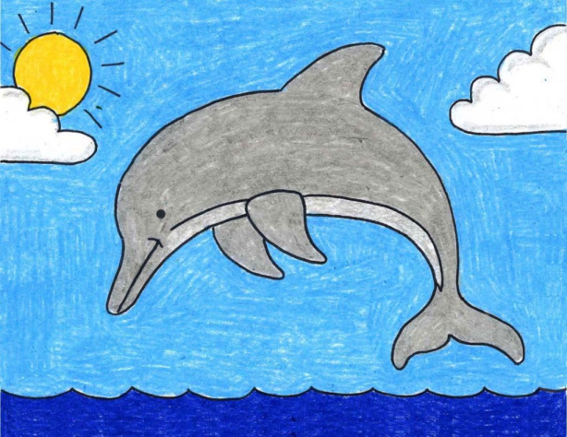
https://artprojectsforkids.org/
Know what you want to draw? This website gives you easy step by step instructions for virtually every animal. A few suggestions.....
https://artprojectsforkids.org/how-to-draw-a-toucan/
https://artprojectsforkids.org/draw-grumpy-cat/
https://artprojectsforkids.org/how-to-draw-a-horse-head/
https://artprojectsforkids.org/how-to-draw-a-dolphin/
https://artprojectsforkids.org/how-to-draw-a-parasaur-dinosaur/

Slide 10
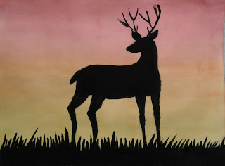
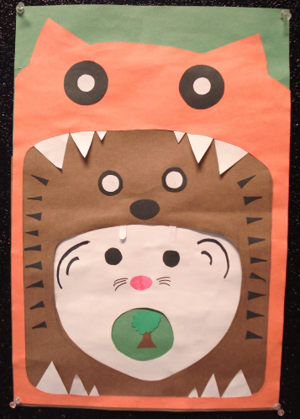
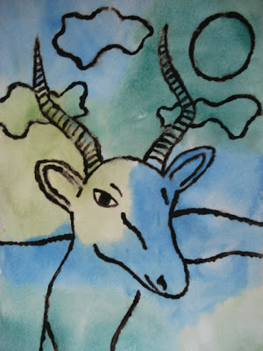
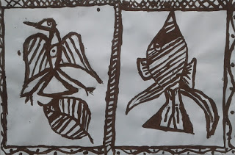
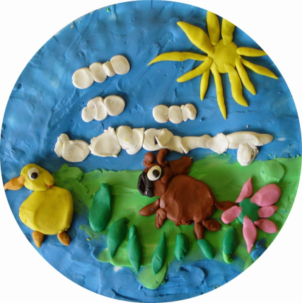
For more arty animal ideas check out this website:
https://afaithfulattempt.blogspot.com/
https://afaithfulattempt.blogspot.com/2019/05/antler-animals-in-silhouette.html
https://afaithfulattempt.blogspot.com/search?q=food+chain+collage+
https://afaithfulattempt.blogspot.com/2011/05/glue-resist-african-animals-watercolour.html
https://afaithfulattempt.blogspot.com/2015/05/plasticine-pictures.html
https://afaithfulattempt.blogspot.com/2019/11/korhogo-cloth-paintings.html

Slide 11
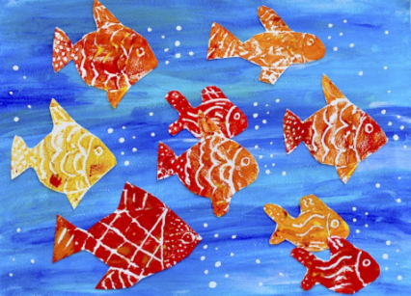
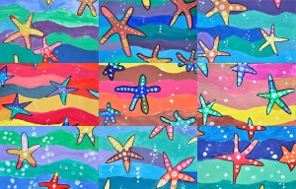
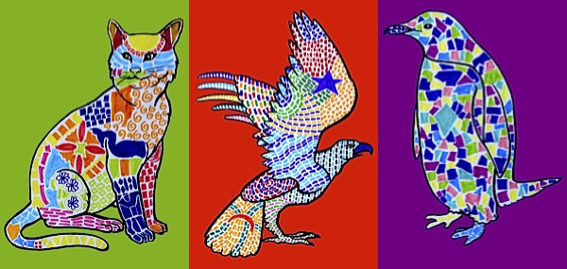
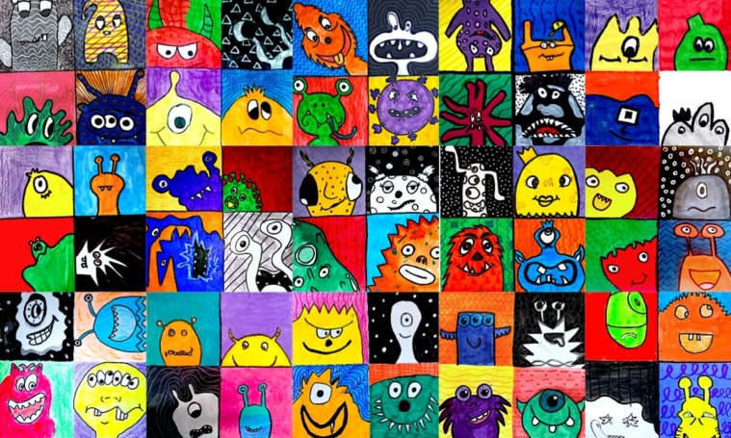
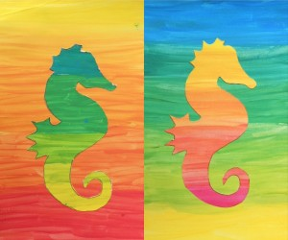
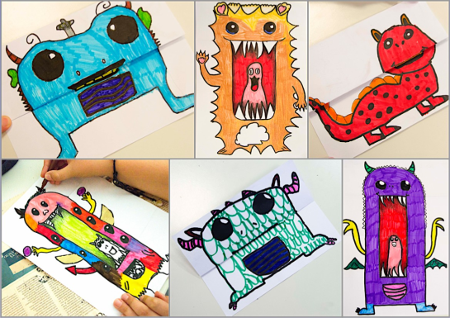
Check out arteascuola.com/ for art lessons that are perfecto! These are aimed at older artists.
http://arteascuola.com/2015/03/animals-decorated-with-mosaics-inspired-by-gaudi/
http://arteascuola.com/2014/02/starfish-in-warm-and-cool-colors/
http://arteascuola.com/2016/01/so-many-goldfish-prints-with-styrofoam/
http://arteascuola.com/2020/05/monsters-in-complementary-colors/
http://arteascuola.com/it/2014/04/silhouette-in-gradazioni-cromatiche/
http://arteascuola.com/2019/06/cute-or-scary-monster/
Remember you have the animal outlines on your home learning pages.

