Slide 1
Good morning Unicorns!
Here’s your work for today: Wednesday 15th July

Slide 2
I’m looking forward to seeing lots of you at our Celebration of Year Two Zoom session at 9.15 this morning. Have your favourite memory to share.

Slide 3
Let’s start the day by being…

Slide 4
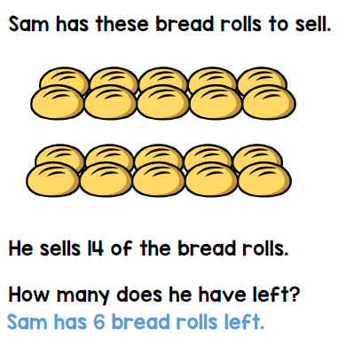
Maths answers from Monday
Challenge 1:

Slide 5
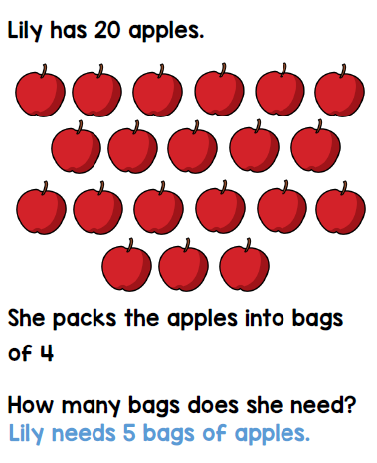
Challenge 2:

Slide 6
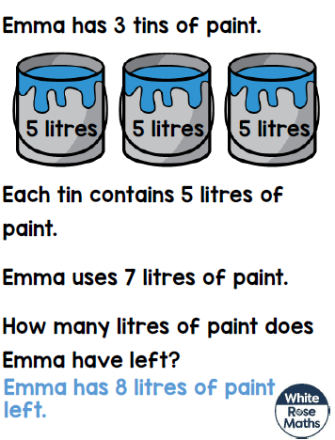
Challenge 3:

Slide 7
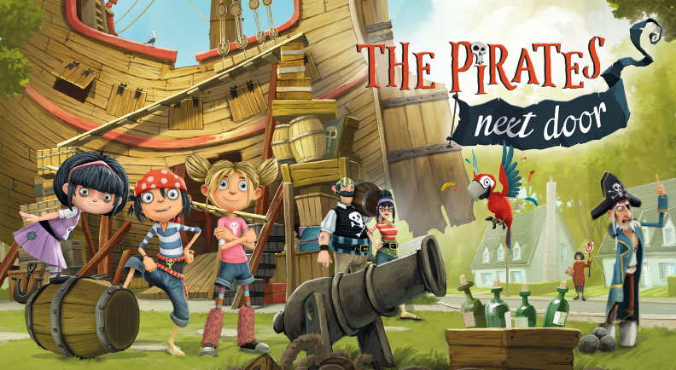
Maths
The pirate family needs your help please, Unicorns!
Can you help them to solve the problems on the next slides?

Slide 8
Challenge 1:

Slide 9
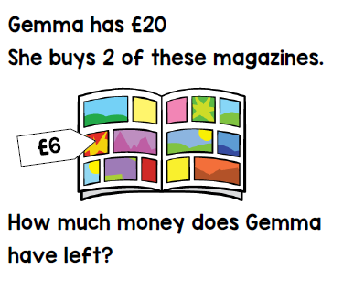
Challenge 2:

Slide 10
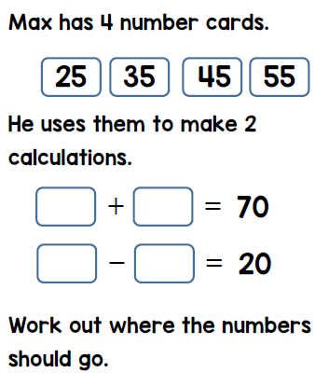
Challenge 3:

Slide 11
Yesterday was the beginning of a new week for Race around the World.
Our final destination is Turkey.
You can see the previous week’s total by clicking on this link:
http://farnboroughprimary.co.uk/active-challenge/

Slide 12
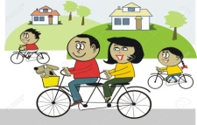
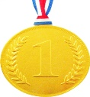
Farnborough’s Race across the World Results up to Monday 6th July
Class | Number of kilometres covered | *Which country did your class reach? From Farnborough School to …..
Pixies | 2909 km | Russia
Elves | 2459 km | Greece
Unicorns | 2576 km | Turkey
Phoenix | 1690 km | Algeria
Pegasus | 5702 km | America
Giants | 3121 km | Russia
Griffins | 3036km | Russia
Centaurs | 4106 km | Russia
Dragons | 1831 km | Algeria

Slide 13
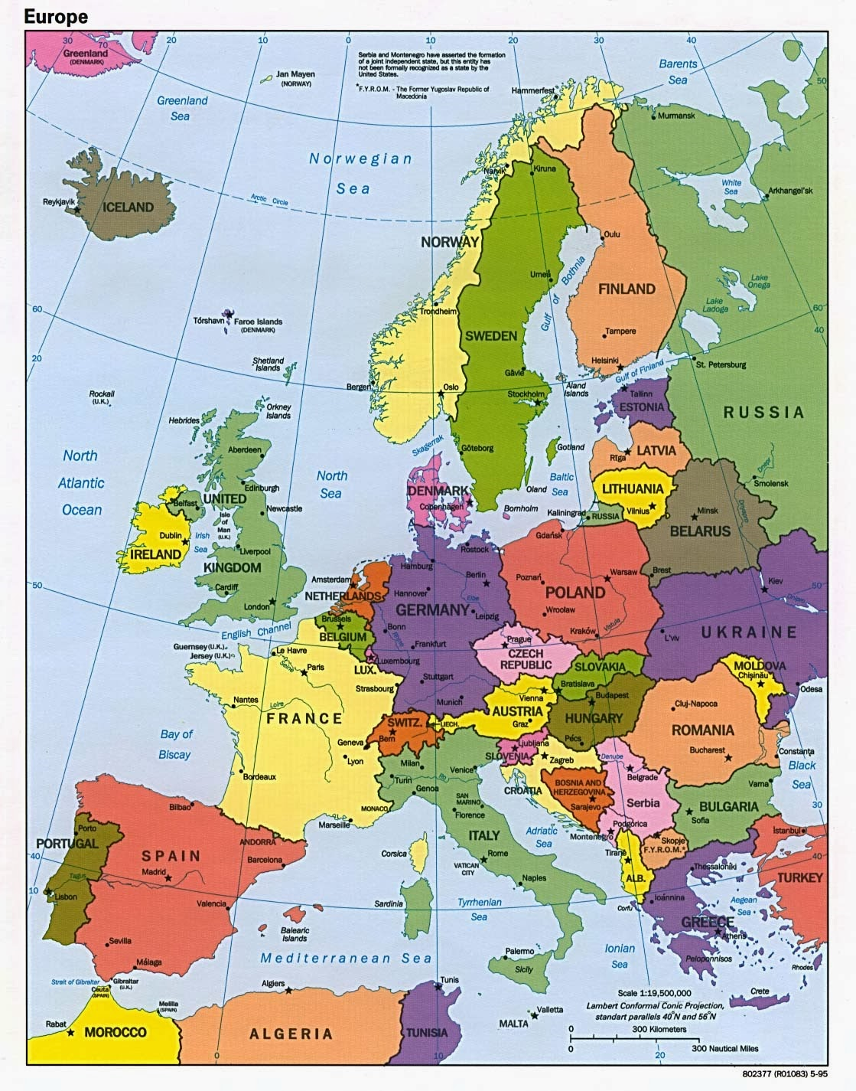
Which country did your class reach?
Map of Europe
Which country did your class reach?

Slide 14
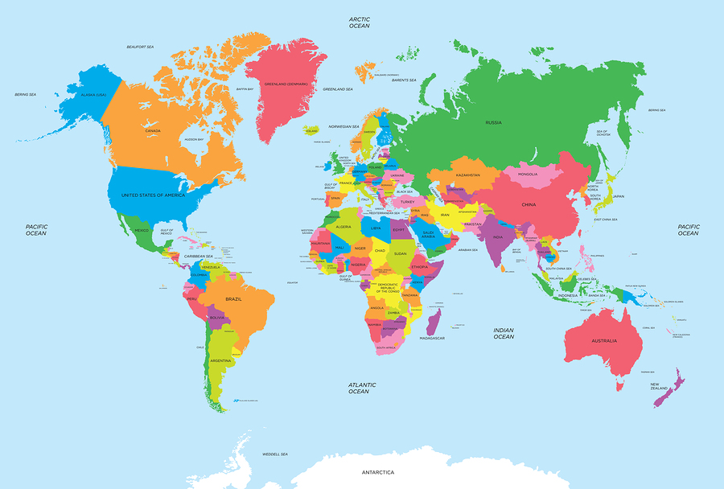
Map of the World
Which country did your class reach?

Slide 15
Follow this link and find Turkey on Google Earth:
Google Earth
Login to:
https://www.oddizzi.com/schools/login/
Username: Unicorns
Password: Unicorns
Go to: Explore The World Places Europe Turkey
Turkey Key Facts
Practise saying some of the handy phrases and decide whether you would like to try any of the popular food mentioned.

Slide 16
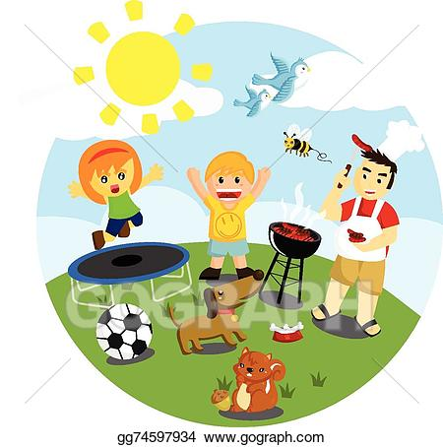
Outdoor Activity
Every day I am going to give you an activity that can be carried out either outdoors, (if the sun is shining) or indoors (if we’re not as lucky as the weather!).

Slide 17
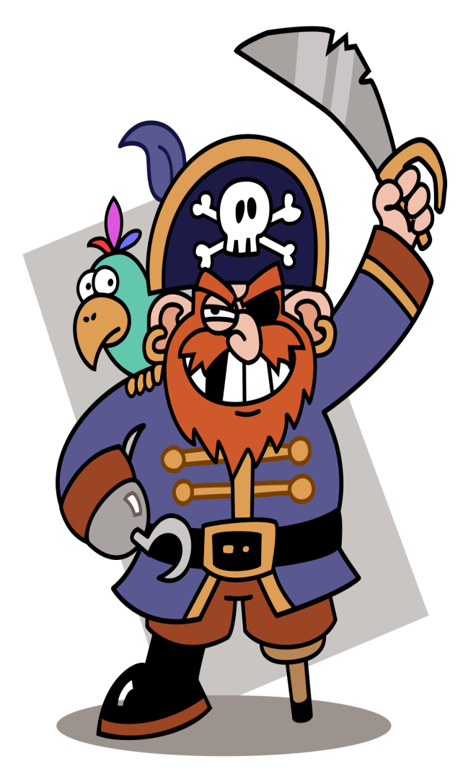
Activity 1:
Design your own pirate flag. You could use patterns or pictures to decorate it. You could make it using natural resources you find outdoors or you could make it using craft resources that you have.
Activity 2:
Walk the plank! Can you walk the plank
without falling off? Create your own
plank and see how many people in
your house can walk it successfully.

Slide 18
Reading online
Please log on to Bug Club and read for at least 15 minutes
Make sure you answer your bug questions!

Slide 19
Enjoy, Unicorns!

