Slide 1
Welcome back Elves!
.
Let’s get busy Elves.

Slide 2
Green group
Wednesday’s
Maths Answers
20p, 20p, 5p
2. 20p, 20p, 5p
20p, 10p, 10p, 5p
10p, 10p, 10p, 10p, 5p
20p, 10p, 5p, 5p, 5p,
10p, 10p, 10p, 5p,5p,5p,
20p, 5p, 5p, 5p, 5p, 5p
10p, 5p, 5p, 5p, 5p, 5p, 5p,5p
5p, 5p, 5p, 5p,5p,5p, 5p, 5p, 5p
10p, 10p, 5p,5p,5p,5p,5p
3. 50p
20p, 20p, 5p, 5p
20p, 10p, 10p, 5p,5p
10p, 10p, 10p, 10p, 5p,5p
20p, 10p, 5p, 5p, 5p, 5p
10p, 10p, 10p, 5p,5p,5p,5p
20p, 5p, 5p, 5p, 5p, 5p, 5p
10p, 5p, 5p, 5p, 5p, 5p, 5p,5p, 5p
5p, 5p, 5p, 5p,5p,5p, 5p, 5p, 5p,5p
10p, 10p, 5p,5p,5p,5p,5p,5p

Slide 3
It’s Thursday!
Thursday 9th July 2020
Good Morning!
.

Slide 4
Farnborough Dance Routine
Mrs Humphries has created our very own Farnborough Dance Routine!
It has five parts and every day this week we are going to start the day by being active and joining in.
Click on the link below:
http://farnboroughprimary.co.uk/farnborough-dance

Slide 5
English
Let’s listen to the Pirates Next Door by Jonny Duddle.
The Pirates Next Door by Jonny Duddle
https://www.youtube.com/watch?v=ZA6tEvWno8c

Slide 6
English
We are learning to understand
Texts.

Slide 7
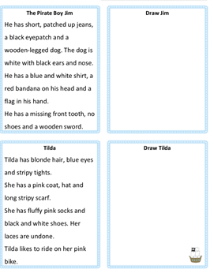
English

Slide 8
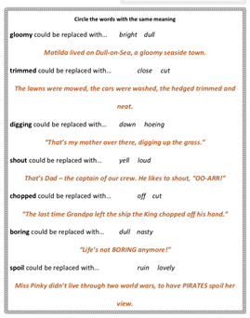
Write out your sentences in your books.

Slide 9
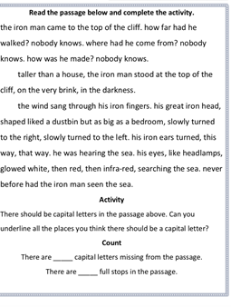

Slide 11
Create a pirate flag to add to the ship you built! What could you add to make it your flag?

Slide 12
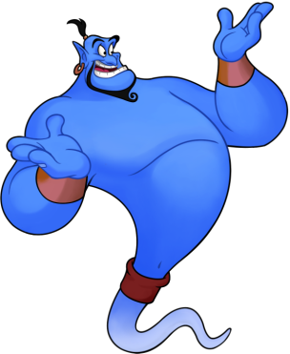
Reading online
I’m so impressed with your reading Elves.
You should be very proud of yourselves!
Please log on to Bug Club
Read for at least 15 minutes.
Please read the key words inside the front cover first.
When you find the bug questions, click and complete them.
Please note down the books you’ve read in your reading
record book.
Your personal login details are on the inside of your reading record book.

Slide 13
Zoom on Friday
It’s Eco Day tomorrow. Can you dress up or wear
an accessory to be an Eco Warrior tomorrow?
We are going to go on a Word Scavenger Hunt. So be
ready to search for things around your house!
I look forward to seeing you tomorrow!

Slide 14
Have a lovely weekend and enjoy Eco Day! Don’t forget to send me photos of your work or activities! Thank you.

