Slide 1
Welcome back Elves! We hope you enjoyed French Day. Congratulations to Millie, Aymen and Eva for their Achievement Awards! I am looking forward to seeing lots of your amazing work this week! If you haven’t already done so, send in your best pieces from last week. Email yearonelearning@farnborough.bromley.sch.uk

Slide 2
I’m looking forward to seeing lots of you at our Storytime Zoom session at 11:00 this morning.
Watch the animation on the next slide to remind yourself of how to keep safe online.

Slide 3
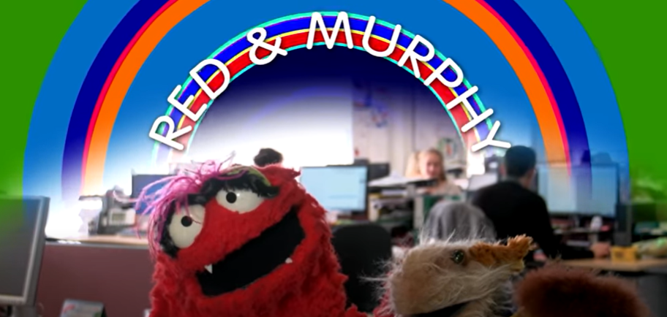
https://www.youtube.com/watch?v=FNQmo0LF6YY

Slide 4
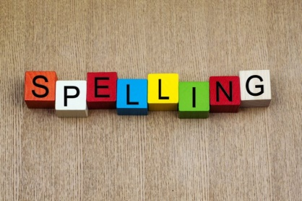
Spellings
This weeks spellings are posted on the
Year 1 Learning page to learn.
Your grown up can carry out the spelling test on Friday!
Happy Spelling

Slide 5
It’s Monday!
Monday 6th July 2020
Good Morning!
.

Slide 6
Farnborough Dance Routine
Mrs Humphries has created our very own Farnborough Dance Routine!
It has five parts and every day this week we are going to start the day by being active and joining in.
Click on the link below:
http://farnboroughprimary.co.uk/farnborough-dance

Slide 7
Maths
1.
2.
Write out the instructions.
3.
Create your own beanstalk and make instructions for a partner to go up the bean stalk.

Slide 8
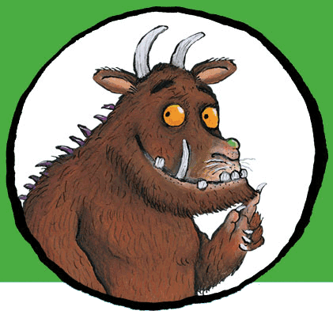
. .
You can write your answers in your exercise books.
If you would like to try Gruffalo work, complete question 1
If you would like to try Horrid Henry work complete question 2
If you would like to try James and the Giant Peach work, complete all questions

Slide 9
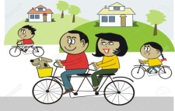
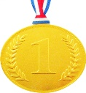
Farnborough’s Race across the World Results up to Monday 29th June
Class | Number of kilometres covered | *Which country did your class reach? From Farnborough School to …..
Pixies | 2637 km | Turkey
Elves | 2135 km | Romania
Unicorns | 2412 km | Greece
Phoenix | 1587km | Tunisia
Pegasus | 5104 km | Canada
Giants | 2771 km | Turkey
Griffins | 2800km | Turkey
Centaurs | 3633 km | Egypt
Dragons | 1750 km | Tunisia

Slide 10
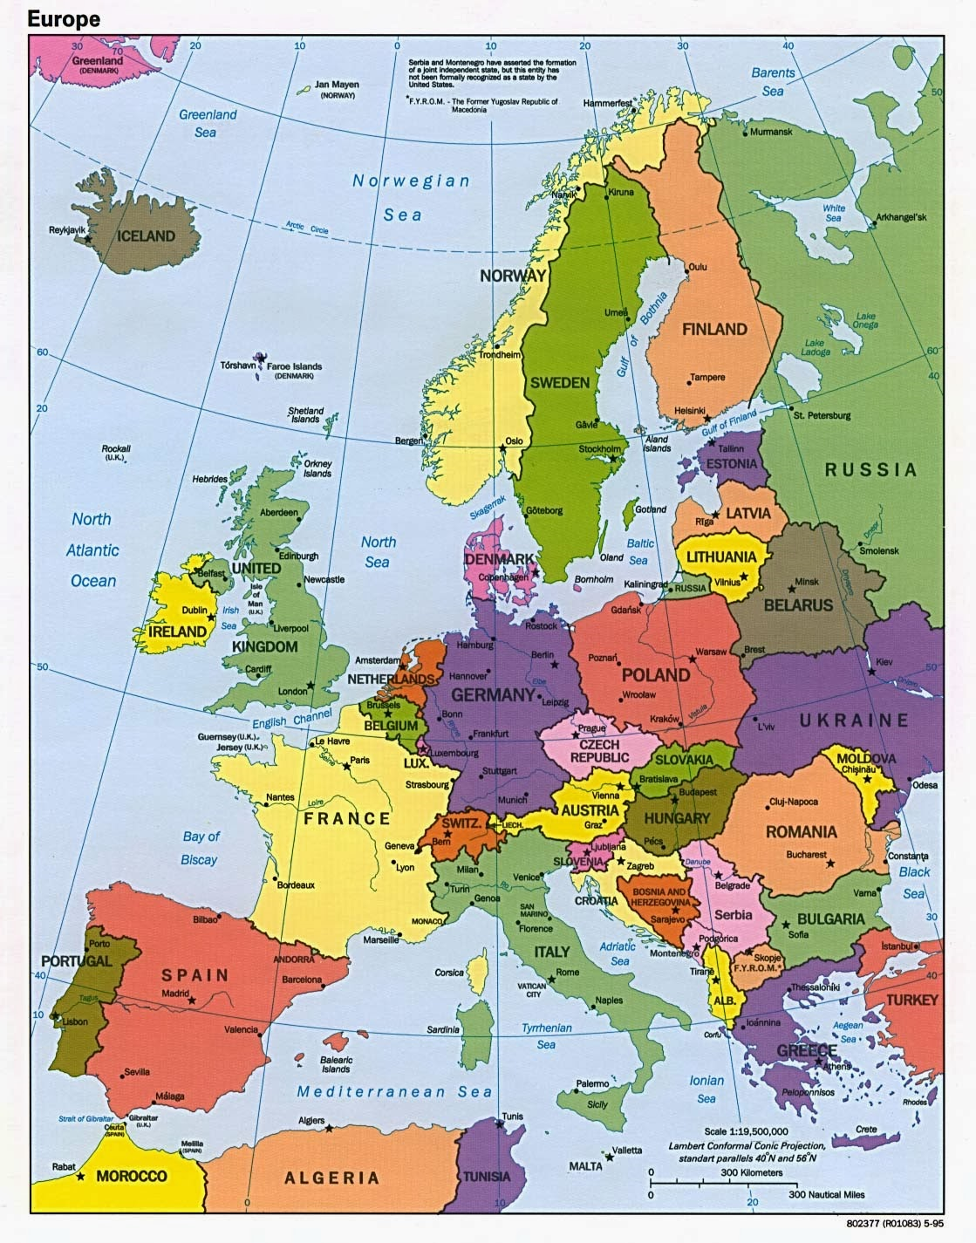
Which country did your class reach?
Map of Europe
Which country did your class reach?

Slide 11
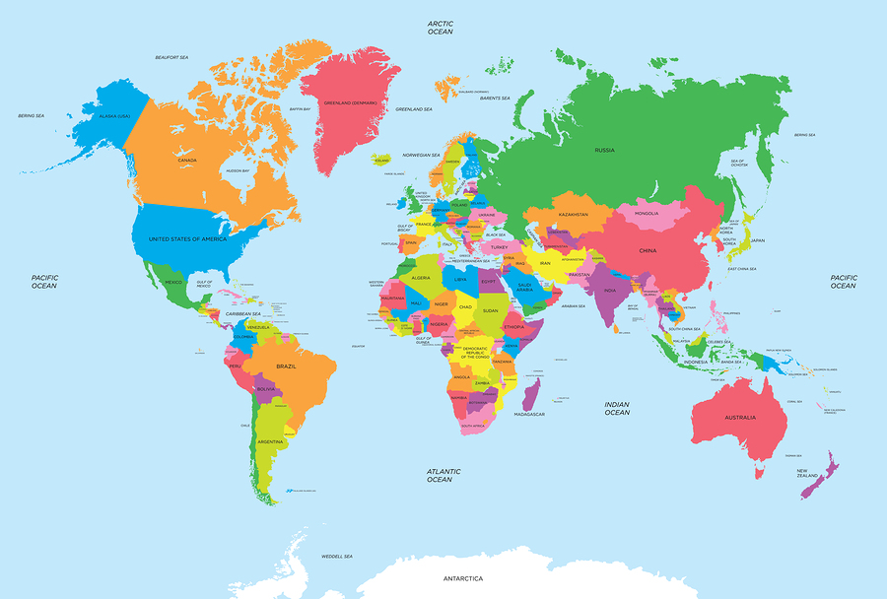
of the World
Map of the World
Which country did your class reach?

Slide 12
Congratulations we have reached
Romania
Google Earth
https://www.google.co.uk/intl/en_uk/earth/
Create a poster about Romania. Follow this link to find
out more!!
romania - Where in the Wold.
https://www.funkidslive.com/learn/where-the-world/romania/#
Check out the radio station for kids while you are exploring!

Slide 13
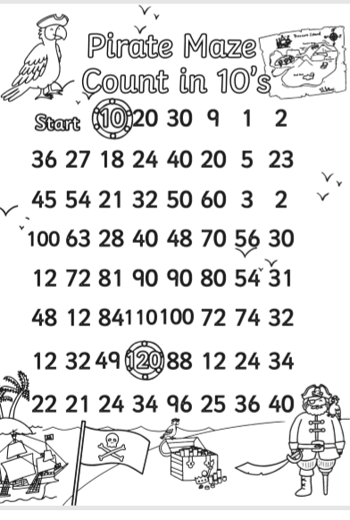

Slide 14
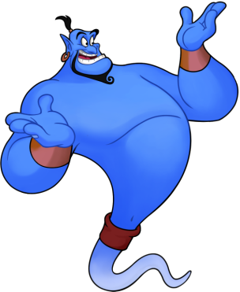
Reading online
I’m so impressed with your reading Elves.
You should be very proud of yourselves!
Please log on to Bug Club
Read for at least 15 minutes.
Please read the key words inside the front cover first.
When you find the bug questions, click and complete them.
Please note down the books you’ve read in your reading
record book.
Your personal login details are on the inside of your reading record book.

Slide 15
PSHE
Talking to the people in our household is always a good thing to do and helps us to understand some of the new things that are happening in our lives at the moment.

