Slide 2
Good morning Unicorns!
Here’s your work for today: Monday 13th July

Slide 3
Mrs Roberts is looking forward to seeing lots of you at her ‘Meet the Teacher’ Zoom session at 11.30 this morning!

Slide 4
Let’s start the day by being…

Slide 5
This week we are continuing with our pirate theme and our book this week is ‘The Pirates Next Door’
Have a listen to this fantastic story:
https://www.youtube.com/watch?v=ZA6tEvWno8c

Slide 6
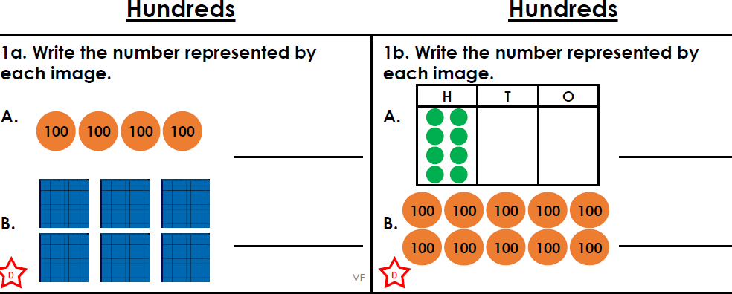
Answers from last Wednesday.
Challenge 1:
400
800
600
1000

Slide 7
Challenge 2:
800
300

Slide 8
Challenge 3:
Can you solve my clues?
I am thinking of a number that is 100 more than 56. What is my number? 156
I am thinking of a number that is 100 less than 678. What is my number? 578
I am thinking of a number that is 100 more than 876. What is my number? 979
I am thinking of a number that is 100 less than 1200. What is my number? 1100

Slide 9
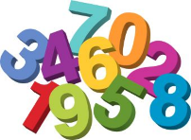
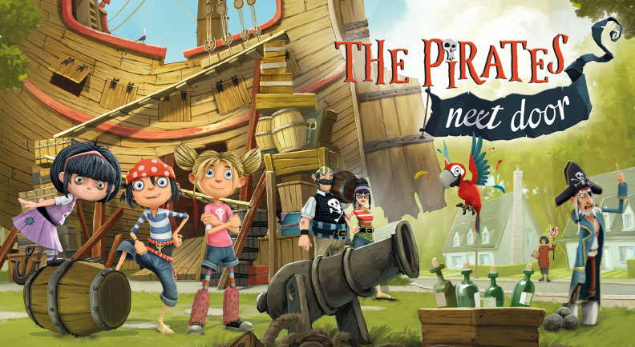
Maths
The pirate family needs your help please, Unicorns!
Can you help them to solve the problems on the next slides?

Slide 10
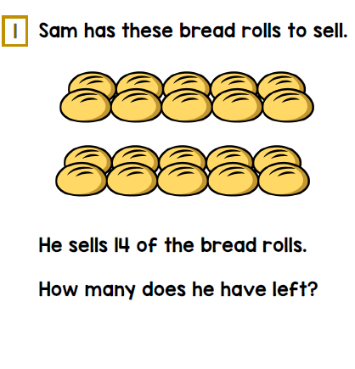
Challenge 1:

Slide 11
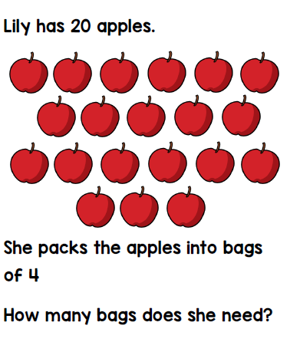
Challenge 2:

Slide 12
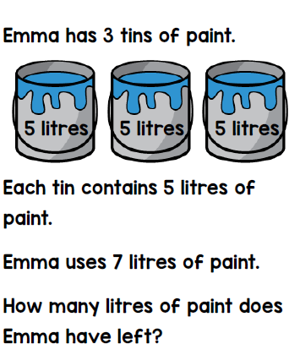
Challenge 3:

Slide 13
You can write your answers in your exercise books.
If you would like to try Gruffalo work, complete Challenge 1.
If you would like to try Horrid Henry work, complete Challenge 2.
If you would like to try James and the Giant Peach work, complete Challenge 3.

Slide 14
Music Music I would like you to compose your own pirate song! This pirate song can be about how the pirates celebrate when they win the treasure and the golden pants. Have a go at performing your song using your best pirate voice!

Slide 15
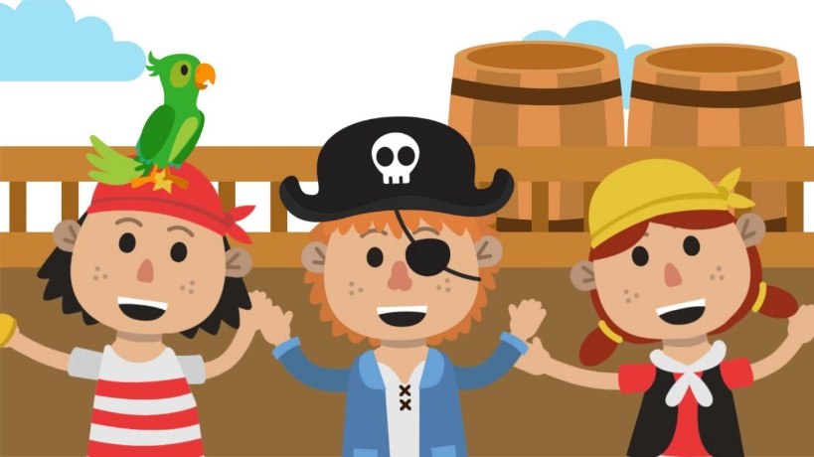
Here is an example of a pirate song:
The Big Ship Sails On The Alley-Alley-O
The big ship sails on the alley-alley-o
The alley-alley-o, the alley-alley-o,
The big ship sails on the alley-alley-o
On the last day of September.
The captain says that’ll never never do,
Never never do, never never do.
The captain says that’ll never never do,
On the last day of September.
The big ship sank to the bottom of the sea
The bottom of the sea, the bottom of the sea,
The big ship sank to the bottom of the sea
On the last day of September.
We all dip our heads in the deep blue sea,
The deep, blue sea, the deep, blue sea,
We all dip our heads in the deep, blue sea,
On the last day of September.

Slide 16
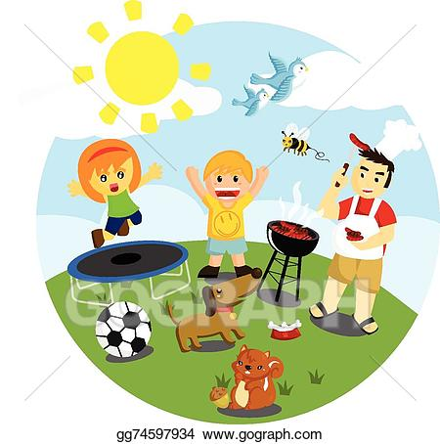
Outdoor Activity
Every day I am going to give you an activity that can be carried out either outdoors, (if the sun is shining) or indoors (if we’re not as lucky as the weather!).
Today it’s building a boat for a pirate…

Slide 17
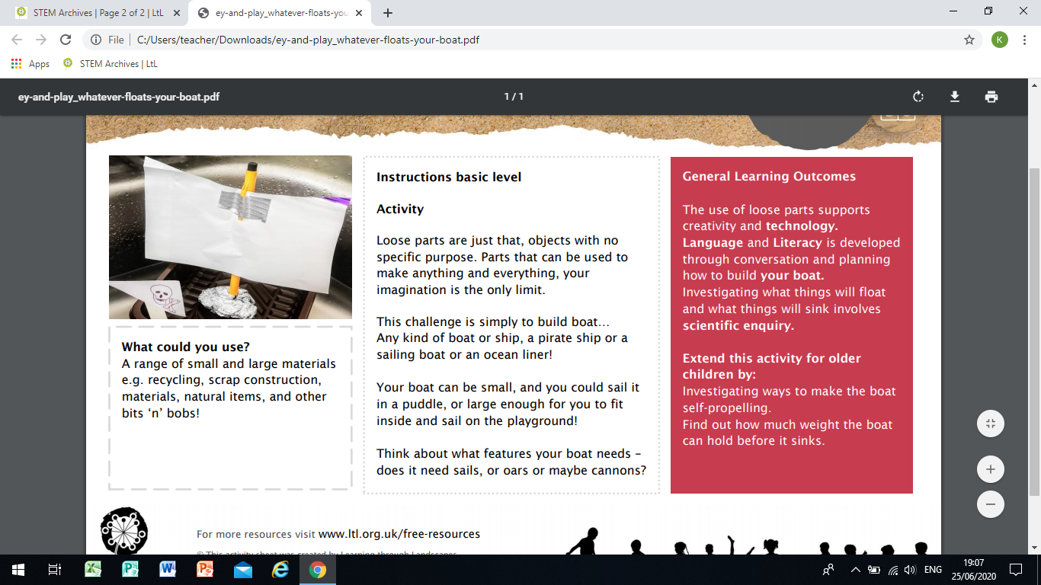

Slide 18
Reading online
Please log on to Bug Club and read for at least 15 minutes
Make sure you answer your bug questions!

Slide 19
Enjoy, Unicorns!

