Slide 1
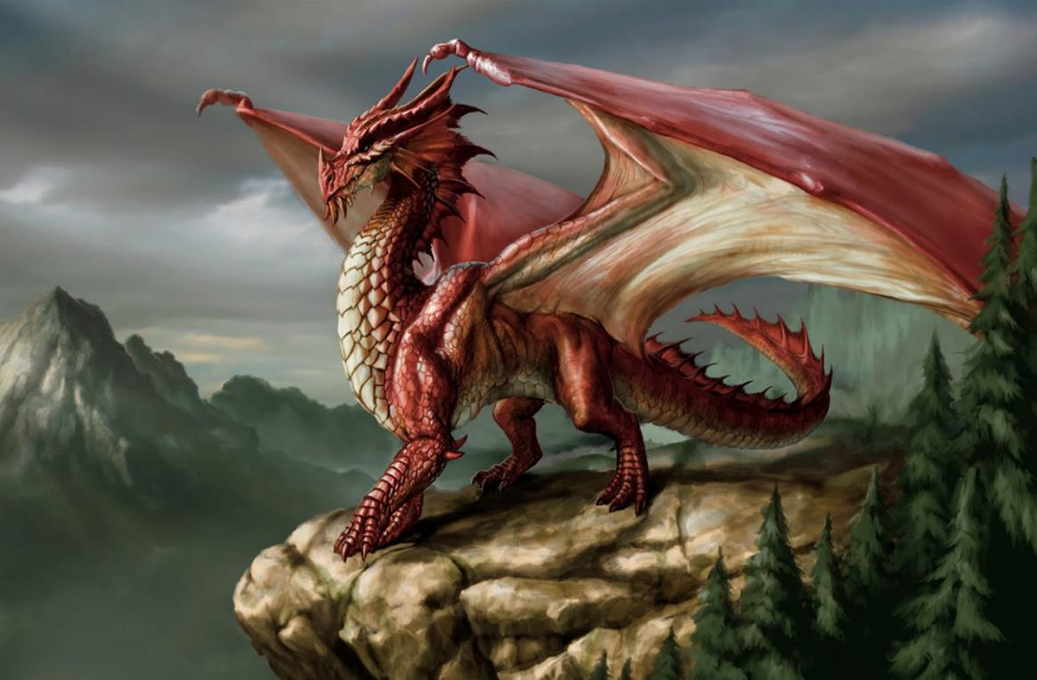
Welcome to Dragons

Slide 2
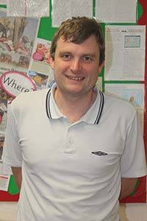
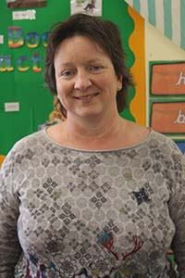
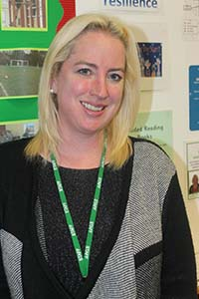
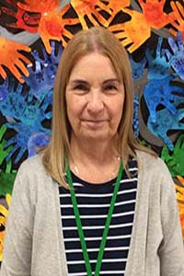
Mr Atkinson
Miss Pattison
Miss Osman
Mrs Delaney

Slide 3
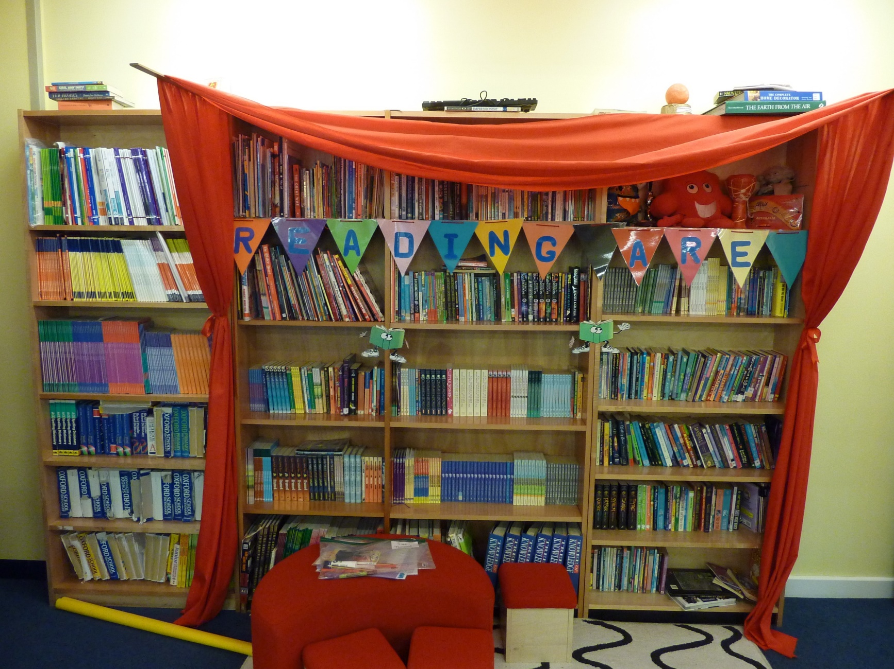
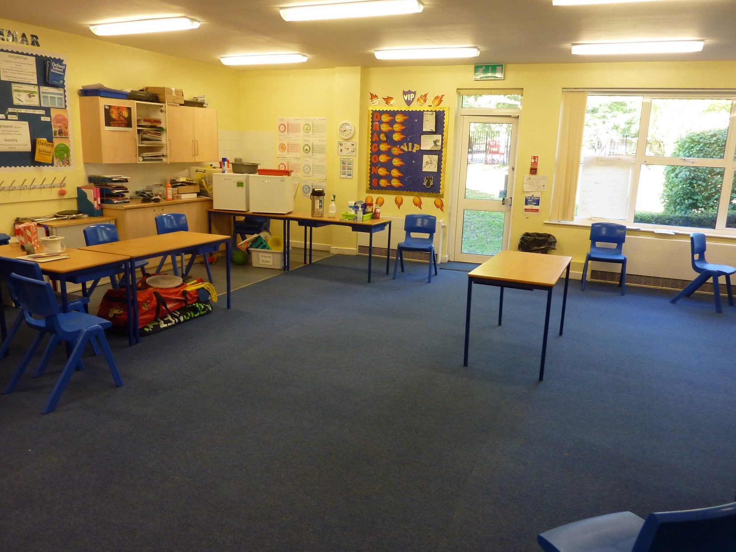
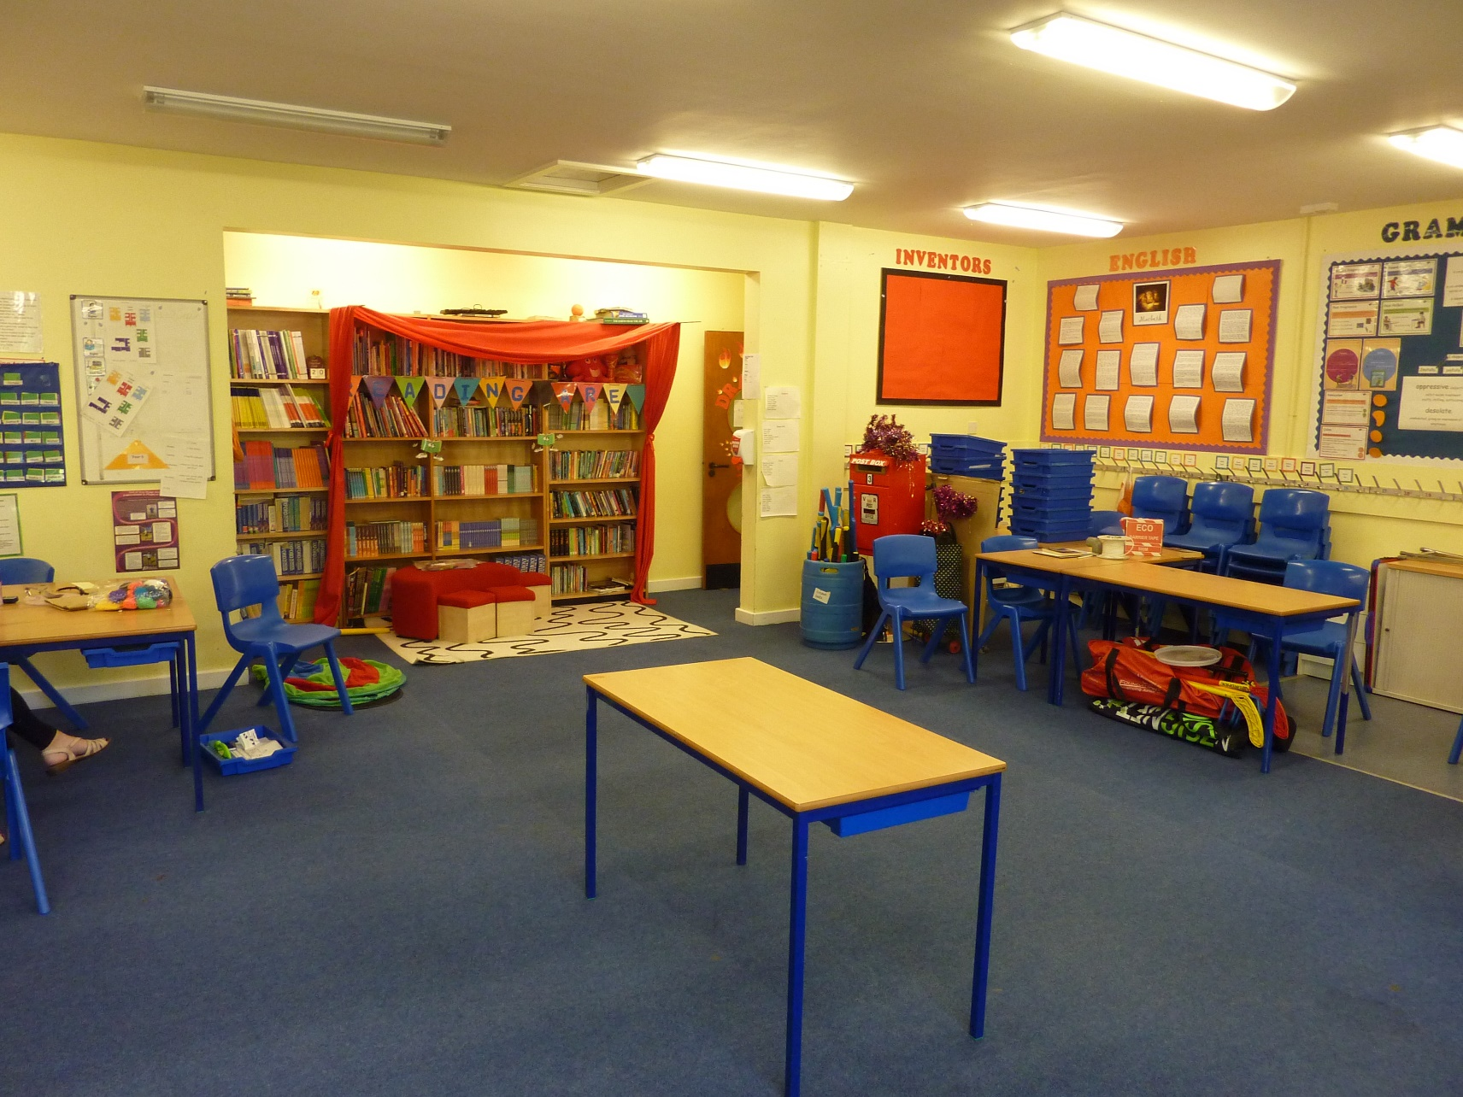

Slide 4
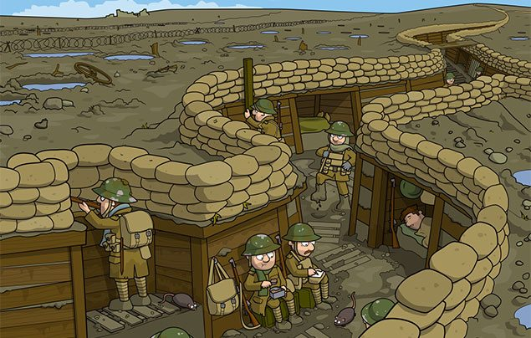
Our Learning:
Our first topic next year is a history topic all about World War One.
You can find out more about WW1 at: DK Find Out or National Geographic
Click here for some reading suggestions about World War One.

Slide 5
Our Learning:
In Science, we will be looking at Animals including humans, focusing on the Human Body.
Using the science investigations and research, we will be trying to answer the question:
How can we maintain a healthy lifestyle?

Slide 6
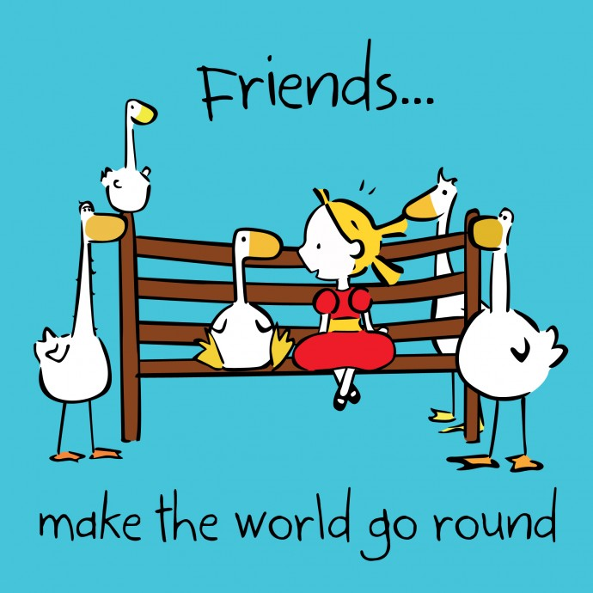
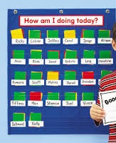
What is a VIP?

Slide 7
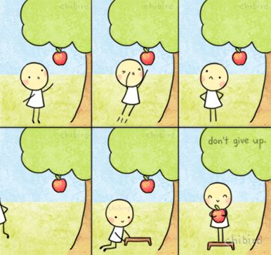
Mr Atkinson
My three main goals for us in Year 6 are:
to always be willing to try something new
be brave with our learning
have confidence in our own abilities

Slide 8
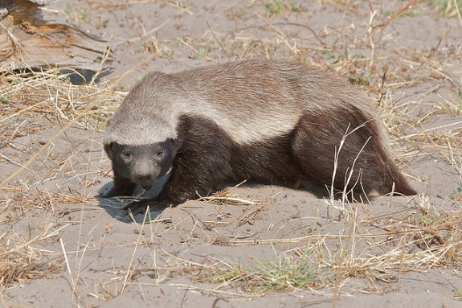
Things I have learnt about you.
We have talented chefs.
We support the following teams:
Crystal Palace
Manchester United
Chelsea
Arsenal
We enjoy computer games like Minecraft and Fortnite.
We are animal lovers.
We love to act, dance and sing.
We are talented musicians.
We are amazing artists.
We are multi-lingual.

