Slide 1
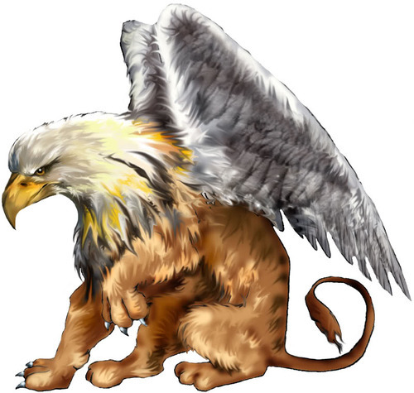
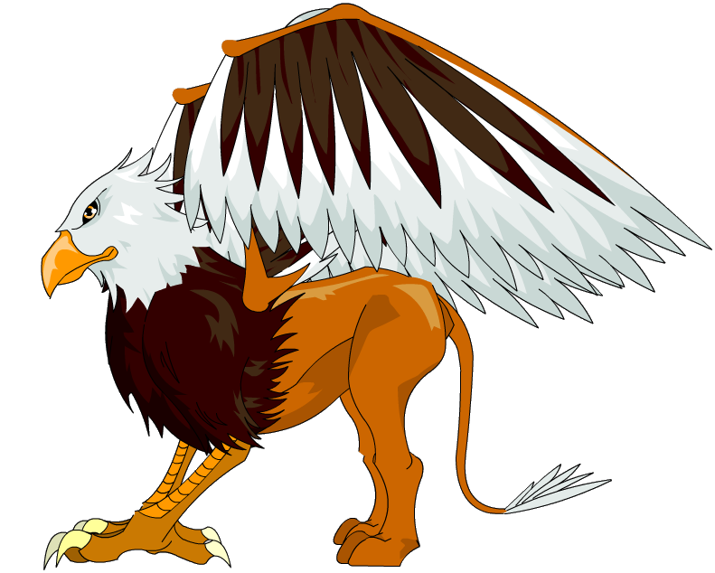
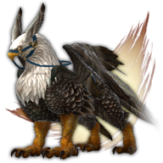
Welcome to Griffins

Slide 2
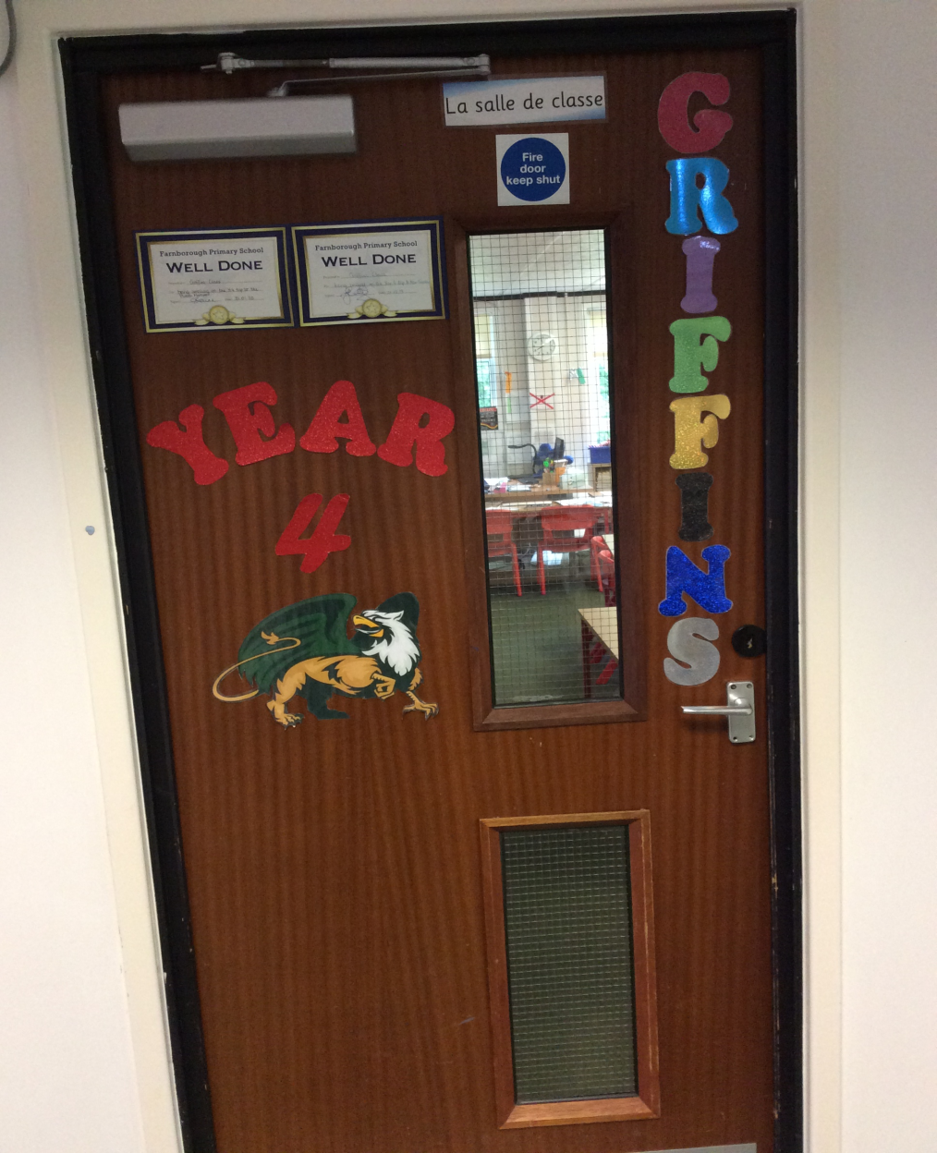
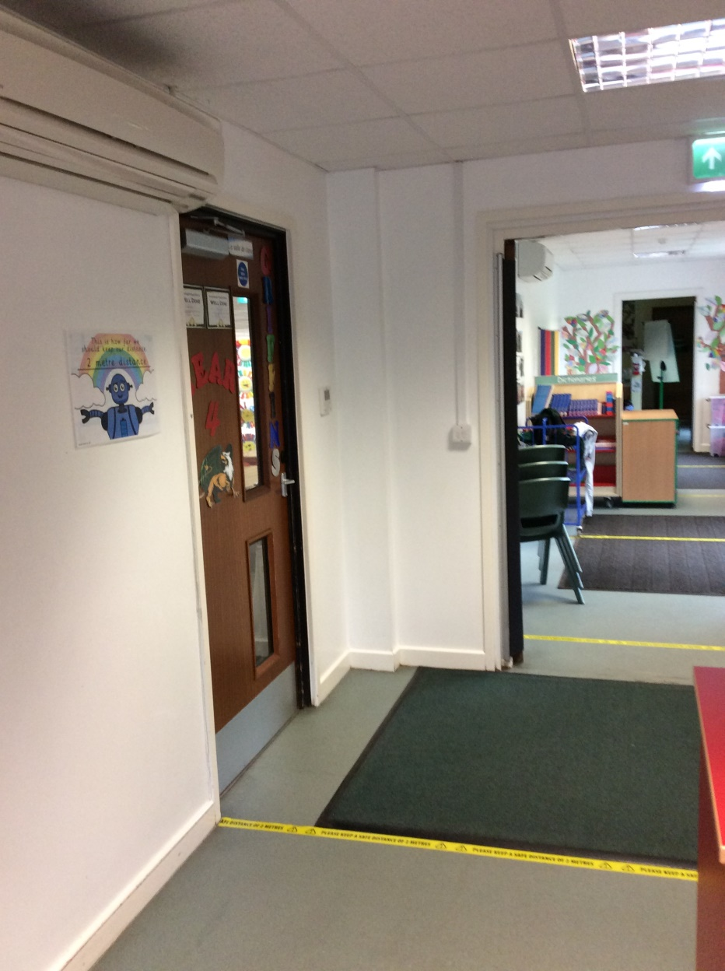
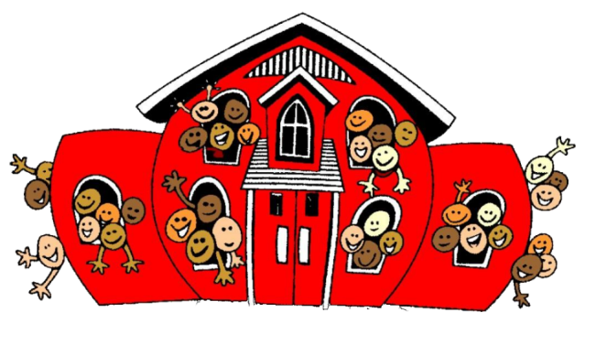
Where is Griffins class?
You will need to walk passed Mrs Roberts’ Classroom, passed the Art Gallery and turn right towards the photocopier. Griffins class is 2nd door on the left.

Slide 3
In Our Classroom Bubble this year
We will have: Mr Vallois, Mrs Dar and Mrs Ward.

Slide 4
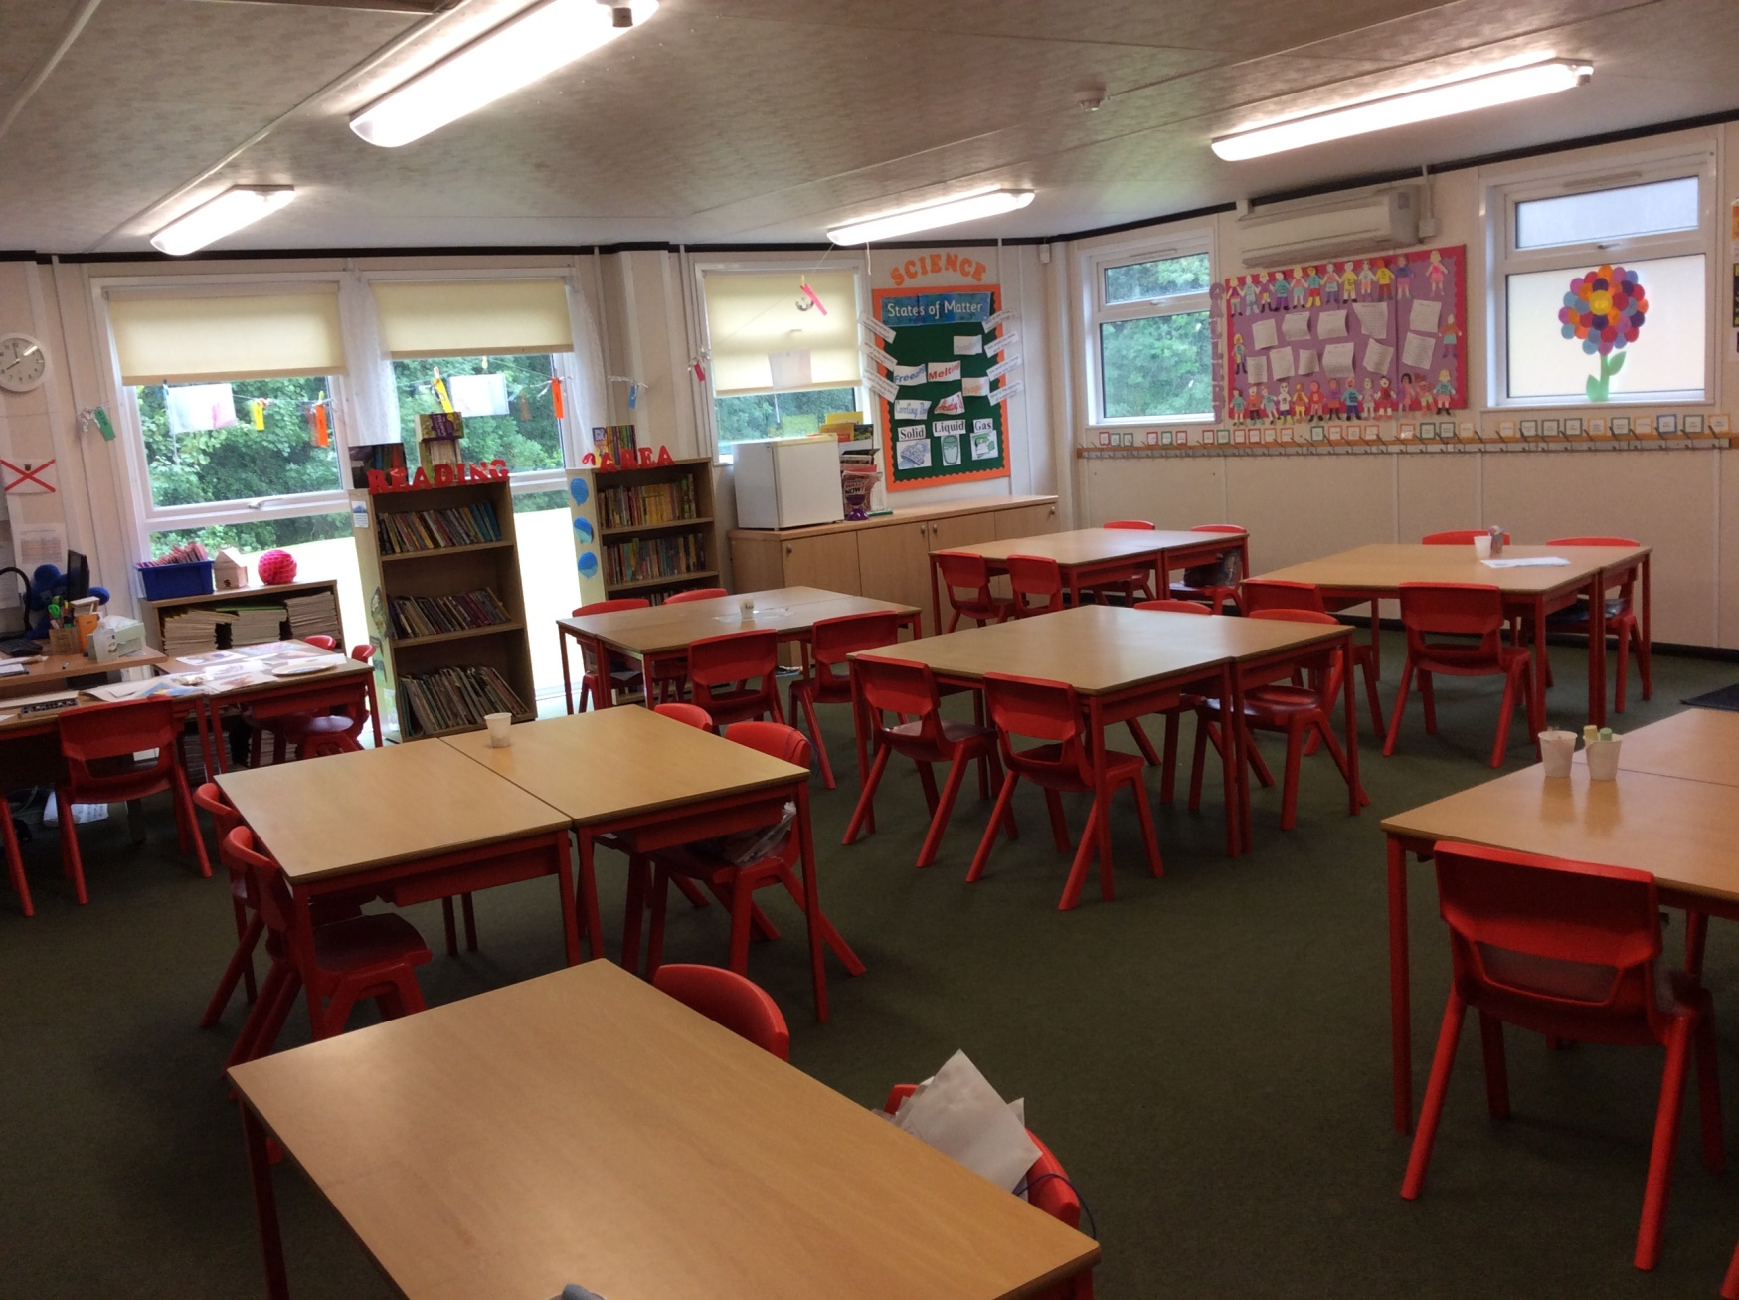
Our Classroom!
Our Classroom might look slightly different currently due to social distancing but we are all hoping we can make the classroom look as bright and amazing as possible come September

Slide 5
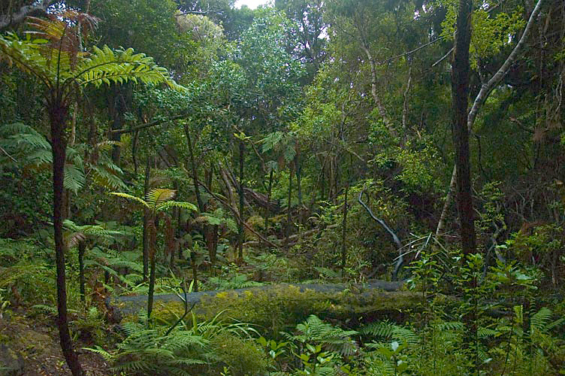
Our topic for Autumn Term will be
‘Swinging in the Rainforest!’
We will be looking at what and who lives in the Rainforest?
What makes a Rainforest?
Climate?
Deforestation?

Slide 6
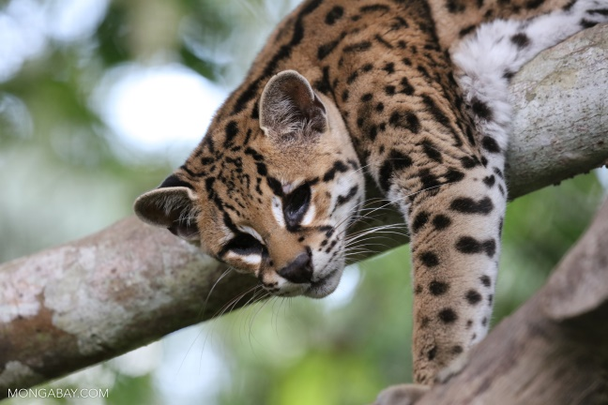
Useful website links if you want to
do some extra research before
September!
https://www.rainforest-alliance.org/kids
https://www.theschoolrun.com/homework-help/rainforest-habitats
https://www.natgeokids.com/uk/discover/geography/physical-geography/15-cool-things-about-rainforests/
https://www.bbc.co.uk/bitesize/topics/zx882hv/articles/zxdsvcw

Slide 7
What Makes us Great?
G – Great, Grateful, Giving, Generous
R – Responsible, Respectful, Reliable
I –Inventive
F – Friendly, Fantastic
F – Forgivable
I – Inclusive
N – Nice, Never give-up
S – Silent, Super, Spectacular, Smile

Slide 8
My Expectations from you:
- You give 100% effort
You allow yourself to make mistakes so you can learn from them.
You follow instructions
You push yourself to be the best version of you!
But most importantly, you have fun!!!

Slide 9
What I have learnt from all of your amazing posters/letters?
We have a lot of children who love Sport!
We have many Charlton Athletic supporters!
We love reading!
We love animals (so many pets!!)
We love spending time outside (going on walks, horse riding, sports!)

