Slide 1
English
This week we will be using our prediction and deduction skills from a series of pictures to base our comprehension and writing around. There is some geography and art activities to complete too – have fun!

Slide 2
Day One – Under the bed

Slide 3
Questions for Day One
What was the noise that Michael heard?
What did he see under the bed?
3) What will happen next?
4) How did he feel when he first heard the noise?
5) How did he feel when he looked under the bed?
6) What time of day do you think it is?
7) Have you ever been frightened of anything?
8) Why do things seem more frightening at night?

Slide 4
Day One continued
Example of a story starter.
The scuttling noise had disturbed Michael, and he’d shot bolt upright in bed. After taking a deep breath, he flung himself onto the smooth wooden boards of his bedroom floor and took a peek…
9) Can you write your own paragraph example of how this story could start?

Slide 5
Day One continued
Weak sentences
10) These sentences are ‘weak’ and need your help to become strong. Can you help?
Michael heard a noise. He felt scared. He sat up in bed. He went to the floor. He looked under the bed.
Perfect picture
11) Can you draw a picture of what Michael saw under the bed?

Slide 6
Monday 13th July 2020

Slide 7
Farnborough’s Race across the World Results up to Monday 6th July
Class | Number of kilometres covered | *Which country did your class reach? From Farnborough School to …..
Pixies | 2909 km | Russia
Elves | 2459 km | Greece
Unicorns | 2576 km | Turkey
Phoenix | 1690 km | Algeria
Pegasus | 5702 km | America
Giants | 3121 km | Russia
Griffins | 3036km | Russia
Centaurs | 4106 km | Russia
Dragons | 1831 km | Algeria

Slide 8
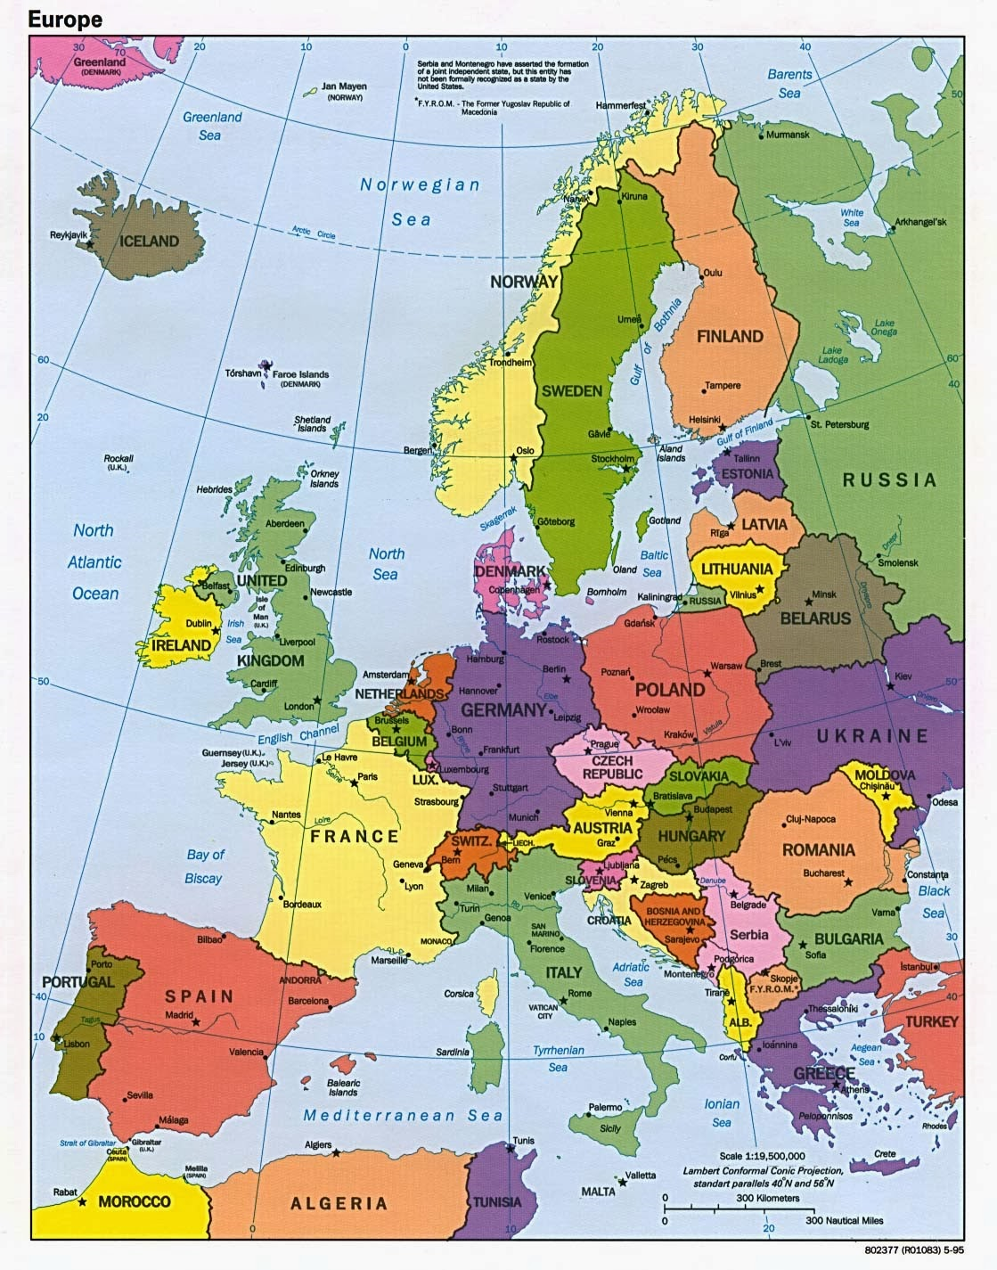
Which country did your class reach?
Map of Europe
Which country did your class reach?

Slide 9
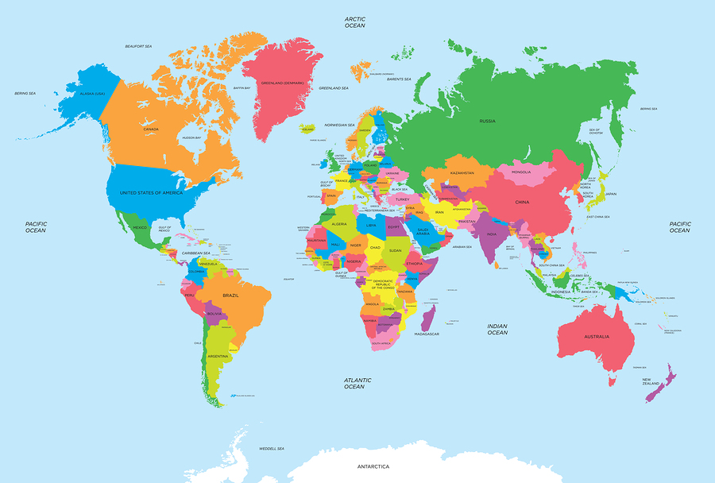
of the World
Map of the World
Which country did your class reach?

Slide 10
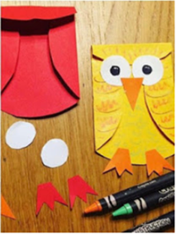
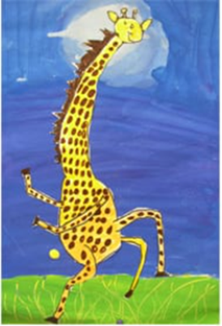
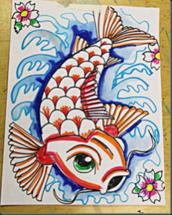
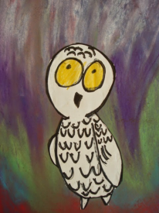
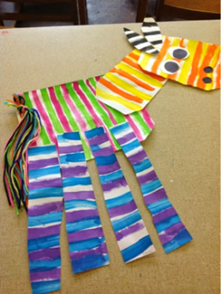
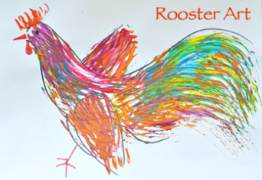
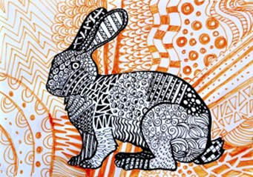
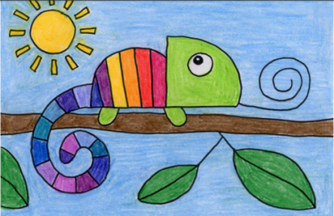
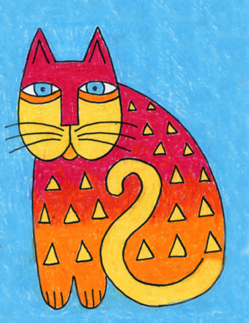
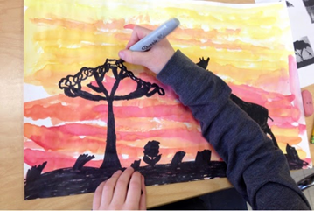
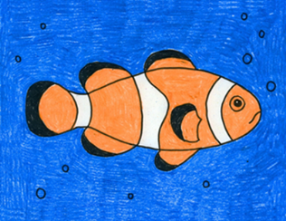
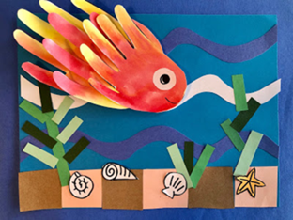
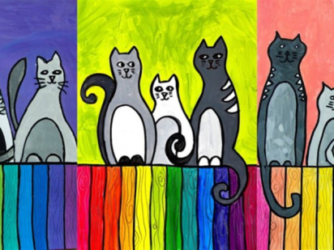
Carnival of the Animals - An Art festival
Hello
Over the last 6 weeks you been creating some great art on the theme of “Carnival of the Animals.”
We hope you have enjoyed the lessons and we have really enjoyed looking at your work. It’s been lovely to hear that family members have also joined in!
This week I am giving you a choice from my favourite websites….
There are so many nice ideas on these websites I found it difficult to choose, so take a look and decide yourself!
Enjoy ,relax, be creative this week and
over the summer.
We would love to see your artwork in September!
Take care
Miss Pattison
Thank you for sending in your fabulous artwork! Remember it’s not too late to send your art to your home learning page. We put up everything that is sent in on the website.

Slide 11
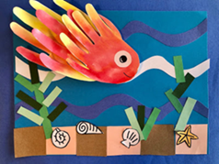
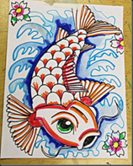
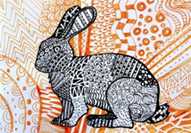
Dear Key Stage 2 children
You are all invited to Zoom on Tuesday 14th July at 1.35 pm. We would really like you to share your artwork from the past few weeks as if we are walking around our Farnborough Art Gallery!
You are also welcome to attend if you are happy just to watch and see your friends showing their artwork!
The meeting ID and password will be sent out on Friday as usual.
See you Tuesday!
Miss Pattison

Slide 12
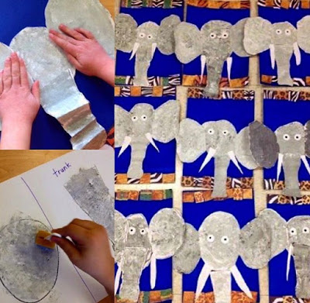
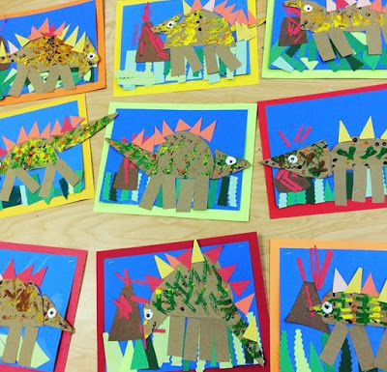
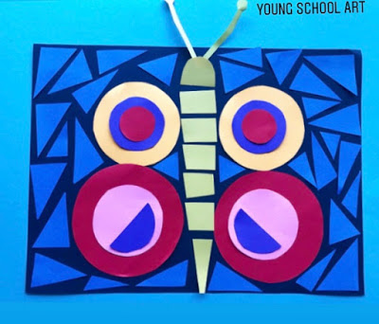
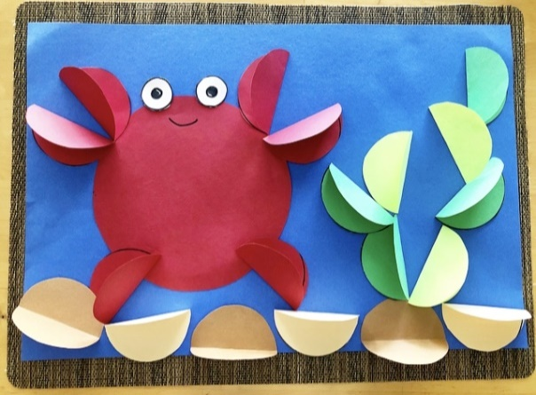
Young artists will enjoy this website
https://youngschoolart.blogspot.com/
https://youngschoolart.blogspot.com/2020/05/online-art-lessons-week-7.html
https://youngschoolart.blogspot.com/2020/06/
https://youngschoolart.blogspot.com/2020/05/online-art-lessons-week-10.html
https://youngschoolart.blogspot.com/2020/05/online-art-lessons-week-9.html

Slide 13
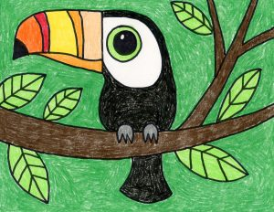
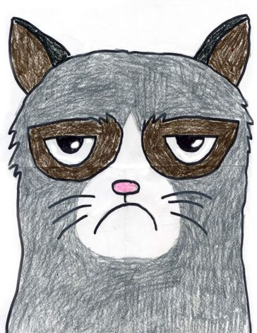
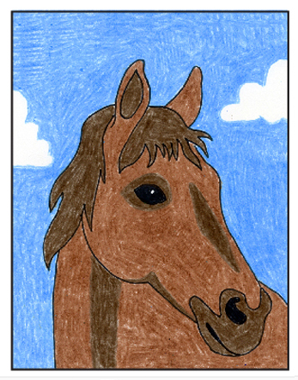
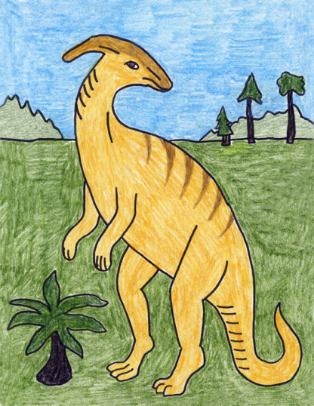
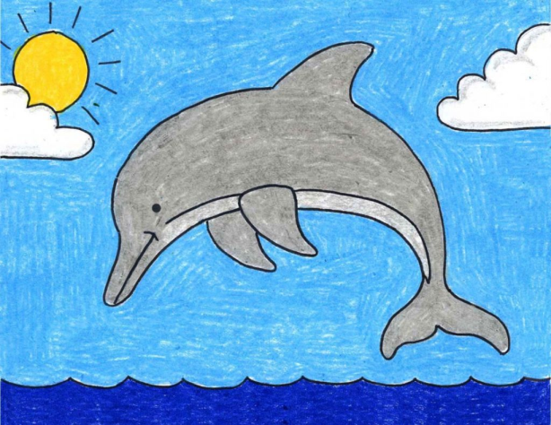
https://artprojectsforkids.org/
Know what you want to draw? This website gives you easy step by step instructions for virtually every animal. A few suggestions.....
https://artprojectsforkids.org/how-to-draw-a-toucan/
https://artprojectsforkids.org/draw-grumpy-cat/
https://artprojectsforkids.org/how-to-draw-a-horse-head/
https://artprojectsforkids.org/how-to-draw-a-dolphin/
https://artprojectsforkids.org/how-to-draw-a-parasaur-dinosaur/

Slide 14
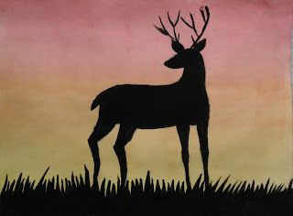
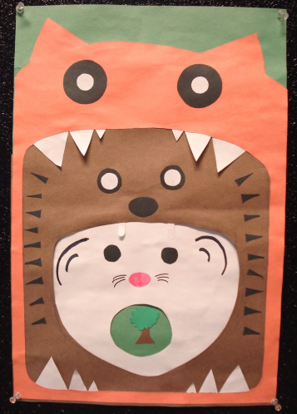
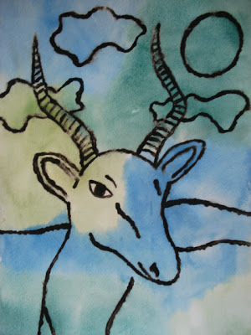
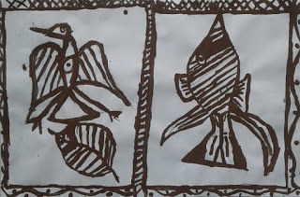
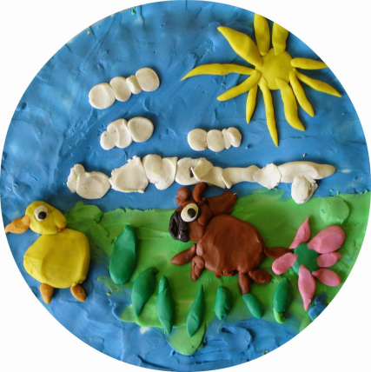
For more arty animal ideas check out this website:
https://afaithfulattempt.blogspot.com/
https://afaithfulattempt.blogspot.com/2019/05/antler-animals-in-silhouette.html
https://afaithfulattempt.blogspot.com/search?q=food+chain+collage+
https://afaithfulattempt.blogspot.com/2011/05/glue-resist-african-animals-watercolour.html
https://afaithfulattempt.blogspot.com/2015/05/plasticine-pictures.html
https://afaithfulattempt.blogspot.com/2019/11/korhogo-cloth-paintings.html

Slide 15
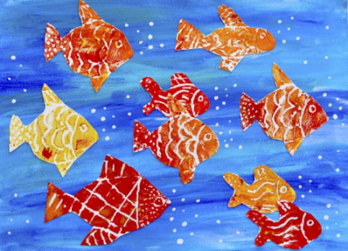
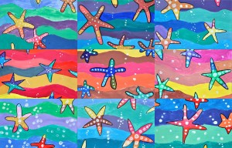
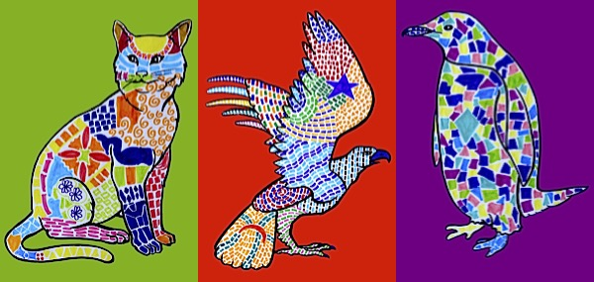
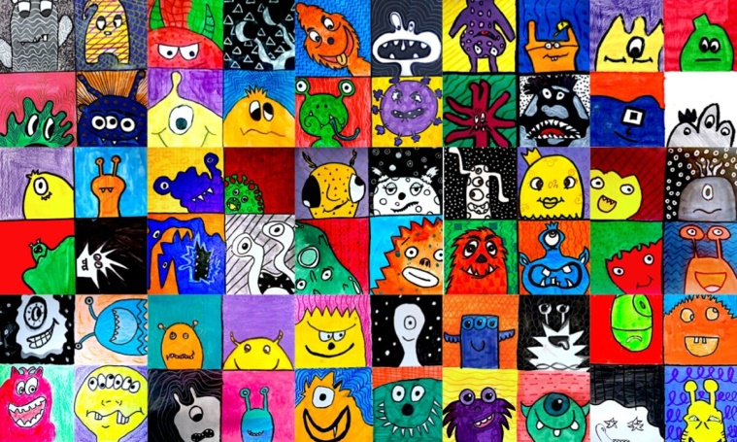
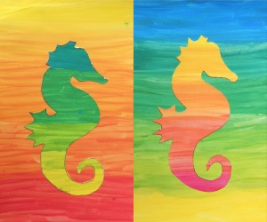
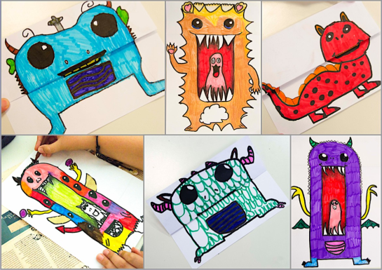
Check out arteascuola.com/ for art lessons that are perfecto! These are aimed at older artists.
http://arteascuola.com/2015/03/animals-decorated-with-mosaics-inspired-by-gaudi/
http://arteascuola.com/2014/02/starfish-in-warm-and-cool-colors/
http://arteascuola.com/2016/01/so-many-goldfish-prints-with-styrofoam/
http://arteascuola.com/2020/05/monsters-in-complementary-colors/
http://arteascuola.com/it/2014/04/silhouette-in-gradazioni-cromatiche/
http://arteascuola.com/2019/06/cute-or-scary-monster/
Remember you have the animal outlines on your home learning pages.

