Slide 1
Friday 10th July-
KS1 Eco Day

Slide 2
Eco Afternoon
Subject / Lesson | Time
Recycling – create from recyclable materials | 45 minutes
Recycling – create a poster encouraging recycling | 1 hour
Physical Activity | 30 minutes
Carbon footprint – researching where food travels from | 45 minutes
Carbon footprint – design an eco-friendly meal | 1 hour

Slide 3
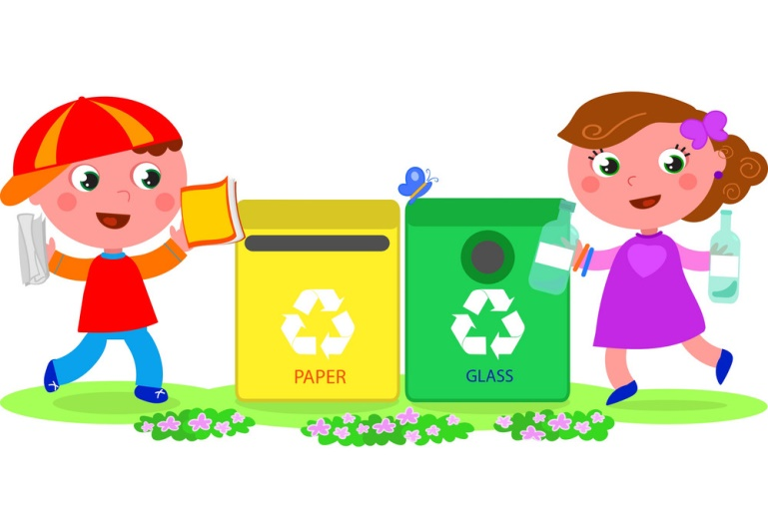
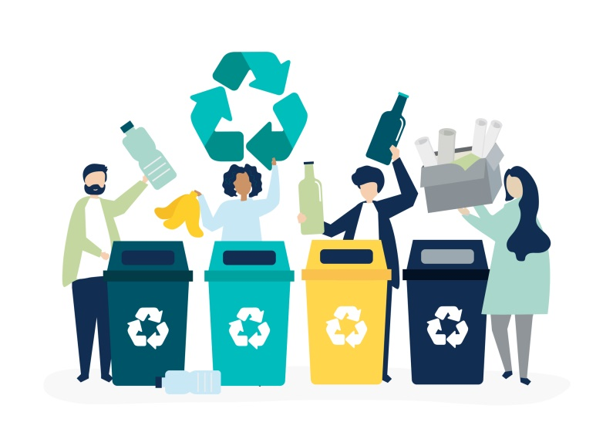
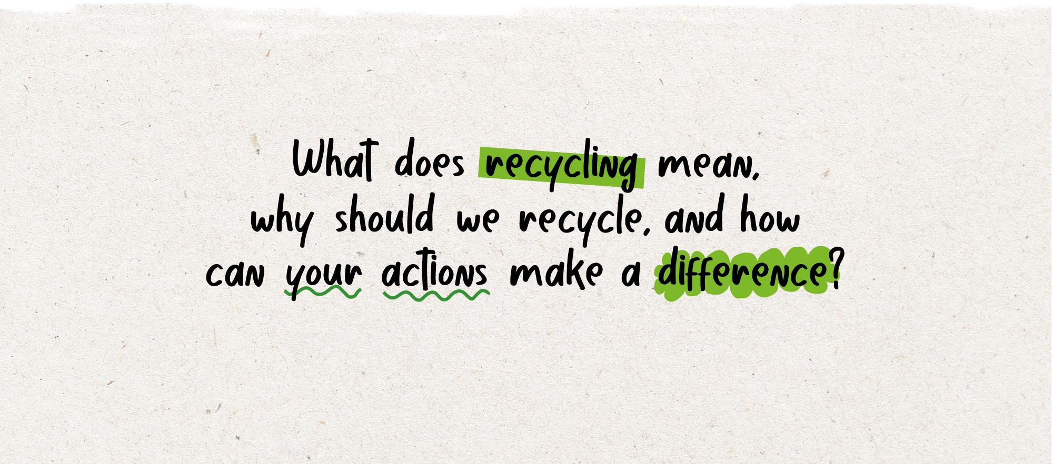
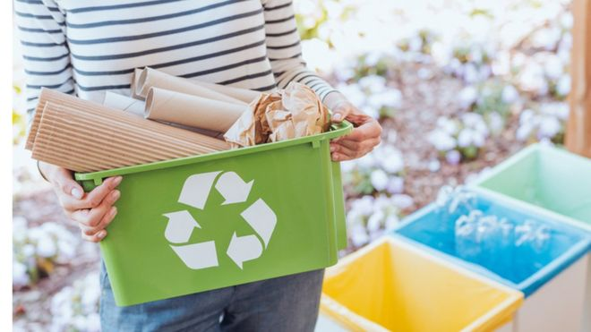

Slide 4
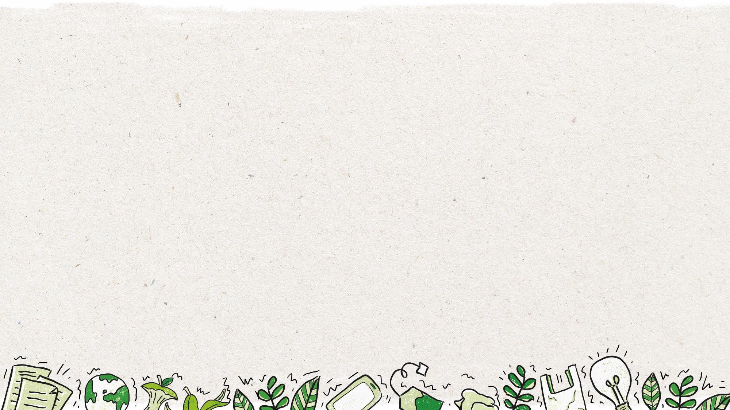

Slide 5
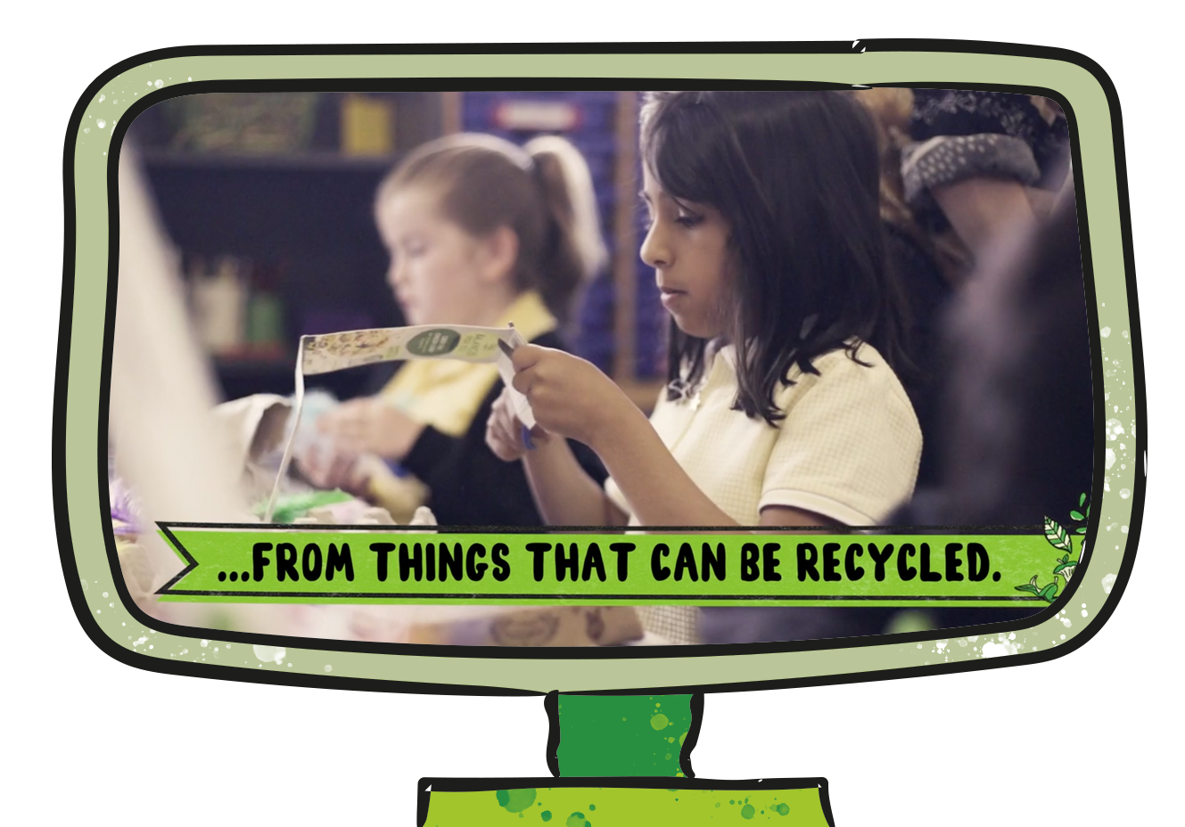
Task 1: create something out of recyclable materials you have in your home. Watch the video for some ideas.
Notes:
Delivery notes:
Join the Action Pack film (5 minutes)
After playing the film to the class, discuss these questions in pairs or as a class:
How did this film make you feel?
What do you think is the message of this film? Does it have more than one message?
Does this film make you want to take action? Why?
Did this film teach you anything?

Slide 6
It takes less energy to make things with recycled materials
It saves energy and natural resources
It uses up natural resources that we don’t need
It means more rubbish is put into landfills
It protects natural environments and wildlife
It reduces carbon emissions, helping to stop climate change

Slide 7
It takes less energy to make things with recycled materials
It uses up natural resources that we don’t need
It saves energy and natural resources
It means more rubbish is put into landfills
It protects natural environments and wildlife
It reduces carbon emissions, helping to stop climate change

Slide 8
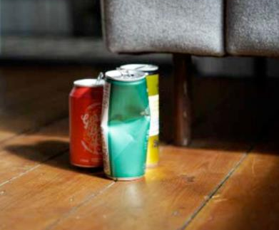
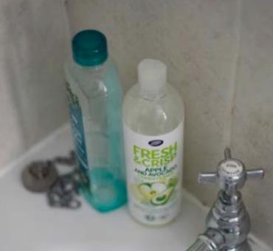
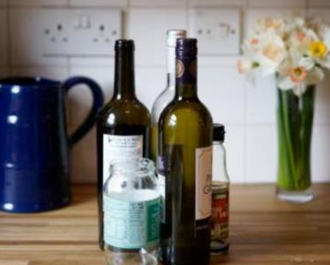
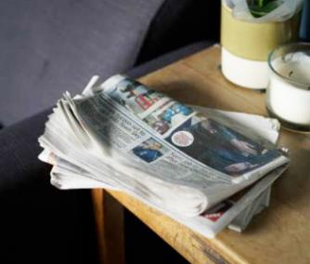
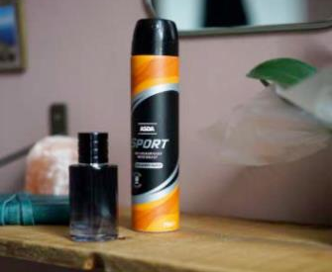
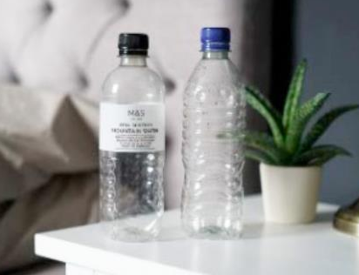
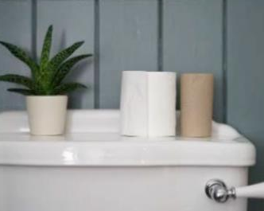
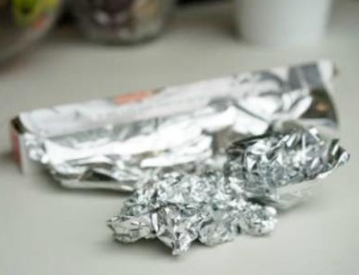
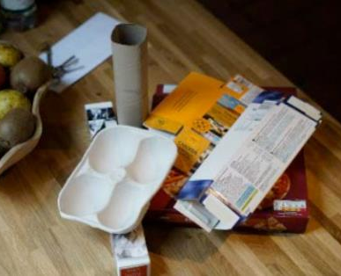

Slide 9
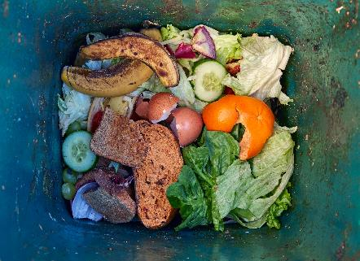
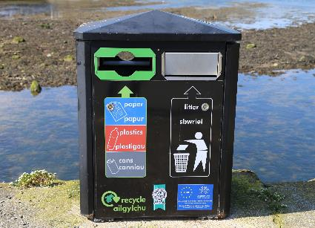
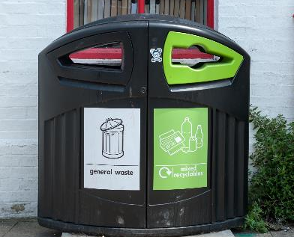
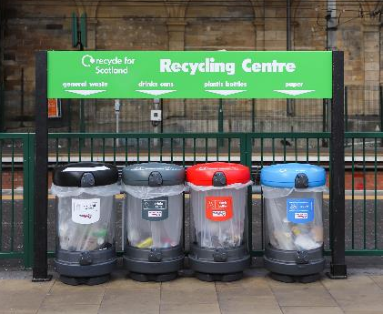
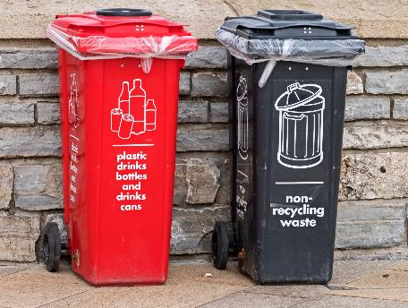
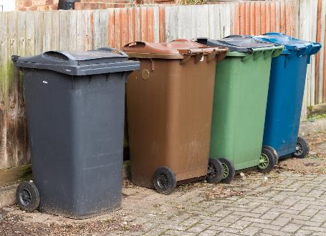
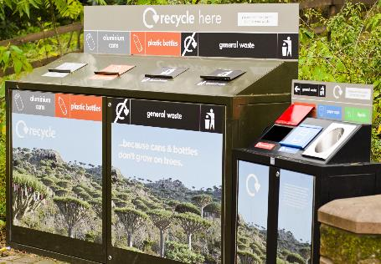

Slide 10
Not recyclable
Sometimes not recyclable
Bubble wrap
Ceramics
Laminated paper
Wood
Mirrors
Paper with metallic, glitter or velvet on it
Toxic containers (items that could usually be recycled, like metal cans, can’t be recycled if they were used to hold toxic materials, such as paint)
Greasy containers (like toxic containers, recyclable items that have grease on them usually aren’t recyclable)
Stickers
Sellotape
Plastic toys
Nappies
Pet food pouches
Cat litter
Toothpaste tubes
Cotton wool
Tissues
Bricks
Pots, tubs and trays– so make sure to check if they can be recycled in your area using the Recycling Locator
Some wrapping materials aren’t recyclable – use the scrunch test to check
Check the recycling locator
Plastic wrapping and bags (sometimes called soft plastic) can often only be recycled at supermarkets. Check the recycling locator to see if this can be recycled in your local area.
Electronic items - these can be recycled, but they usually need to be recycled separately at a recycling centre. Some local authorities do collect them from your kerbside collection so check the recycling locator to see if they can be recycled in your local area.

Slide 11
Check locally
This symbol is put on items that can only be recycled in some parts of the UK. It is up to you to check whether it can be recycled in your area.
Not yet recycled
This symbol is put on items that aren’t recycled in most parts of the UK yet.
The Mobius Symbol
This symbol is used on items that are made of a recyclable material. However, it doesn’t say anything about whether the material is recyclable in your area.
Widely recycled
This symbol is put on items that are recycled in most parts of the UK. However, it’s still a good idea to check whether the items are recyclable in your area.
The Green Dot
This symbol is used by companies who have paid money to help with recycling efforts in Europe, but it doesn’t mean the item is recyclable.
Tidyman
This symbol is part of a campaign called Keep Britain Tidy. It is used to encourage people to throw rubbish away instead of littering, but doesn’t relate to recycling.
Notes:
Delivery notes
Symbol identification activity: How do you know if something can be recycled? (5 minutes)
Reinforce that not all materials, or types of a material (e.g. types of plastic) can be recycled. Ask pupils:
How do you know if something can be recycled? Explain that many materials have symbols to give you information about recycling.
On screen are a number of recycling-related symbols. Ask pupils:
Do they recognise any of the symbols? What do they mean?
Explain that many people don’t know what these symbols actually mean. To check what the symbols on the screen mean, click to reveal their definitions. Ask students to suggest what each symbol might mean before revealing them.
Check out Recycle Now’s comprehensive guide to recycling symbols here: www.recyclenow.com/recycling-knowledge/packaging-symbols-explained

Slide 12
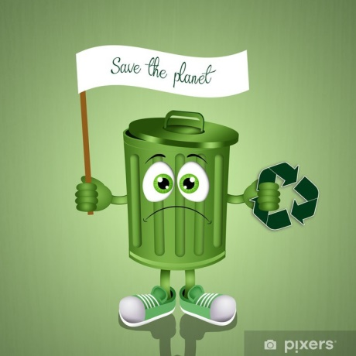
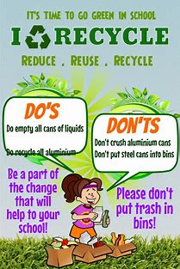
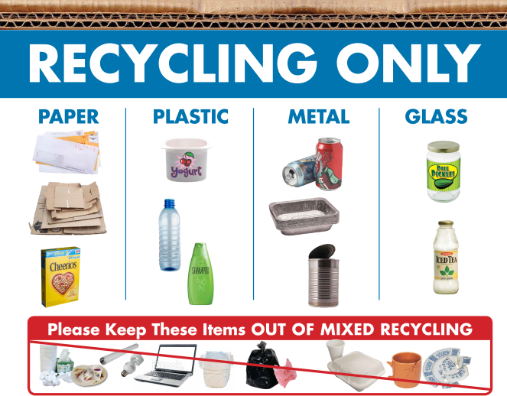
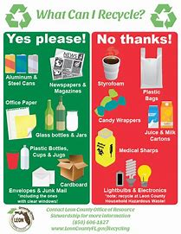
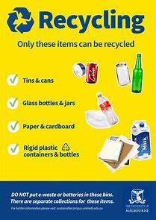
Your mission: Create a poster to help others recycle more, and recycle better.
Task 1: Create a memorable animal character to feature on your poster
Task 2: Create a short, catchy message.

Slide 13
Your first task is to create your own character to inspire others to recycle.
Remember, your character should be:
an animal or creature (this can be any animal, from the sea, land, or sky!)
memorable – what will make your character stand out to people who see your poster? What makes them different from other characters?
passionate about recycling and ready to inspire others to recycle more and better!
Notes:
Delivery notes
Create your character (3 minutes)
Run through the information on the slide.
Please note: We suggest pupils’ characters should be an animal to reinforce the impact recycling can have on the natural world. However, we do encourage creativity, so entries that are mystical creatures/original creations are also allowed as long as they inspire others to recycle more and better!
Optional extension (10-20 minutes)
Ask pupils (working independently or with a partner) to use the My Action Pack Character activity sheet (slide 12) to think about their character’s traits.
Once pupils have had time to complete their activity sheet/discuss their characters select a couple of pupils to present their ideas.
Why have you chosen that animal?
What is your character’s most important character trait?
Why does your character want more people to recycle?
Support: highlight the My character activity sheet word bank to help pupils design their character.
Challenge: when selecting key words to describe their characters, ask pupils to consider what characteristics they think are important for a character who wants to persuade others to recycle? (E.g. brave and outspoken to spread the word, helpful to inform and support others, or friendly and happy to help persuade?)
Use the example animals on the Personification activity sheet (Slide 13) to start pupils thinking about the animal they could create and personify to be their character. Discuss with the class:
Why have you chosen that animal/creature? (e.g. a whale lives in the sea, which is where a lot of rubbish goes if we don’t recycle!)
What characteristics do you think that animal might have? (Make clear there are no right or wrong answers!)
Ask pupils to think of further animals they could create – e.g. what animals do they think would be most affected if people don’t recycle?

Slide 14
Add notes to answer the questions below to start creating your Action Pack character
What animal will inspire your character?
What is your character’s name?
Draw/sketch your character.
Where do they live?
How old is your character?
What is your character like? Pick three words to describe their personality.
What does your character like to do? Name two activities.
Why is recycling important to your Eco Guardian? Write three reasons
Word bank Places - setting
sea * ocean * forest * garden * nest * mountain * recycling bin * shed * city * hill * nest * wood
Verbs - doing words
walk * run * smile * play * recycle * sort * rinse * clean * help * swim * fly * laugh * sing *
Adjectives - describing personality
loud * quiet * shy * outgoing * energetic * lazy * happy * sad * outspoken * clever * brave * friendly * funny * caring * sensible * cool * calm * adventures * awkward * patient * helpful

Slide 15
Your second task is to think who will see your poster and decide on a message for your poster
Look at the slides later on to help you come up with some ideas.
Message
Your message should:
inform others about what can be recycled in your area
inspire everyone to recycle more, and recycle better
be clear – don’t try to say too much at once
include some facts

Slide 16
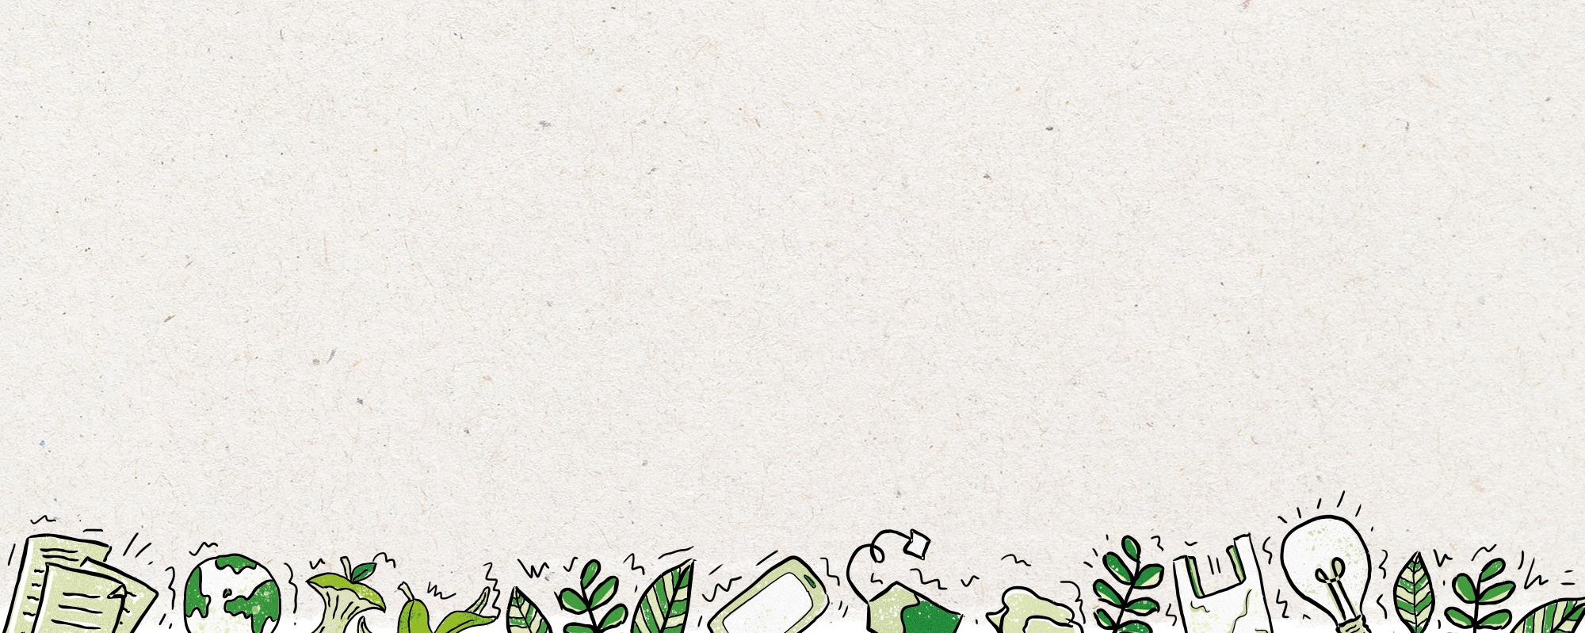
Below and on the next few slides are some ideas you might want to use on your poster.
Recycle plastic bags at the supermarket.
Put recycling bins in every room of the house.
Remember to recycle items from the bathroom.
Squash plastic bottles and replace the lids before recycling them.
Recycle batteries using the bin at school.
Learn the different recycling symbols.
Make sure to recycle aluminium foil.
Use the Recycling Locator to help you recycle better!

Slide 17
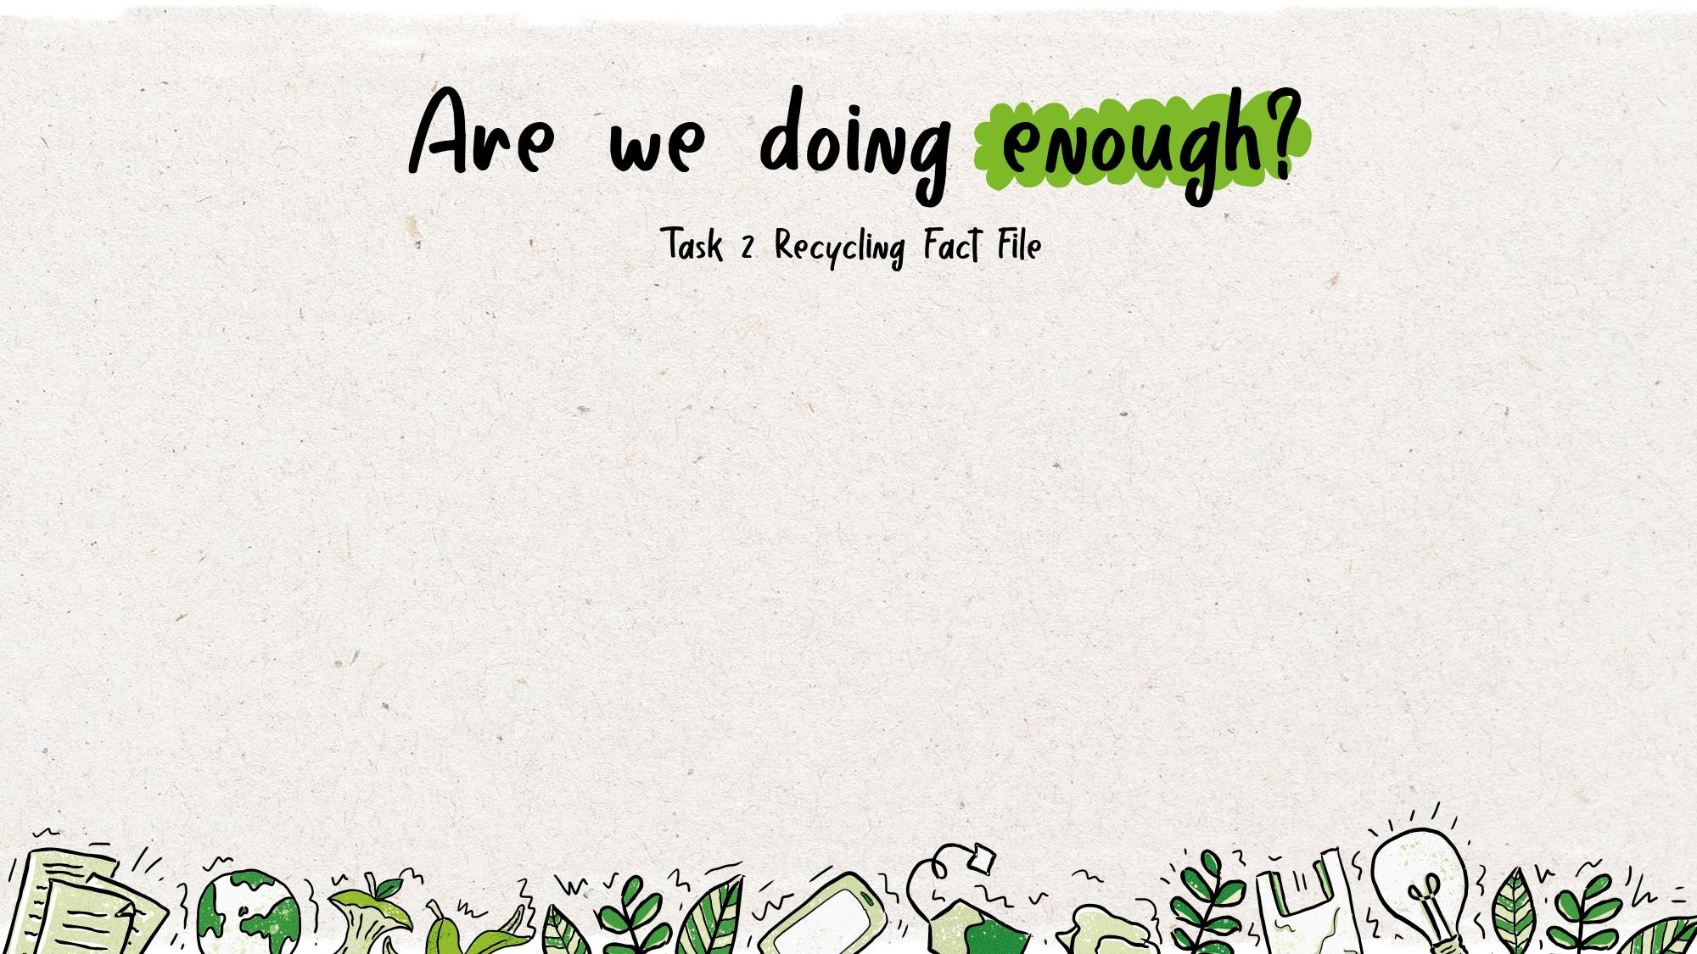
Before the numbers appear (when you click), can you estimate what they will be?
In the UK, we recycle roughly ___% of our household waste.
Every house in the UK throws away over _____ kilograms of waste each year on average.
It takes ___% less energy to make a newspaper from recycled materials, rather than new.
70
The UK recycles about ___% of its cans. Countries like Brazil recycle nearly 100% of their cans.
75
45
1,000

Slide 18
1,000,000
In the UK we use roughly _________ plastic bottles a day, of which _________ are not recycled.
Over __________ tonnes of paper and card was not captured for recycling in 2017.
Plastic bottles that end up in the ocean take ____ years to fully break down.
38,500,000
450
15,000,000

Slide 19
Over __________ tonnes o paper and card was not captured for recycling in 2017.
We are looking forward to seeing all your wonderful posters!

Slide 20
What is a carbon footprint?
A carbon footprint is defined as the total amount of greenhouse gases produced to directly and indirectly support human activities, usually expressed in equivalent tons of carbon dioxide (CO2).

Slide 21
What is included in your carbon footprint?
Any time you use things powered by fossil fuels (like petrol/diesel cars) you are adding to your carbon footprint. This also includes when things are brought to you e.g. food delivered by a truck to the supermarket which your family then buys.

Slide 22
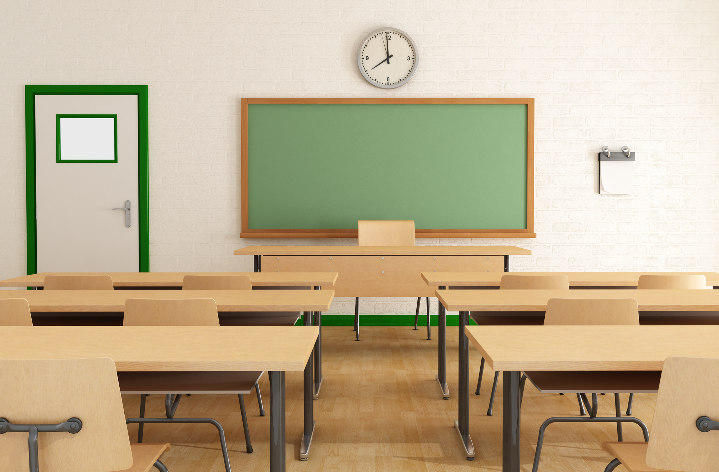
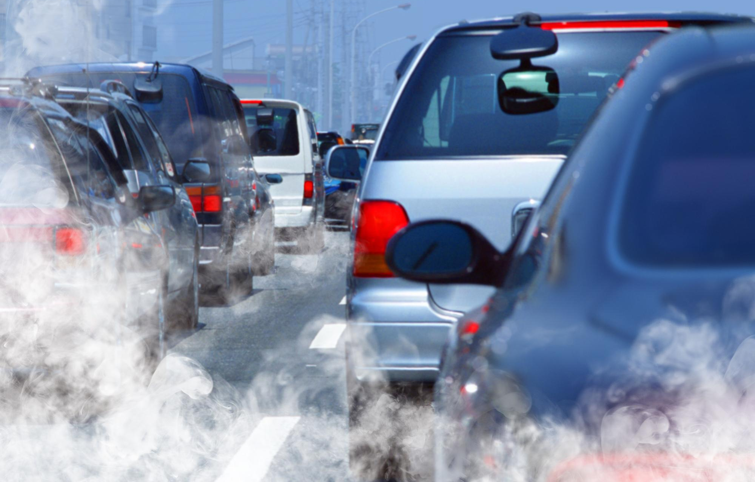
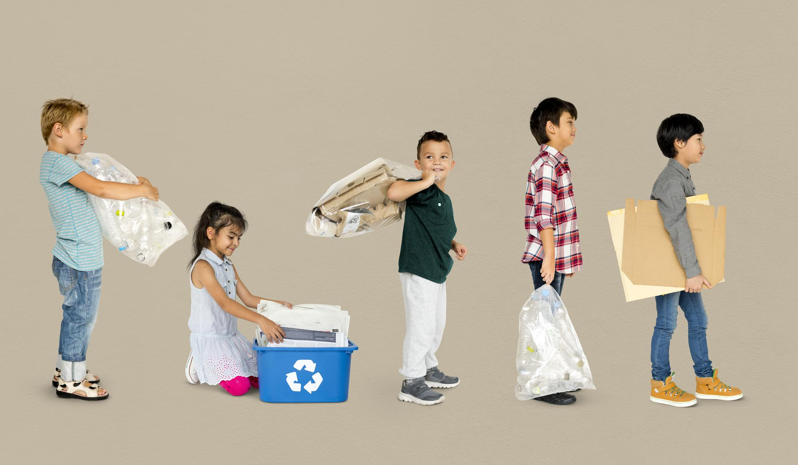
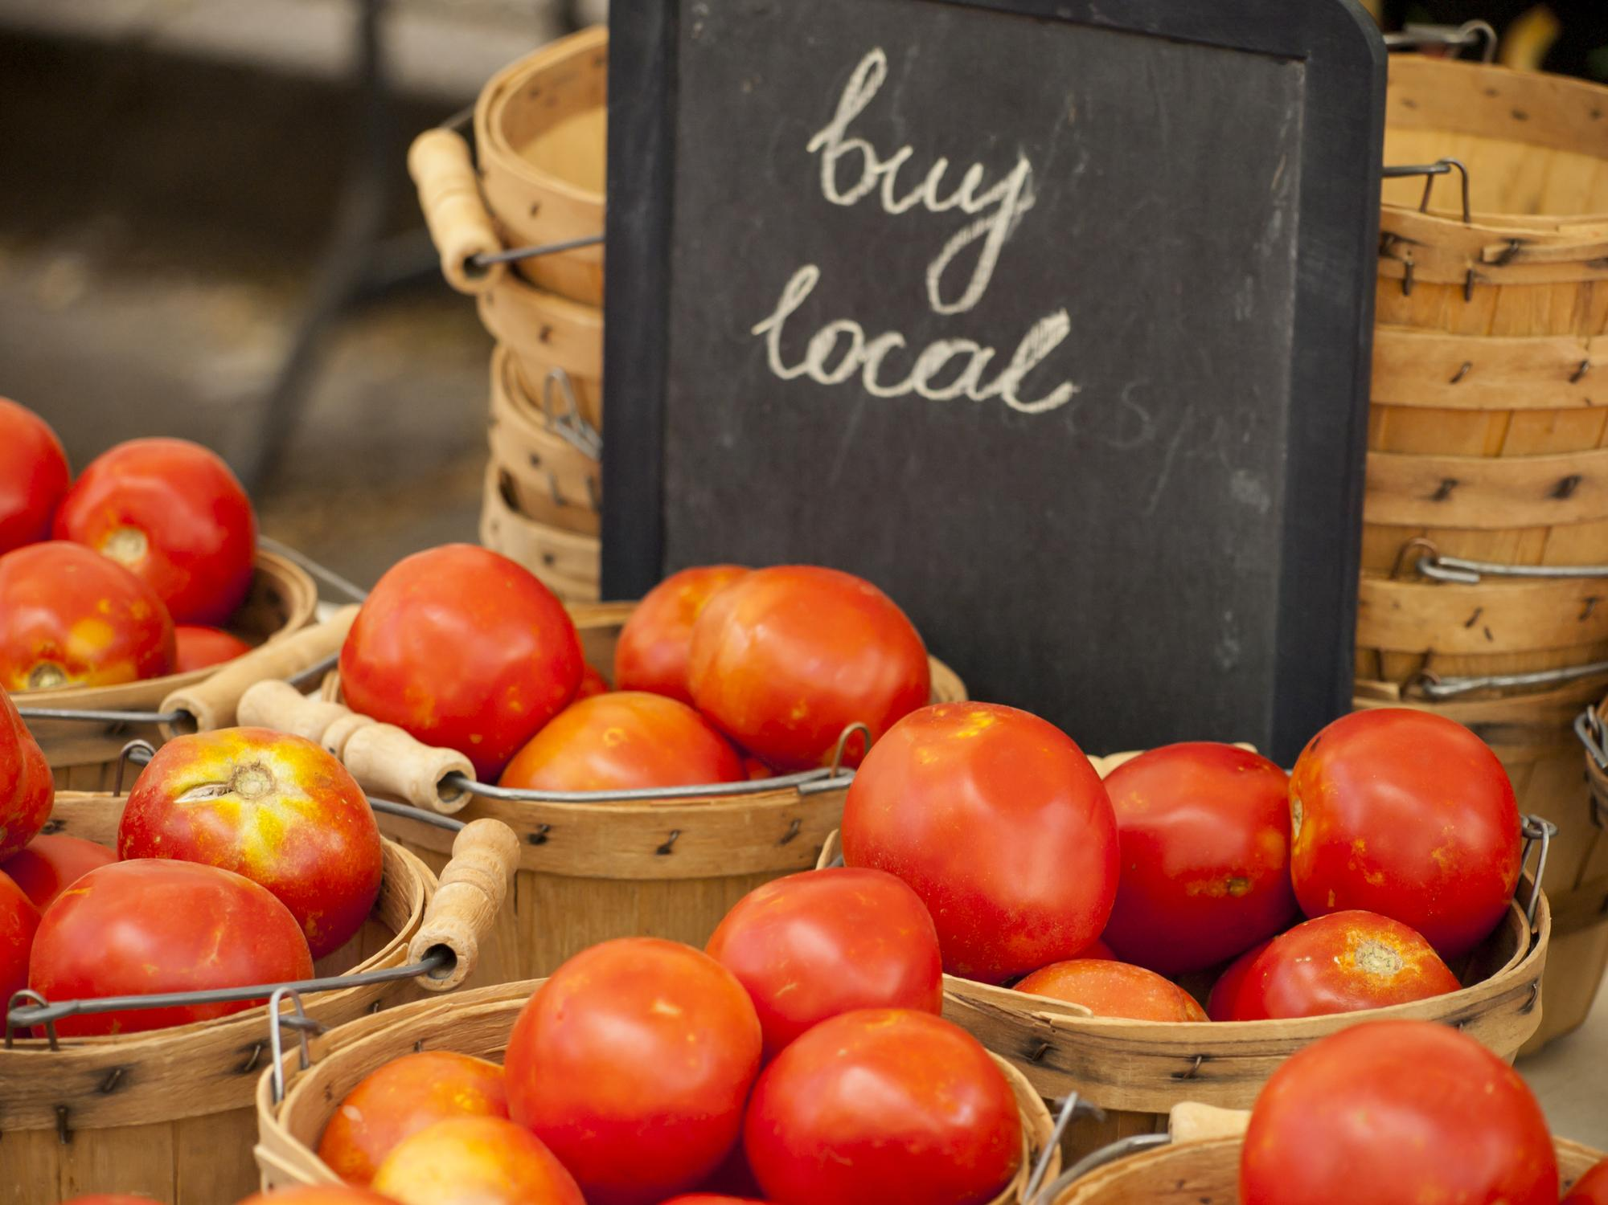
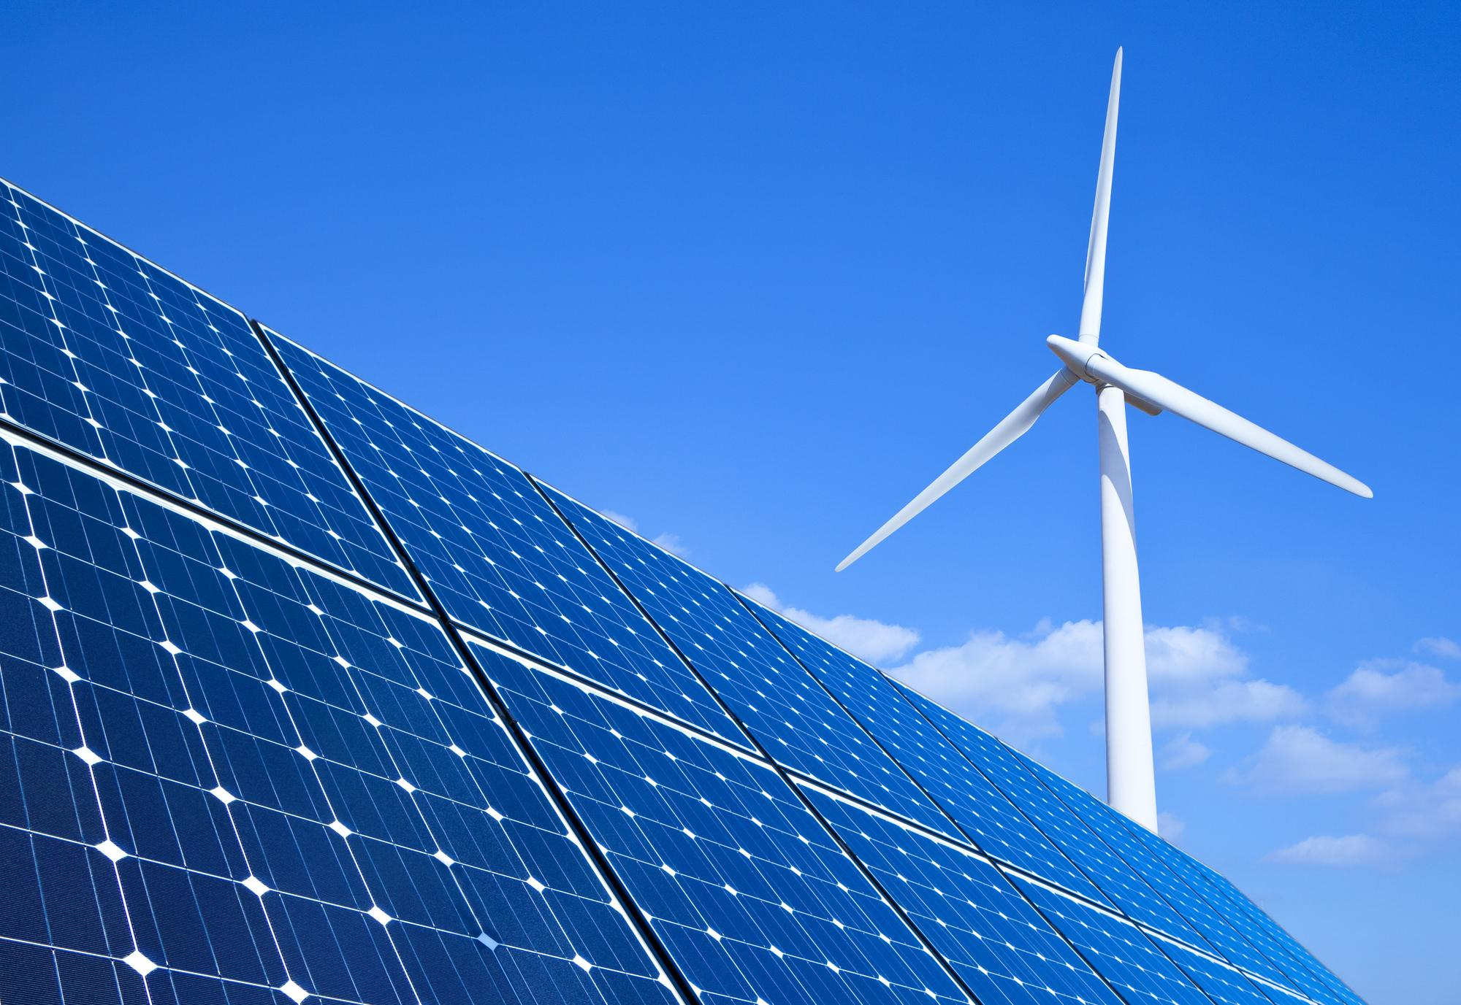
There are many ways we could reduce our carbon footprint.

Slide 23
We are focusing today on where our food travels before reaching our plate.

Slide 24
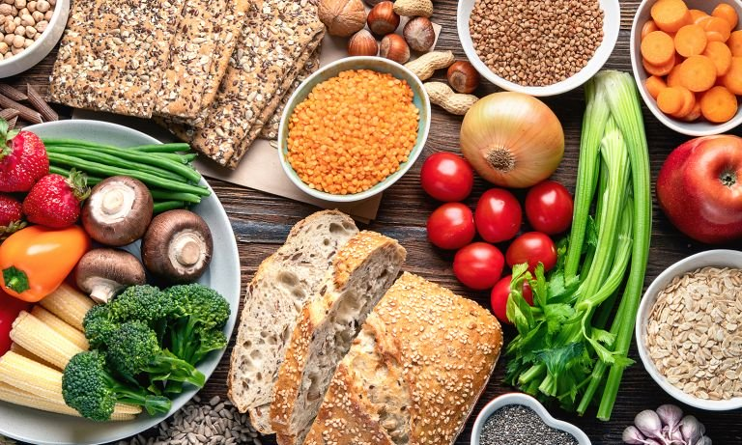
Your activity:
Have a look at the food in your house and find out where it is from. Make a list of what you find out.
Did your results surprise you? Why?

Slide 25
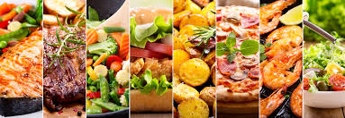
Next activity:
Now you know about where some of the food in your house comes from, can you create a meal of your choice (breakfast, lunch or dinner) which has a low carbon footprint?
Each food you pick gets a number of ‘planet points’ based on how far it has travelled. You want to pick foods which have less points:
0 points for anything from the UK
3 points for any food from other European countries
4 points for food from USA or Africa
5 points for food from Asia
Can you create a healthy, tasty meal which counts as no more than 12 planet points?
Challenge: can you create a menu for a day which includes less than 20 planet points?
Use the map at the end of this presentation to find out which continent your food is from.

Slide 26
Remember: Each food you pick gets a number of ‘planet points’:
0 points for anything from the UK
3 points for any food from other European countries
4 points for food from USA or Africa
5 points for food from Asia

Slide 27
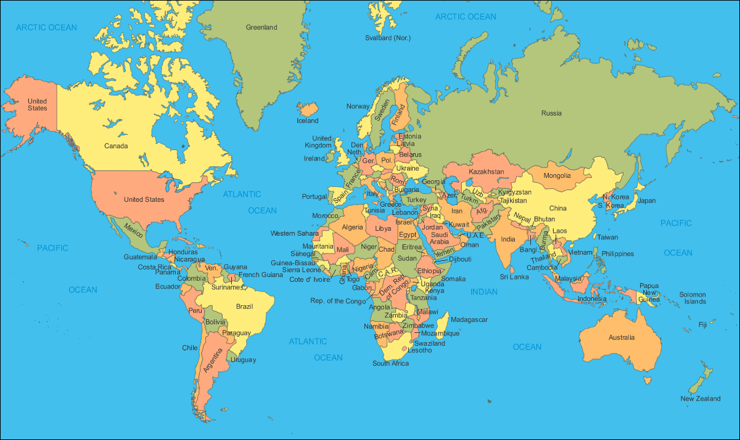
Remember: Each food you pick gets a number of ‘planet points’:
0 points for anything from the UK
3 points for any food from other European countries
4 points for food from USA or Africa
5 points for food from Asia

Slide 28
Have a lovely weekend, Unicorns!

