Slide 1
Good morning Unicorns!
Here’s your work for today: Tuesday 30th June

Slide 2
Let’s start the day by being…

Slide 3
English
Our next book that we are going to be carrying out activities based upon is ‘A Squash and a Squeeze’
First watch this clip:
https://www.youtube.com/watch?v=0xFTGakzEIA

Slide 4
In the story,the old lady follows the wise old man's advice so that her house does not feel too small...
What is an estate agent?

Slide 5
Estate agents sell houses and they are very good at persuading people to buy houses by describing them in a positive way.
Have a look at how estate agents may have described story character's houses.
Can you guess which house they are describing on the next slides?

Slide 6
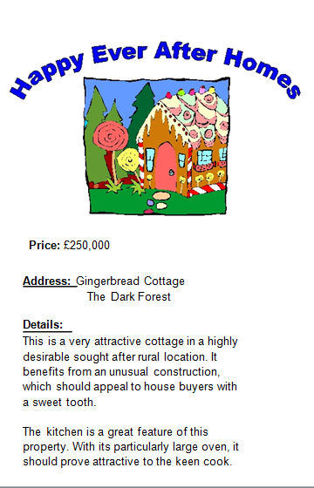

Slide 7
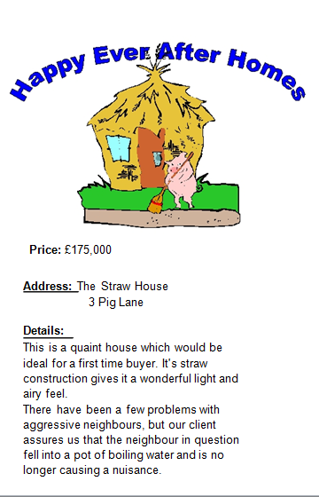

Slide 9
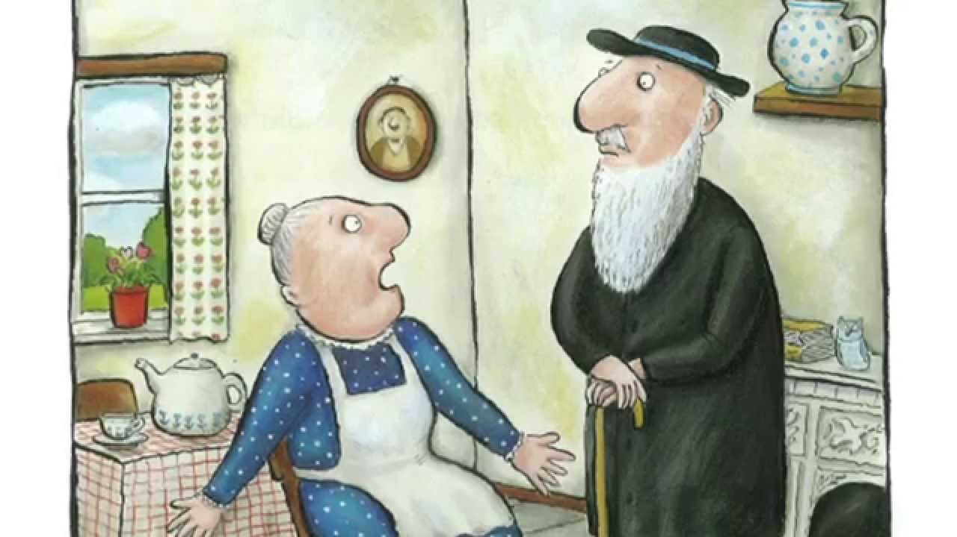
Which persuasive sentences could you use to describe the old lady's house?
I’m thinking of…
Perfect for animal lovers.
Ideal for someone who doesn’t like doing too much housework!

Slide 10
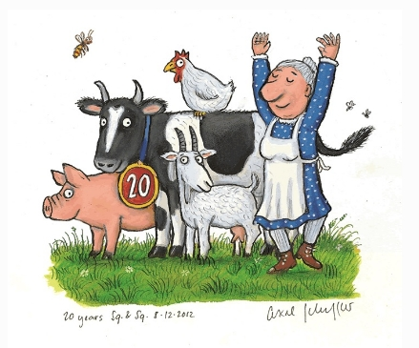
I would now like you to create an estate agent’s advert for the house in ‘The Squash and A Squeeze’.
I might start my writing like this…
I am sure that this house will be sold the moment that it goes up for sale. Why? I hear you ask. Let me tell you why… If you’re someone who is always losing things then this house is perfect for you as there aren’t too many hiding places! Also, if you don’t like housework, then this is your ideal home as cleaning this house will not take you long at all!

Slide 11
Remember to Battle today!
The Battles will commence from 8.30am to 2pm today. You can battle for half an hour - more or less. It is up to you!
https://ttrockstars.com/

Slide 12
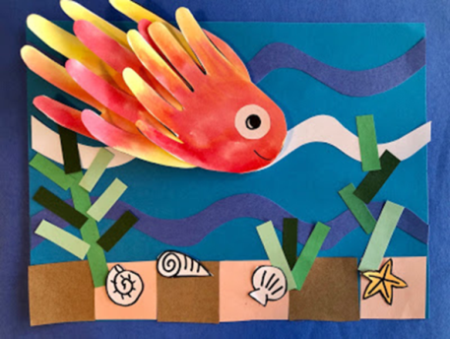
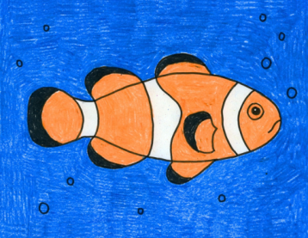
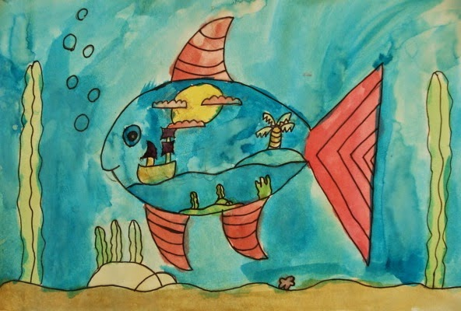
Carnival of the Animals An Art festival
For the next few weeks we are going to run a series of art lessons based around animals.
So whether you are working at home or in school you can create some great pictures. We would like to fill the Farnborough Art Gallery with your work to create a “Carnival of the Animals.”
If you are home learning, you can scan your work and send it in to your teacher.
Good luck, have fun and we want you to be creative, so if you have your own ideas we would love to see your artwork!

Slide 13
Finding Nemo…….Draw a clownfish!

Slide 14
1. Fold your paper into quarters. Start the fish body..
2. Finish with the tail.

Slide 15
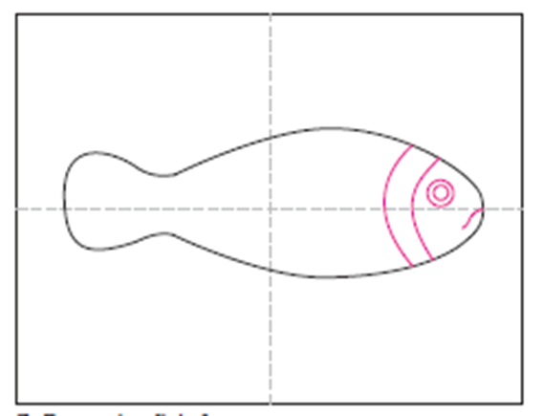
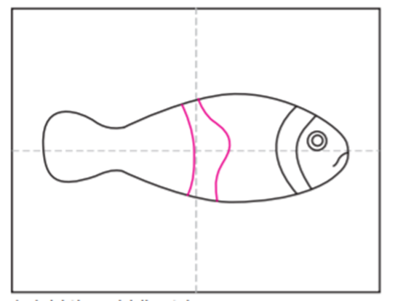
3. Draw the face on the fish.
4. Add the middle stripe.

Slide 16
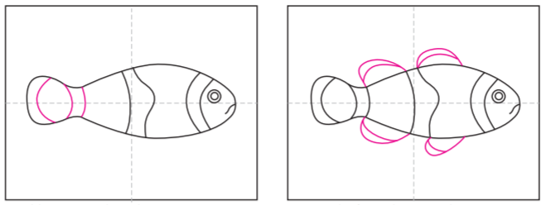
5. Add stripes to the tail.
6. Draw the fins in between the stripes.

Slide 17
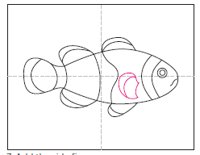
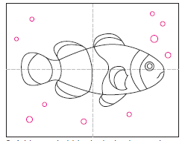
7. Add the side fin.
8. Add some bubbles and seaweed to the backgound.
You could draw another smaller friend for Nemo…just in case he gets lost!

Slide 18
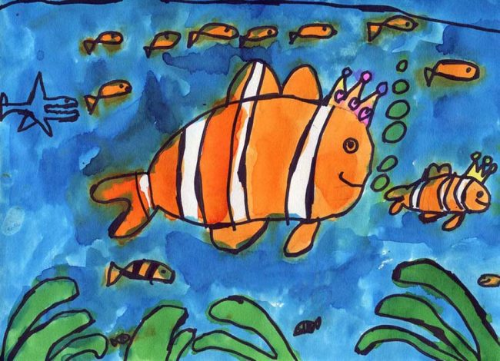
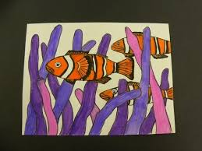
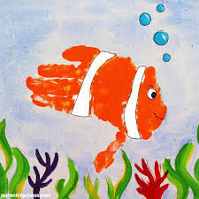
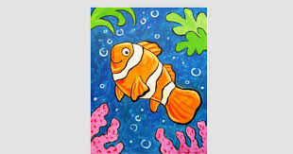
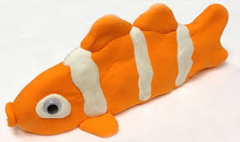
Use watercolours or pastels or felt tip pens or pencils to colour your picture.

Slide 19
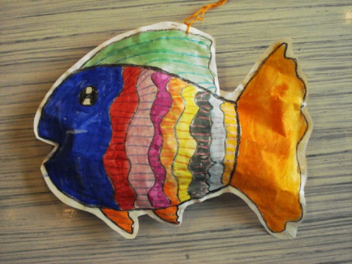
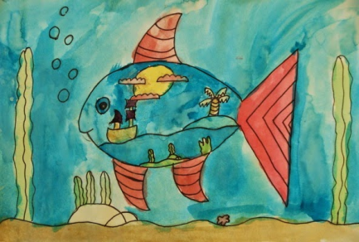
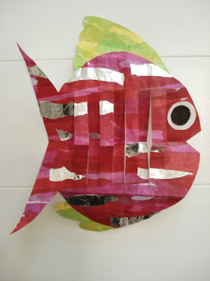
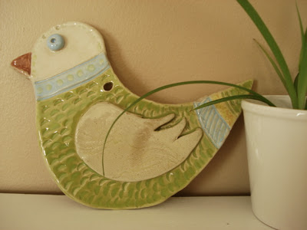
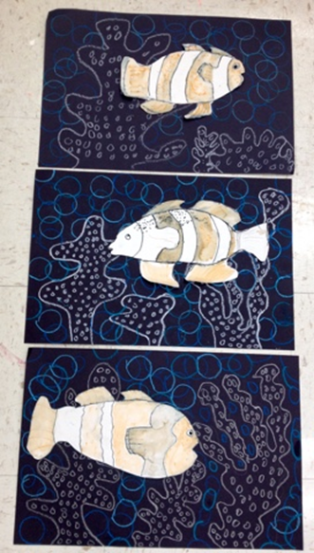
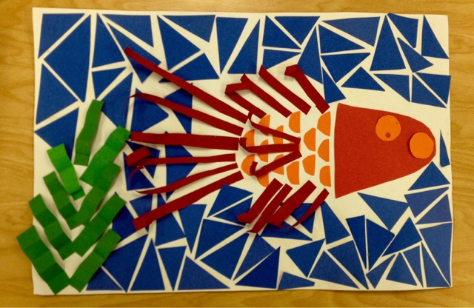
Love fish? …….
But don’t think you will get to the sea this year? Check out these websites below for more fishy fun!
https://afaithfulattempt.blogspot.com/search?q=fish
https://youngschoolart.blogspot.com/search?q=fish

Slide 20
Outdoor Activity
Every day I am going to give you an activity that can be carried out either outdoors, (if the sun is shining) or indoors (if we’re not as lucky as the weather!).

Slide 21
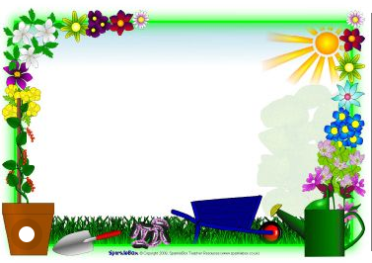
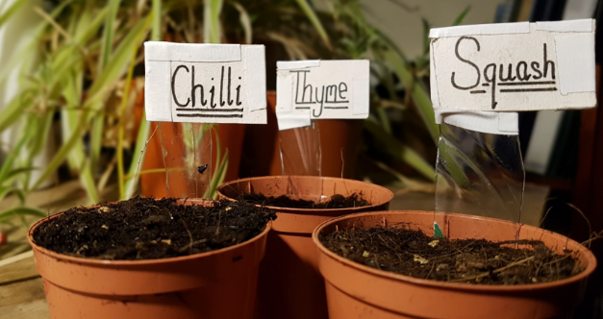
Outdoor Home Learning
Name That Plant
Look at the plants around you and give them new descriptive names. Consider the names and the folklore around plants in the Harry Potter series and have some fun inventing your own.Make your own recycled labels for the plants.
Open the link to investigate this further…
https://www.ltl.org.uk/resources/plant-names-and-labels/

Slide 22
Reading online
Please log on to Bug Club and read for at least 15 minutes
Make sure you answer your bug questions!

Slide 23
Remember to send in your totals for the Race across the World.
Which country will we reach this week?

Slide 24
Maths Bingo
We will have another zoom session tomorrow where you will be taking part in Maths Bingo.
In preparation for this I would like you to draw a grid like you would if you were playing noughts and crosses:
Then choose nine numbers between 1 and 20 to put in the grid.
Tomorrow I will be giving you different number sentences. If your answer is a number in your grid, then you cross out the number.
The first person to cross out all nine of the numbers wins the game!

Slide 25
Enjoy, Unicorns!

