Slide 1
Good morning Unicorns!
Here’s your work for today: Thursday 11th June

Slide 2
Farnborough Dance Routine
Mrs Humphries has created our very own Farnborough Dance Routine!
It has five parts and every day this week we are going to start the day by being active and joining in.
Click on the link below:
http://farnboroughprimary.co.uk/farnborough-dance

Slide 3
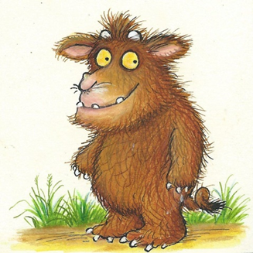
English
The Gruffalo’s Child needs your help to become as fantastic at writing as all of you in Unicorns Class!
Today we are going to finish writing our own version of ‘The Gruffalo’.

Slide 4
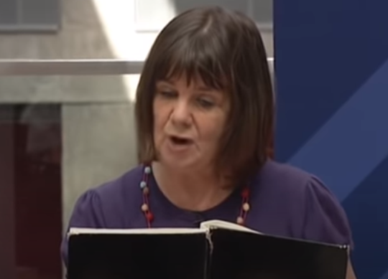
•First, watch Julia Donaldson talking about how she wrote the book.
Click on this link:
https://www.youtube.com/watch?v=845w3sfbYv4

Slide 5
•Now look back at your story map from last week to remind yourself of what is going to happen in your story…
•Today you are going to write about the mouse meeting your second character.

Slide 6
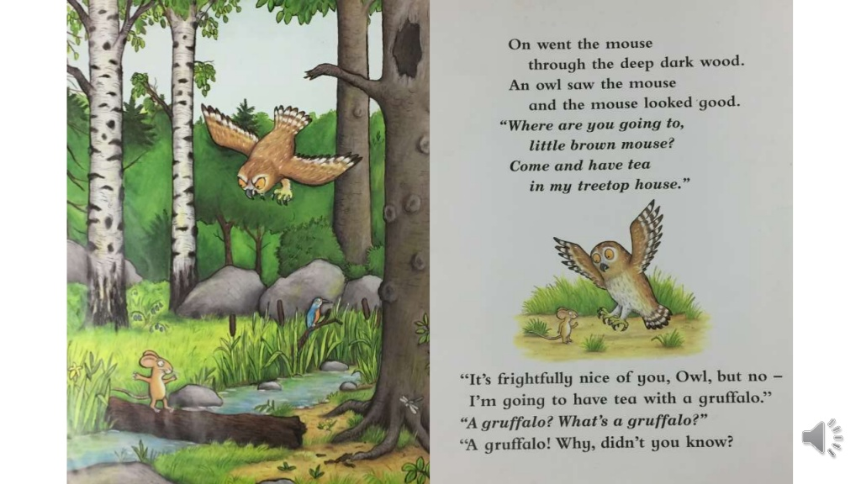
So, you will use the first sentence and then write about the first character that the mouse meets and the type of house that your animal is inviting the mouse to.

Slide 7
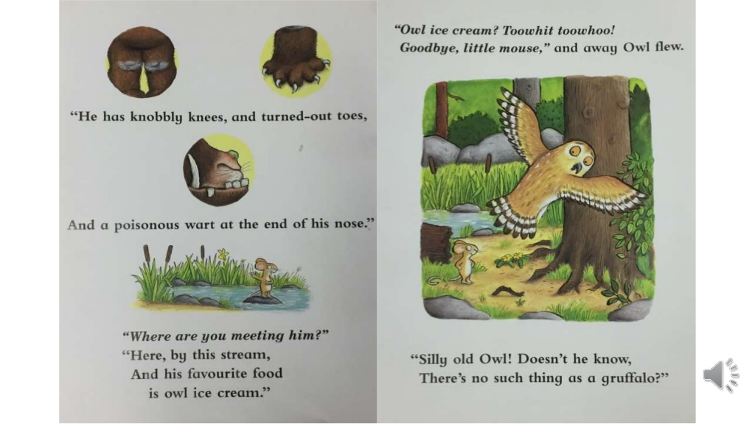
You will add a description of the Gruffalo and end with the Gruffalo’s favourite food (Your character!)
Finally you will write about your character racing away!

Slide 8
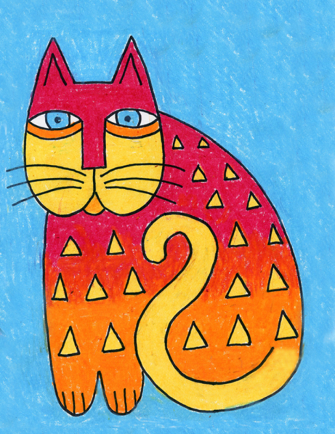
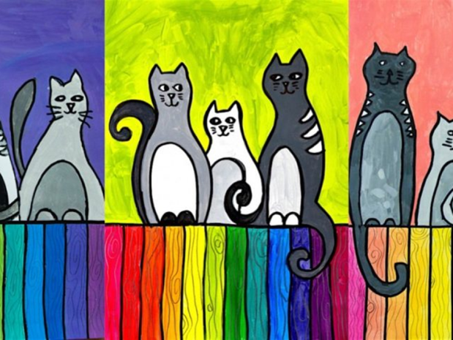
Carnival of the Animals An Art festival
For the next few weeks we are going to run a series of art lessons based around animals.
So whether you are working at home or in school you can create some great pictures. We would like to fill the Farnborough Art Gallery with your work to create a “Carnival of the Animals.”
If you are home learning, you can scan your work and send it in to your teacher.
Good luck, have fun and we want you to be creative, so if you have your own ideas we would love to see your artwork!

Slide 9
Laurel Burch Cat Drawing
Try this step by step lesson to draw a cat in the style of the artist Laurel Burch.

Slide 10
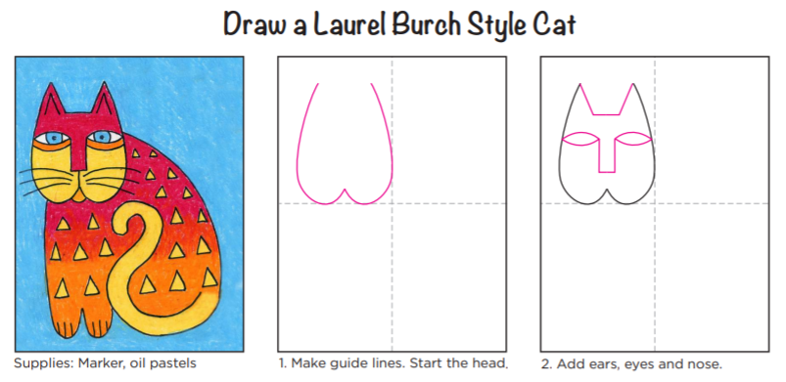
You can use whatever you wish to colour in your cat. Have fun and enjoy!

Slide 11
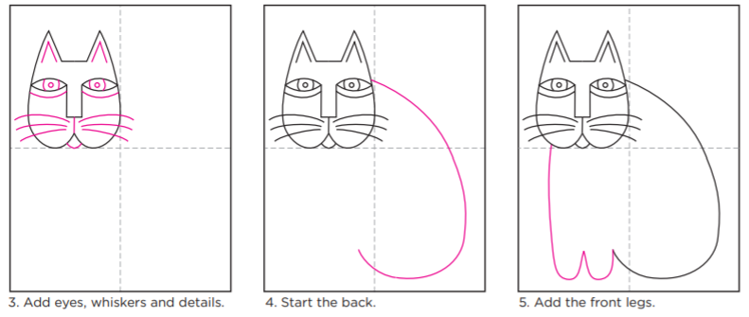

Slide 12
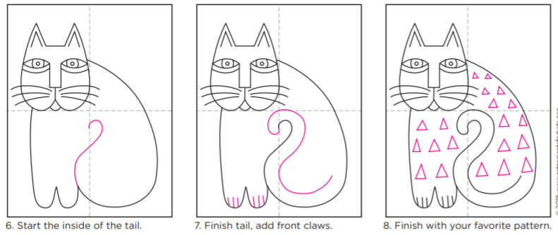

Slide 13
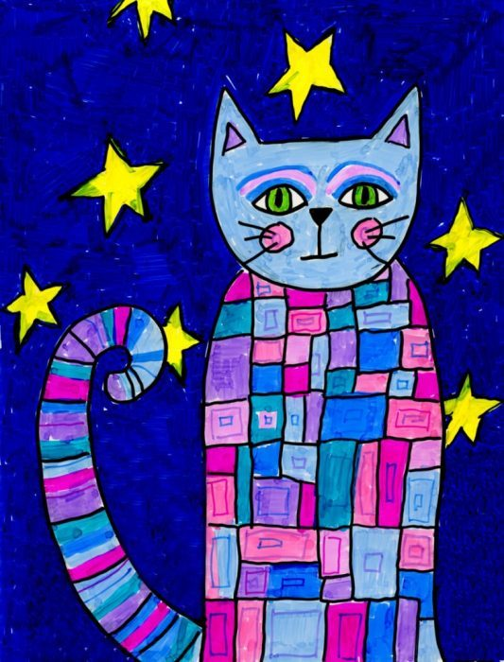
Remember to create your own pattern and use whatever you have to colour your cat. It’s your cat!
Does your cat have a name?

Slide 14
Want to listen to The Carnival of the Animals by Camille Saint-Saëns?Click below: https://www.youtube.com/watch?v=1L993HNAa8M

Slide 15
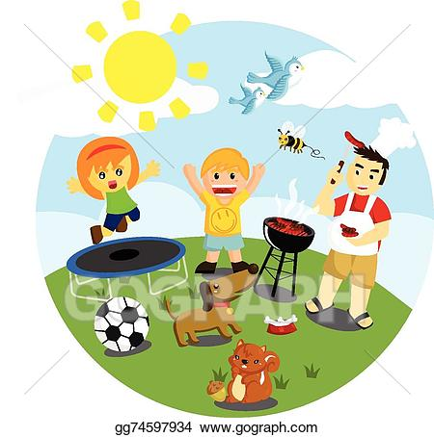
Outdoor Activity
Every day I am going to give you an activity that can be carried out either outdoors, (if the sun is shining) or indoors (if we’re not as lucky as the weather!).

Slide 16
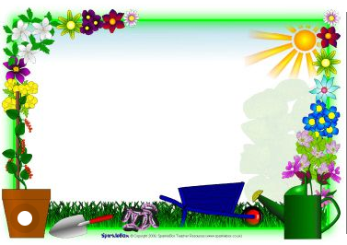
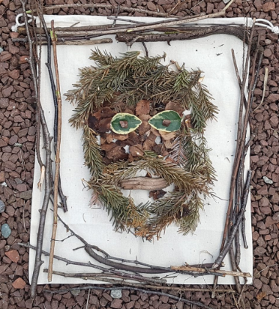
Outdoor Home Learning
Who’s Been Framed?
Gather some loose materials indoors or out and create a portrait of someone you know. Can anyone guess who it is?
Open the link to investigate this further…
https://www.ltl.org.uk/resources/whos-been-framed/

Slide 17
PSHE
Talking to the people in our household is always a good thing to do and helps us to understand some of the new things that are happening in our lives at the moment.

Slide 18
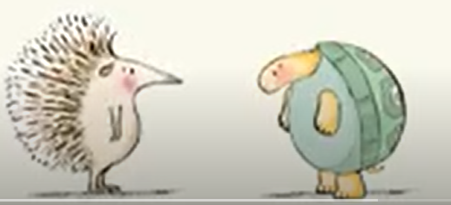
Click on the link below:
While We Can't Hug - YouTube

Slide 19
Now think about these questions:
Why can’t we hug the hedgehog and tortoise hug?
Can you think of ways hedgehog and tortoise can play without hugging?

Slide 20
Reading online
Please log on to Bug Club and read for at least 15 minutes
Make sure you answer your bug questions!

Slide 21
Enjoy, Unicorns!

