Slide 1
Early Years/KS1

Slide 2
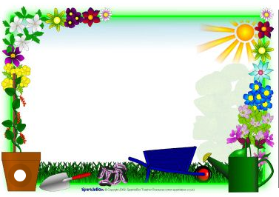
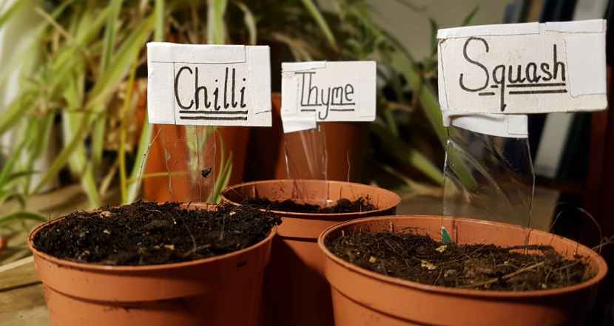
Outdoor Home Learning
Name That Plant
Look at the plants around you, give them new descriptive names. Consider the names and the folklore around plants in the Harry Potter series, have some fun inventing your own. Make your own recycled labels for the plants.
https://www.ltl.org.uk/resources/plantnames-and-labels/
Open the link to investigate this further…

Slide 3
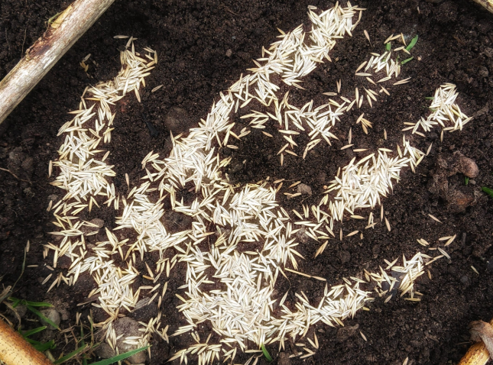
Outdoor Home Learning
A Green High Five
Get playful with quick growing seeds like grass or cress sowing them in a handprint or other simple quirky shapes.
https://www.ltl.org.uk/resources/greenhigh-five/
Open the link to investigate this further…

Slide 4
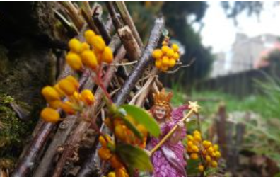
Outdoor Home Learning
Where the Fairies Live
Let your imagination run wild and create a garden fit for a fairy perhaps in a container or a plant pot using whatever resources you have available. Add pebble bugs, peg people or clay critters and share your pictures!
Open the link to investigate this further…
https://www.ltl.org.uk/resources/fairy-garden/

Slide 5
KS2

Slide 6
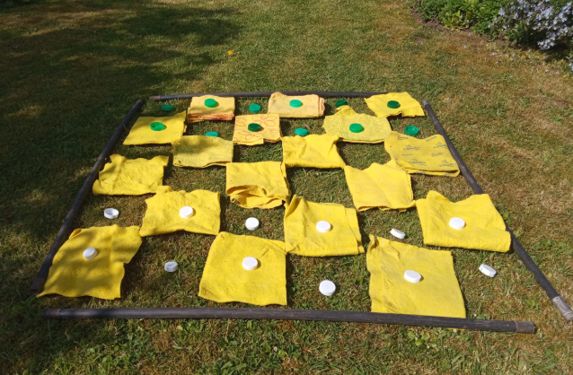
Outdoor Home Learning
Played all the board games in your house already?
Then it’s time to invent a new one. This could be desk-based or if you have the space take it outside and go large-scale with family member counters, real ladders and …real snakes!
Open the link to investigate this further…
https://www.ltl.org.uk/resources/boredom-busting-board-games/

Slide 7
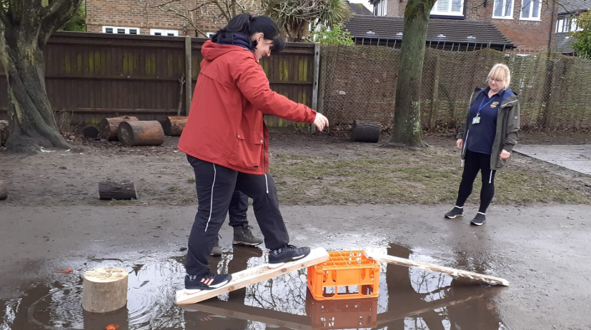
Outdoor Home Learning
Bridging the Gap
Can you build a bridge that will hold your weight and enable you to cross a puddle, a raging tarpaulin river, or a bubbling lava blanket? Alternatively go small-scale and create micro bridge to hold a 500g bag of sugar or similar.
Open the link to investigate this further…
https://www.ltl.org.uk/resources/bridging-the-gap/

Slide 8
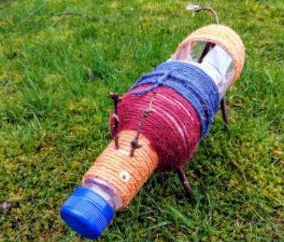
Outdoor Home Learning
Plastic Planters
Give the plastic recycling a new lease of life and design your own planter. You could even use it to grow one of your cuttings in!
https://www.ltl.org.uk/resources/recycl ed-planters/
Open the link to investigate this further…

