Slide 1
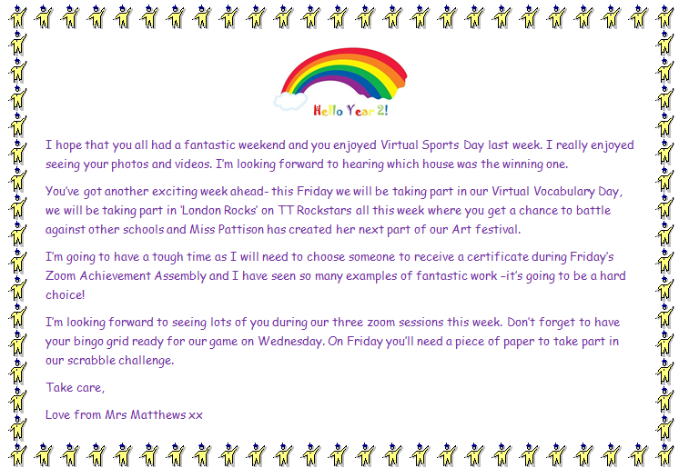

Slide 2
Good morning Unicorns!
Here’s your work for today: Monday 22nd June

Slide 3
I’m looking forward to seeing lots of you at our Storytime Zoom session at 9.15 this morning.
Watch the animation on the next slide to remind yourself of how to keep safe online.

Slide 4
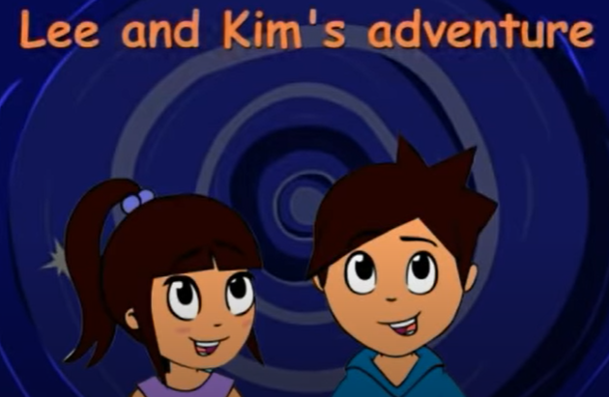
https://www.youtube.com/watch?v=-nMUbHuffO8

Slide 5
Let’s start the day by being…

Slide 6
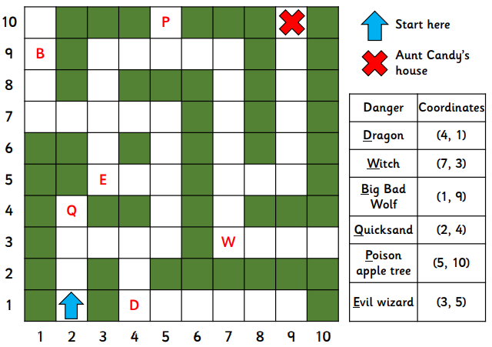
Maths answers from last Wednesday:

Slide 7
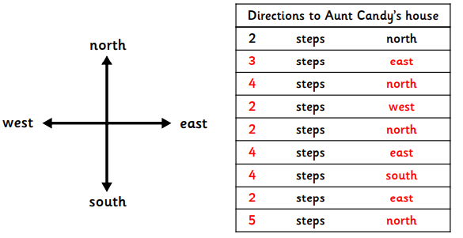
Maths answers from last Wednesday:

Slide 8
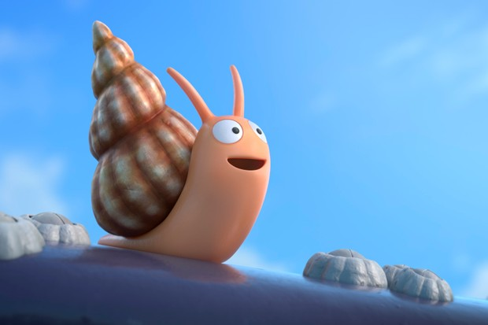
Maths
The snail from ‘The Snail and the Whale’ isn’t very good at calculations and he needs your help please, Unicorns!
Can you help him to solve the problems on the next slides?

Slide 9
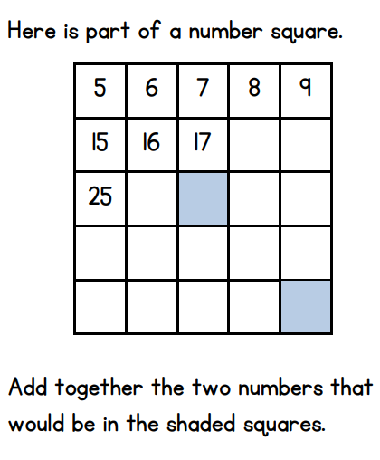
Challenge 1:

Slide 10
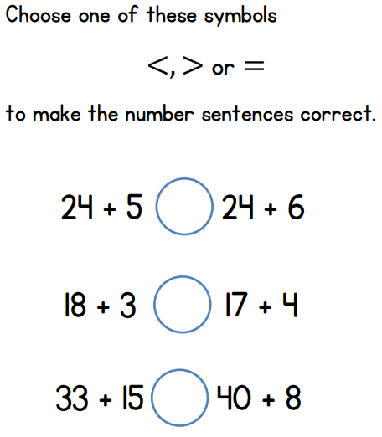
Challenge 2:
Remember Charlie Crocodile to help you remember what the symbols represent…

Slide 11
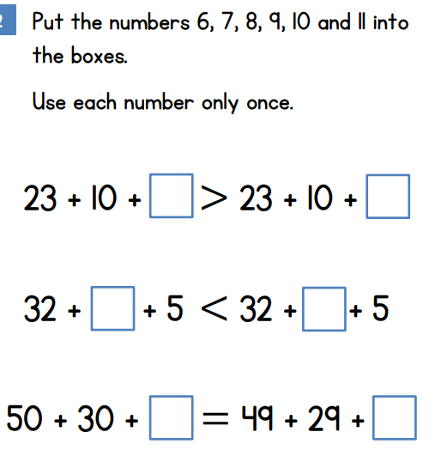
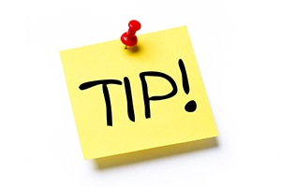
Challenge 3:
Starting with the last calculation will make solving this easier…

Slide 12
You can write your answers in your exercise books.
If you would like to try Gruffalo work, complete Challenge 1.
If you would like to try Horrid Henry work, complete Challenge 2.
If you would like to try James and the Giant Peach work, complete Challenge 3.

Slide 13
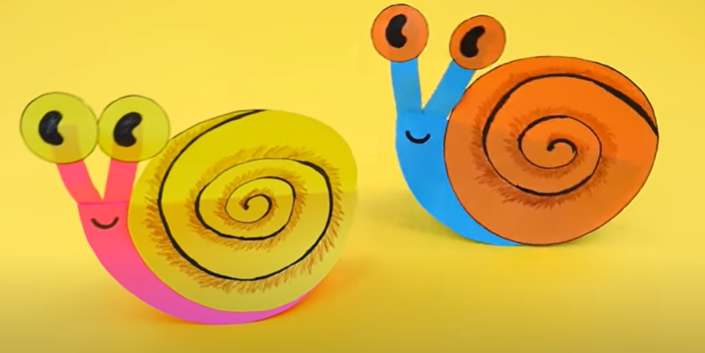
Today you are going to have a go at creating your very own paper Snail!
Click on this link:
https://www.youtube.com/watch?v=bfrqpj4vaJk

Slide 14
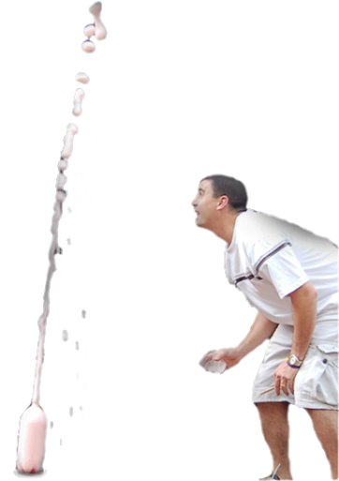
Outdoor Activity
Every day I am going to give you an activity that can be carried out either outdoors, (if the sun is shining) or indoors (if we’re not as lucky as the weather!). Today it’s a Science experiment…

Slide 15
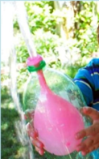
Water Volcano in a Bottle
You will need:
2l plastic bottle
Balloon
Water

Slide 16
Put the balloon inside the bottle and stretch the end around the opening. Try to blow up the balloon- you won’t be able to!
Cut a ¼inch hole in the side off the bottle and try again. The balloon will inflate as the air inside the bottle can escape through the hole. If you put your finger on the hole it will lock the pressure and keep the air inside.
While the balloon is blown up ( with your finger over the hole) fill the balloon with water.
When you’re ready, move your finger to start the water volcano!
Put the lid on your bottle to keep the balloon inflated without having to cover the hole. The balloon needs both holes uncovered to deflate!

Slide 17
What’s the Science behind it? The balloon won’t inflate much the first time because the bottle is already filled with air. There’s no room for the balloon to expand inside the bottle. However, when you put a hole in the bottle, the air is pushed out as the balloon fills the space inside. As long as you plug the hole, the balloon stays inflated. When you take your thumb off the hole, outside air flows back into the bottle which pushes air ( or water!) out of the balloon.

Slide 18
Reading online
Please log on to Bug Club and read for at least 15 minutes
Make sure you answer your bug questions!

Slide 19
By
Battling schools across London with TT Rockstars.
Running from: Monday 22nd June to Friday 26th June
Times: 2pm to 7pm
https://play.ttrockstars.com/

Slide 20
Enjoy, Unicorns!

