Slide 1
English
This week we will be collating all of the creative ideas we have worked with over the past 2 weeks from the ‘Impossibly Possible Bookshop’ story and using them to write our own stories.
Please remember to use the writing checklist further on in this presentation which will help to move your writing from good to great.

Slide 2
Day One
Read through the next few slides carefully as they will give you ideas for your own story.
If you are not sure what to write about, look at the story ideas sheet to help you.

Slide 8
Spellings – Week 5
Group 1 – Plurals
leaf, leaves, knife, knives, shelf, shelves, wolf, wolves, loaf, loaves
Group 2 - Tricky words
therefore, various thought through, though, although, woman, women, necessary, official

Slide 9
Spelling activities for week 5
Try and learn the words for 5 – 10 minutes each day. Break down the words into syllables and/or use the ‘Look, Say, Cover, Write, Check’ method to help you learn them. Complete one of the activities below during the week:
Write your words using one colour for the vowels and another colour for the consonants
Word classes – sort your spelling words into nouns, verbs, adjectives, adverbs etc
Find an antonym (opposite) for each of your spelling words
Write your words, then write them again with the letters mixed up. Can you unscramble them the next day and spell them correctly?
Write your words. Then use a coloured pencil to divide your words into syllables, e.g. sen-tence, re-mem-ber
Use a thesaurus to find some synonyms
X words – write 2 words with 1 letter in common so that they cross over each other, as if they were on a scrabble board
Type out your words on the computer – try to use at least 4 different fonts
Set a timer for 2 minutes. See how many times you can write each word perfectly during that time.
Ask an adult to test you at the end of the week. Good luck!

Slide 10
Spatial Exploration with Pentominoes
Monday 29th June 2020

Slide 11
What are Pentominoes?
Pentominoes are shapes made by joining 5 squares together.
Squares must touch along their sides, not their corners, like these:

Slide 12
Challenge 1
There are 12 different pentominoes to find – you have already seen 2 of them.
Be careful though – rotations and reflections do not count.
For example:
These are all the same pentomino!

Slide 13
Challenge 1
Working on your own or with a partner see if you can make all 12 pentominoes.
Choosing a different colour for each pentomino will make it easier for you to spot the different combinations.

Slide 14
Challenge 1
You can either make your pentominoes out of cubes (3D pentominoes), or draw them on squared paper, colour them and then cut them out (2D pentominoes).
Ready?
Then off you go – you have 10 minutes!

Slide 15
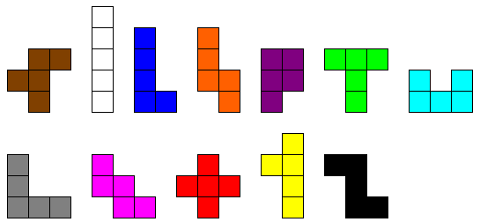
Challenge 1
Did you manage to find all 12?
You can check now. Here they are:

