Slide 1
English – Day Two
Read the next 3 slides of the story, ‘Staying Out’.
Carry your story on using a similar format.
Paragraph 4 – characters chatting/playing a game together.
Paragraph 5 – a noise is heard which is not familiar. How do you both react?
Paragraph 6 – the noise happens again. Really build up the tension here in your writing. Describe the noise using more detail and how the characters’ bodies react. Remember to use shorter sentences for effect and choose your vocabulary carefully; use an online or paper thesaurus and/or dictionary to help you.

Slide 5
Tuesday 9th June 2020 - Maths Investigation
Remember to show your working!

Slide 6
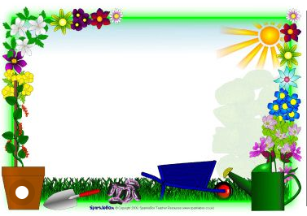
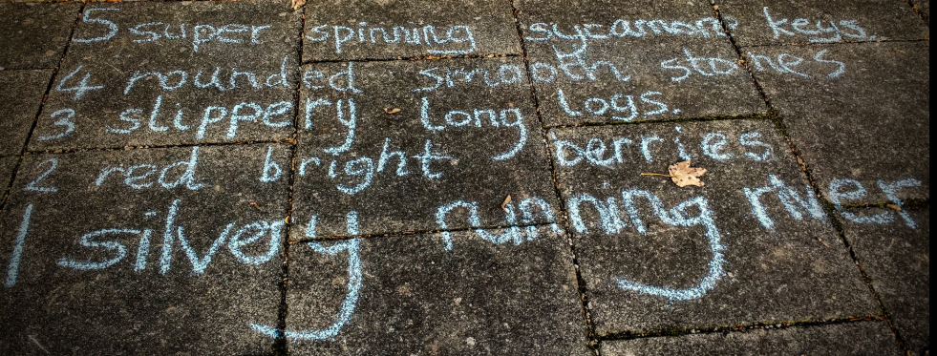
Outdoor Home Learning
Number Poem Challenge
Head out or look out for inspiration for a number poem. Each line needs a number, a noun and an adjective. Try to make it alliterative – that is every word begins with the same starting letter. For example, “lots of lumpy logs”
Open the link to investigate this further…
https://www.ltl.org.uk/resources/outdoor-number-poems/

Slide 8
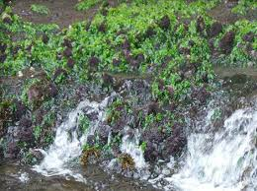
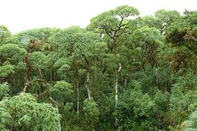
Using Classification Keys to identify Galapagos wildlife
Look at this selection of living things from the Galapagos. Then use the key to identify each species..
.
1
2
3

Slide 9
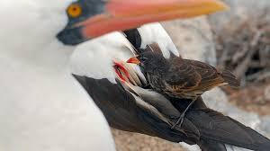
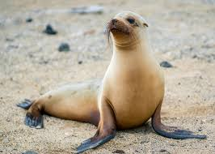
4
5

Slide 10
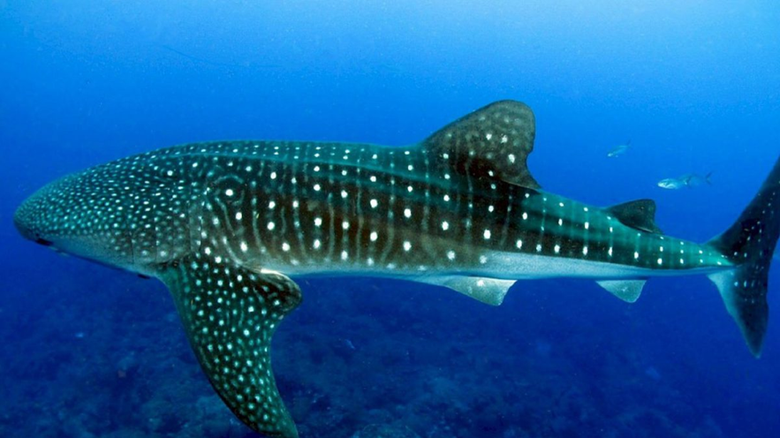
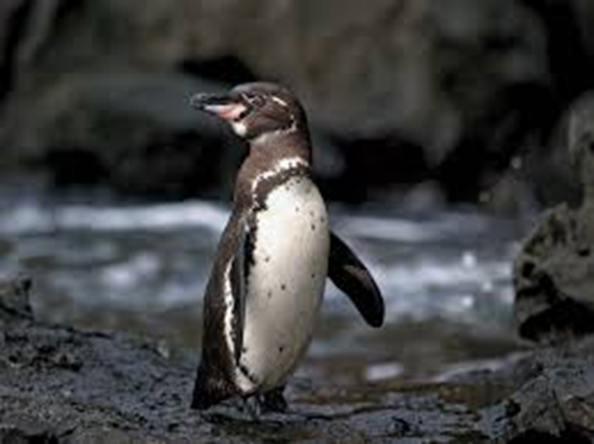
6
Use the classification key to identify each
Species.
7

Slide 11
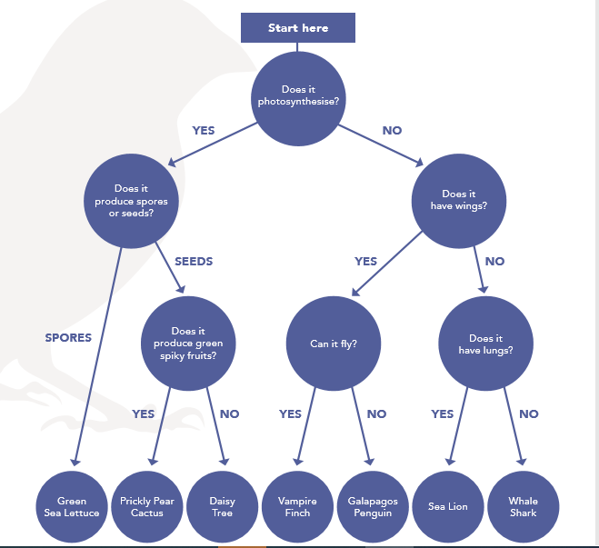
Can you now think a of a way to present your answers?
In a table? Print out and annotate with some key facts from the key & your own research? It’s up to you, which way will help you with your learning?

Slide 12
Find out more on the Galapagos Islands by following this link: https://www.natgeokids.com/uk/discover/geography/countries/ng-kids-heads-to-the-galapagos-islands

Slide 13
Farnborough Dance Routine
Mrs Humphries has created our very own Farnborough Dance Routine!
It has five parts and every day this week we are going to start the day by being active and joining in.
Click on the link below:
http://farnboroughprimary.co.uk/farnborough-dance

