Slide 1


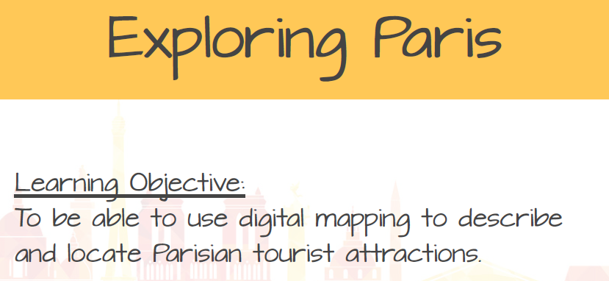
Friday 3rd July - KS2 Virtual French Day!!

Slide 2
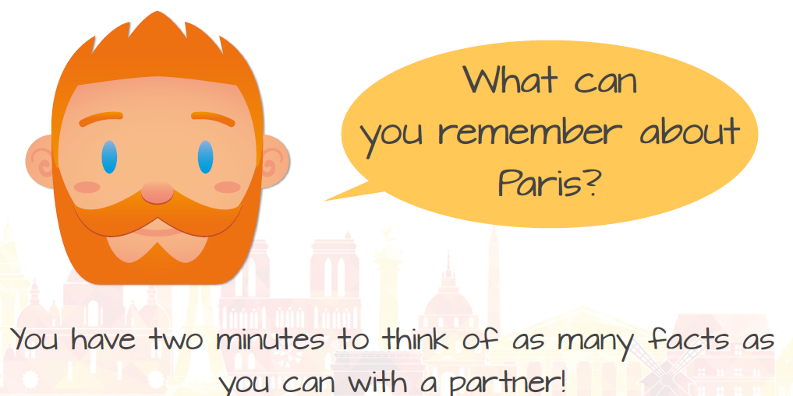

Slide 3
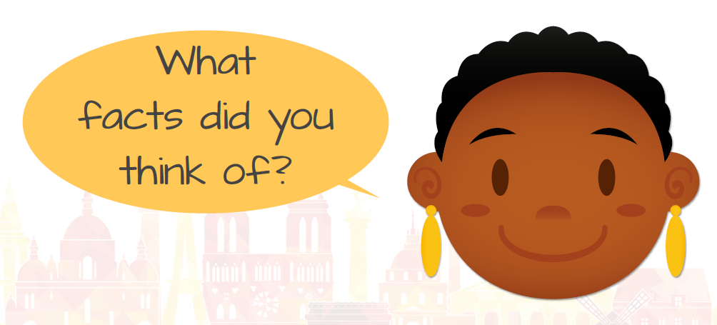

Slide 4
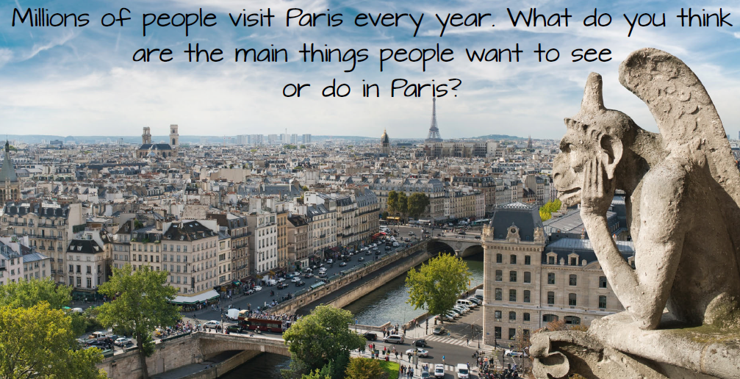

Slide 5
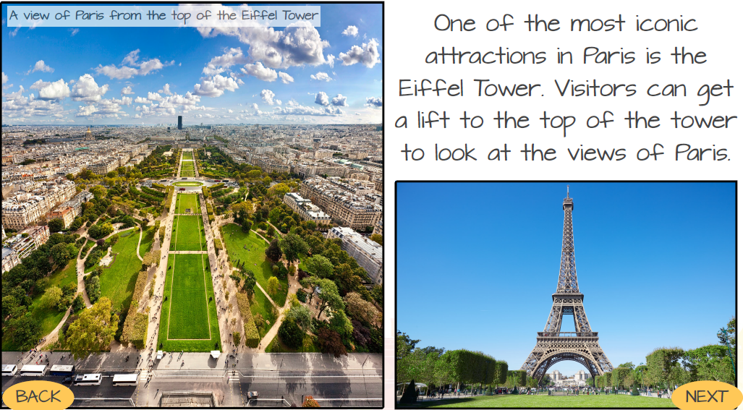

Slide 6
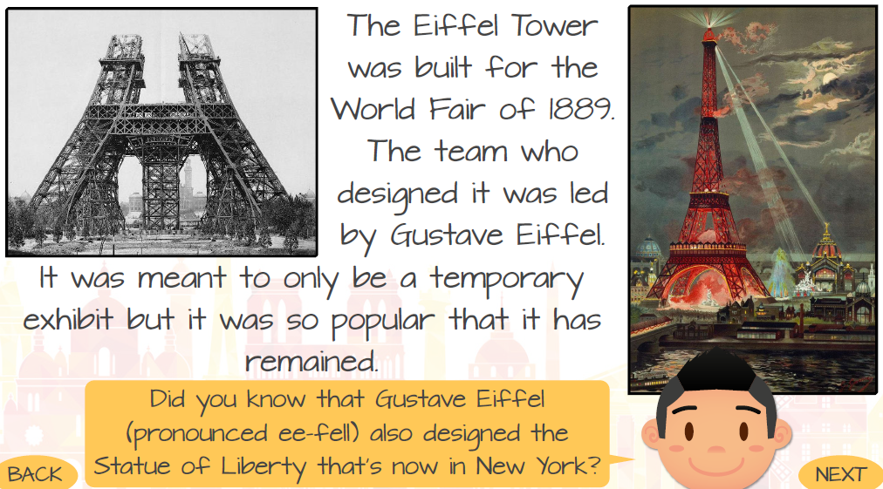

Slide 7
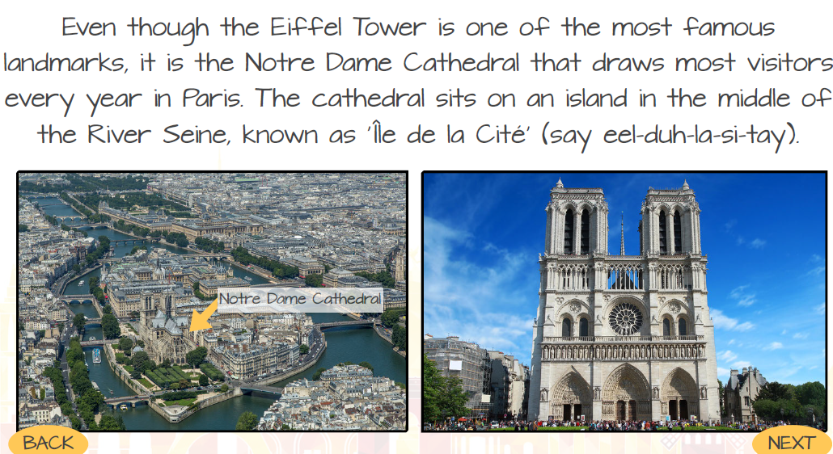

Slide 8
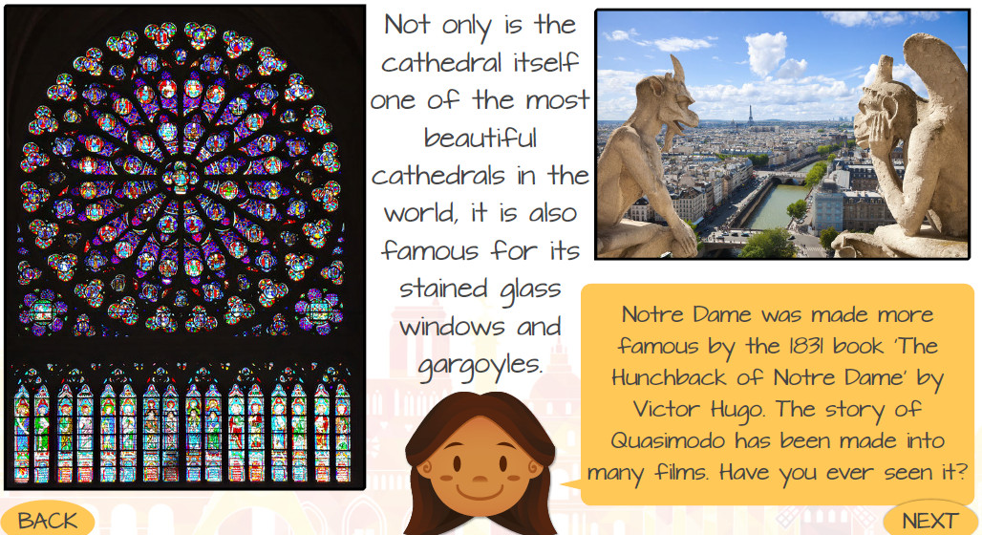

Slide 9
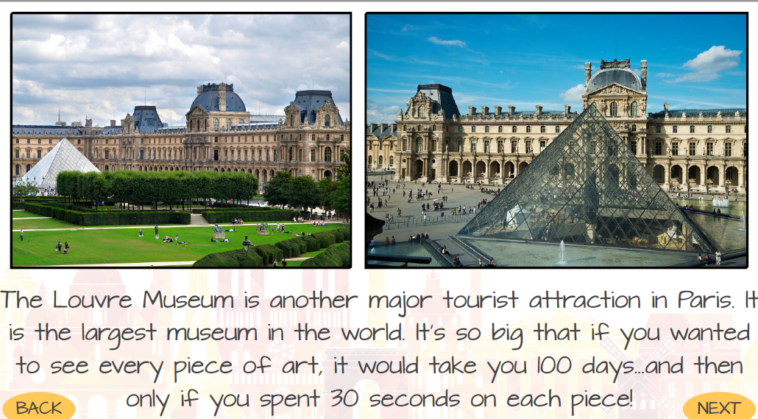

Slide 10
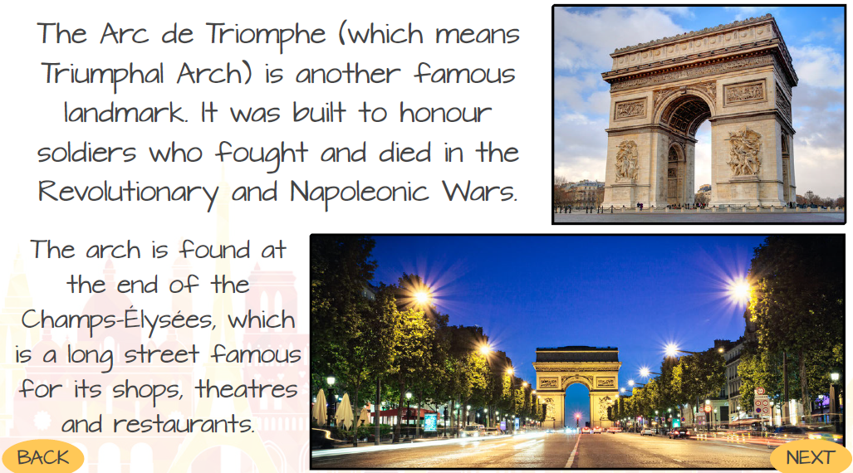

Slide 11
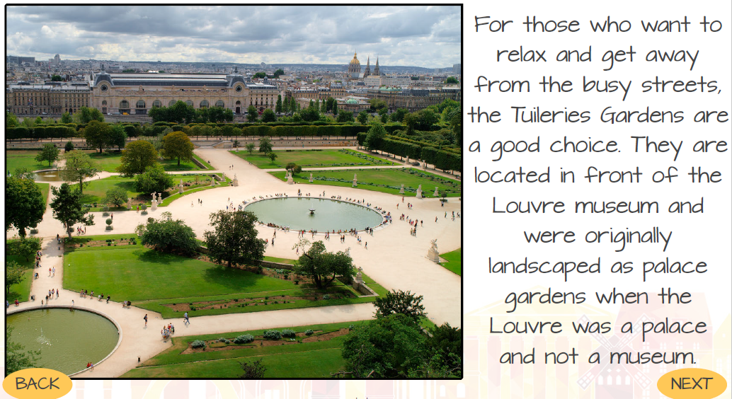

Slide 12
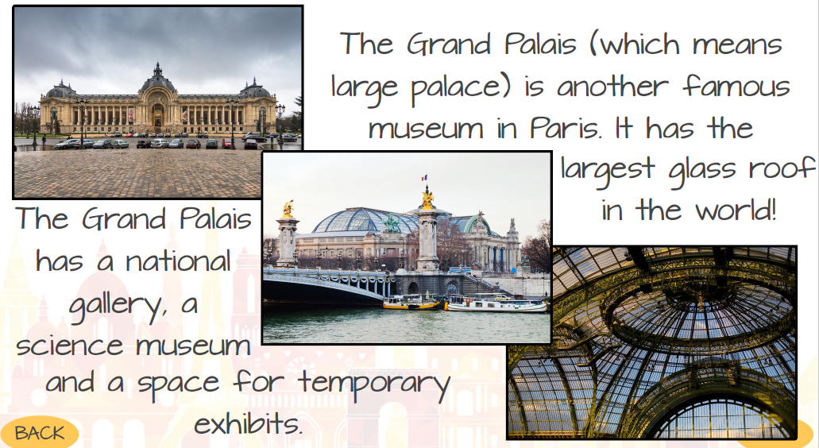

Slide 13
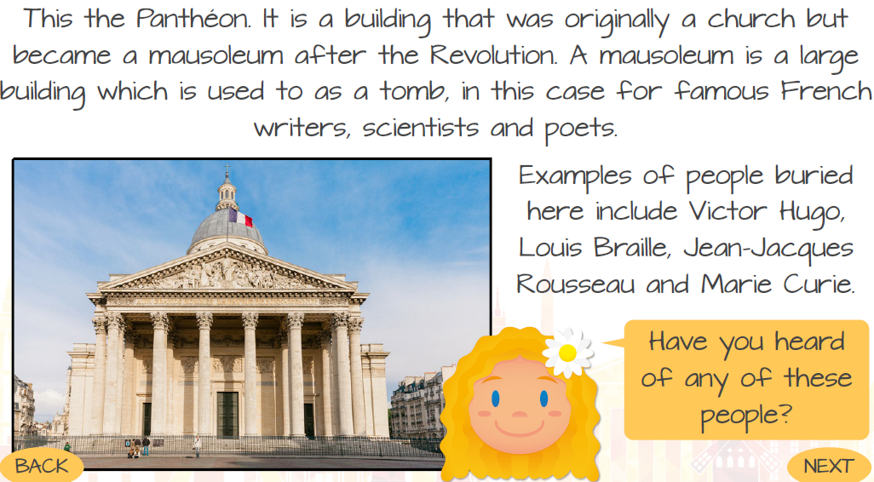

Slide 14
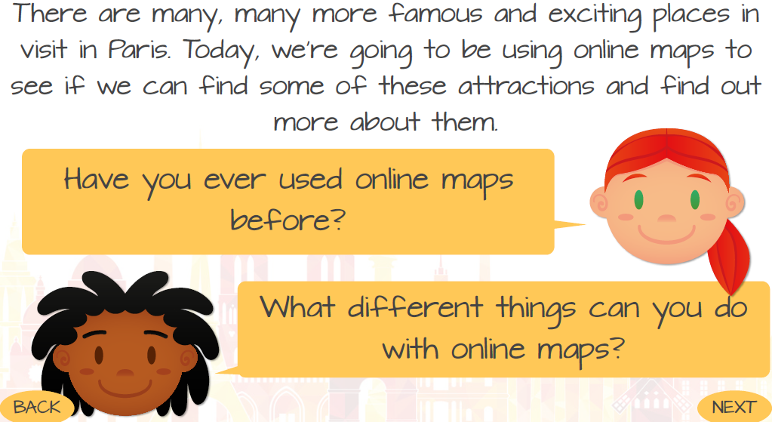

Slide 15
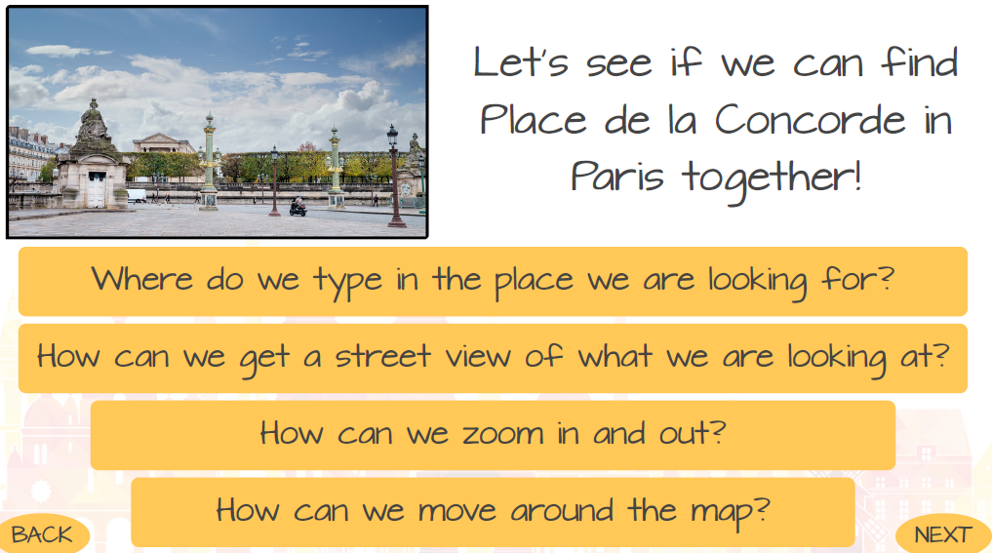
Have a quick exploration of google maps to get used to the controls.

Slide 16
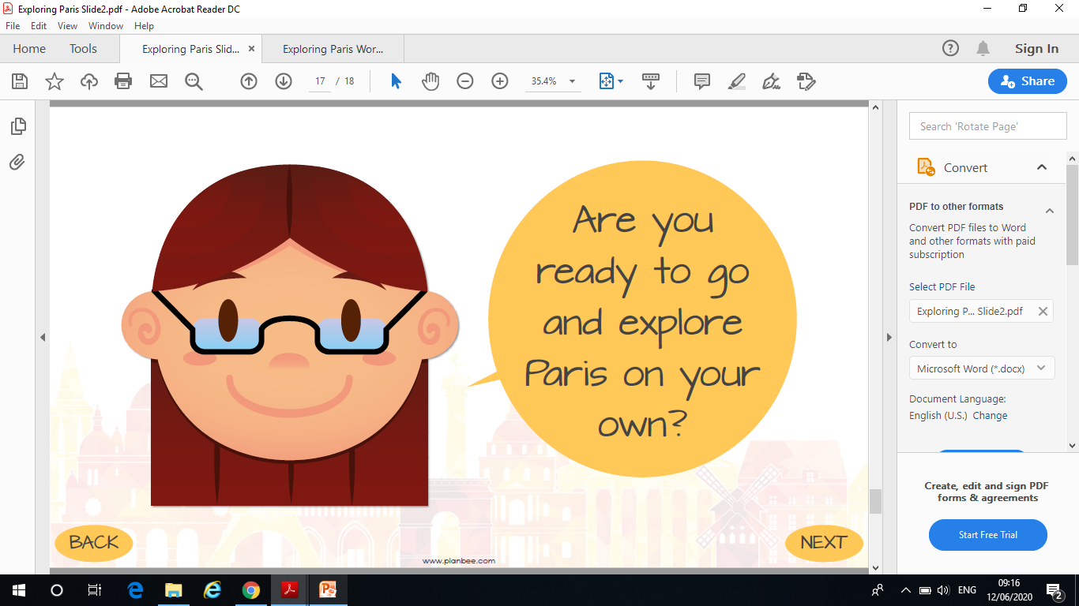

Slide 17
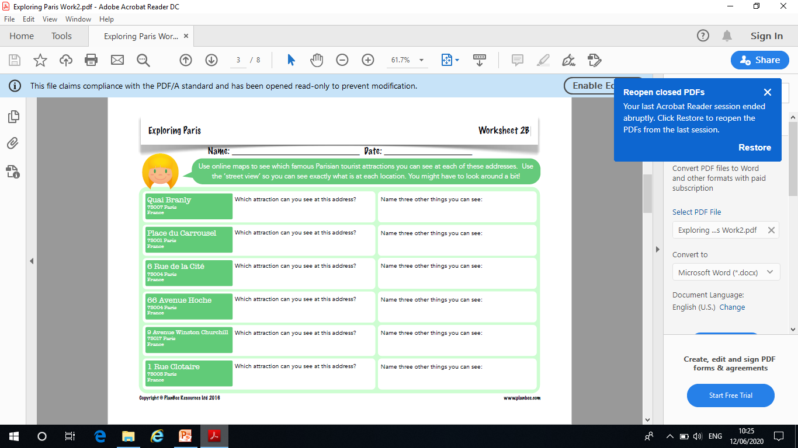

Slide 18
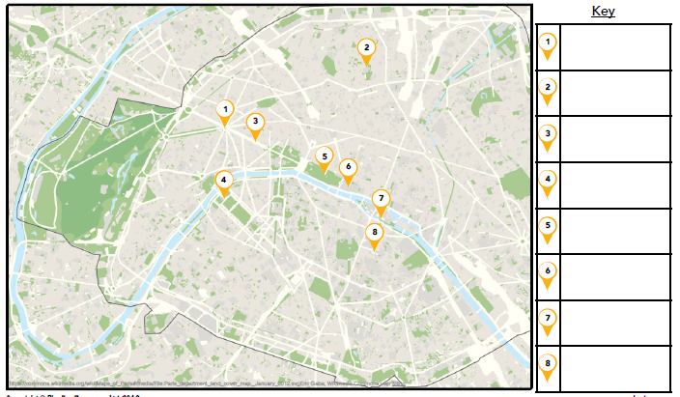
For an extra challenge see if you can locate each of these landmarks and fill in the key using google maps!

Slide 19
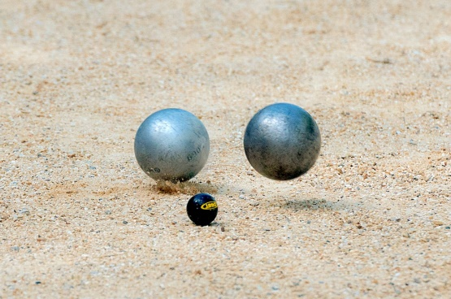
Hopefully the weather is amazing now that we are in July, if it is, try and go outside and play some French Sports!
How to play French Cricket:
https://www.youtube.com/watch?v=PMNlgIiF61g
How to play Petanque:
https://www.youtube.com/watch?v=VxXUEWgpIOs

Slide 20
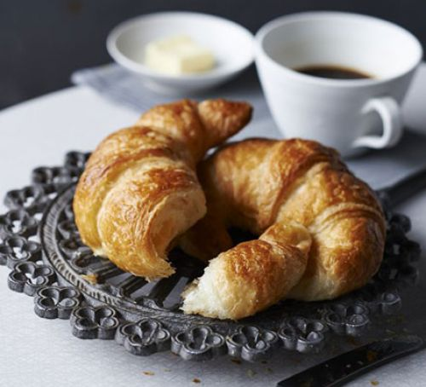
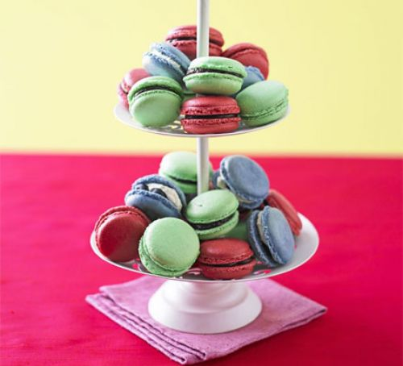
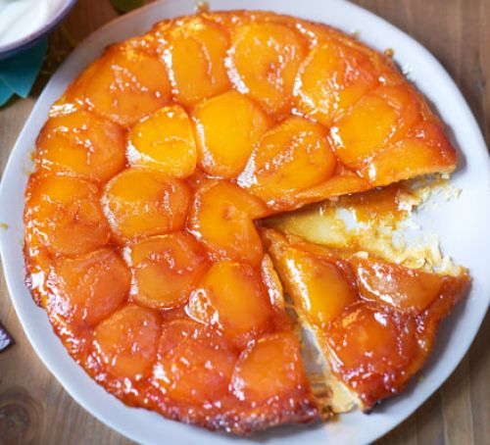
Have a go at your own French Recipe:
Croissants: https://www.bbcgoodfood.com/recipes/croissants
Macarons: https://www.bbcgoodfood.com/recipes/macarons
Tarte tatin
https://www.bbcgoodfood.com/recipes/tarte-tatin

Slide 21
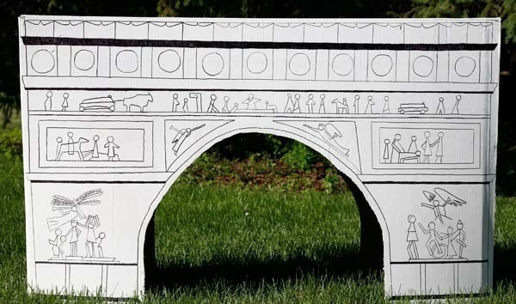
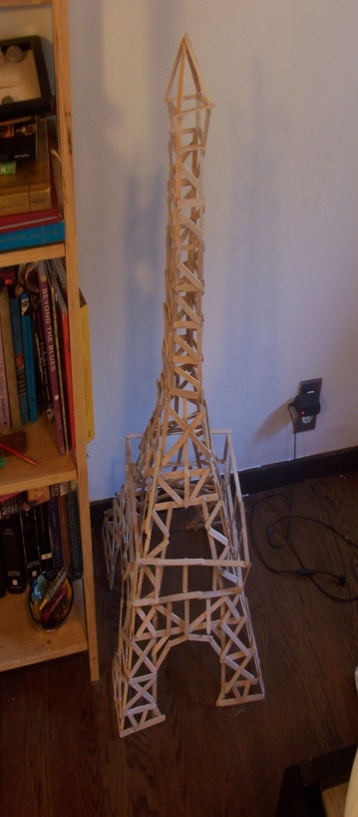
You have explored many French/Parisian landmarks throughout the day.
Now I want you to pick your favourite landmark and draw/create a model of it using materials in your home!

Slide 22
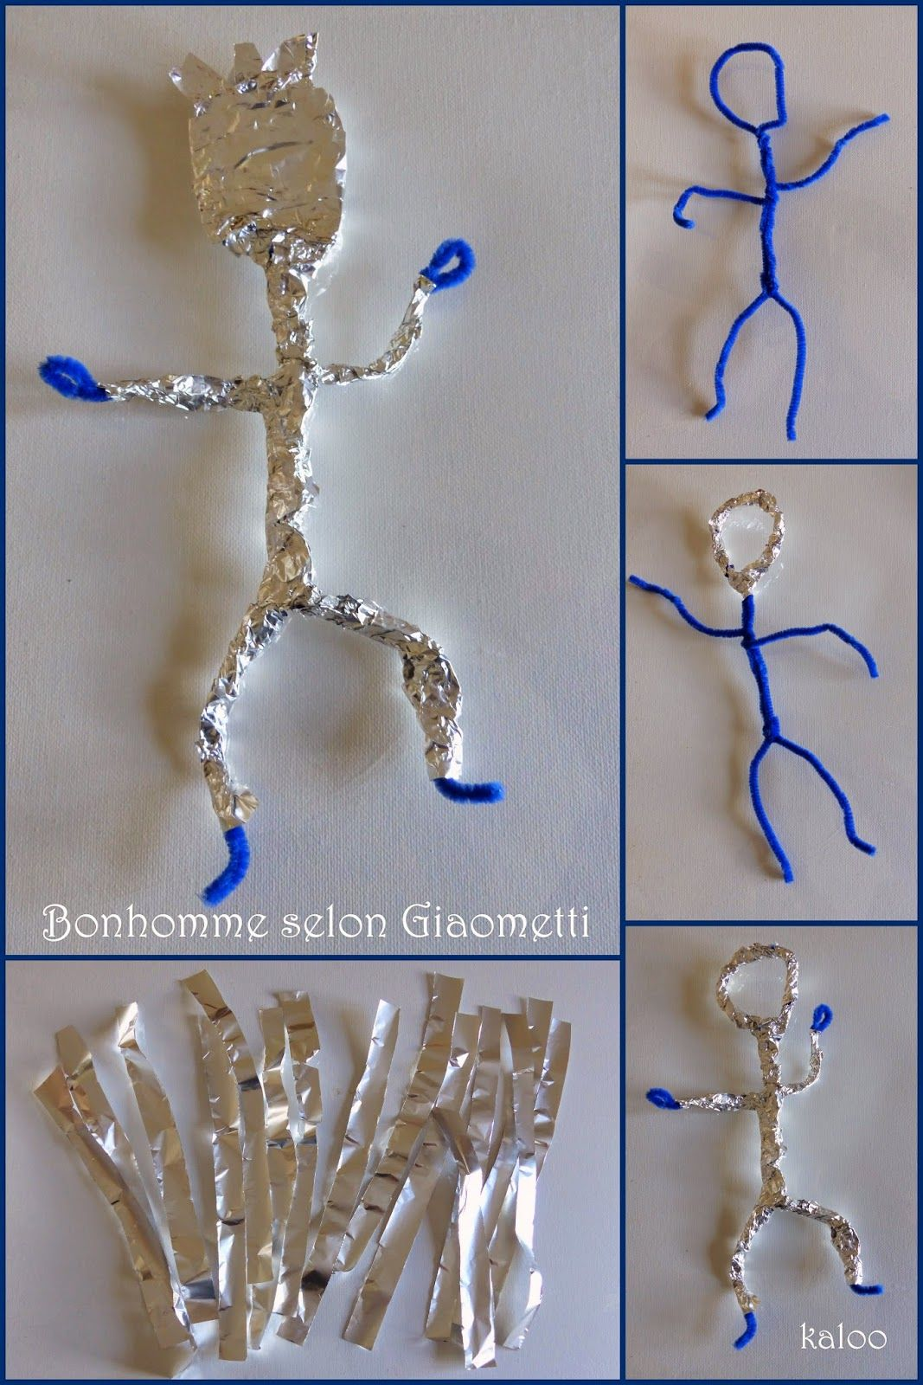
Or you may want to try this instead: Learn about Alberto Giacometti and look at some of his art work that exists in Centre Pompidou in Paris.
Try quick figure sketching, thinking about how we position our bodies, and how they can show our emotions.
Use kitchen foil to create a sculpture inspired by Giacometti’s bronze figures.

Slide 23
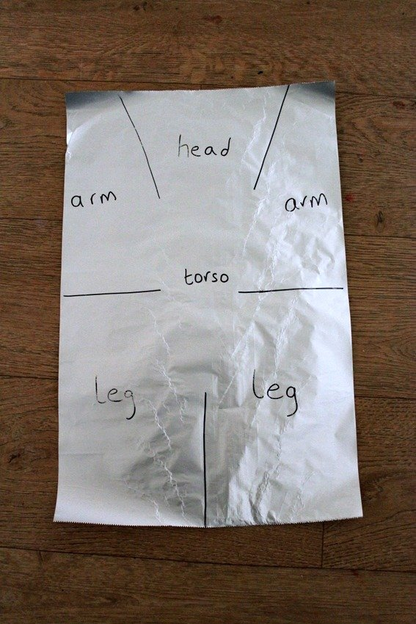
For this art lesson you will need:
- paper
- pen or pencil
- kitchen foil (tin foil / aluminium foil)
- scissors
Have a look at the photo below to see how you can segment the foil into pieces that will become the head, arms, legs, and torso of your person. Draw out the guide lines on your own piece of foil, and then cut along them. Next, used your hands to scrunch up the foil sections to make your person.

Slide 24
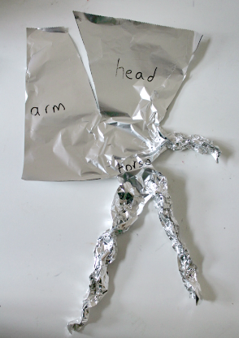
Once you’ve got the idea of how the flat kitchen foil can be sectioned out and scrunched up, you can have fun creating all sorts of different figures.

Slide 25
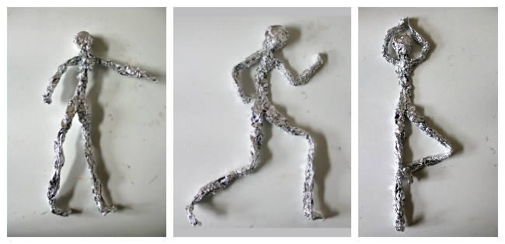
Move your foil figure to create some stick figures . The arms, legs, back, and neck will all bend easily so you can carefully re-position your person.
You can also use additional pieces of foil to make more people.
Try to make your figure stand, run, even do yoga!

Slide 26
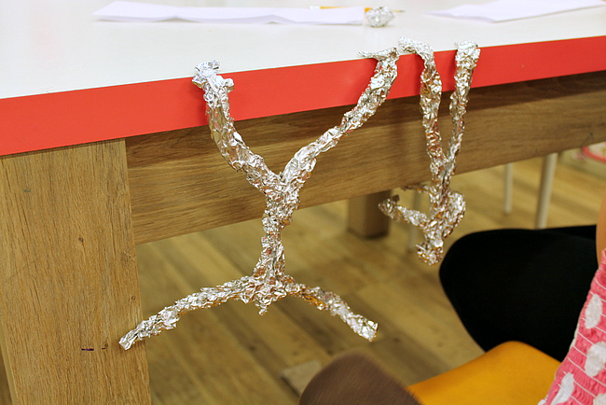
Work in pairs if you like: one person uses their own body to strike a pose, the other person re-creates the pose in their sculpture.
Maybe you can get your sculpture to stand up on its own? This is quite hard, as you need to play around with the balance of your person and their centre of gravity.
Your figure might like to hang upside down from the table!

Slide 27
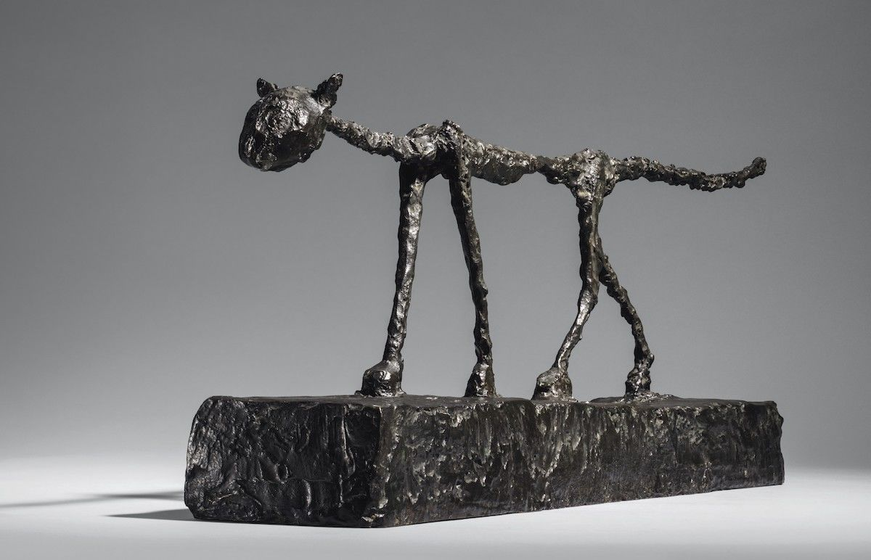
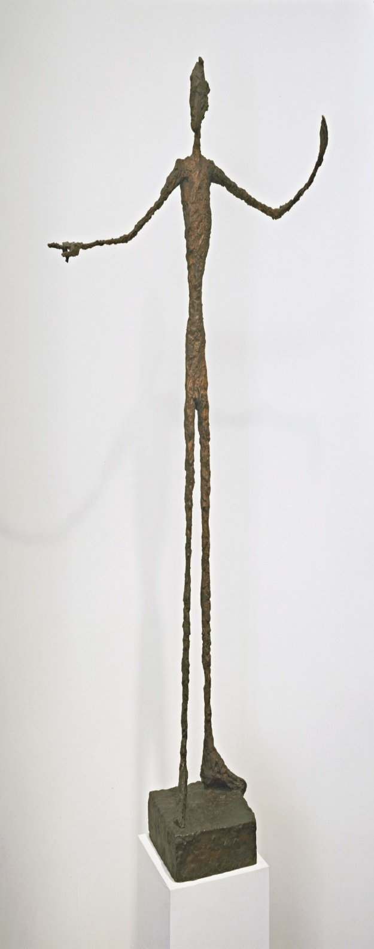
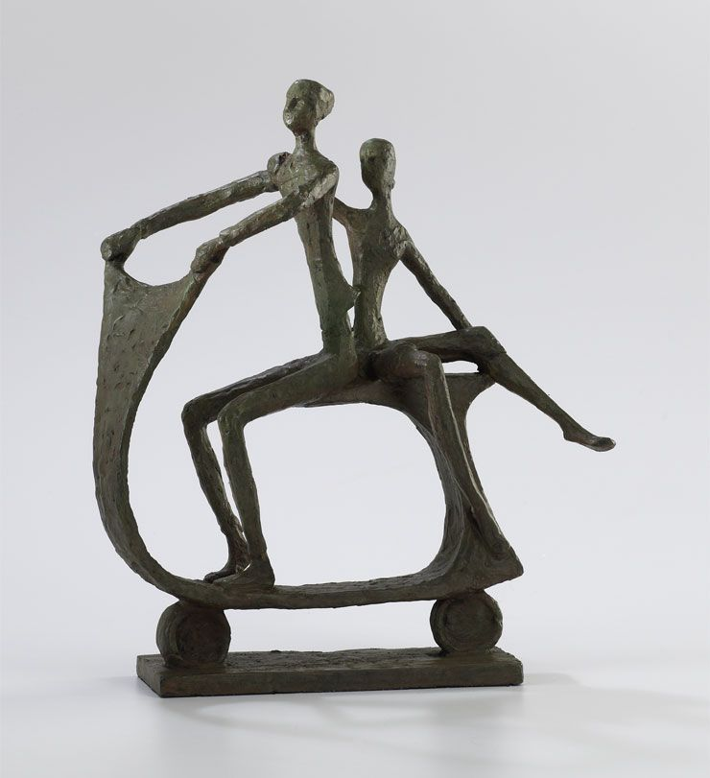

Slide 28


Conversation Practice
Film yourself having a conversation with your family while speaking French! You can try and make it as simple or as complex as you like!
Be sure to send the videos to your learning email!

Slide 29
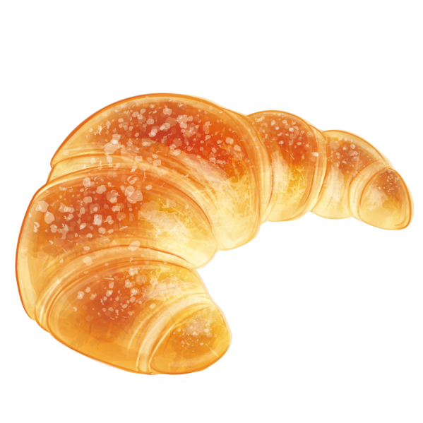
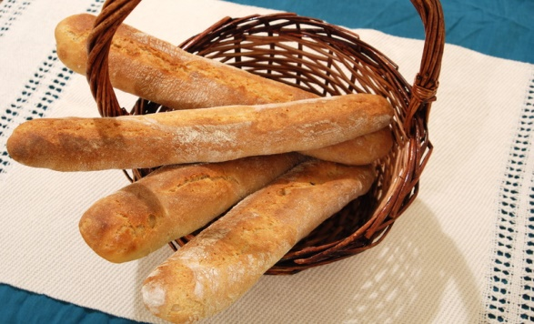
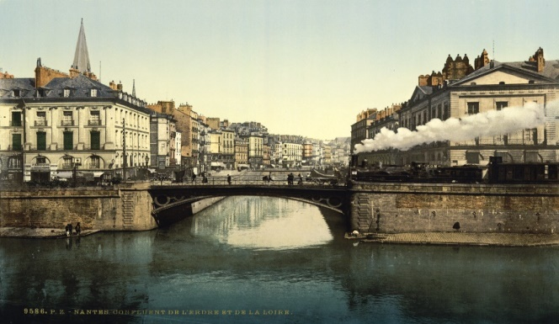
We hope you enjoyed French Day! Don’t forget to send in all your photos to: yearfourlearning@farnborough.bromley.sch.uk!
We look forward to seeing all your amazing creations. Have a brilliant weekend!

