Slide 1
!
Dear Centaurs,
I hope you are all well and have enjoyed all of the wonderful weather we have had over the weeks.
This week we have lots of super work to do. Even though I will not be delivering your Zoom lessons I will be answering your emails. Remember we have Achievement Assembly on Friday so please continue to send your work to
yearfivelearning@farnborough.bromley.sch.uk.
I will be choosing who will be presented with certificates from the work that is sent in.
Take care and stay safe,
Miss Morrison

Slide 2
Day 1
English

Slide 3
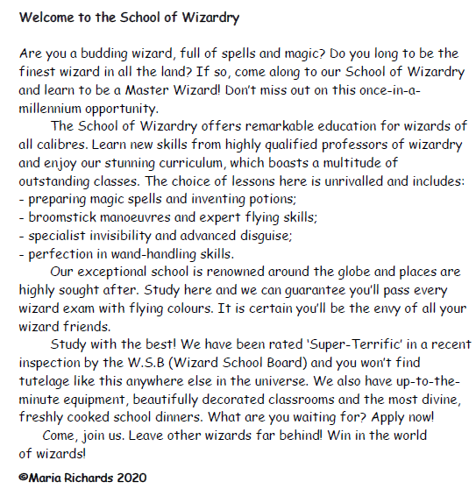

Slide 4
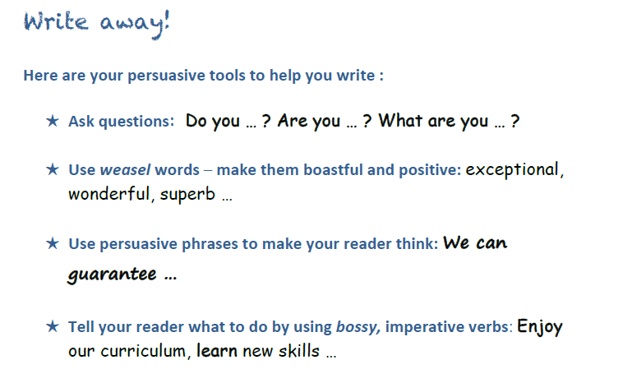
Today you are going to write your ‘Welcome to _____________ School.
You will persuade other children why your school is the best to attend.
.

Slide 6
Day 1

Slide 7
Answers

Slide 9
Help Tools!
Percentages
https://www.bbc.co.uk/bitesize/topics/znjqtfr/articles/z8ws3k7
https://www.bbc.co.uk/bitesize/topics/znjqtfr/articles/zcfyw6f
https://www.bbc.co.uk/bitesize/topics/znjqtfr/articles/zsgwq6f
Mean
https://www.bbc.co.uk/bitesize/topics/zm49q6f/articles/z99jpbk
Reading Pie Charts https://www.youtube.com/watch?v=Ruc9n6ho3l4

Slide 10
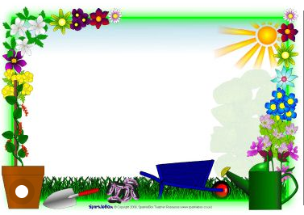
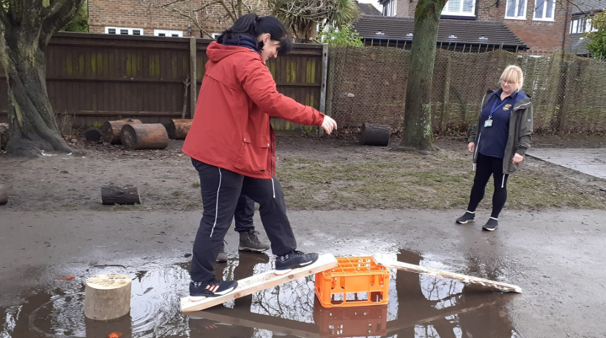
Outdoor Home Learning
Bridging the Gap
Can you build a bridge that will hold your weight and enable you to cross a puddle, a raging tarpaulin river, or a bubbling lava blanket? Alternatively go small-scale and create micro bridge to hold a 500g bag of sugar or similar.
Open the link to investigate this further…
https://www.ltl.org.uk/resources/bridging-the-gap/

Slide 11
Active Learning!

Slide 12
Quick Read!

