Slide 1
Remember to Battle today!
The Battles will commence from 8.30am to 2pm today. You can battle for half an hour - more or less. It is up to you!
https://ttrockstars.com/

Slide 3
Centaurs…
In last week’s challenge we arrived in…
Algeria

Slide 4
Farnborough’s Race across the World Results up to Monday 8th June
Class | Number of kilometres covered | *Which country did your class reach? From Farnborough School to …..
Pixies | 1727 km | Algeria
Elves | 1015 km | Italy
Unicorns | 1122 km | Italy
Phoenix | 910 km | Italy
Pegasus | 3788 km | Egypt
Giants | 1631km | Algeria
Griffins | 1960 km | Morocco
Centaurs | 1696 km | Algeria
Dragons | 1445km | Italy

Slide 5
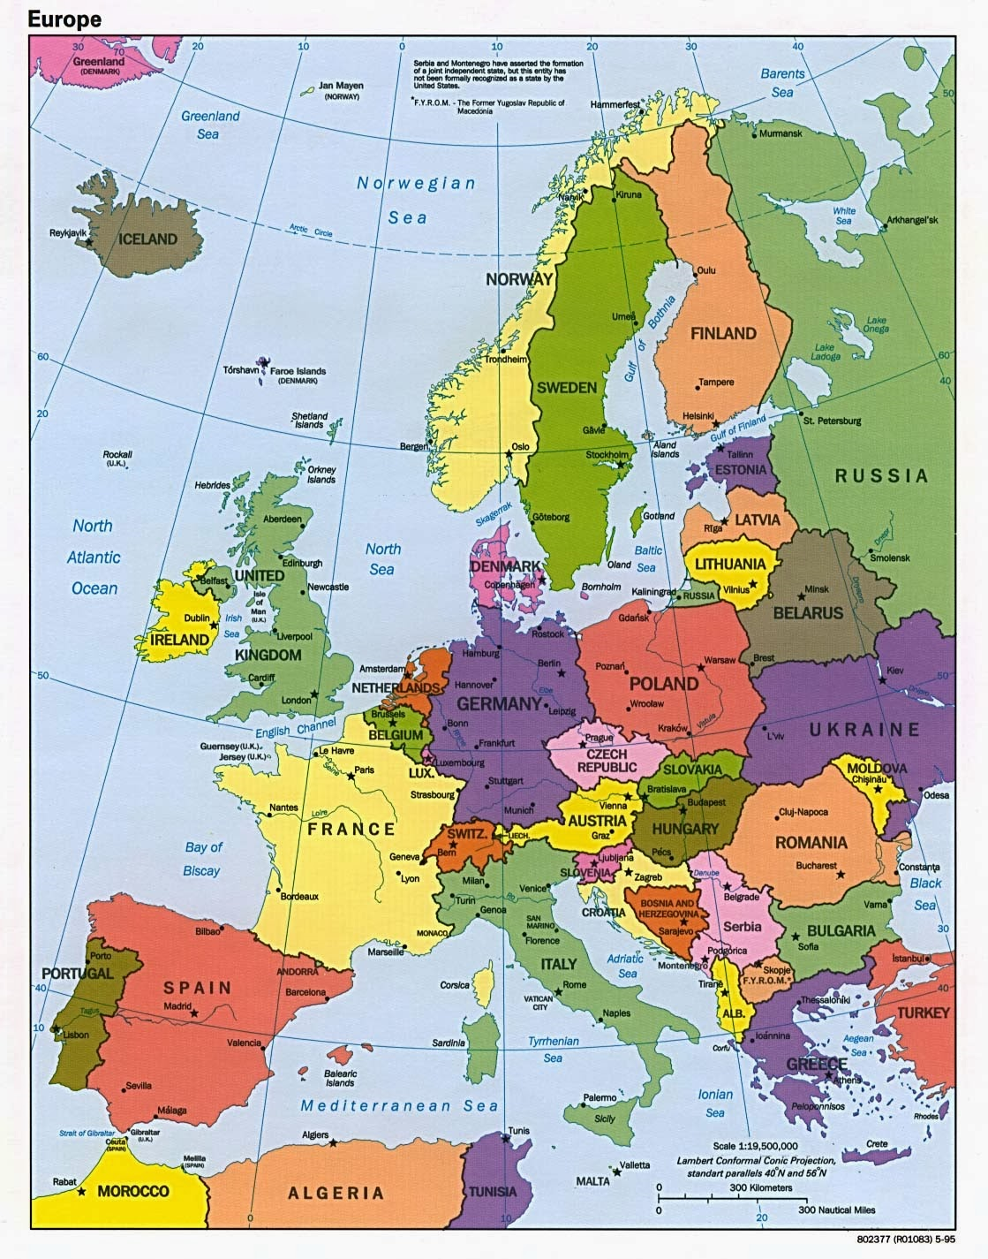
Which country did your class reach?
Map of Europe
Which country did your class reach?

Slide 6
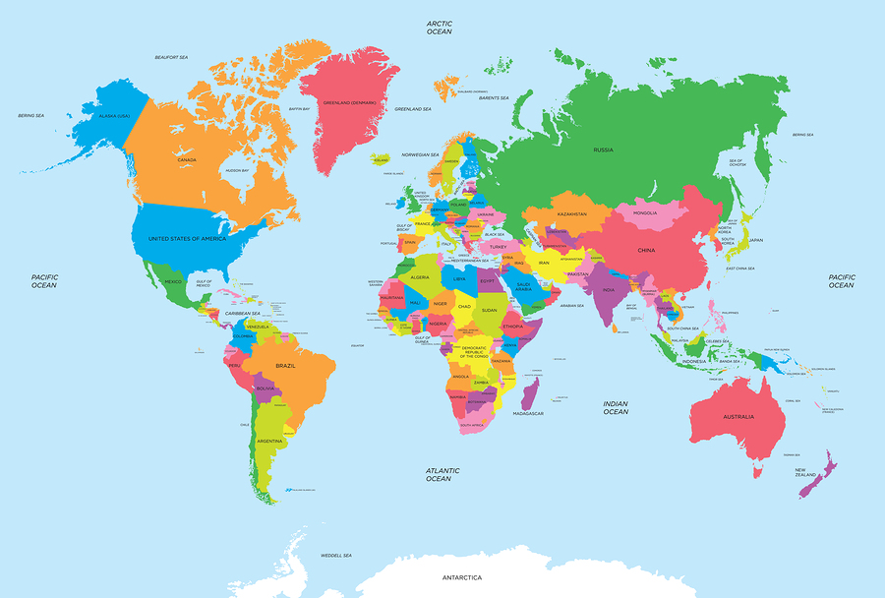
of the World
Map of the World
Which country did your class reach?

Slide 7
of the World
Map of the World
Which country do you think we could get to next?

Slide 8
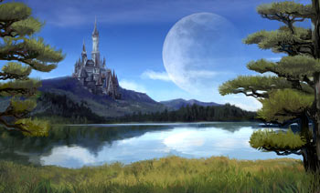
Day 2
English

Slide 10
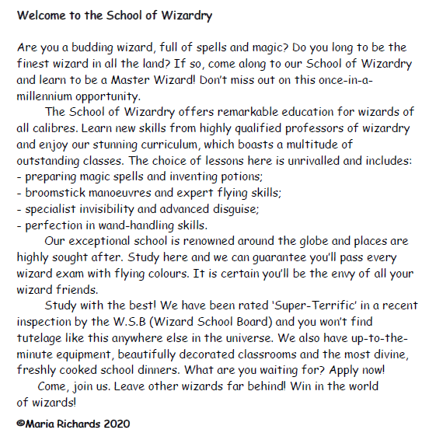

Slide 11
You can also listen to the text here: https://soundcloud.com/talkforwriting/wizards/s-N2Kss3KDdxd

Slide 13
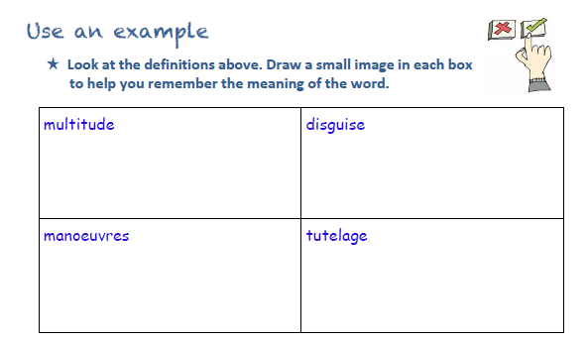

Slide 14
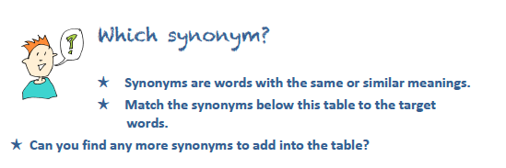

Slide 15
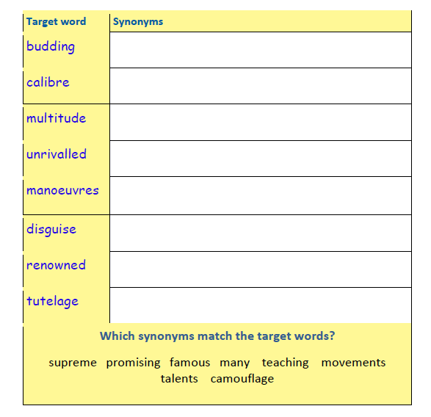

Slide 16
Day 2

Slide 17
This weeks challenges have two things in common – they are all based around the house and you will have to move to do them!
Today you will do questions – 4,5 and 6. Enjoy! Look at the ‘Help Tool’ page to watch videos that could help you answer todays questions.

Slide 18
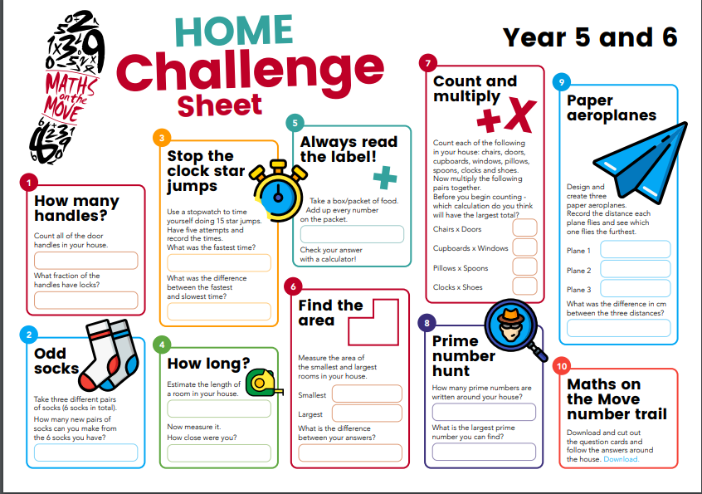

Slide 19
Help Tools!
Estimating Length
https://www.youtube.com/watch?v=NcYg7qh38F4
Measurement song https://www.youtube.com/watch?v=djTNUp4XIRo
Area of composite
https://www.youtube.com/watch?v=z4Lat1uOQI4

Slide 20
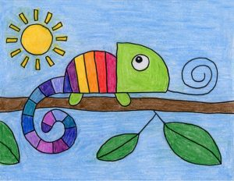
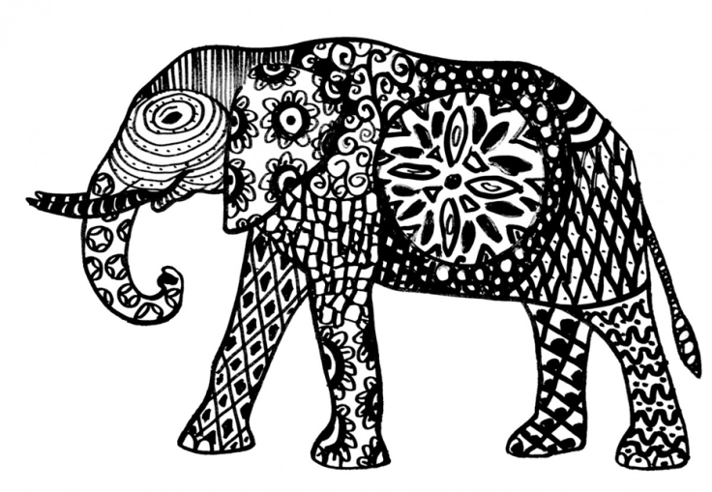
Carnival of the Animals An Art festival
For the next few weeks we are going to run a series of art lessons based around animals.
So whether you are working at home or in school you can create some great pictures. We would like to fill the Farnborough Art Gallery with your work to create a “Carnival of the Animals.”
If you are home learning, you can scan your work and send it in to your teacher.
Good luck, have fun and we want you to be creative, so if you have your own ideas we would love to see your artwork!

Slide 21
Zentangle* Animals
Doodles can help you to relax, you don’t have to worry about representing something, just draw different patterns.
*Zentangles just means doodling!
We can all do that!

Slide 22
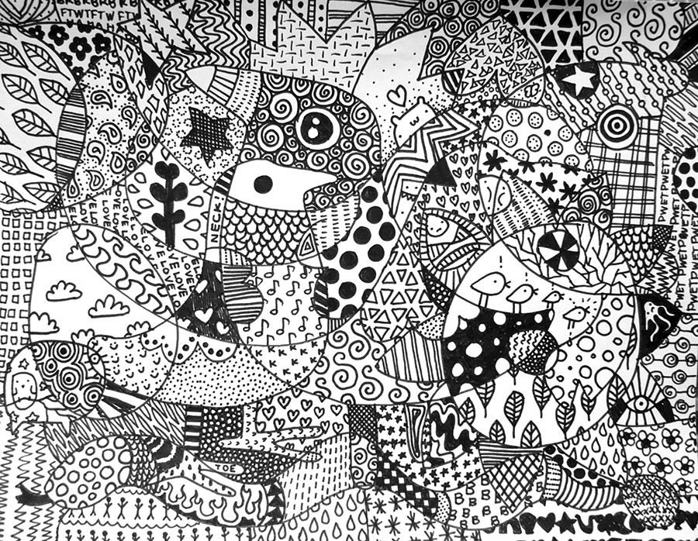
What shall I doodle?
Anything!

Slide 23
Colouring books are very
popular now and could be a source of ideas for you.

Slide 24
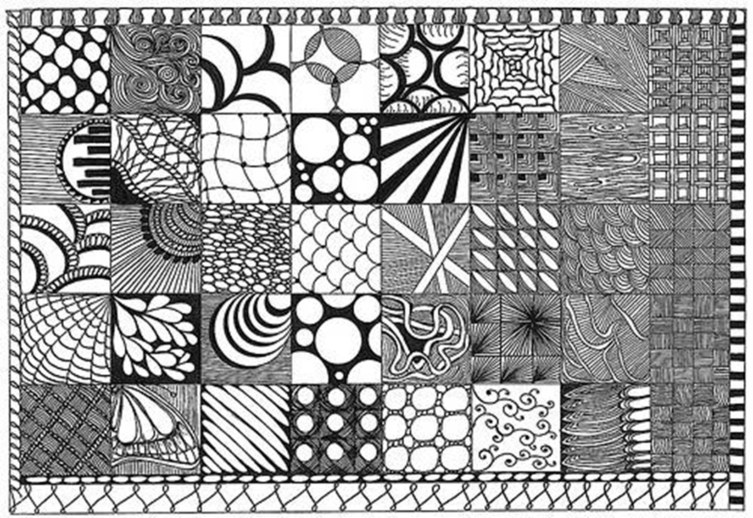

Slide 25
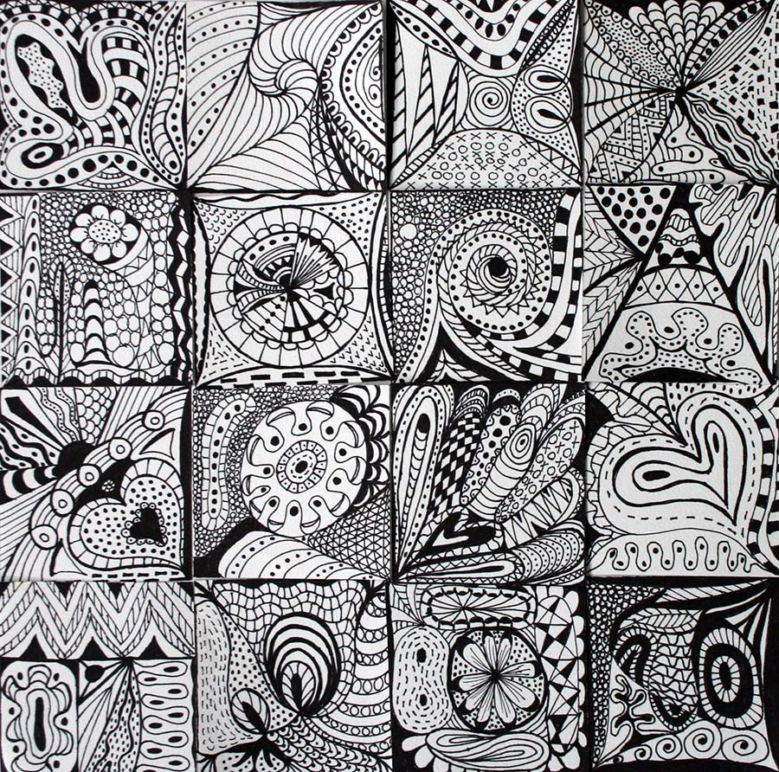
All you need is a pen, some time and your fabulous imagination……………
Still unsure? No worries, watch: https://www.youtube.com/watch?time_continue=25&v=2W6KD1xq_Zo&feature=emb_logo

Slide 26
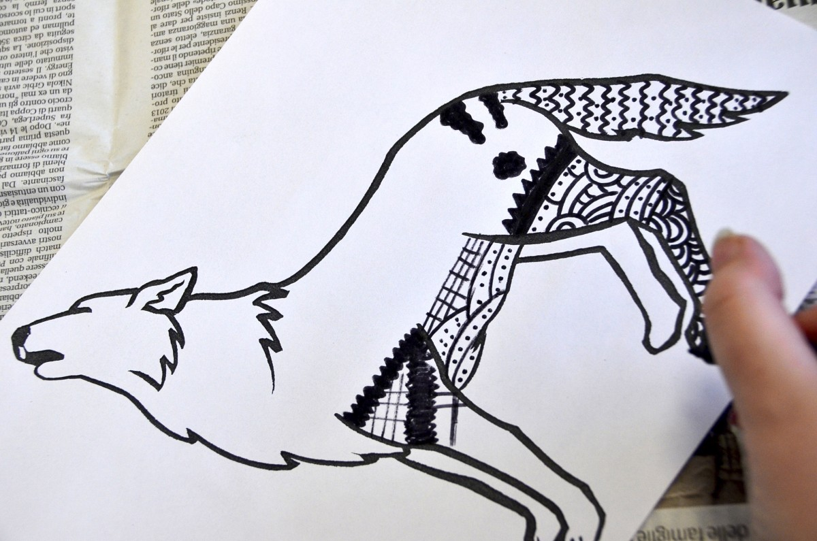
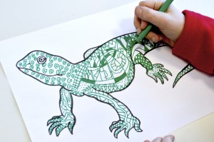
You can either use the animal outlines that are on your learning page or draw your own outline of an animal.

Slide 27
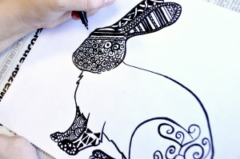
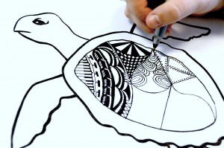
If you can, use pens of different thicknesses so maybe a fine pen and a broad pen.

Slide 28
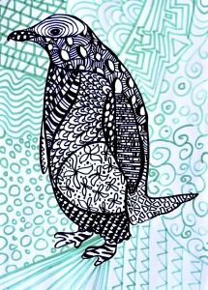
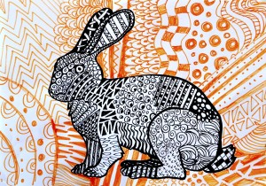
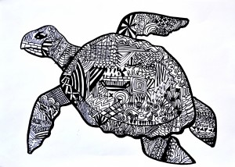
You can have a plain background or one filled with Zentangles.
It’s up to you!

Slide 29
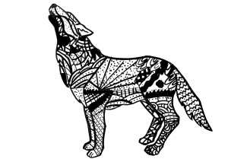
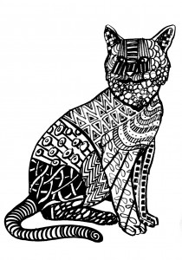
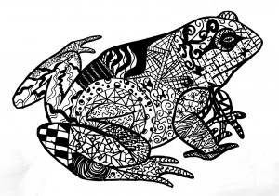
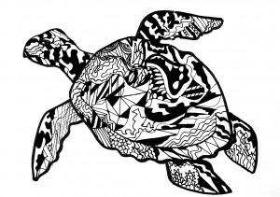
Detailed doodles can take a long time and are best with a fine pen.
Broad pens can help you to work more quickly and are great for big, bold patterns

Slide 30
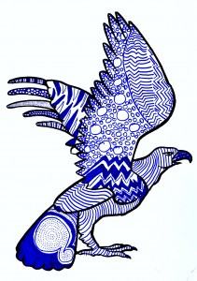
It’s up to you which colour you choose to doodle in……
Enjoy and remember to send your work in!

Slide 31
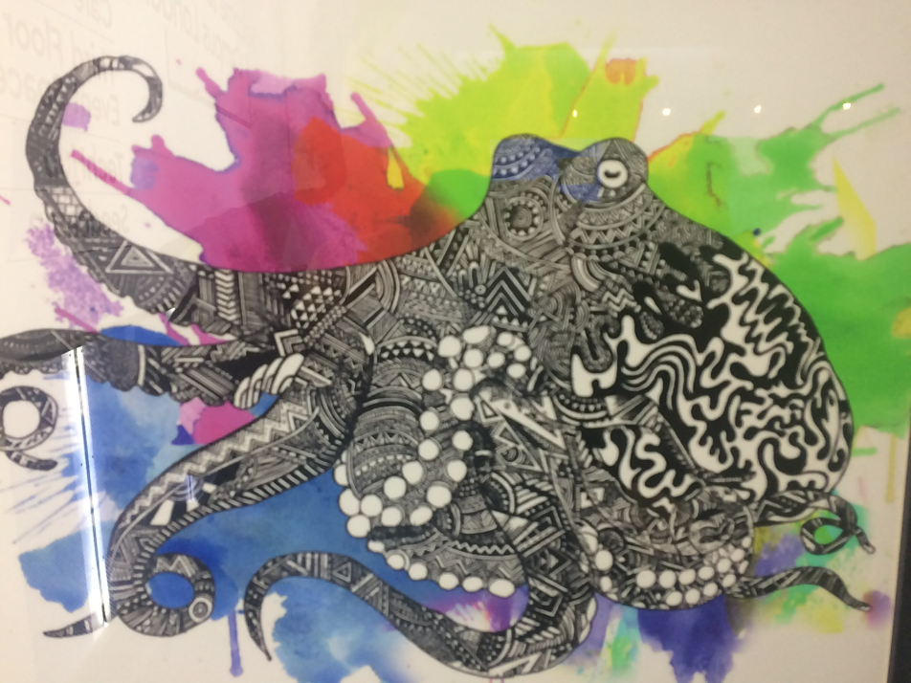
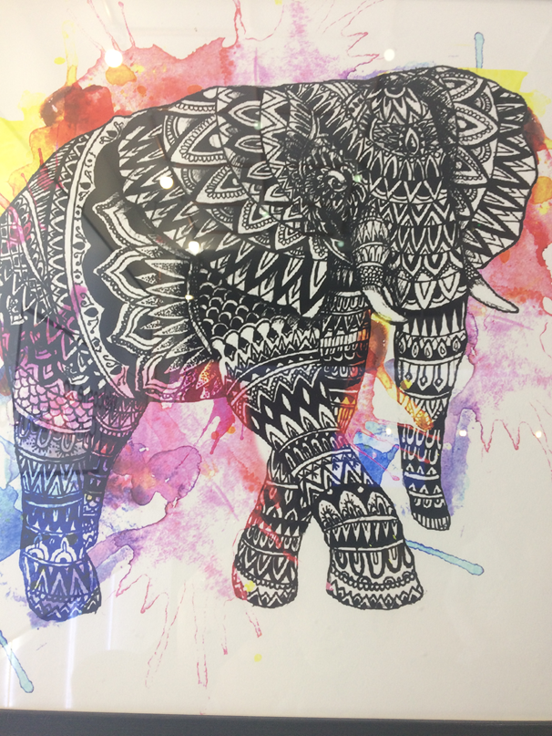
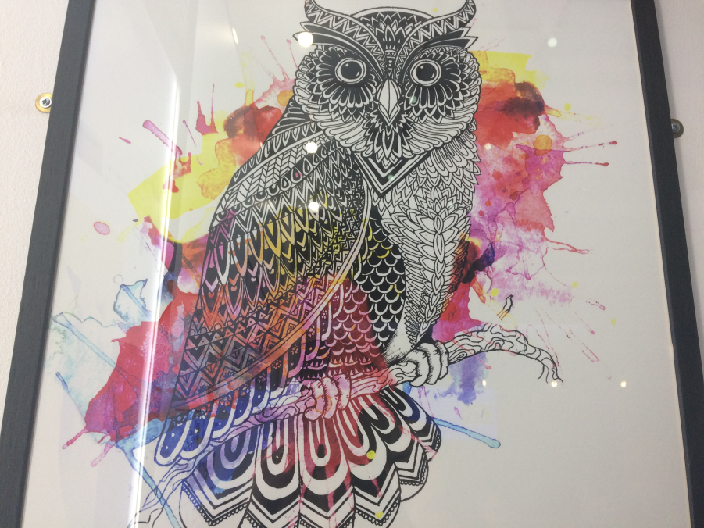
Can you work out the technique used in the background? Can you think of your own original background?

