Slide 1
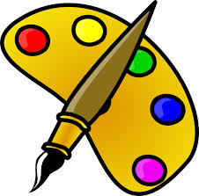
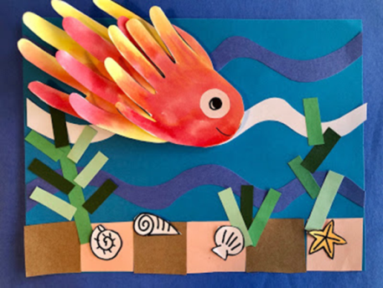
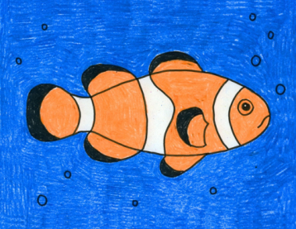
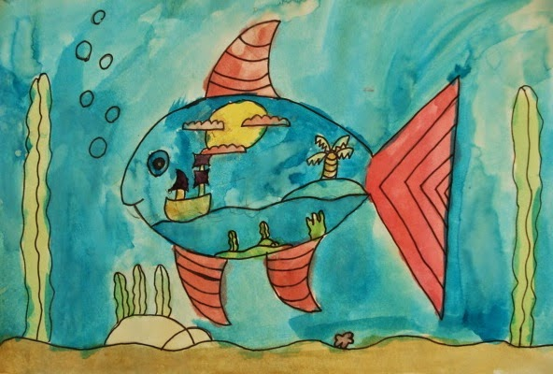
Carnival of the Animals An Art festival
For the next few weeks we are going to run a series of art lessons based around animals.
So whether you are working at home or in school you can create some great pictures. We would like to fill the Farnborough Art Gallery with your work to create a “Carnival of the Animals.”
If you are home learning, you can scan your work and send it in to your teacher.
Good luck, have fun and we want you to be creative, so if you have your own ideas we would love to see your artwork!

Slide 2
Finding Nemo…….Draw a clownfish!

Slide 3
1. Fold your paper into quarters. Start the fish body..
2. Finish with the tail.

Slide 4
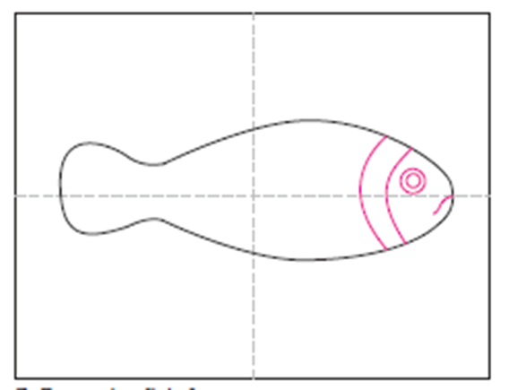
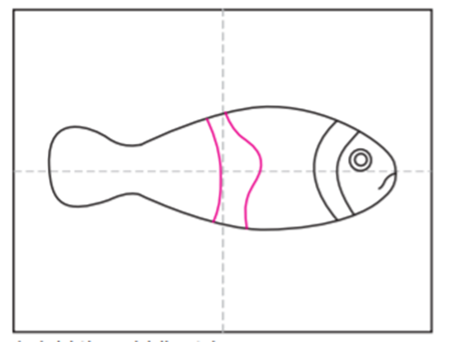
3. Draw the face on the fish.
4. Add the middle stripe.

Slide 5
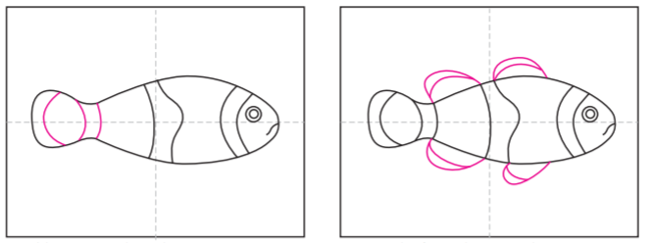
5. Add stripes to the tail.
6. Draw the fins in between the stripes.

Slide 6
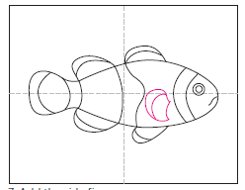
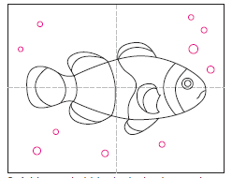
7. Add the side fin.
8. Add some bubbles and seaweed to the backgound.
You could draw another smaller friend for Nemo…just in case he gets lost!

Slide 7
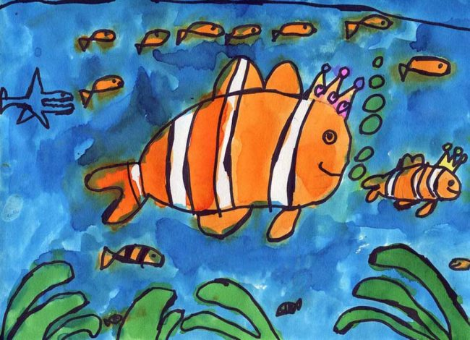
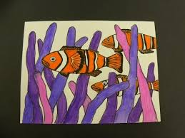
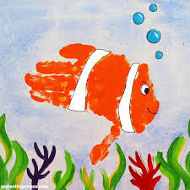
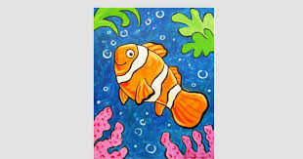
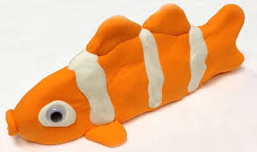
Use watercolours or pastels or felt tip pens or pencils to colour your picture.

Slide 8
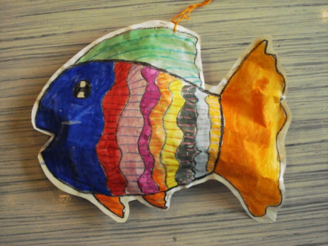
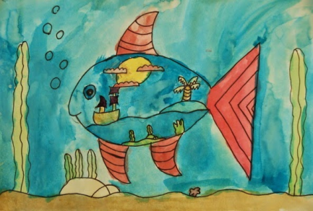
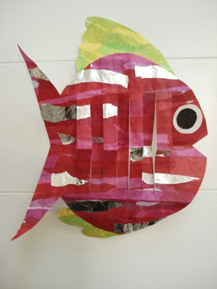
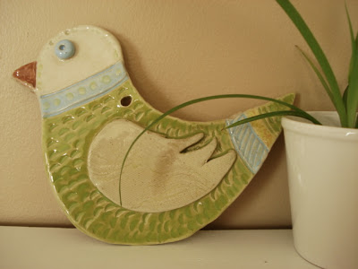
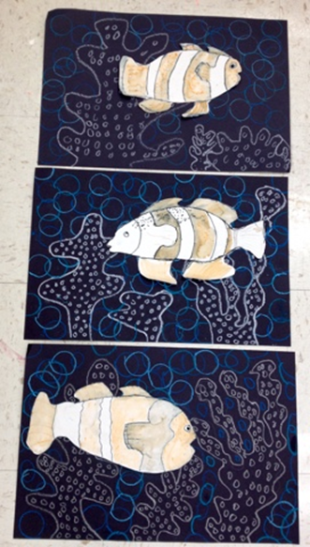
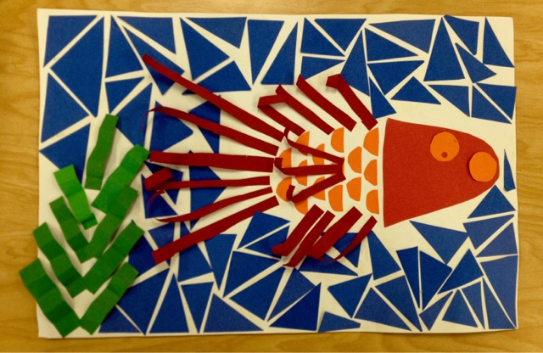
Love fish? …….
But don’t think you will get to the sea this year? Check out these websites below for more fishy fun!
https://afaithfulattempt.blogspot.com/search?q=fish
https://youngschoolart.blogspot.com/search?q=fish

