Slide 1
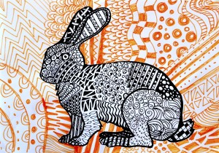
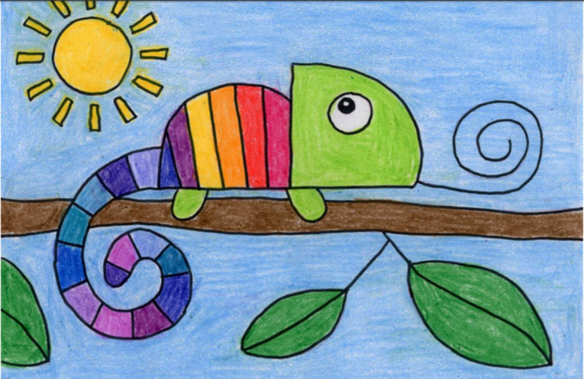
Carnival of the Animals An Art festival
For the next few weeks we are going to run a series of art lessons based around animals.
So whether you are working at home or in school you can create some great pictures. We would like to fill the Farnborough Art Gallery with your work to create a “Carnival of the Animals.”
If you are home learning, you can scan your work and send it in to your teacher.
Good luck, have fun and we want you to be creative, so if you have your own ideas we would love to see your artwork!

Slide 2
Try drawing this rainbow chameleon!

Slide 3
Follow these simple steps to draw your chameleon

Slide 4
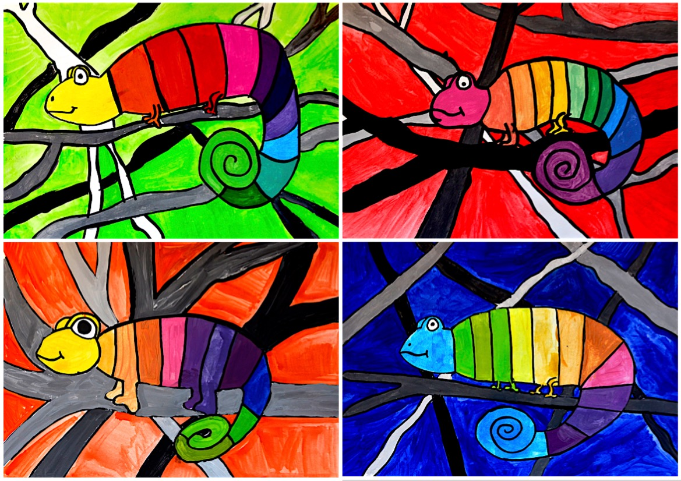
You can use the background in the example or try your own ideas. It’s up to you!
Use pencils, paints or felt pens to colour your fabulous picture!

Slide 5
